Slide 1



How to Boost Students’ Motivation in Chinese Character Writing?
Yuqing Hu 胡羽晴
Achievement Director of Mandarin
Harris Academy Chafford Hundred
Email: Y.Hu@harrischaffordhundred.org.uk

Slide 2
Y10 students’ voice – one word to describe your feeling towards Learning characters
Notes:
Students voice to be added

Slide 3
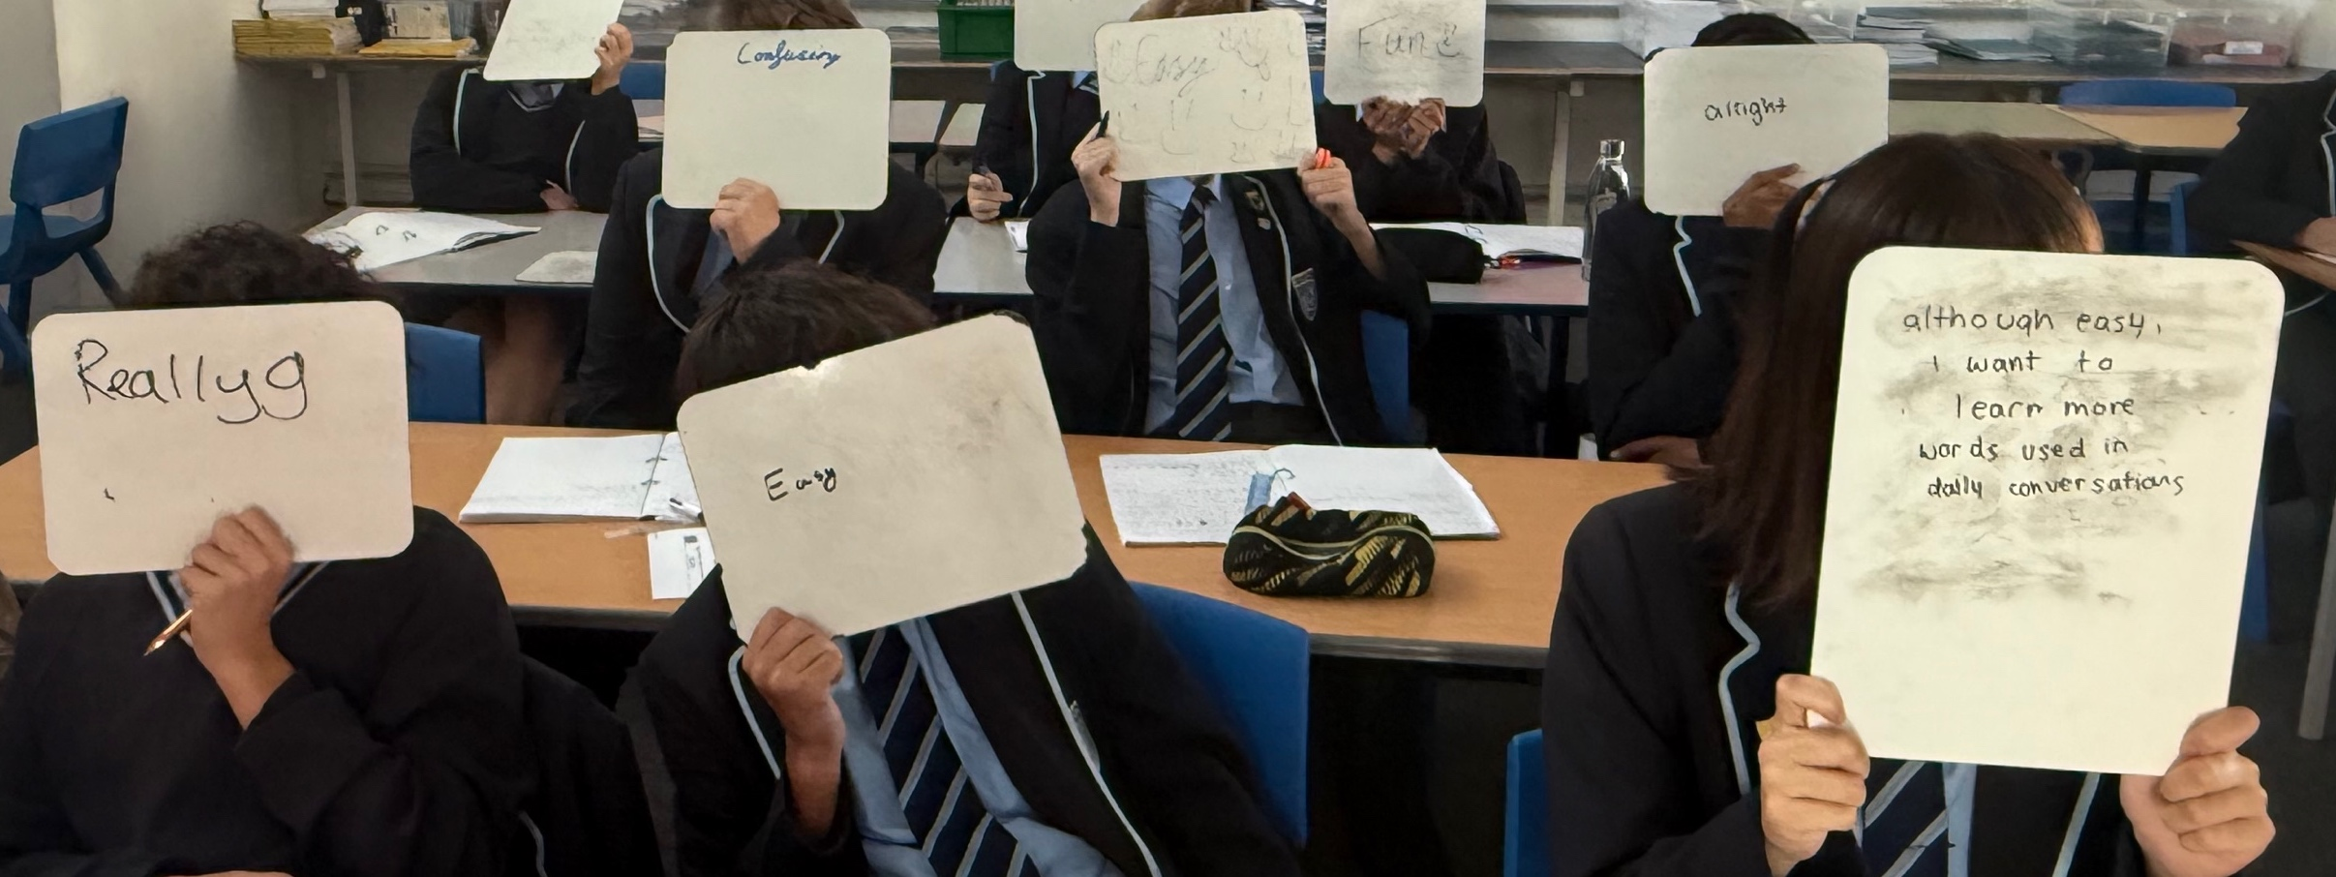
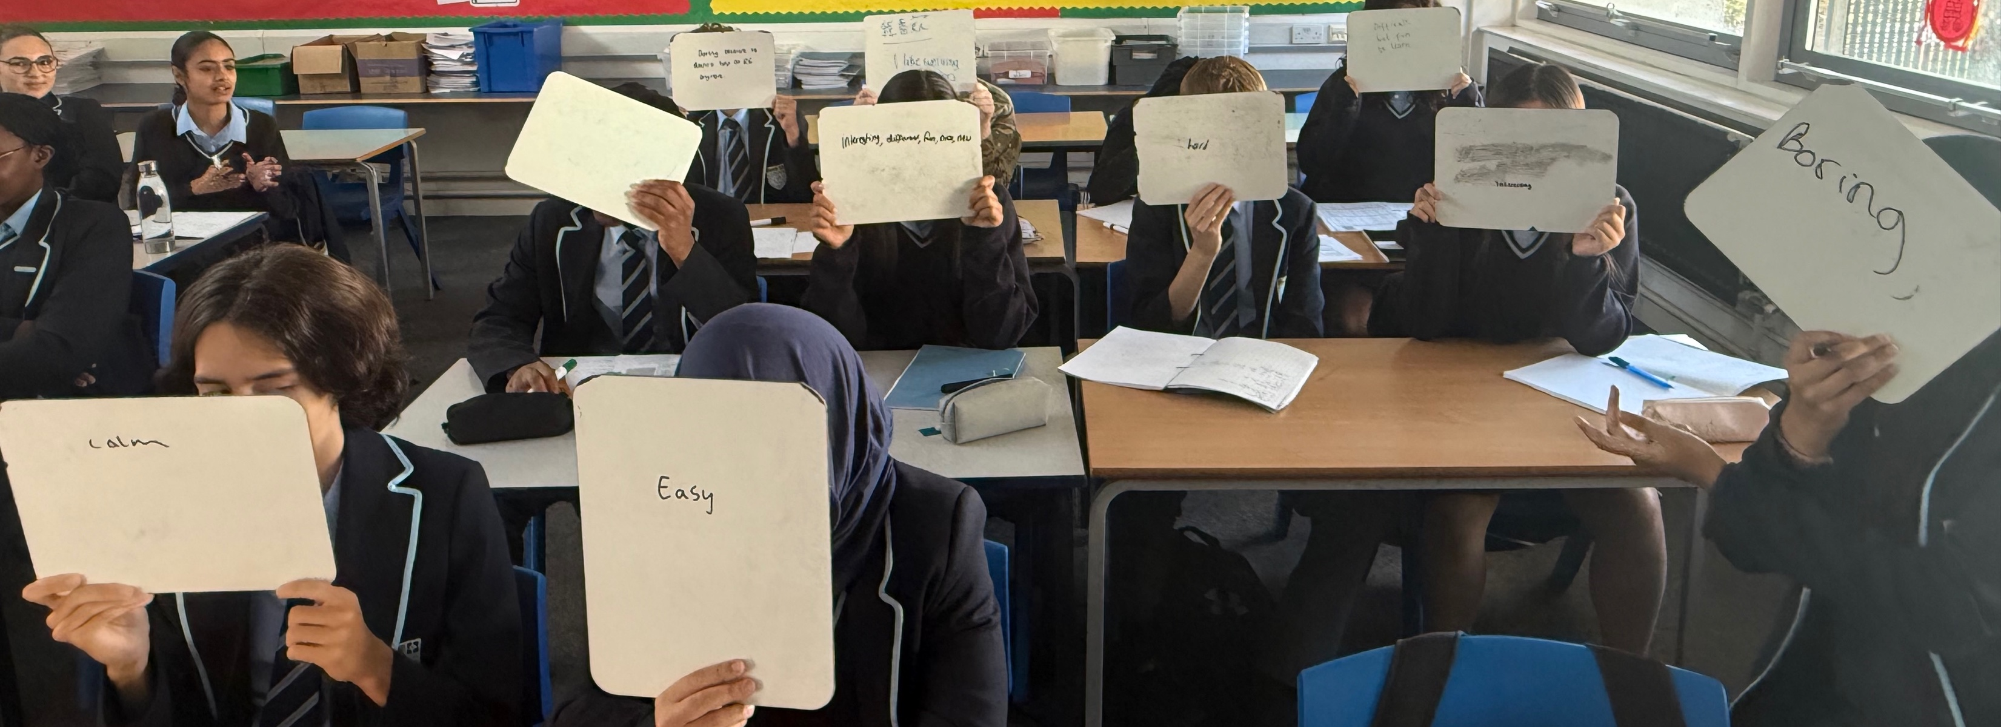
Y10 students’ voice – one word to describe your feeling towards Learning characters
Easy X 3
Confusing
Clam
Like X 2
Alright
Boring X 2
Difficult but fun to learn
Fun, interesting X 3
Notes:
Students voice to be added

Slide 4
Turn and talk
Fill in the blank - what can we say to the students?
If you are ____________,
you will be good at writing characters.
Notes:
Tell the story of how I encouraged a boy who didn’t like Mandarin at first, but then began to develop an interest in writing characters as an example.

Slide 5
Turn and talk
Fill in the blank - what can we say to the students?
Good at drawing, full of imagination, pay attention to details, patient, etc.
If you are ____________,
you will be good at writing characters.
This is called positive transfer in educational psychology — using an existing strength to build confidence and motivation in a related task.

Slide 6
 | What can we say instead?
Chinese is difficult because you need to learn how to write characters.
You have to remember lots of characters!
Writing characters is hard and takes a lot of time to practice.
Speaking and listening is more than enough for you to travel in China. So it’s okay you don’t learn Characters.
Notes:
How teacher interpret things can have huge impact on students learning attitude! Using more positive language can encourage better learning outcomes.

Slide 7
 | What can we say instead?
Chinese is difficult because you need to learn how to write characters. | You get to write the characters because you are learning Chinese!
You have to remember lots of characters! | Learning characters gives you a new way to see the world!
Writing characters is hard and takes a lot of time to practice. | Writing characters helps you become patient and focused, like an artist.
Speaking and listening is more than enough for you to travel in China. So it’s okay you don’t learn Characters. | Chinese characters have more than 3,000 years of history! you’ll be able to understand the writings on ancient artifacts in the British Museum.
Notes:
How teacher interpret things can have huge impact on students learning attitude! Using more positive language can encourage better learning outcomes.

Slide 8
Boosting motivation in the lesson:
Use mini-whiteboards to address misconceptions first→ builds students’ confidence and prevents bad habits.
Set a clear amount of writing practice in each lesson → helps students see steady progress.
Use repetition and memory-based writing (e.g. games, recall tasks) → makes practice active and enjoyable.

Slide 9
Boosting motivation in the lesson:
Use mini-whiteboards to address misconceptions first→ builds students’ confidence and prevents bad habits.

Slide 10
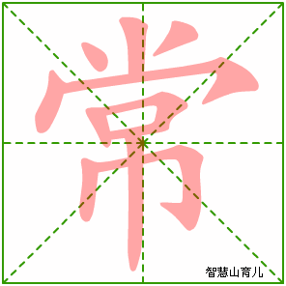
TIME’S UP!
TIME LIMIT:
1 minute
START TIMER
60
50
10
40
20
30
often
Notes:
When we first introduce the words, we use mini-whiteboard to correct mis-conception.

Slide 11


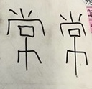
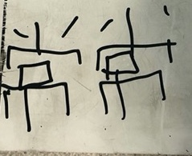

Slide 12
Boosting motivation in the lesson:
Set a clear amount of writing practice in each lesson → helps students see steady progress.

Slide 13
Week 4: What do you do on holiday？你暑假的时候做什么？
寒假 暑假 假期 |  | 我喜欢 | 去 |  | 山区 海边 河边 体育馆 博物馆 美术馆 | 爬山 拍照 游泳 钓鱼 听音乐会 晒太阳 看展览 看比赛
上个 | 暑假 寒假 假期 | 我和 | 朋友 爸爸 妈妈 哥哥 姐姐 | 去了 | 海边 河边 体育馆 博物馆 美术馆 动物园 | ， | 我们在那 | 游了泳 钓了鱼 听了音乐会 晒了太阳 看了展览 看了比赛 看了动物
Notes:
Certain amount of writing practice in each lesson

Slide 14
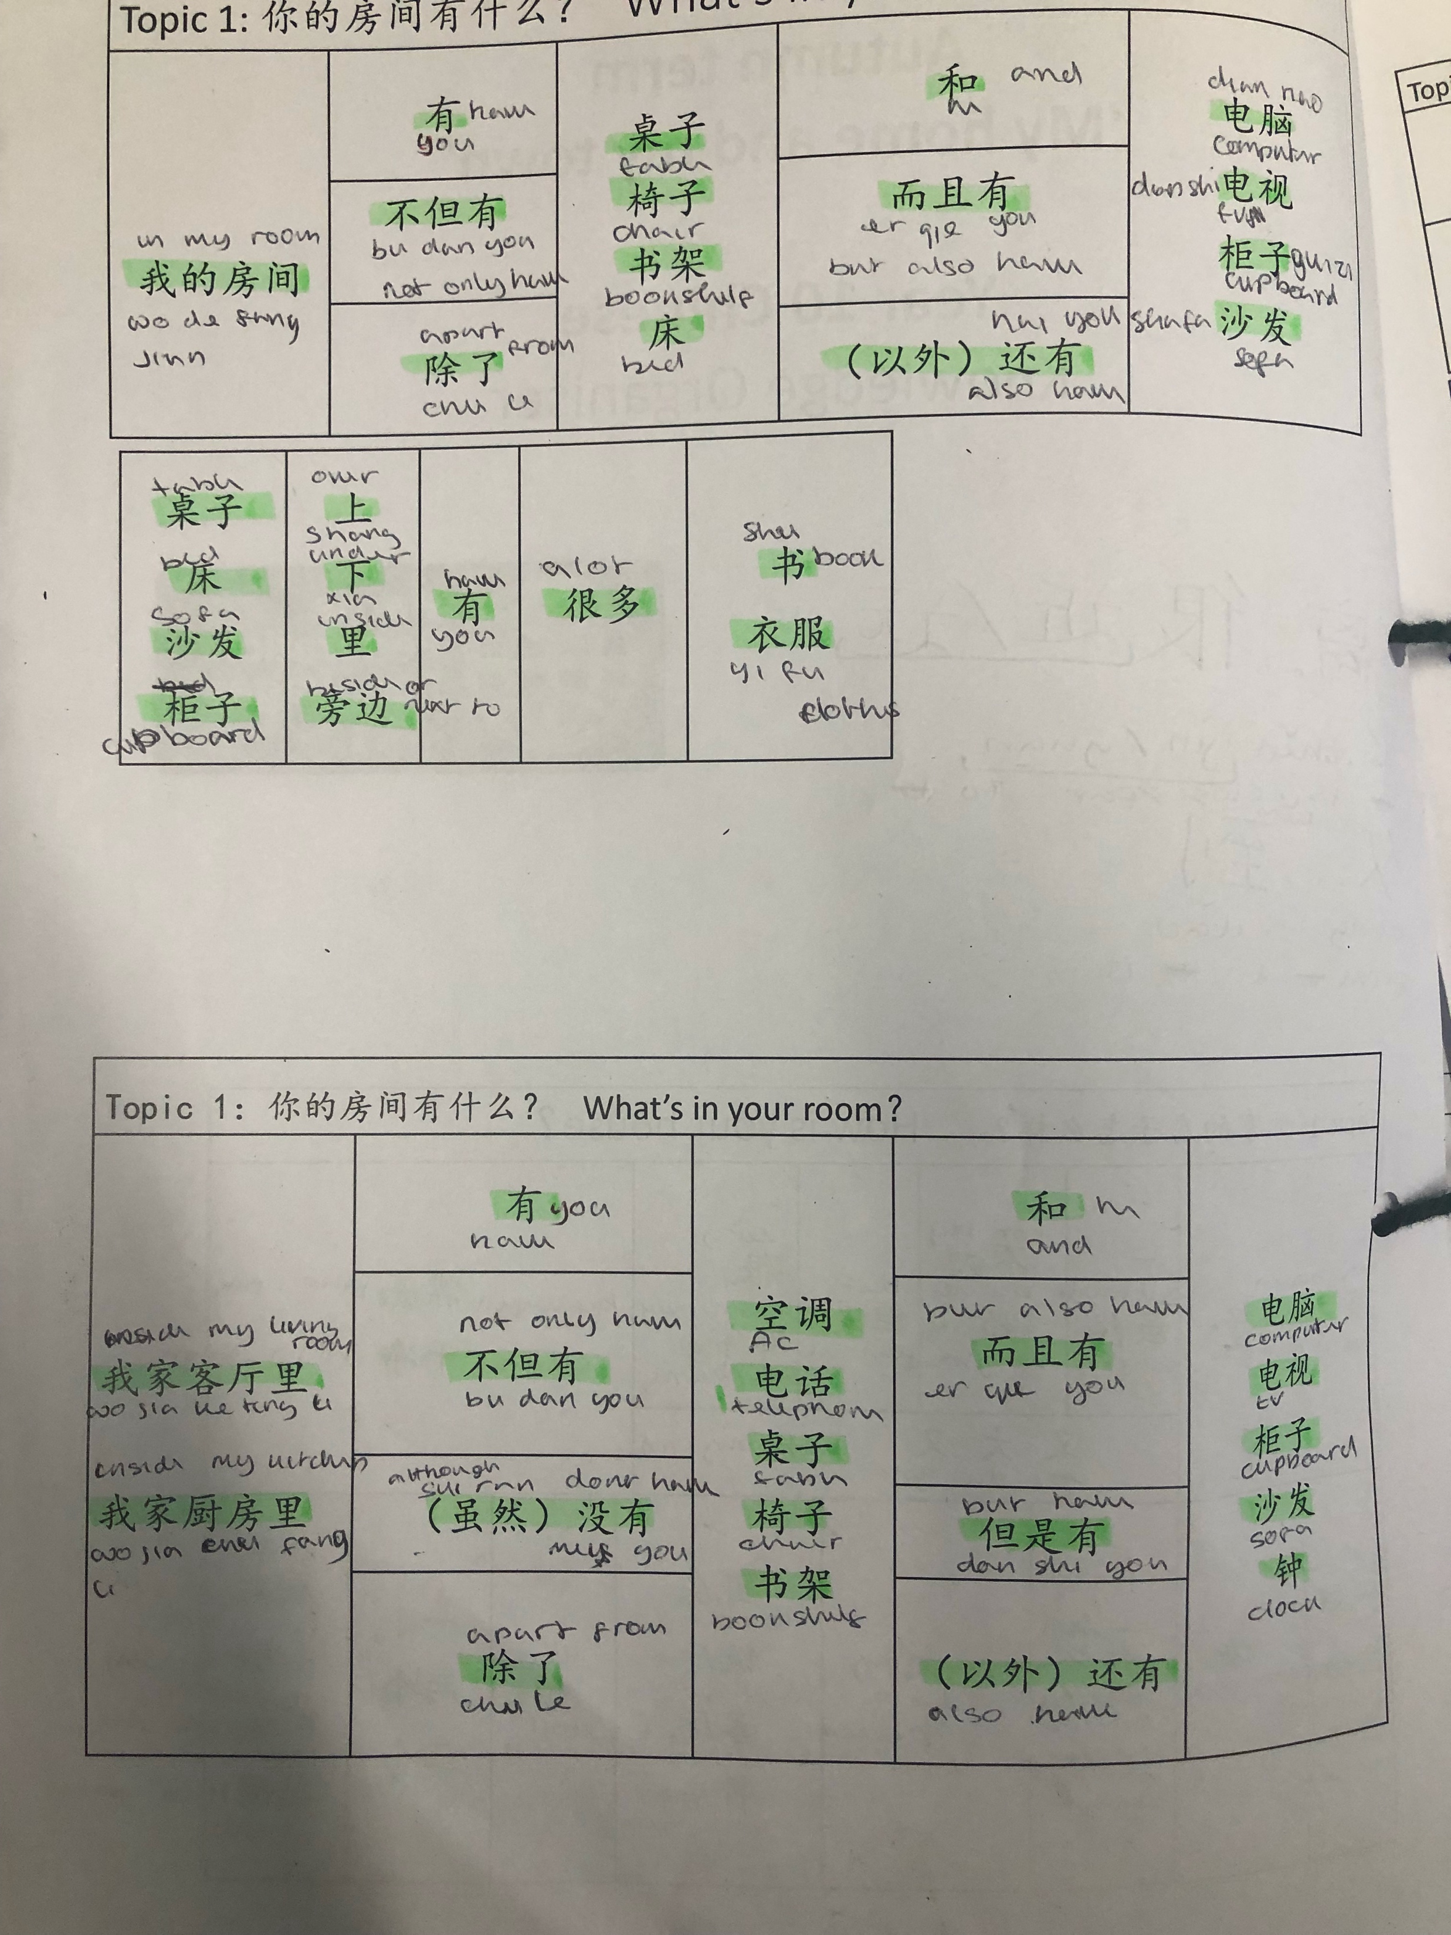
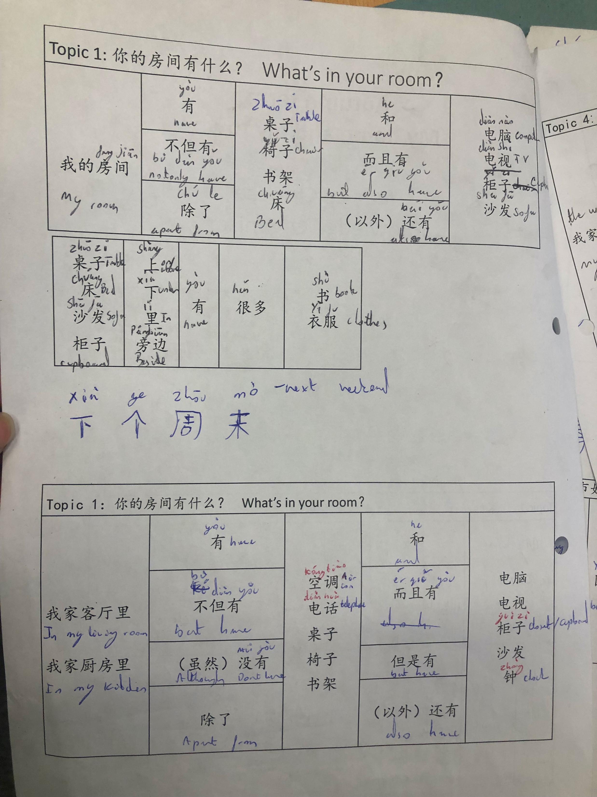
Notes:
Certain amount of writing practice in each lesson

Slide 15
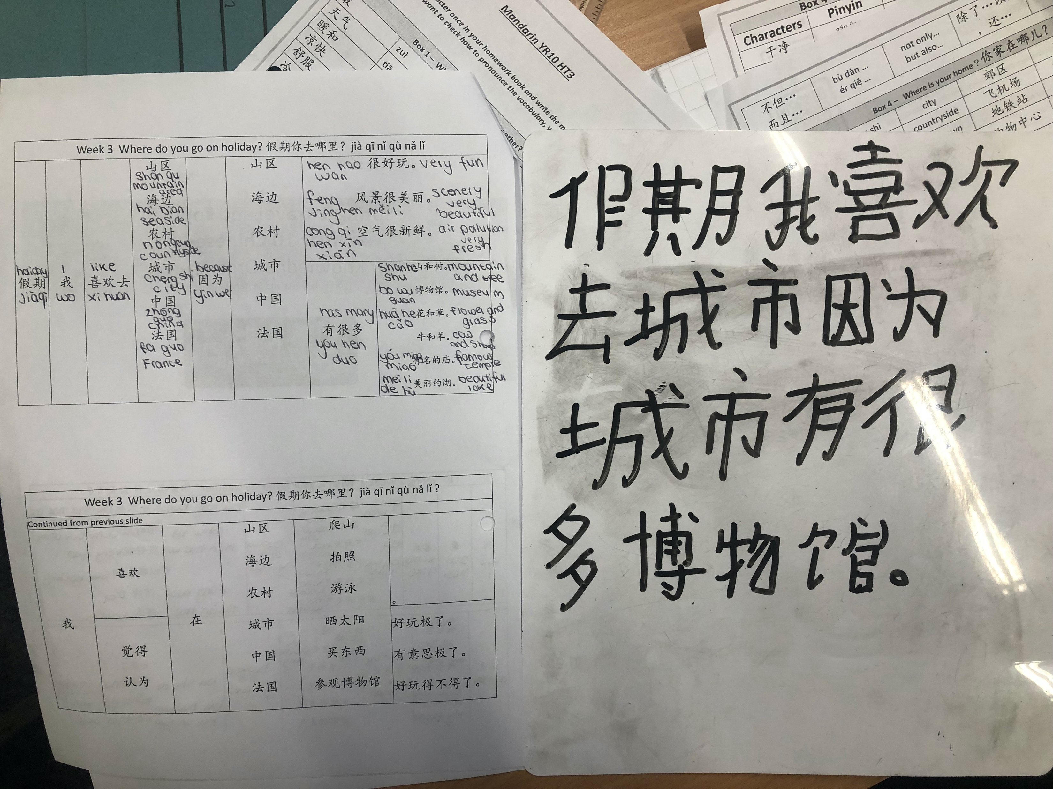
Notes:
Certain amount of writing practice in each lesson

Slide 16
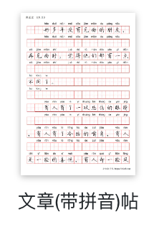
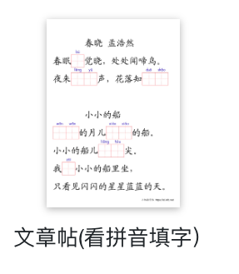
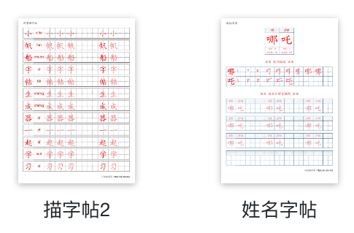
https://zi.ixfc.net/zi/
小帆船字帖
Notes:
Certain amount of writing practice in each lesson

Slide 17
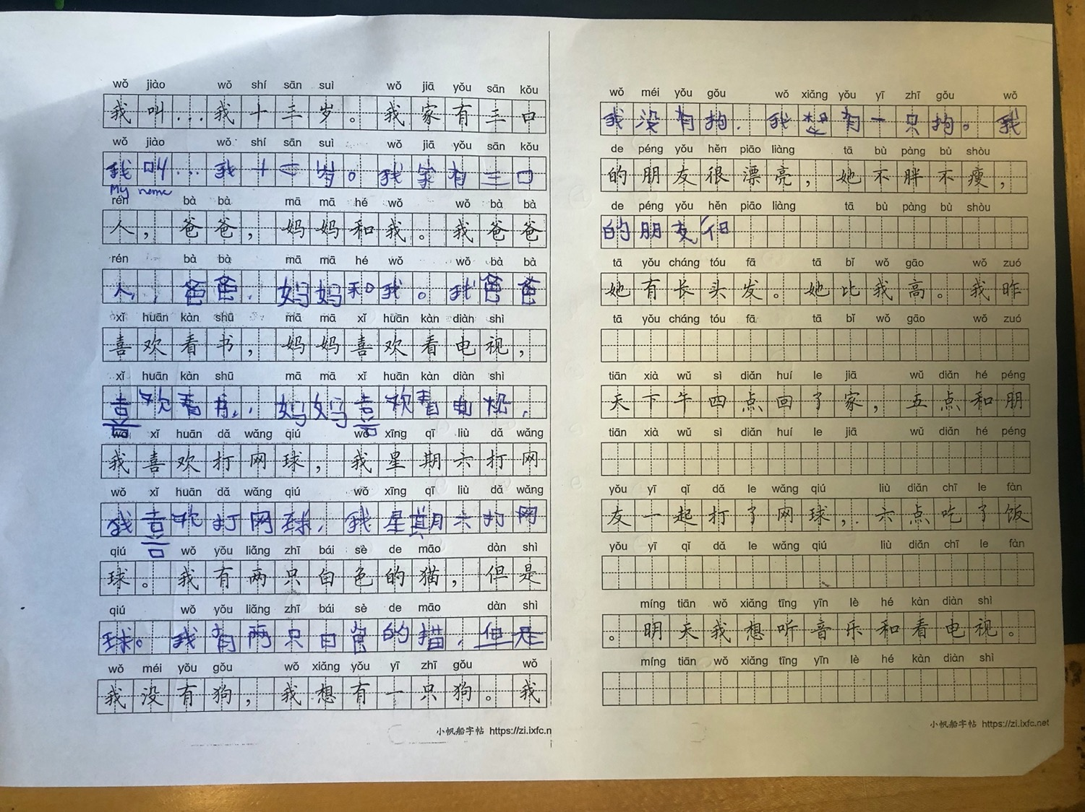
Notes:
Certain amount of writing practice in each lesson

Slide 18
Boosting motivation in the lesson:
Use repetition and memory-based writing (e.g. games, recall tasks) → makes practice active and enjoyable.

Slide 19
Character Bingo
Divide your mini-white board into 9 boxes. Draw 井
Pick 9 words randomly from the table
When teacher call out the words you have to circle the right words.
The first one who get 3 in a row wins!
Notes:
Push students write out of memory through steps

Slide 20
旅行 | travel | 常常 | often | 不但...而且... | Not only...but also..
贵 | expensive | 太吵了 | Too noisy | 一起 | together
方便 | convenient | 坐火车 | By train | 认为 | think
假期 | holiday | 安全 | safe | 下个月 | Next month

Slide 21
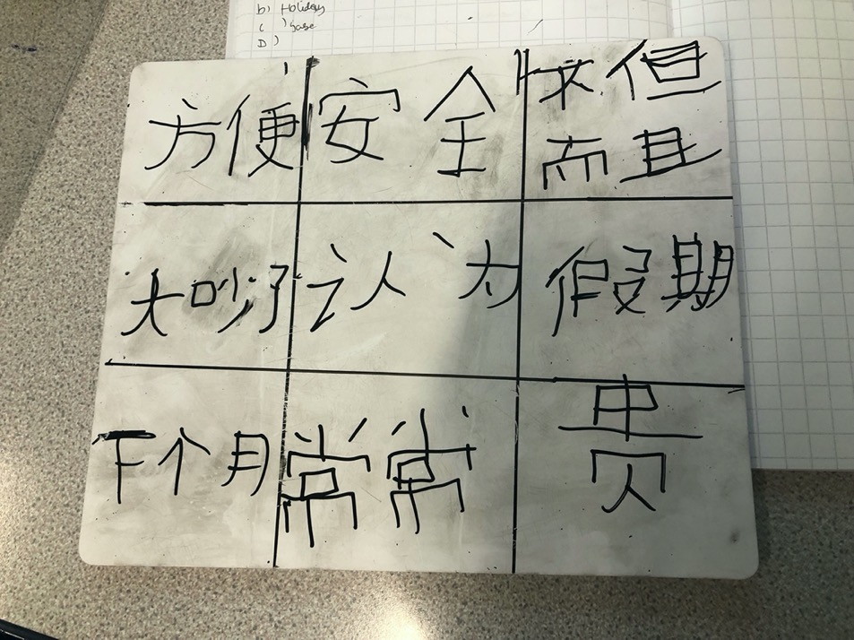
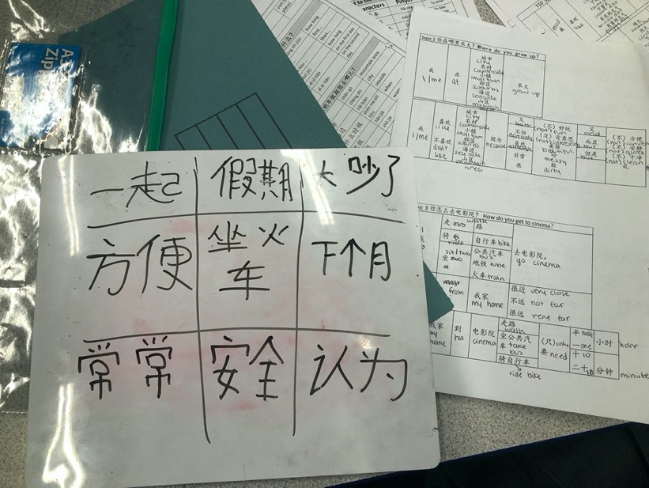
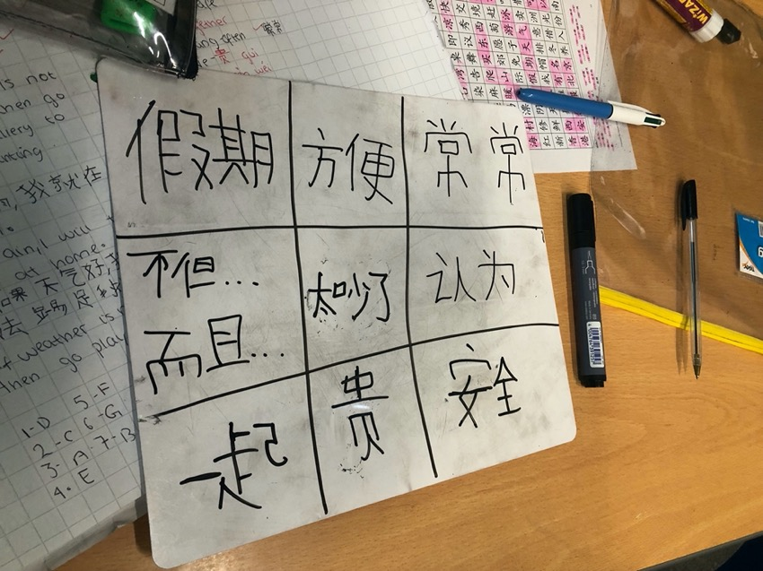
Notes:
What students’ work looks like

Slide 22
旅行 |  | 常常 |  | 不但...而且...
贵 |  | 太吵了 |  | 一起
方便 |  | 坐火车 |  | 认为
假期 |  | 安全 |  | 下个月
Notes:
假期，我喜欢去海边旅行。 我常常和朋友一起旅行。 下个月我想去中国旅行，因为好玩。

Slide 23
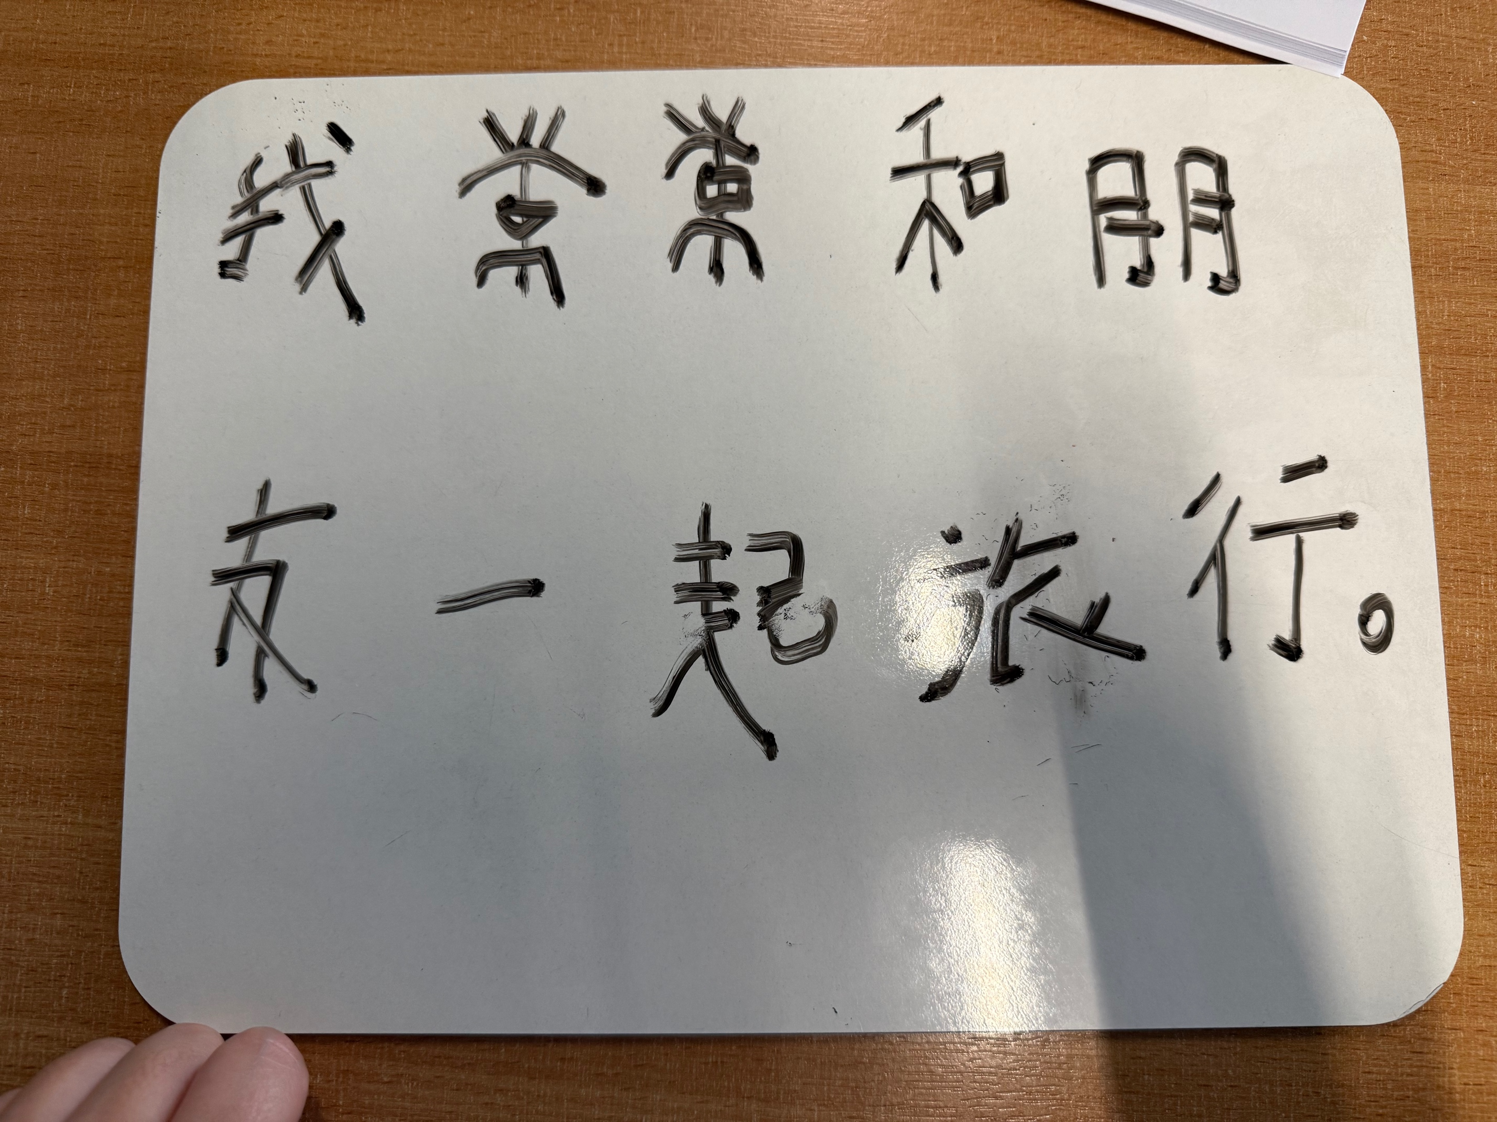
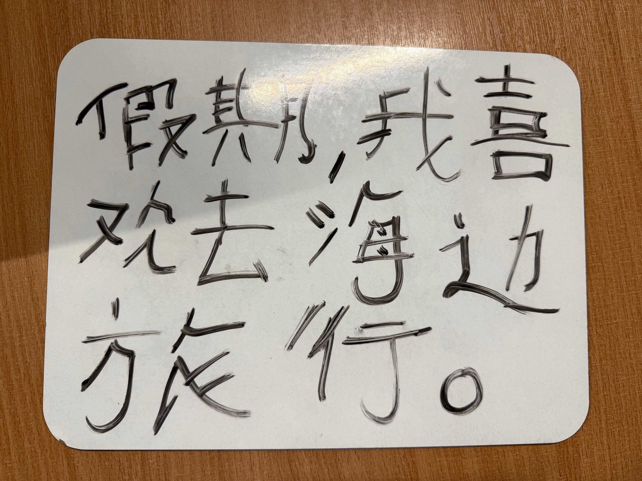
Notes:
假期，我喜欢去海边旅行。 我常常和朋友一起旅行。 下个月我想去中国旅行，因为好玩。

Slide 24

Delay dictation
You will see a sentence for 20 seconds, after 20 seconds, you will have to re-write it on the mini-white board out of memory

Slide 25

Reverse Psychology
Notes:
Reverse Psychology - when you tell students don’t do it, they want to do

Slide 26
Delay dictation
我认为旅行很贵。
I think travel is expensive.

Slide 27
Delay dictation
I think travel is expensive.

Slide 28
Delay dictation
我认为旅行很贵。
I think travel is expensive.

Slide 29
Delay dictation
我喜欢坐火车旅行。
I like travel by train.

Slide 30
Delay dictation
I like travel by train.

Slide 31
Delay dictation
我喜欢坐火车旅行。
I like travel by train.

Slide 32
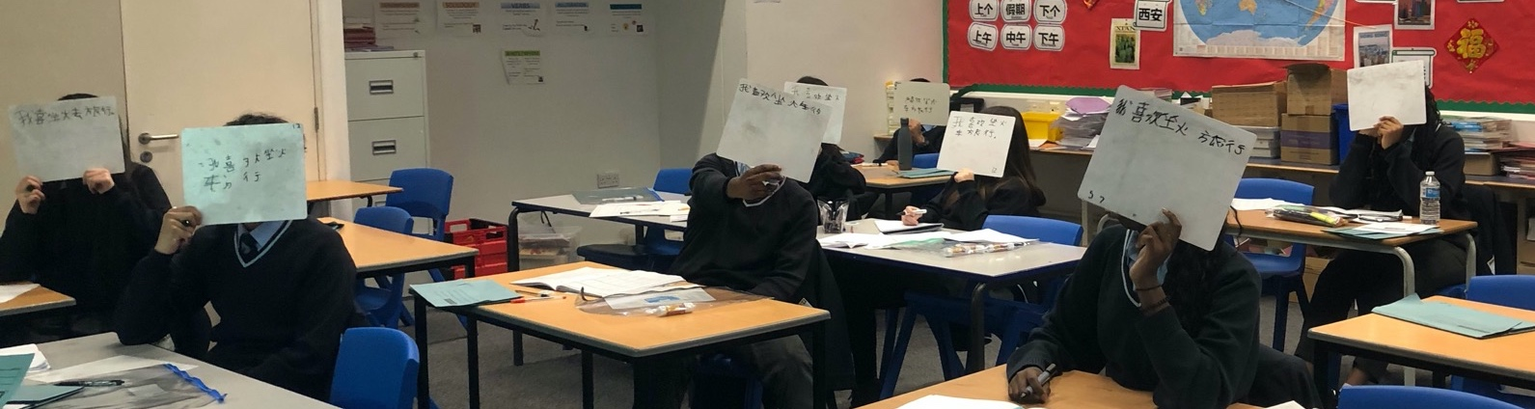
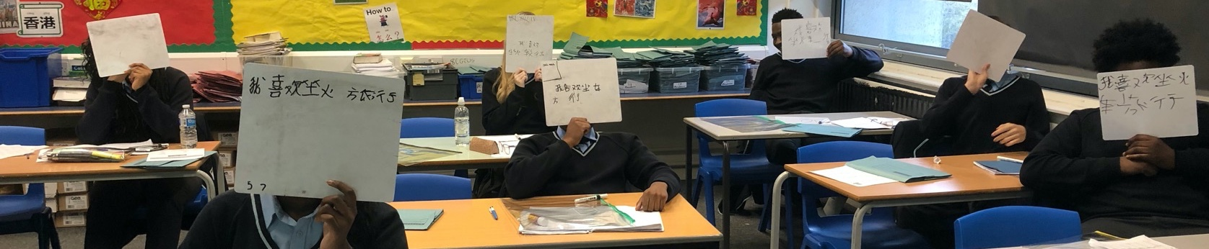
Notes:
What students’ work looks like

Slide 33
 | travel |  | often |  | Not only...but also..
 | expensive |  | Too noisy |  | together
 | convenient |  | By train |  | think
 | holiday |  | safe |  | Next month

Slide 34
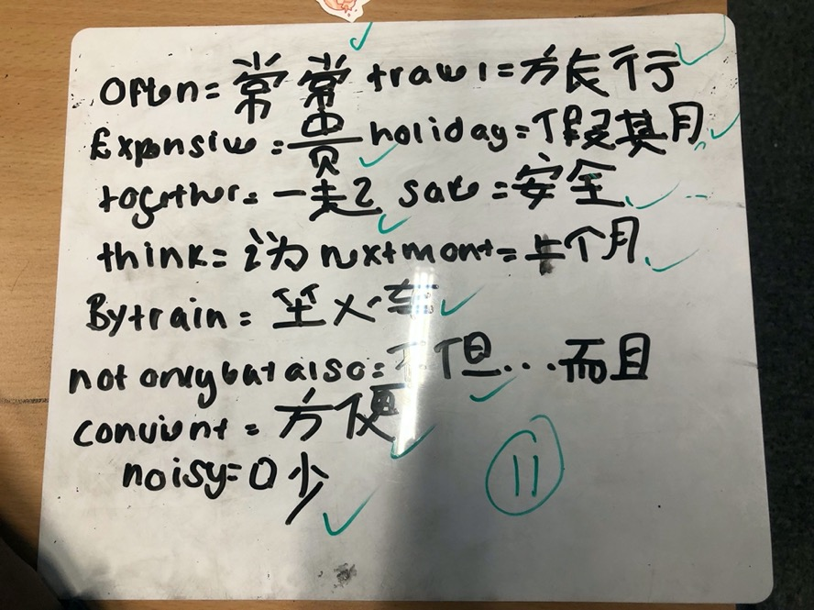
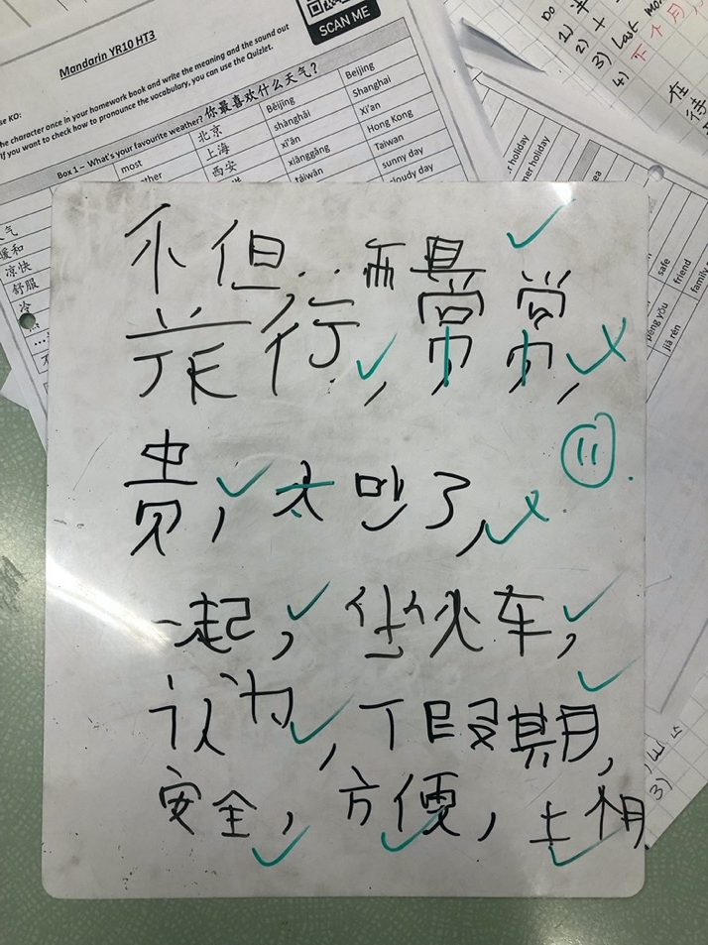
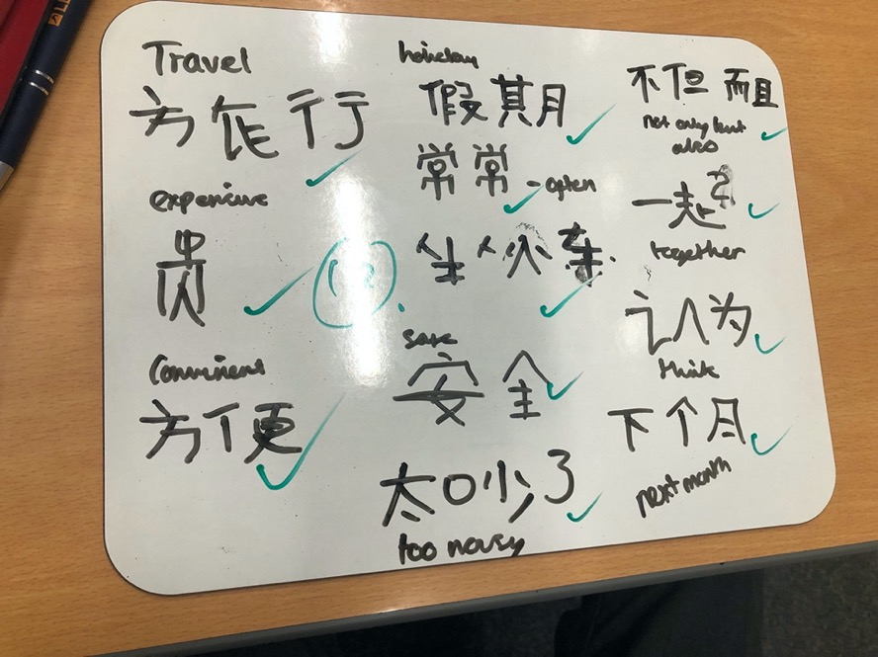

Slide 35
Characters writing routine:
In groups, can you put the steps in order?
Notes:
Will cut the steps in strips and let the teacher re-order

Slide 36
Characters writing routine:
Step 1: Practice writing characters – Use mini-whiteboard to address mis-conceptions at early stage
Step 2:Character Bingo – Students know how the words looks like
Step 3: Writing key sentences with Bingo table – Reinforce on reading the words and practice writing with support
Step 4: Delay dictation – remove support, focus on writing sentence out of memory using short-term memory
Step 5: Words dictation – students write the key words out of memory

Slide 37
Key takeaways:
Begin developing a positive mindset around character writing from Year 7.
Correct misconceptions early using mini-whiteboards so students feel secure and capable.
Sustain progress through practice – consistent, engaging writing tasks build motivation and long-term memory.

Slide 38
Thank you!
Q&A

Slide 39


