Slide 1
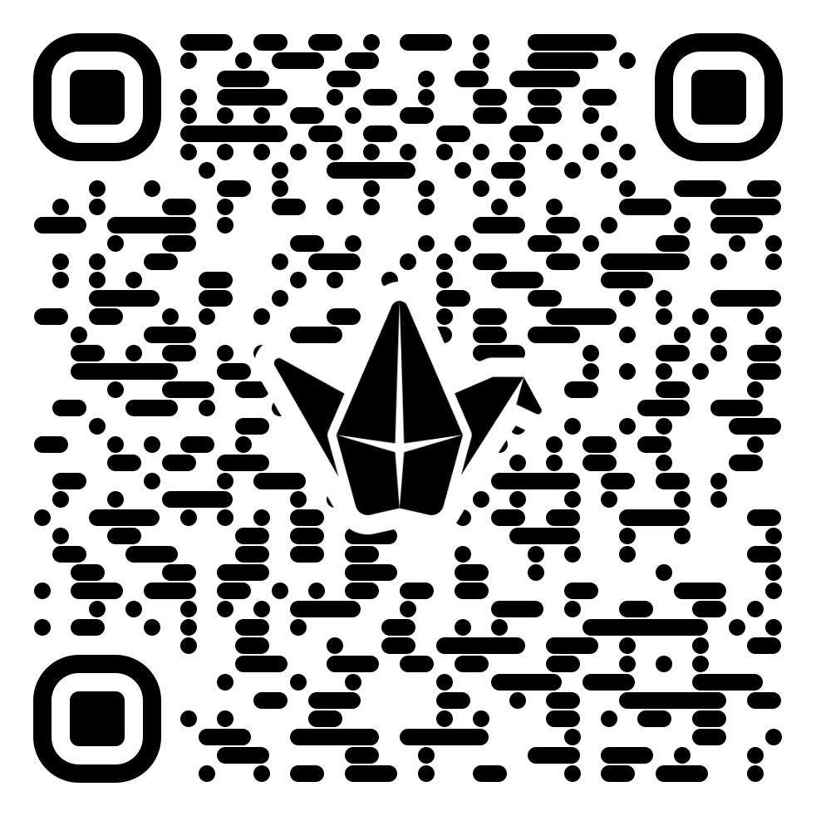
Schools Without Borders
“One map, many journeys — from first contact to future partnerships.”
1️⃣ Scan the QR code to open the map on Padlet. 2️⃣ Drop a pin on your school’s location. 3️⃣ In your pin note, please add:
Your School Name
If you already have a partner school → name & location of that partner.
If you are looking for a partner school → write “Seeking partner”.
One word: What does “partnership” mean to you?
Notes:
"Hello, everyone! Welcome, and thank you for choosing to spend your valuable conference time with me today. It’s wonderful to see so many dedicated Chinese teachers in one room. If you’ve ever felt like starting a partnership with a Chinese school is like trying to schedule a simple video call across seven different time zones, then you are absolutely in the right place!"Before we begin our formal journey, let’s see where we all are right now. Take out your phones—yes, it’s allowed, in fact, it’s required!

Slide 2

From First Contact to Lifelong Connections
Building China-UK School Partnerships, Planning Exchanges, and Sustaining Motivation
A practical workshop for school teachers who wish to develop meaningful international partnerships.
Shanshan Nai
Notes:
Welcome back! My name is Shanshan Nai, and I'm a Chinese teacher/Partnership Coordinator at Bohunt School Worthing. Today, we're here to talk about turning a simple email introduction—that 'first contact'—into a truly 'lifelong connection'.
Our goal is not just to talk about school partnerships, but specifically how to build them sustainably, especially for China-UK exchanges. We’ll be focusing on practical steps, tackling the biggest hurdles, and planning exchanges that don't just happen once, but become an annual, embedded tradition."

Slide 3
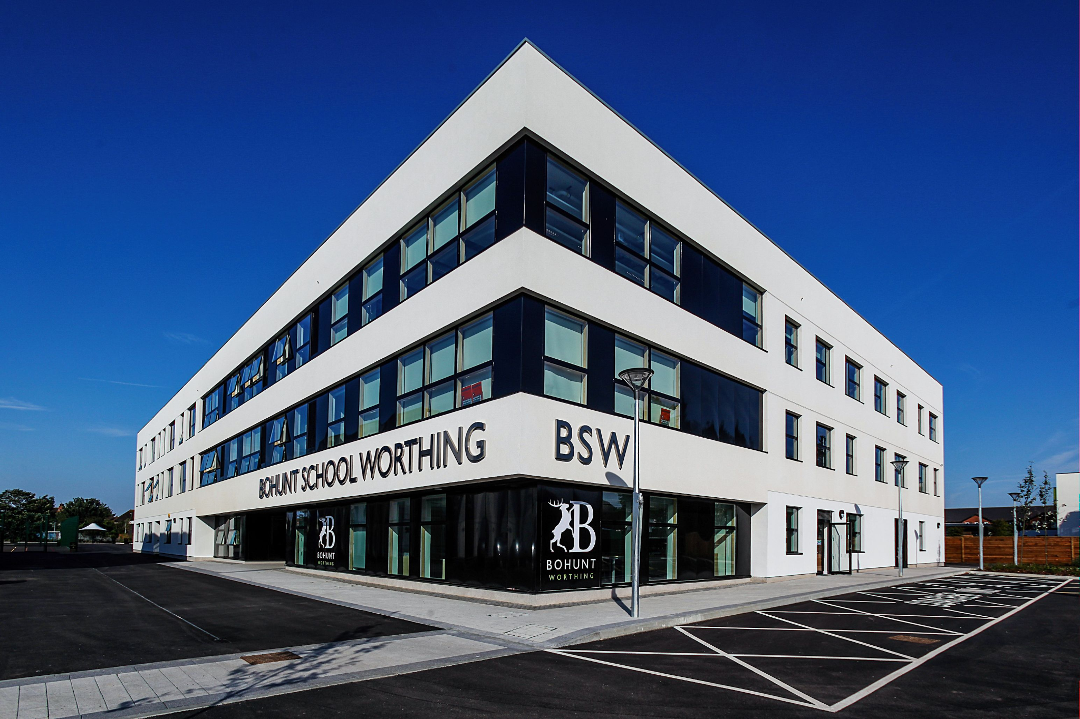
Bohunt School Worthing is a secondary school with academy status located in Worthing, West Sussex.
Our purpose built, modern and innovative Academy school opened in September 2015 to Year 7 and 8, and has since grown into a vibrant and successful 11-16 comprehensive school in the heart of the Worthing community, where all our young people and staff genuinely enjoy, respect and achieve.
Notes:
To give us a real-world framework, we're going to look at a case study: Bohunt School Worthing in the UK. We’re a comprehensive school, part of the wider Bohunt Education Trust

Slide 4
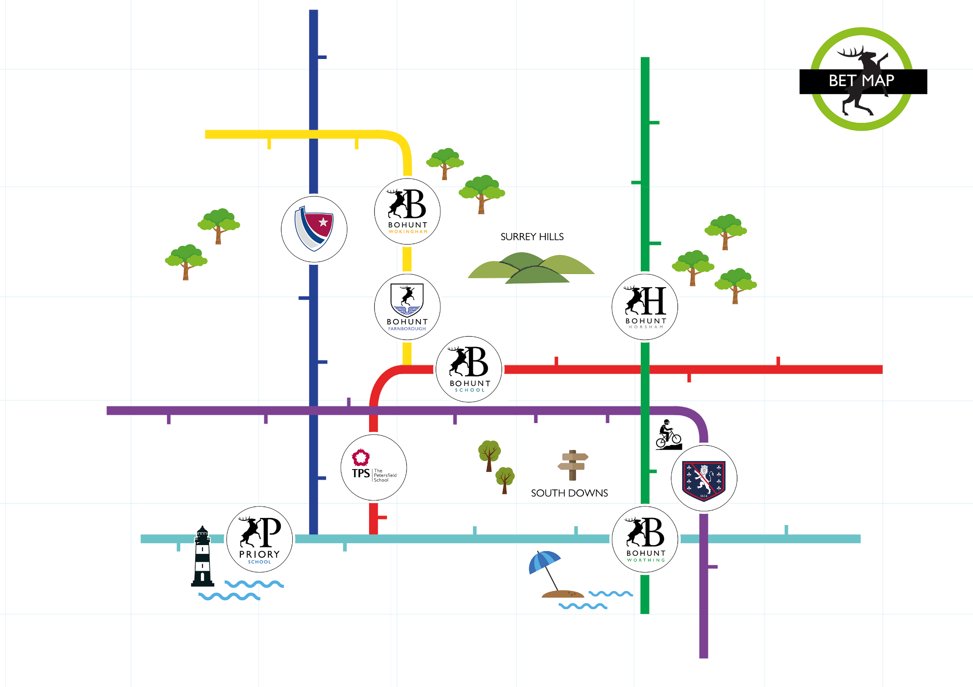
Bohunt Education Trust
As a multi-academy trust (MAT) of non-fee paying schools, BET provides innovative, high-quality education for children aged four to 18.
Notes:
We started small, but we believe our story proves that even if you’re a busy secondary school, a dynamic, long-term international partnership is absolutely achievable.

Slide 5
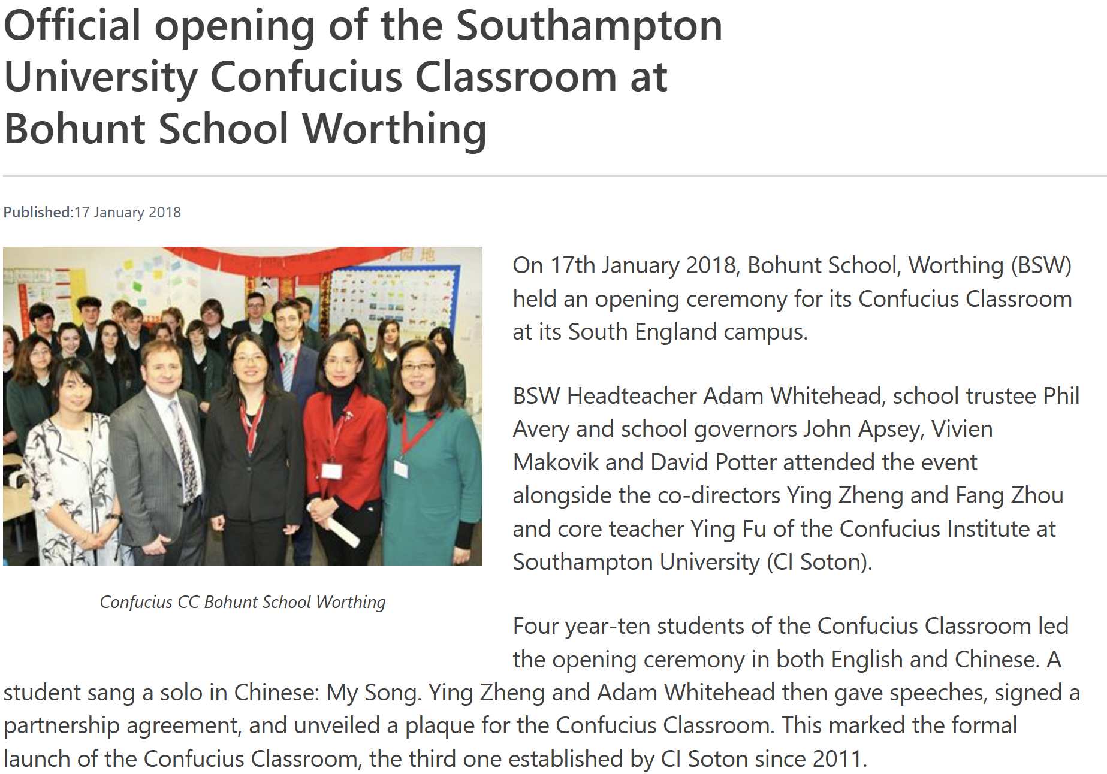
2017 - Confucius Classroom
We become a Confucius Classroom linked with Confucius Institute in University of Southampton in 2017. The official opening ceremony hold in January 2018
where does the journey start…

Slide 6

2017 - Confucius Classroom
2017 - Mandarin Excellence Program
In 2017, Bohunt School Worthing joined the Mandarin Excellence Programme, led by UCL’s Institute of Education. This initiative offers students intensive Mandarin study, preparing them with valuable language and cultural skills for a global future.
where does the journey start…

Slide 7
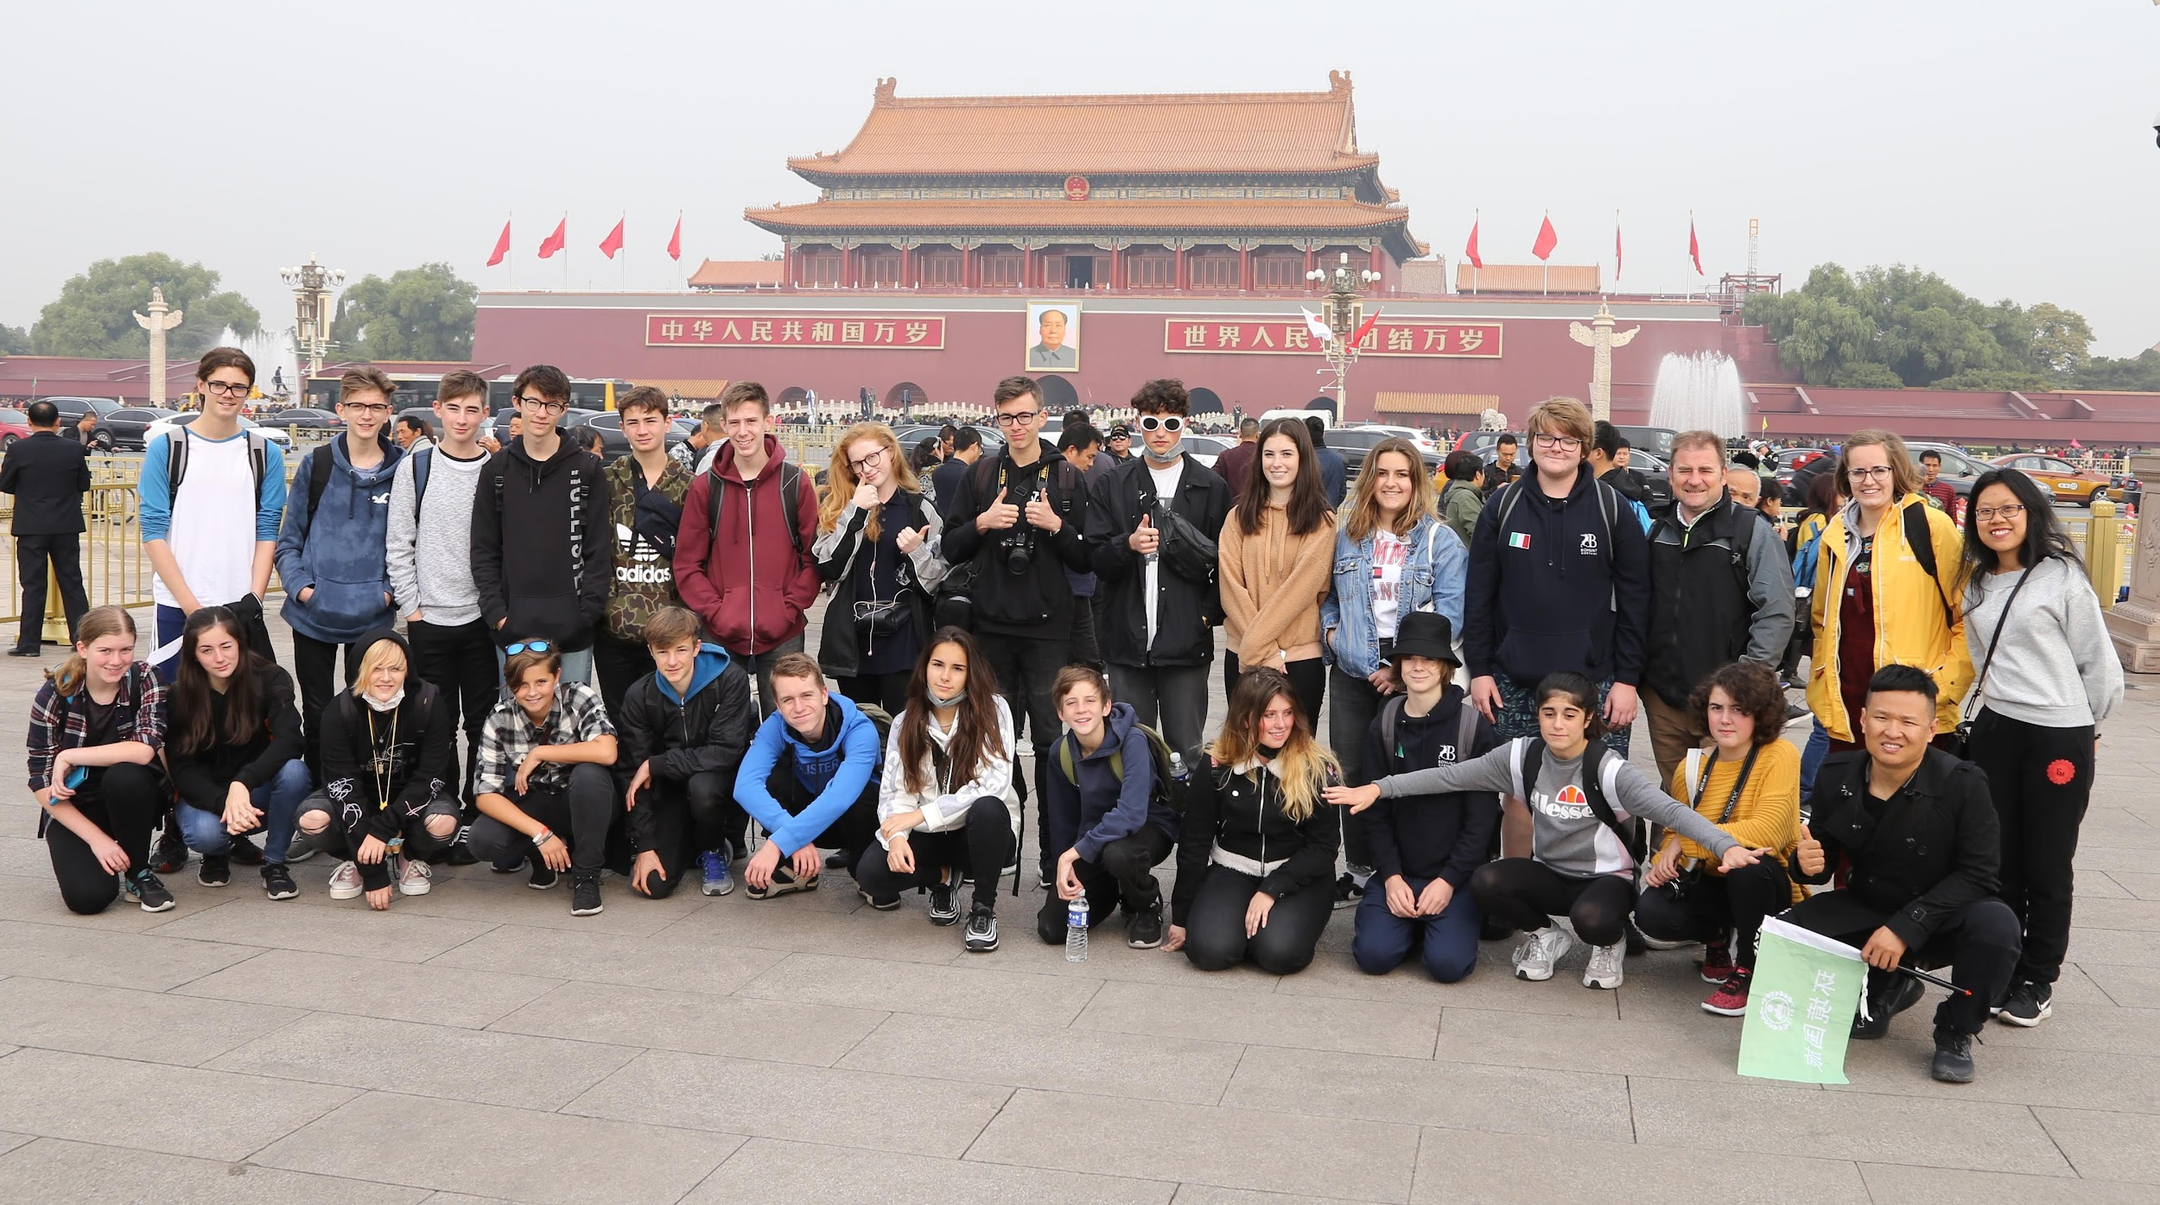
2017 - Confucius Classroom
2017 - Mandarin Excellence Program
2018/2019 - GCSE China Trip
In 2018 and 2019, Mandarin GCSE students from Bohunt School Worthing visited Xiamen University in China through the Confucius Institute. The trip offered immersive experiences in Chinese language, culture, and history—from calligraphy workshops to exploring local landmarks. It deepened students’ global awareness, built lasting friendships, and sparked a lifelong interest in international exchange.
where does the journey start…

Slide 8
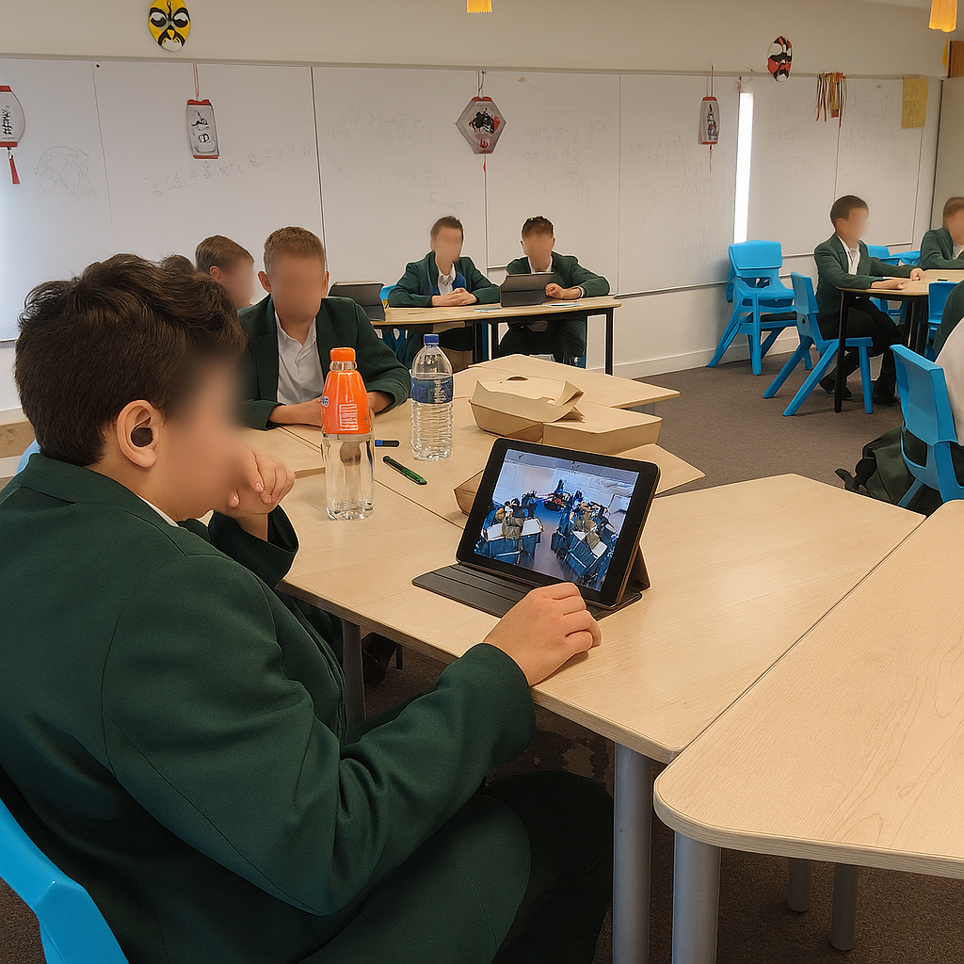
2017 - Confucius Classroom
2017 - Mandarin Excellence Program
2018/2019 - GCSE China Trip
2023 - Virtual School Partnerships
In Autumn 2023, Year 8 MEP students will join a Virtual Partnership Project with High School Affiliated to Nanjing Normal University in China to boost Mandarin skills and explore Chinese culture through interactive language and cultural activities.
The project also aims to foster long-term relationships between students and their partner schools, encouraging ongoing communication and cultural exchange beyond the initial activities.
where does the journey start…

Slide 9

2017 - Confucius Classroom
2017 - Mandarin Excellence Program
2018/2019 - GCSE China Trip
2023 - Virtual School Partnerships
2023 - School Partnership
where does the journey start…
In April 2023, Bohunt School Worthing and the Middle School Attached to USTC formalised a sister-school partnership through Global School Alliance to promote holistic education and cross-cultural exchange. The agreement encourages collaboration in leadership, teacher development, and student learning, laying the groundwork for lasting relationships through shared programmes and ongoing dialogue.

Slide 10
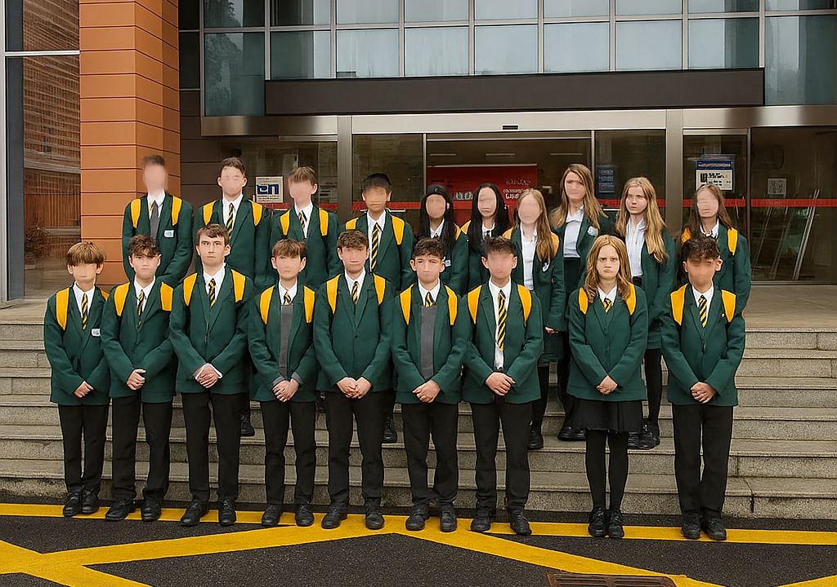
2017 - Confucius Classroom
2017 - Mandarin Excellence Program
2018/2019 - GCSE China Trip
2023 - Virtual School Partnerships
2023 - School Partnership
where does the journey start…
2024 - Annual China exchange trip
In Spring 2024, 22 Year 8 students from Bohunt School Worthing visited their sister school in Hefei, China. The trip offered cultural immersion and real-world Mandarin practice, strengthening ties between the schools.

Slide 11
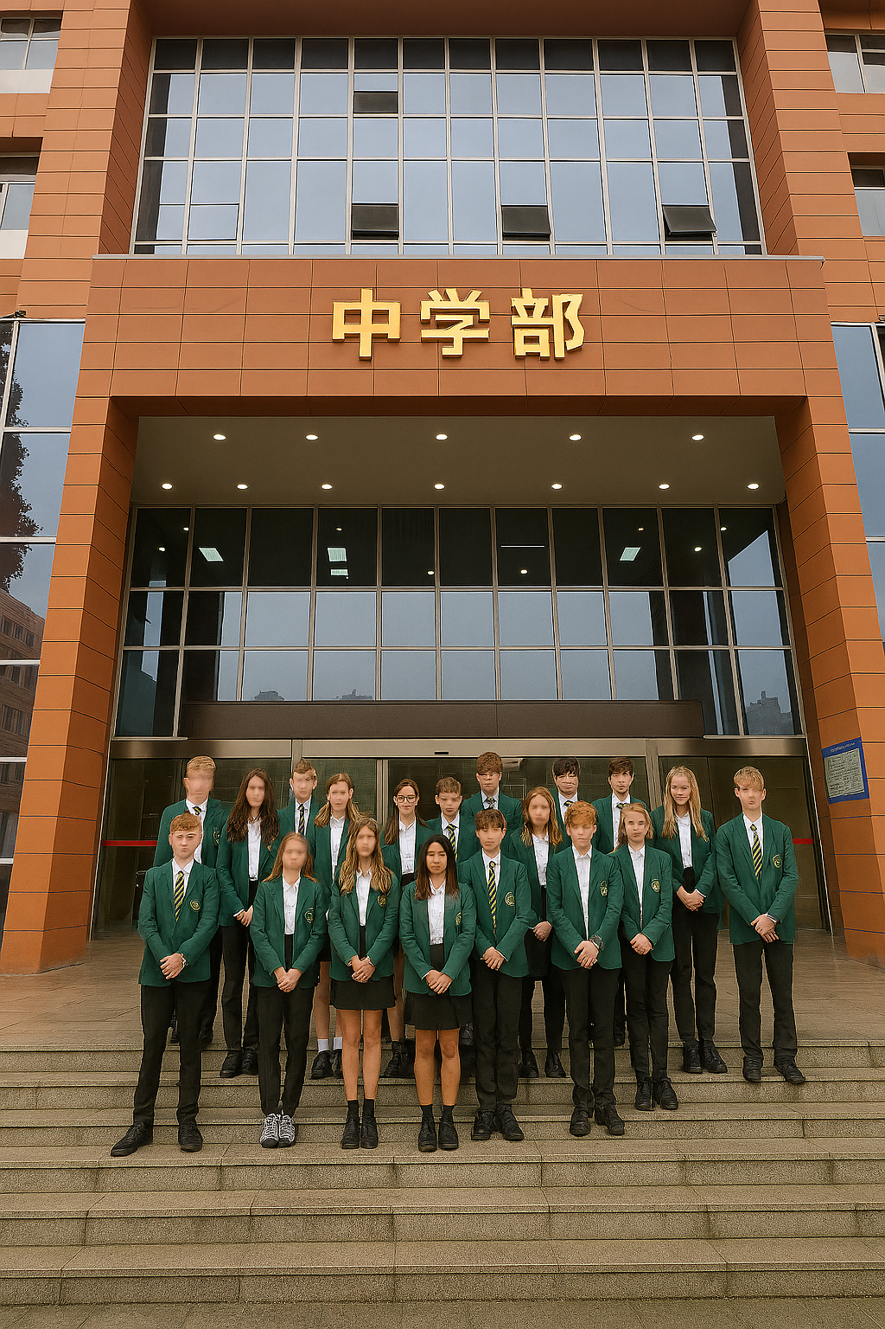
2017 - Confucius Classroom
2017 - Mandarin Excellence Program
2018/2019 - GCSE China Trip
2023 - Virtual School Partnerships
2023 - School Partnership
where does the journey start…
2024 - Annual China exchange trip
2025 - Annual China exchange trip
Over Easter 2025, 22 Bohunt School Worthing students visited our partner school in China, strengthening ties through shared lessons and cultural exchange. The trip marked the beginning of a lasting international relationship.

Slide 12
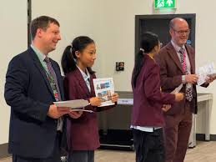
2017 - Confucius Classroom
2017 - Mandarin Excellence Program
2018/2019 - GCSE China Trip
2023 - Virtual School Partnerships
2023 - School Partnership
where does the journey start…
2024 - Annual China exchange trip
2025 - Annual China exchange trip
2025 - Host partner school
In 2025, Bohunt School Worthing proudly hosted our partner school from China, welcoming their students for a four-day visit. The Chinese students joined lessons and built lasting friendships with our pupils, deepening our international partnership.

Slide 13

Case Study: Bohunt School Worthing’s Partnership Journey
Origins & Milestones
Challenges & Successes
Partnership began through Confucius Classroom Connecting Classrooms programme in 2017
Initial hurdle: securing sustainable funding through grants and parent contributions
Gold award from Global School Alliance in 2023
Overcame parental safety concerns with thorough planning and communication
First reciprocal visits to our partner school established in 2023
Increased student Mandarin uptake, nearly 70% students continue Mandarin learning following first exchange
Now includes student/teacher exchanges and annual student visits
Created alumni network that continues cultural connections beyond school

Slide 14

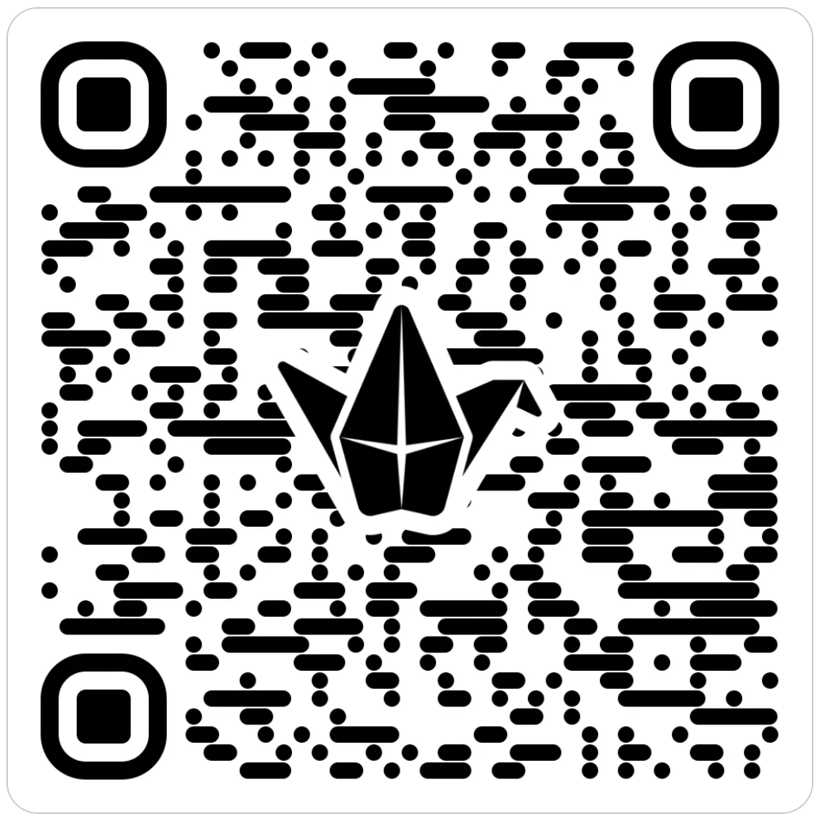

Tackling Challenges in International School Exchanges
Interactive Session 1: Potential Problems
We'll work in small groups to identify the key challenges faced when establishing educational links with China and planning student exchange trips.
Notes:
Discuss the biggest pain point your school currently faces in one of these four areas. We'll share one challenge from each table

Slide 15
Tackling Challenges in International School Exchanges
Interactive Session 1: Potential Problems
1
Funding & Budgeting
How can we secure sustainable funding models for long-term partnerships?
2
Parental Engagement
How do we address concerns whilst building enthusiasm for international experiences?
3
Organizational Stability
How can we embed exchange programs into school structures so they persist beyond individual staff or leadership changes?
4
Student Legacy & Progression
What strategies help students build on exchange experiences year after year, fostering deeper cultural understanding and long-term engagement?

Slide 16

Potential Problems & Solutions
Funding & Budgeting Challenge: Securing sustainable funding for long-term partnerships Solutions:
Apply for government and cultural exchange grants (e.g. British Council, DoE, CLEC)
Partner with local businesses for sponsorship or in-kind support
Build cost-sharing models with partner schools (e.g. alternating hosting years)
Organize fundraising events involving students and parents (easyfundraising)

Slide 17


The Turing Scheme now offers opportunities for pupils to benefit from international study. Funded by the UK government, it gives grants for organisational support, cost of living and travel. The programme opens once a year, in the spring, for applications from schools and further and higher education establishments.
Easyfundraising is a free UK platform that lets people raise money for charities, schools, and community groups while shopping online. When users buy from partnered retailers through Easyfundraising, the retailer donates a percentage to the chosen cause—at no extra cost to the shopper.
Notes:
Government Grants: In the UK, the Turing Scheme is a massive opportunity, providing grants for travel and living costs
Creativity: Don't underestimate platforms like Easyfundraising for passive income , or simply implementing a cost-sharing model where schools take turns hosting

Slide 18

The Confucius Institute provides valuable support for students and professionals interested in experiencing China first-hand. Through its partnerships with universities and cultural organizations, it offers opportunities such as scholarships, language immersion, and cultural exchange programs. These initiatives can help fund and organize trips to China, giving participants the chance to improve their Mandarin, explore Chinese culture, and build international connections that support both personal and academic development.
Notes:
Institutional Support: Don’t forget the Confucius Institute offers scholarships and programs that can directly help fund and organize trips

Slide 19


The Great British School Trip helps students access inspiring, educational visits to UK museums, cultural sites, and attractions. It supports schools with funding and opportunities, making learning beyond the classroom more accessible and memorable.
The Jack Petchey Foundation supports young people’s learning and personal development by funding educational trips and activities. Through its grants, schools and youth groups can give students opportunities to explore new places, gain valuable experiences, and broaden their horizons beyond the classroom.

Slide 20

Potential Problems & Solutions
Parental Engagement Challenge: Addressing concerns while building enthusiasm Solutions:
Host information evenings with Q&A and past trip testimonials
Share clear itineraries, safeguarding measures, and cost breakdowns
Provide regular updates via newsletters or a trip-specific communication channel
Involve parents in pre-departure cultural preparation activities

Slide 21

Potential Problems & Solutions
Organizational Stability Challenge: Without a permanent partner school or long-term planning, exchanges risk becoming one-off events rather than sustained annual collaborations—online or in person.
Solutions:
Establish Formal Partnerships
Create a Multi-Year Exchange Calendar
Embed in Curriculum & School Strategy
Build Institutional Memory
Diversify Staff Involvement

Slide 22

Potential Problems & Solutions
Student Legacy & Progression Challenge: Without structured follow-up, exchange experiences can feel like one-off events, limiting long-term impact on students’ cultural understanding and language growth.
Solutions:
Create Multi-Year Pathways
Student-Led Legacy Projects
Mentorship & Peer Leadership
Curriculum Integration
Celebrate & Showcase Progression
Notes:
Create Multi-Year Pathways: Design exchange-related activities that span Key Stages, allowing students to build on prior experiences (e.g. Year 8 cultural prep → Year 9 exchange → Year 10 leadership roles).
Student-Led Legacy Projects: Encourage returning students to create resources for future cohorts—such as travel guides, cultural journals, or short videos—to pass on insights and enthusiasm.
Mentorship & Peer Leadership: Establish a buddy or ambassador system where experienced students support new participants, fostering continuity and ownership.
Curriculum Integration: Embed exchange themes into Mandarin, PSHE, Geograph, food tech and career lessons to reinforce cultural learning beyond the trip itself.
Celebrate & Showcase Progression: Host assemblies, exhibitions, or digital showcases that highlight student growth and contributions over time, reinforcing the value of long-term engagement.

Slide 23

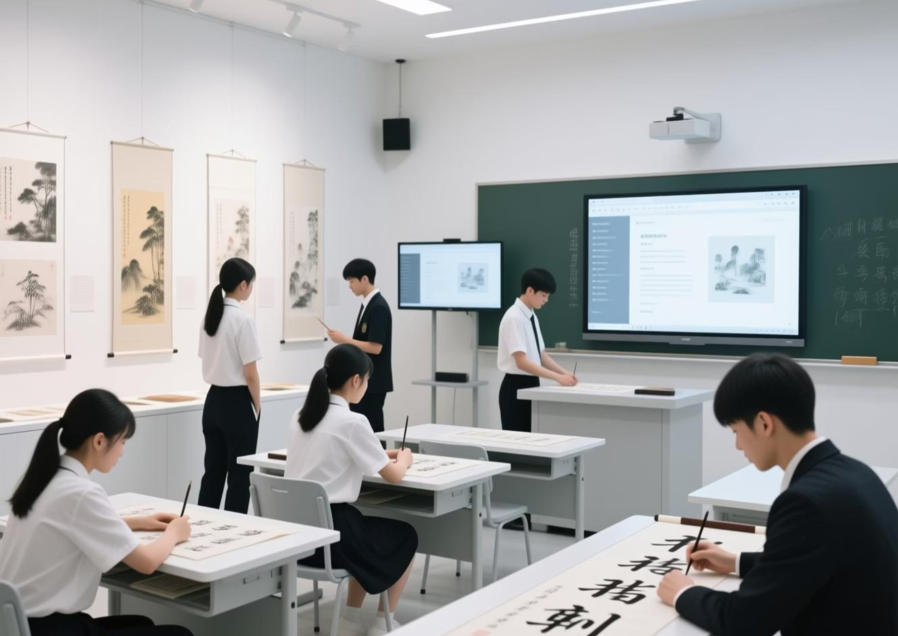
Pre-Trip Projects: Building Bridges Before Travel
Interactive Session 2
Working in your table groups, you'll design a pre-trip project that engages students before they even pack their suitcases.
Design Elements to Consider:
Choose a compelling cultural theme
Select appropriate digital platforms
Plan tangible student outputs
Consider assessment opportunities
Cultural Exploration
Digital Platforms
Student Outputs
Art, music, festivals, food traditions, family structures
Showbie, Padlet, Zoom exchanges
Virtual museums, bilingual presentations, cultural guidebooks
Notes:
Let's get practical. The real magic happens before the suitcase is packed. Pre-trip projects build anticipation, boost confidence, and ensure students arrive ready to engage.
Working in your same groups, let's design a brilliant Pre-Trip Project:
Cultural Theme: Pick one: Art, food, festivals, or family structure.
Digital Platform: How will they connect? (e.g., Padlet, Zoom exchanges).
Student Output: What do they create? (e.g., A bilingual presentation on British food like Fish and Chips, or a virtual guidebook to their hometown

Slide 24
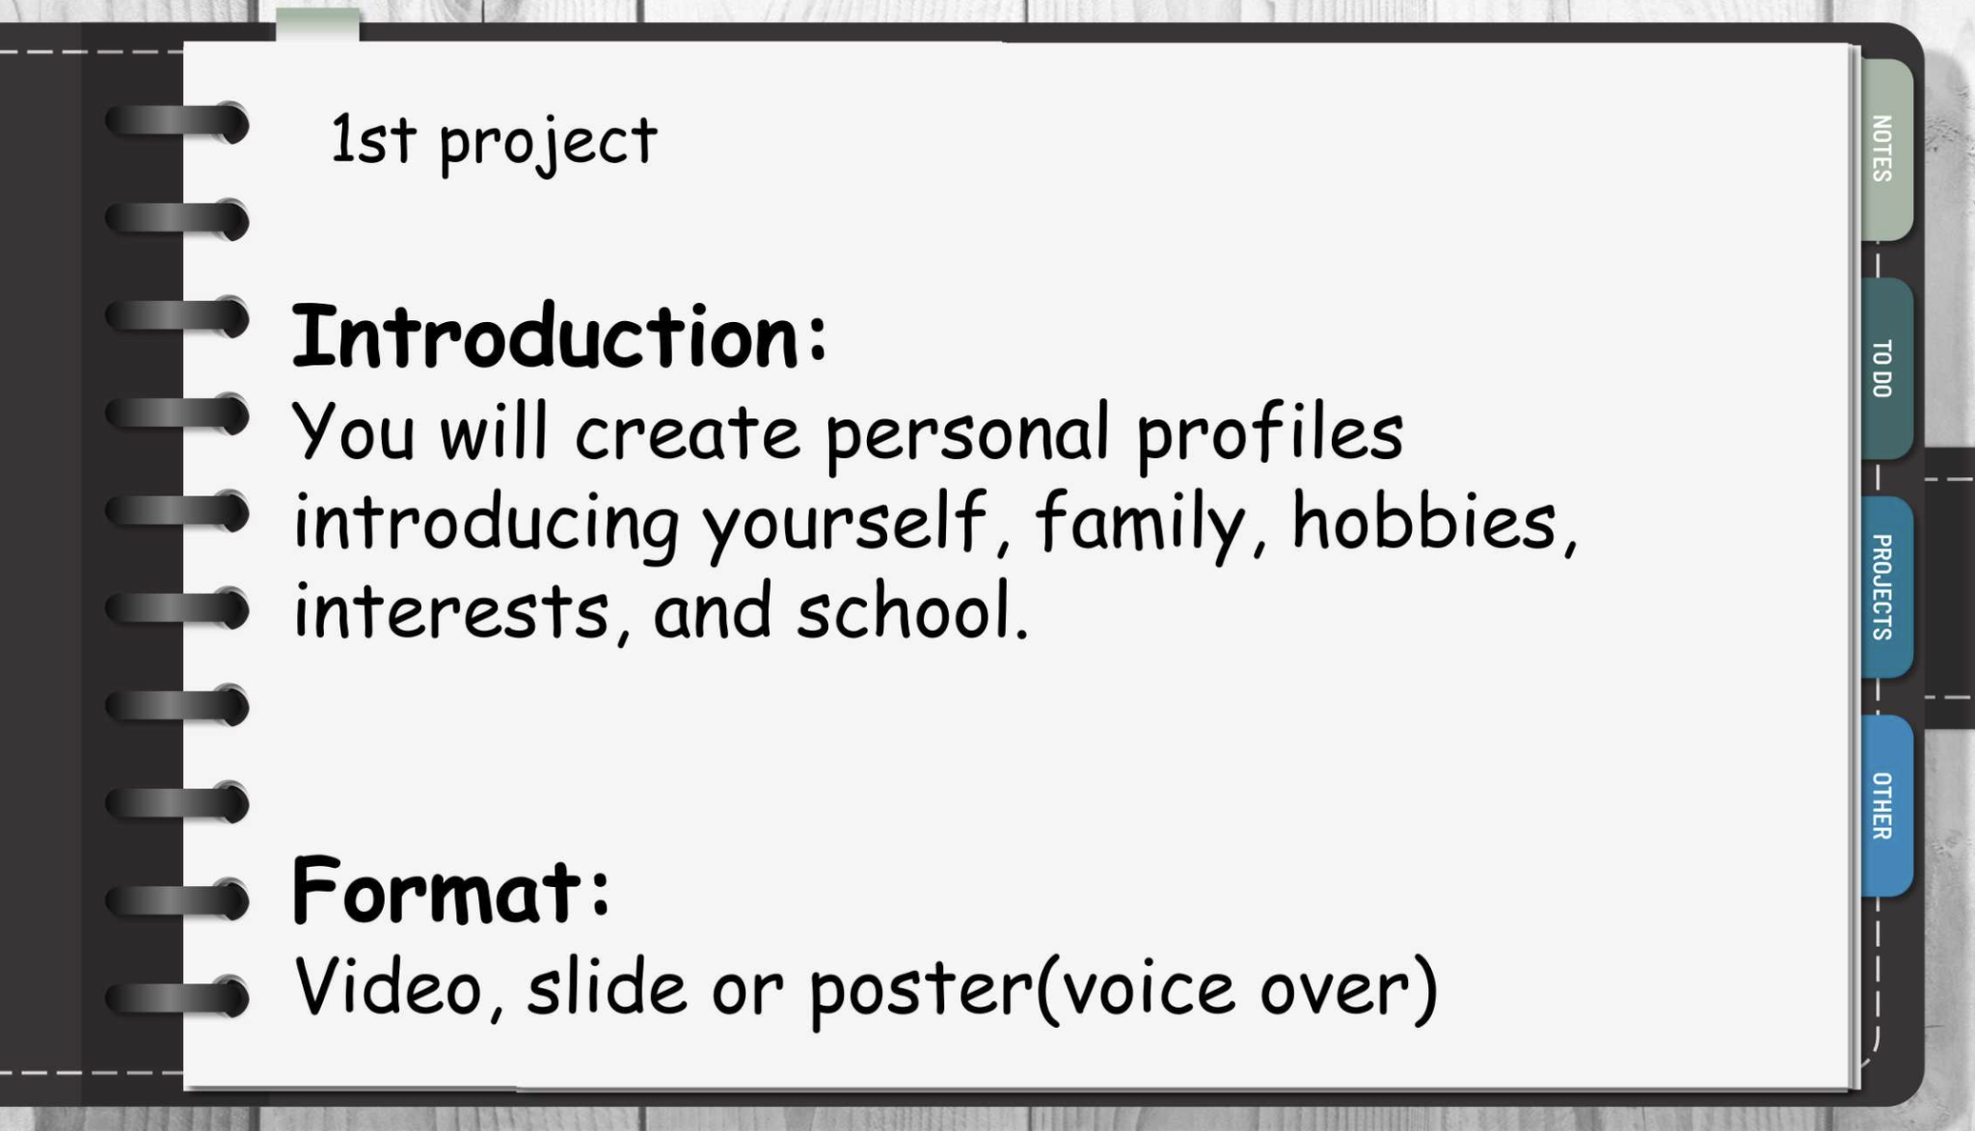
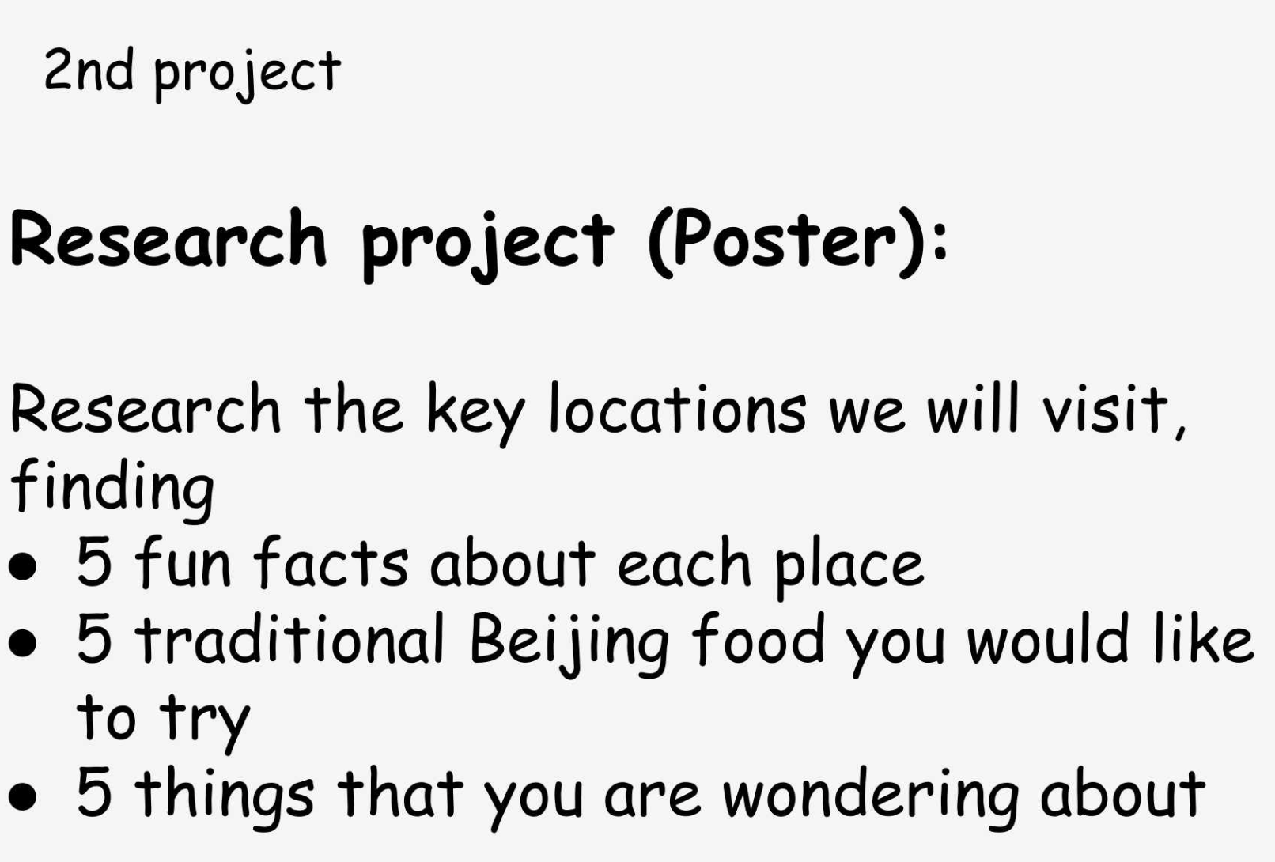
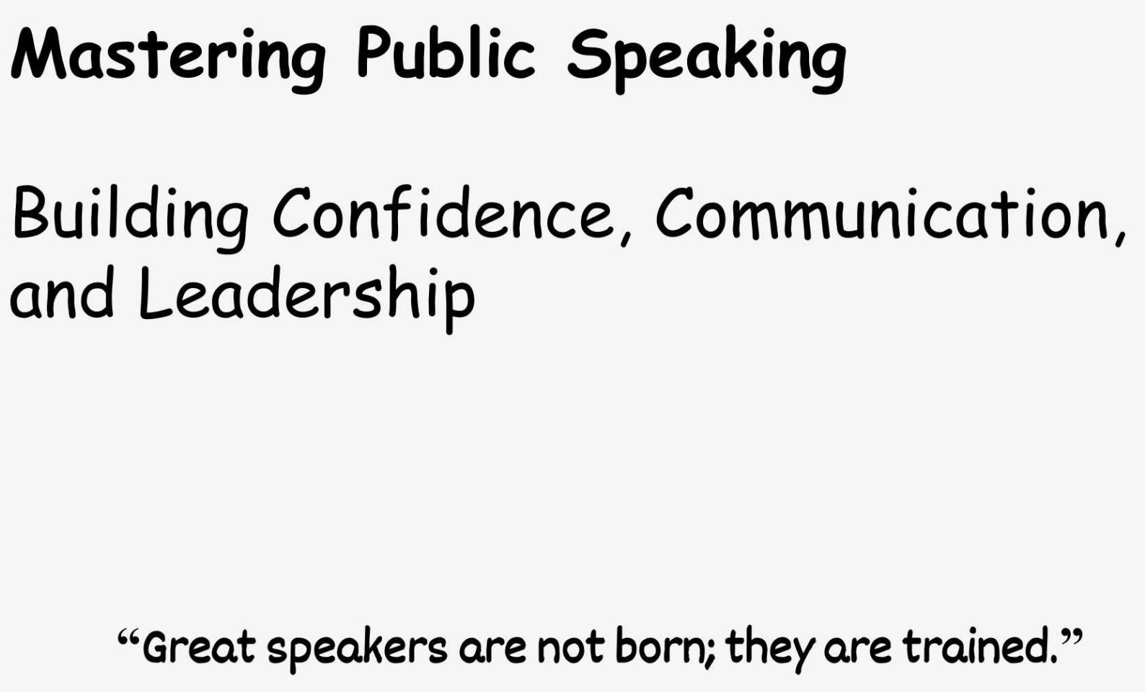
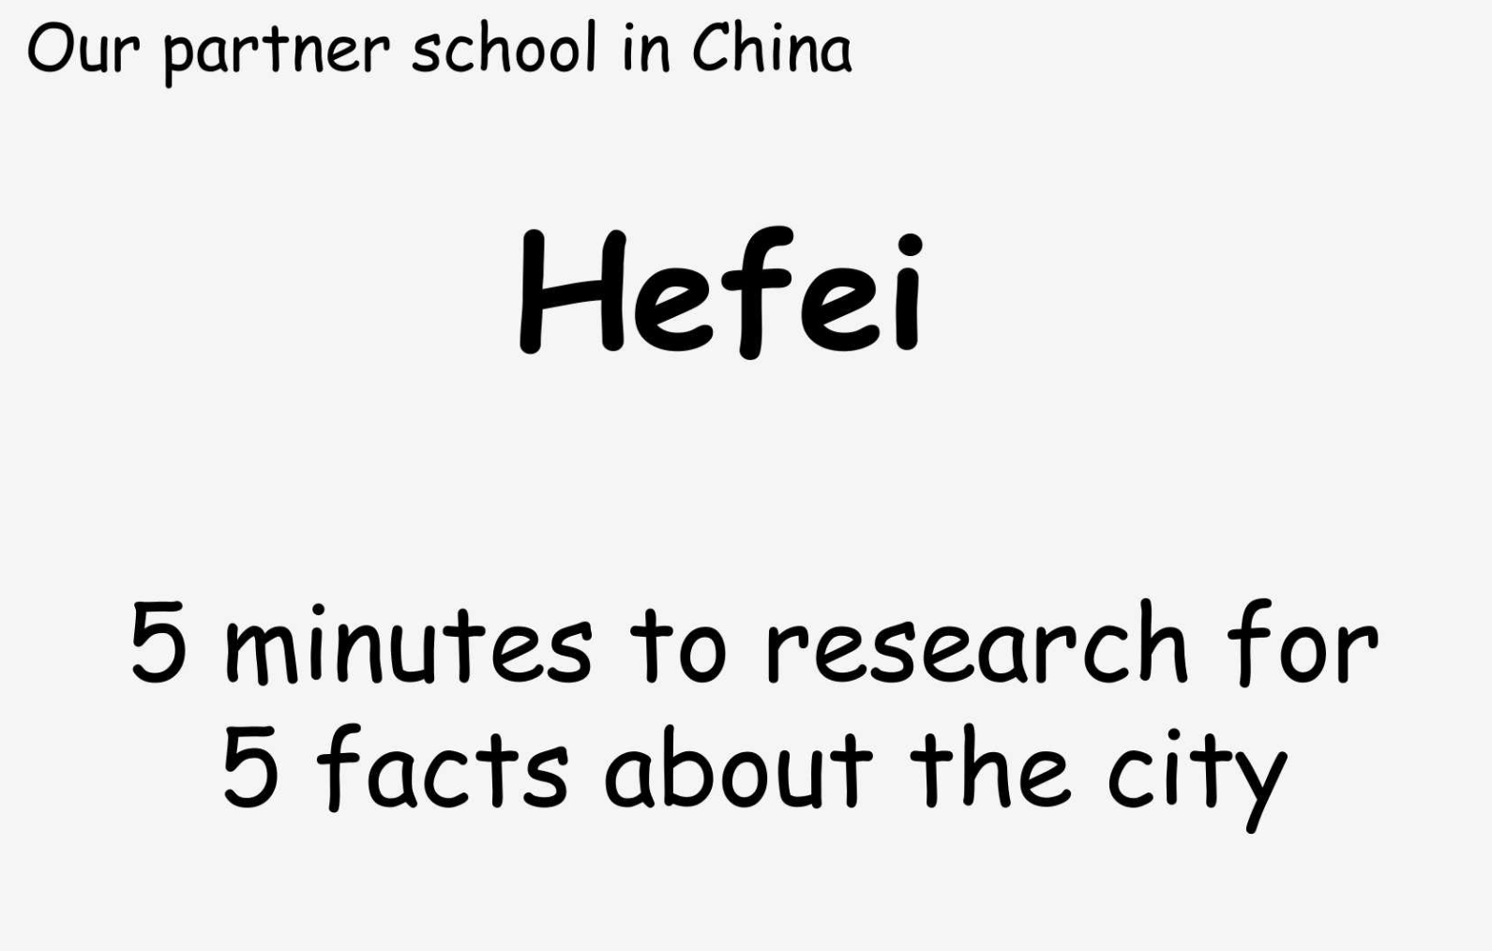
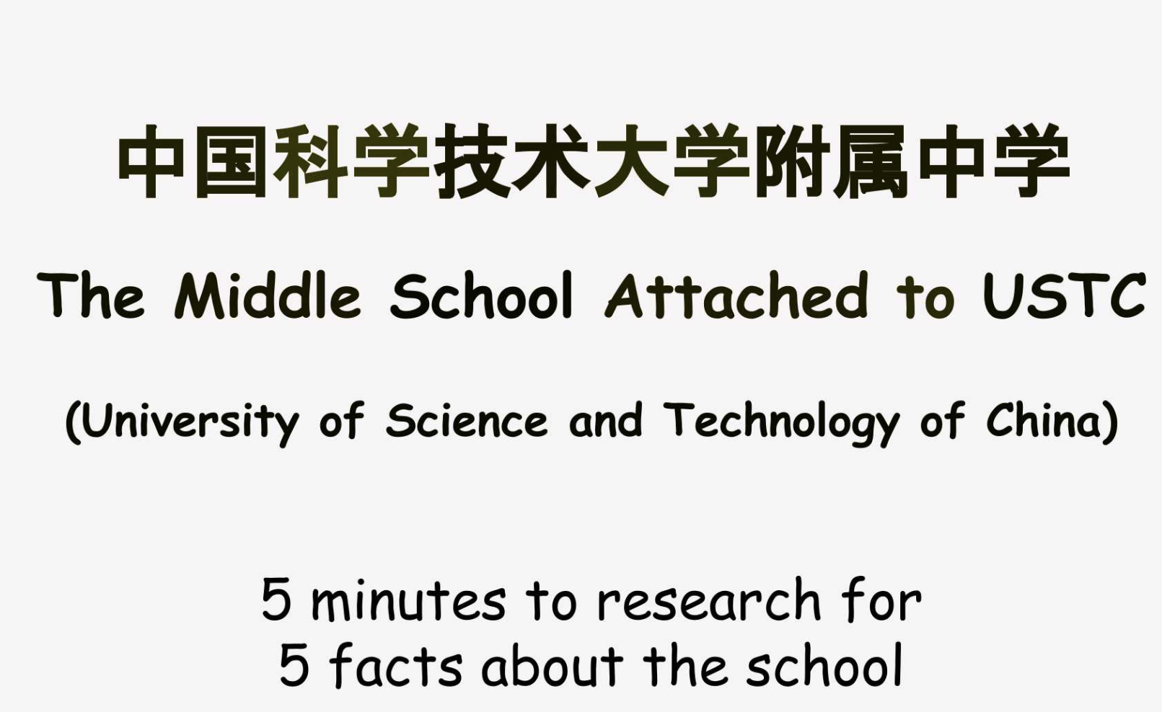



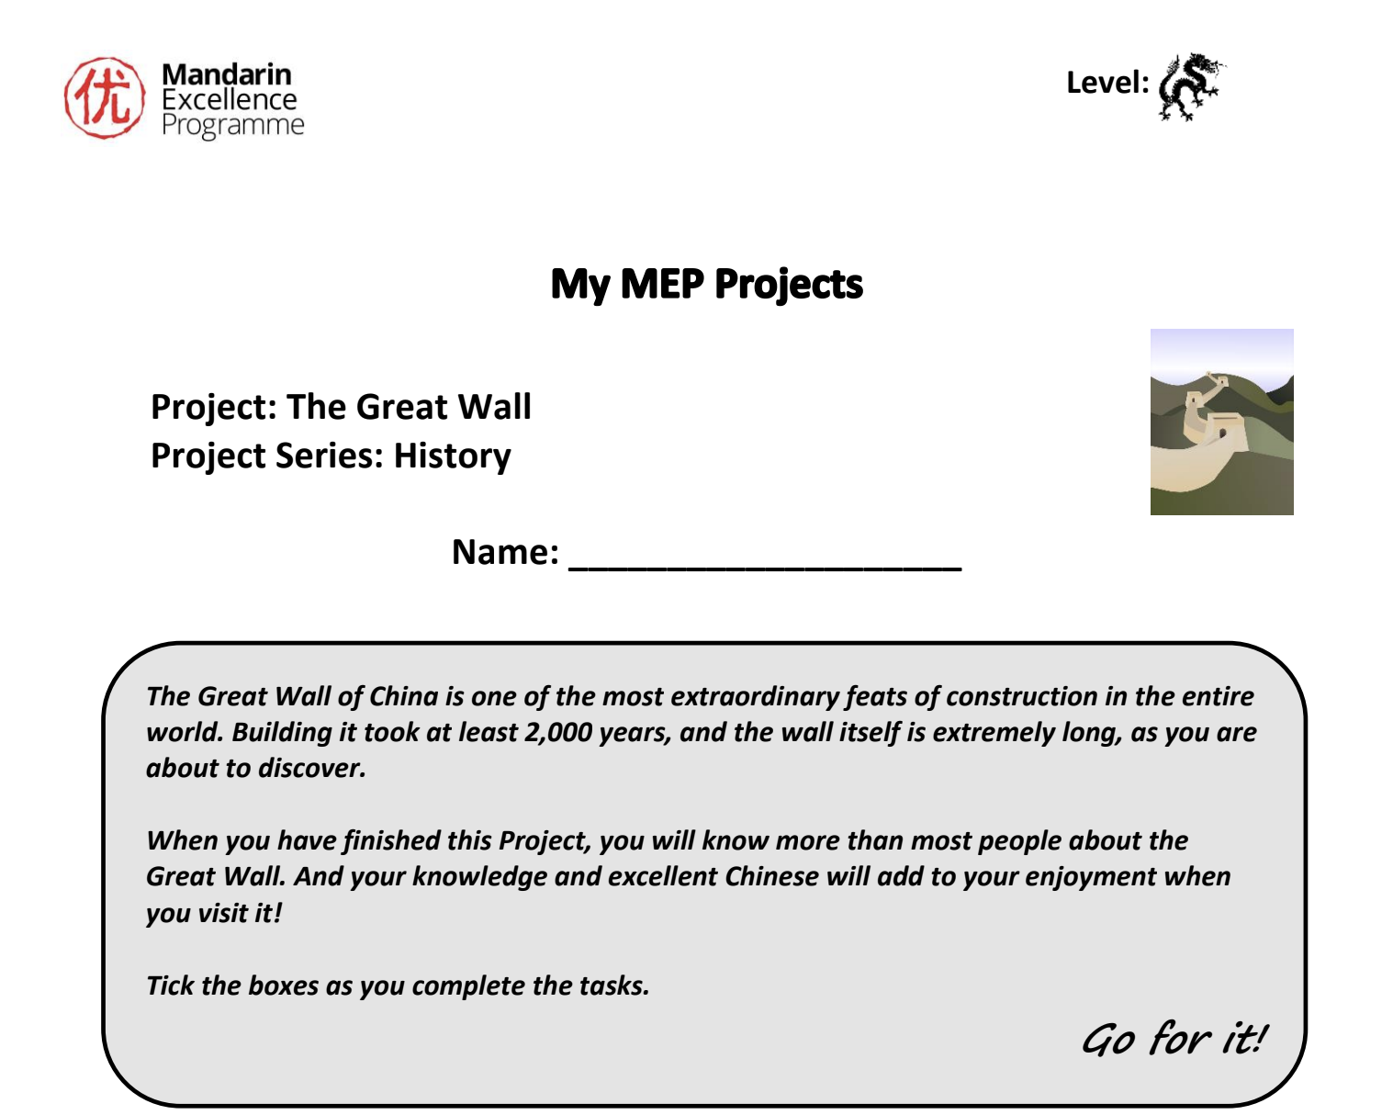

Slide 25
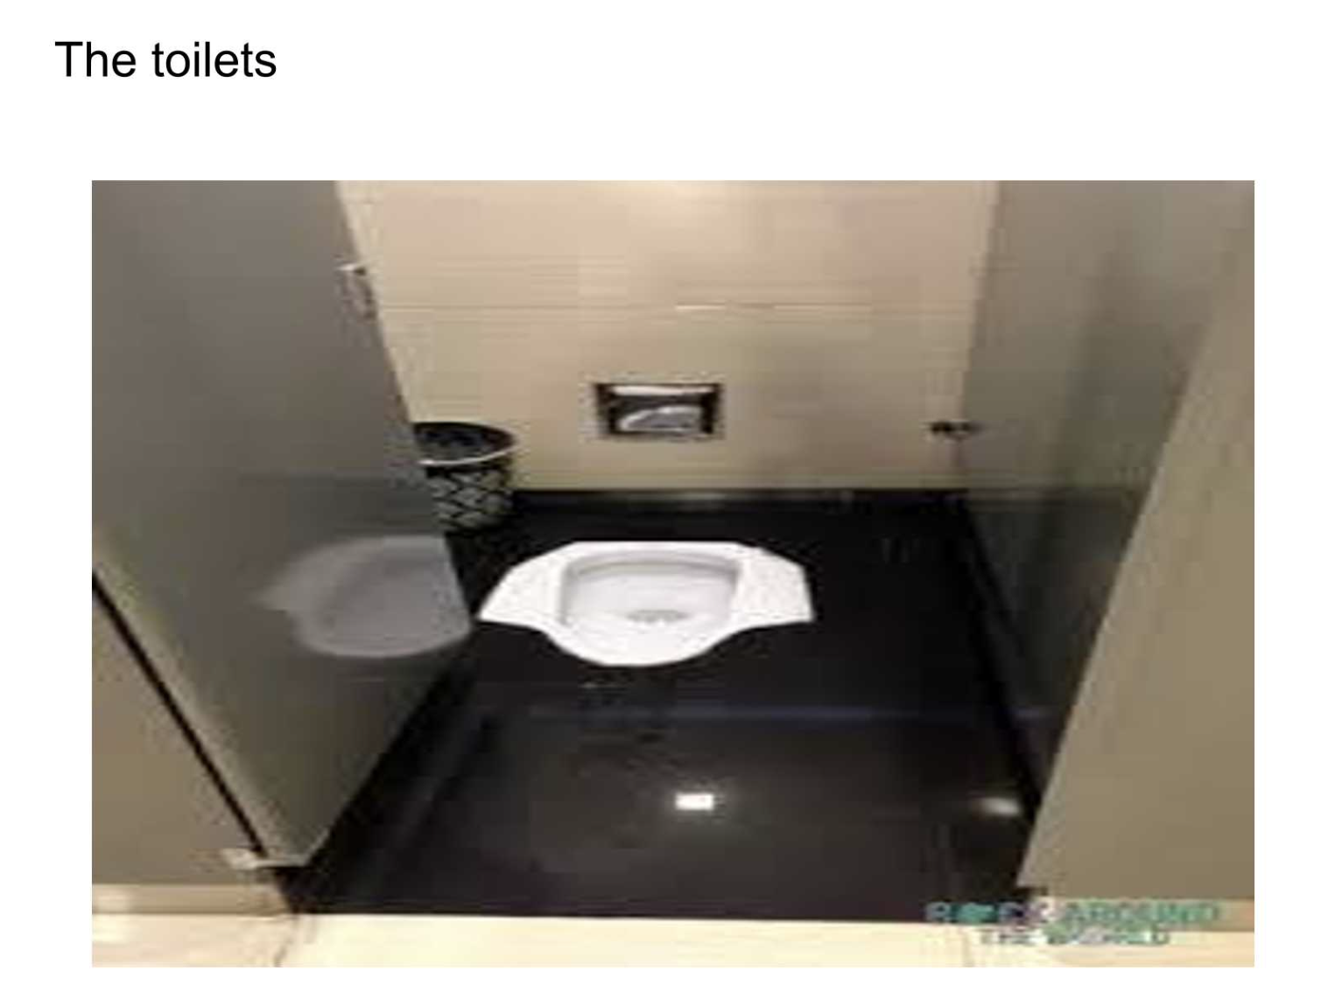
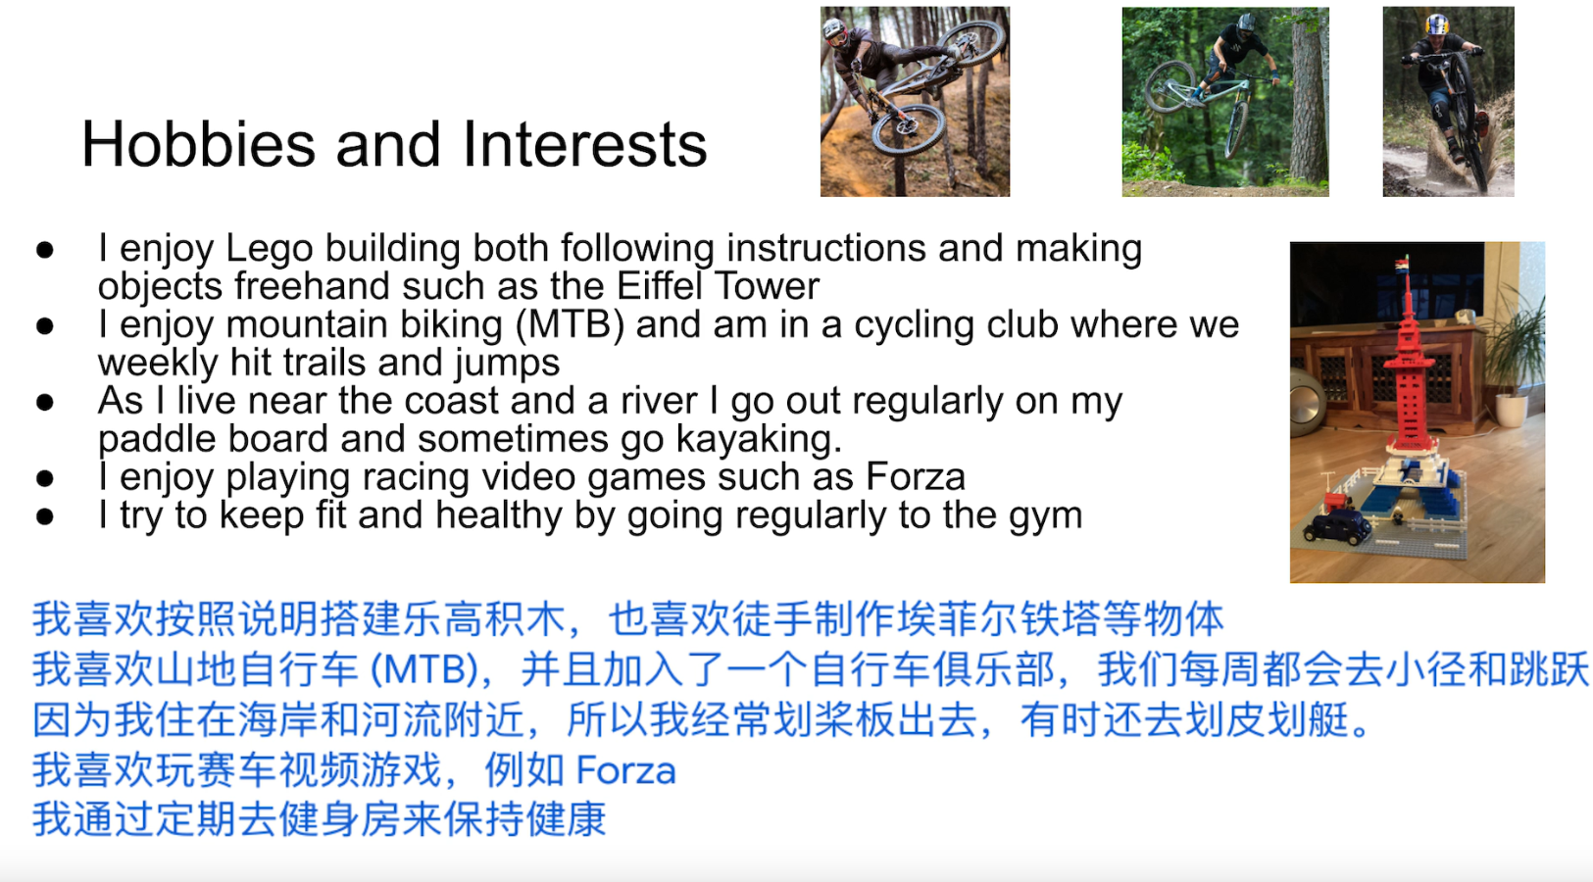
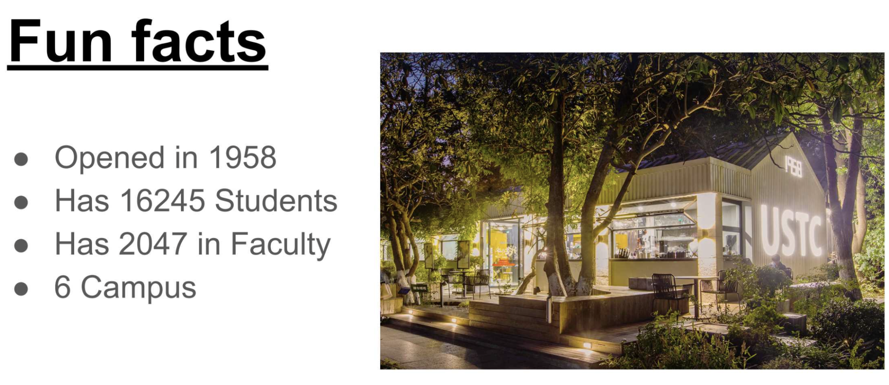

Slide 26
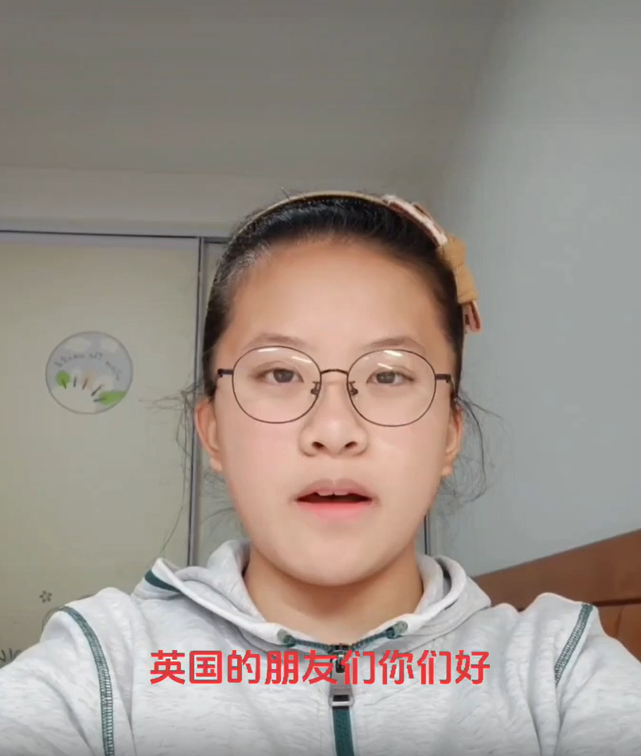
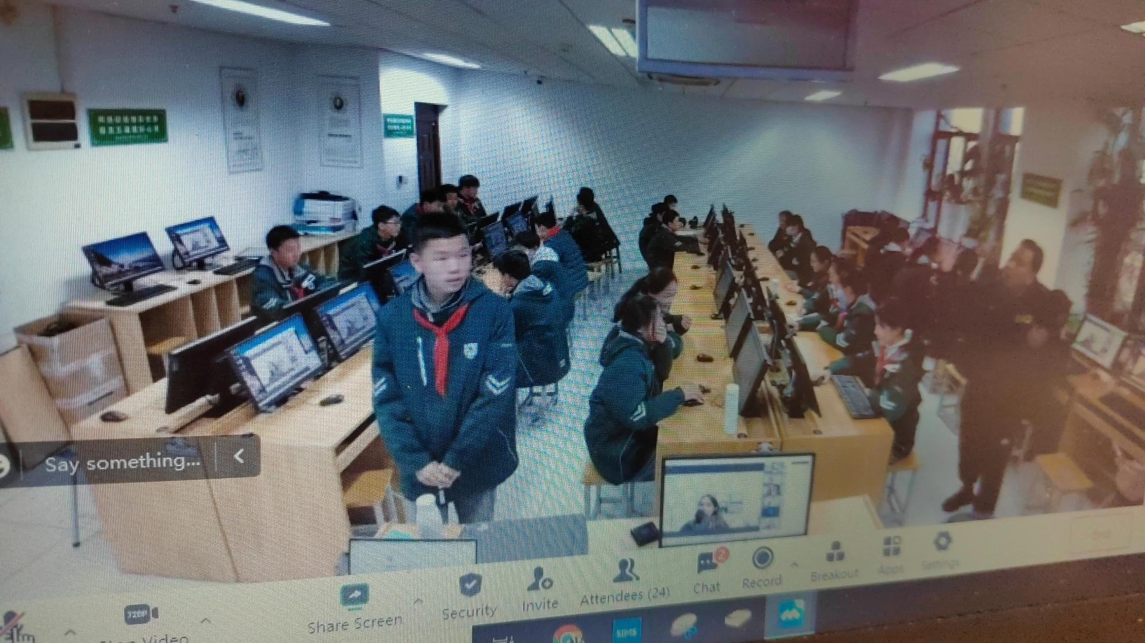
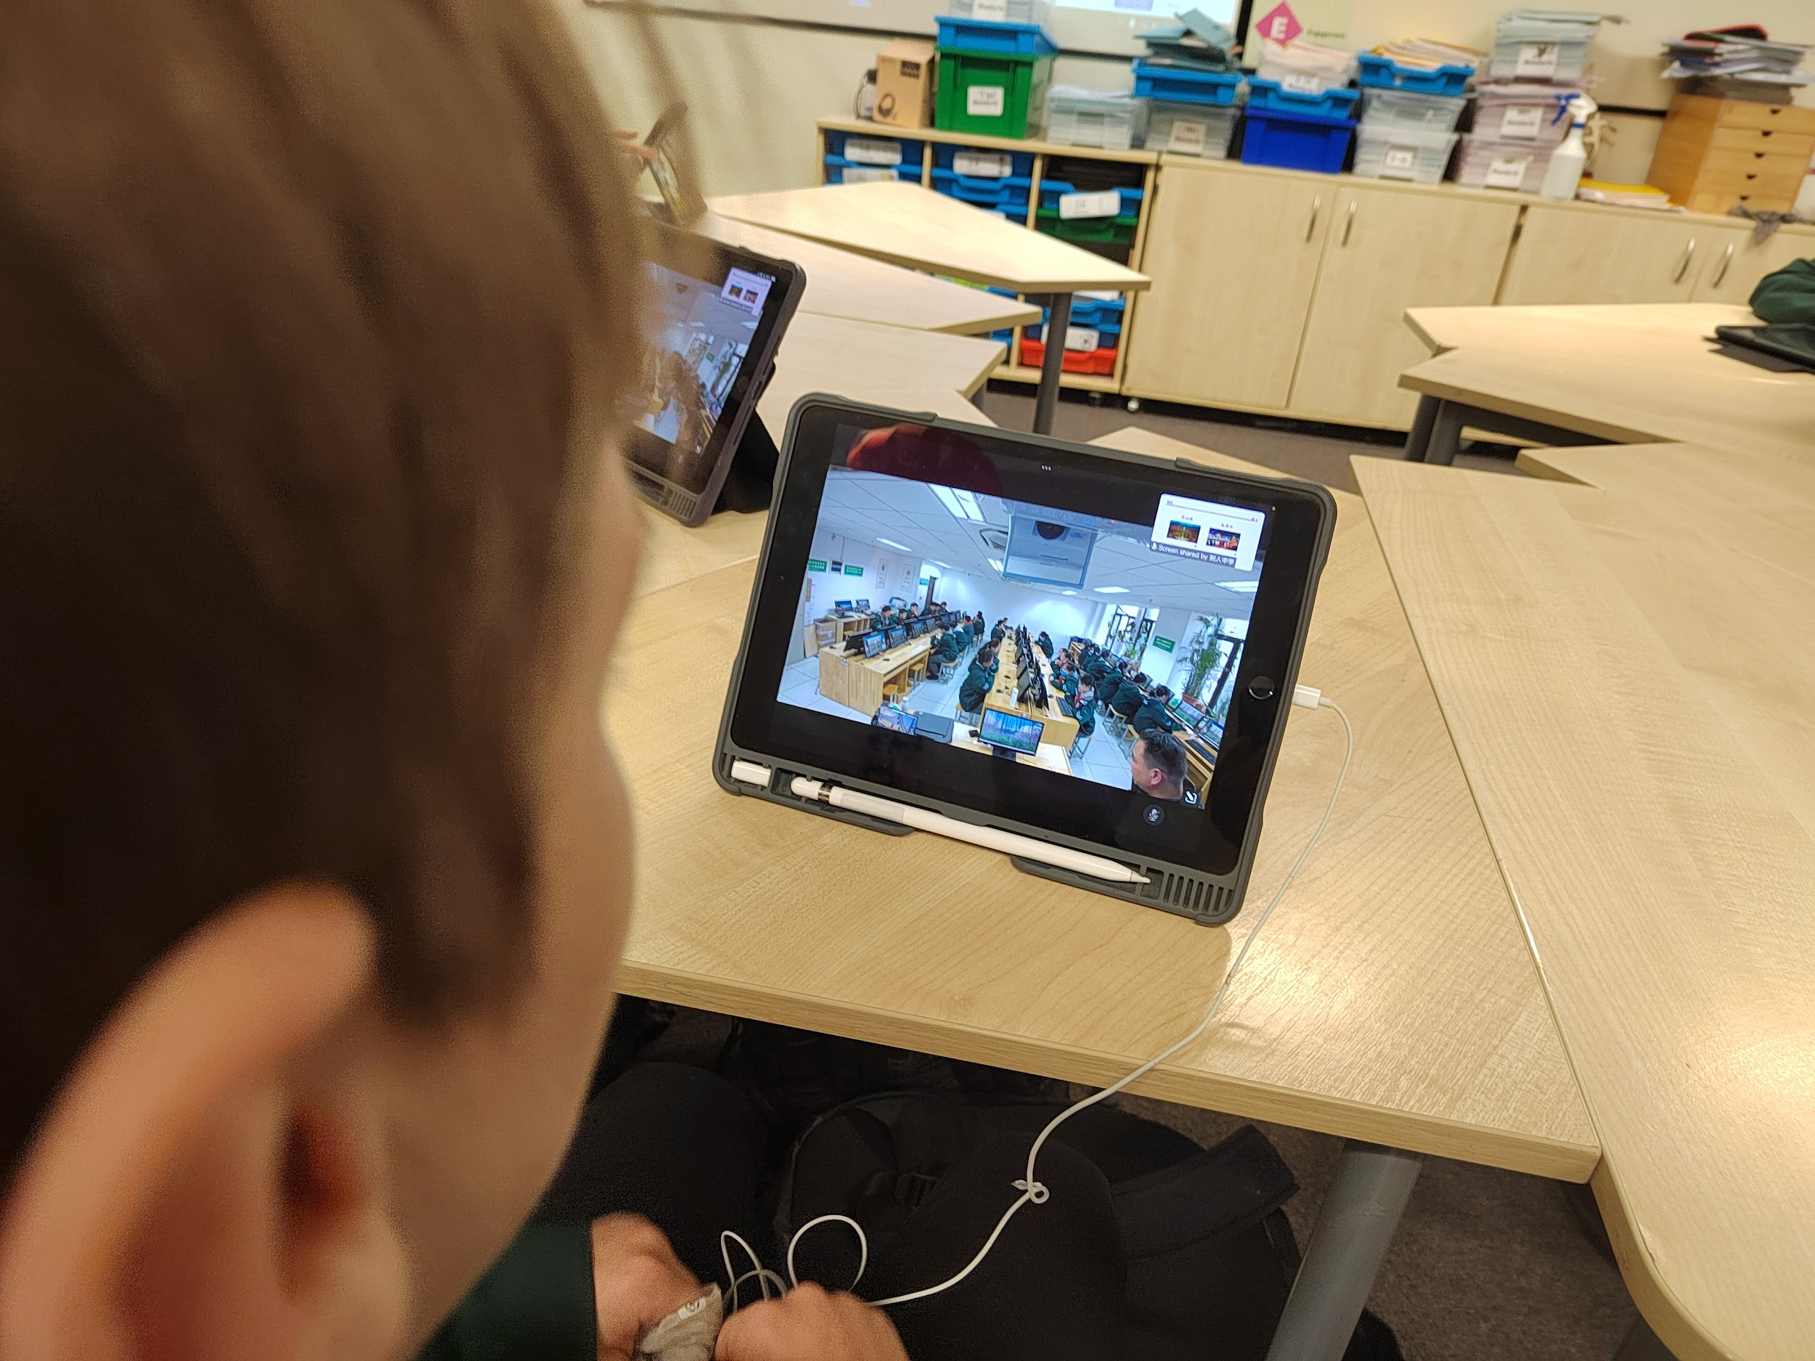
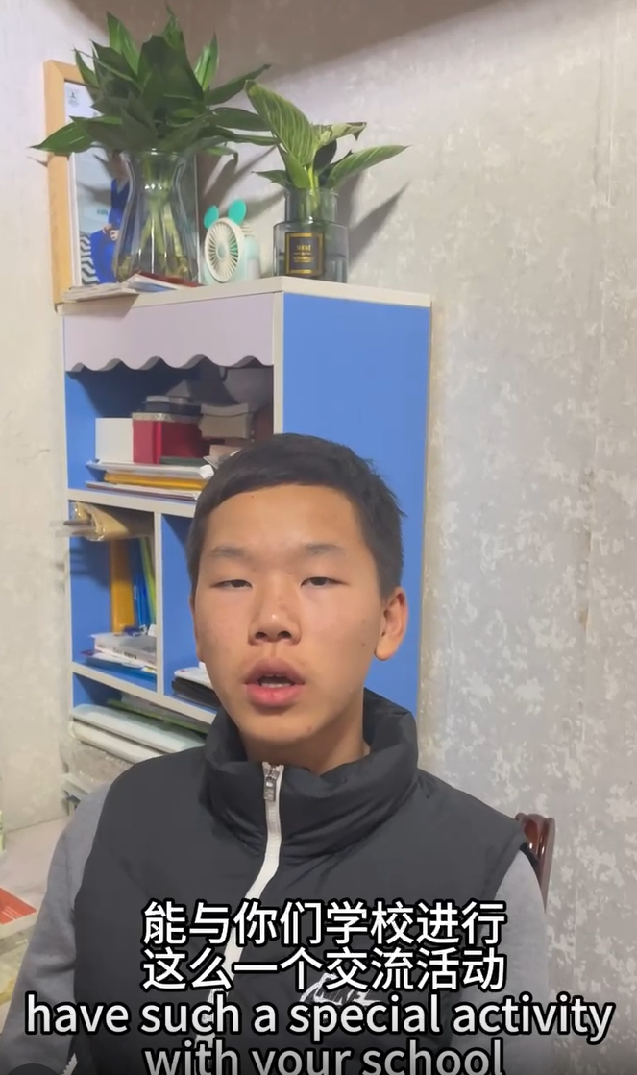
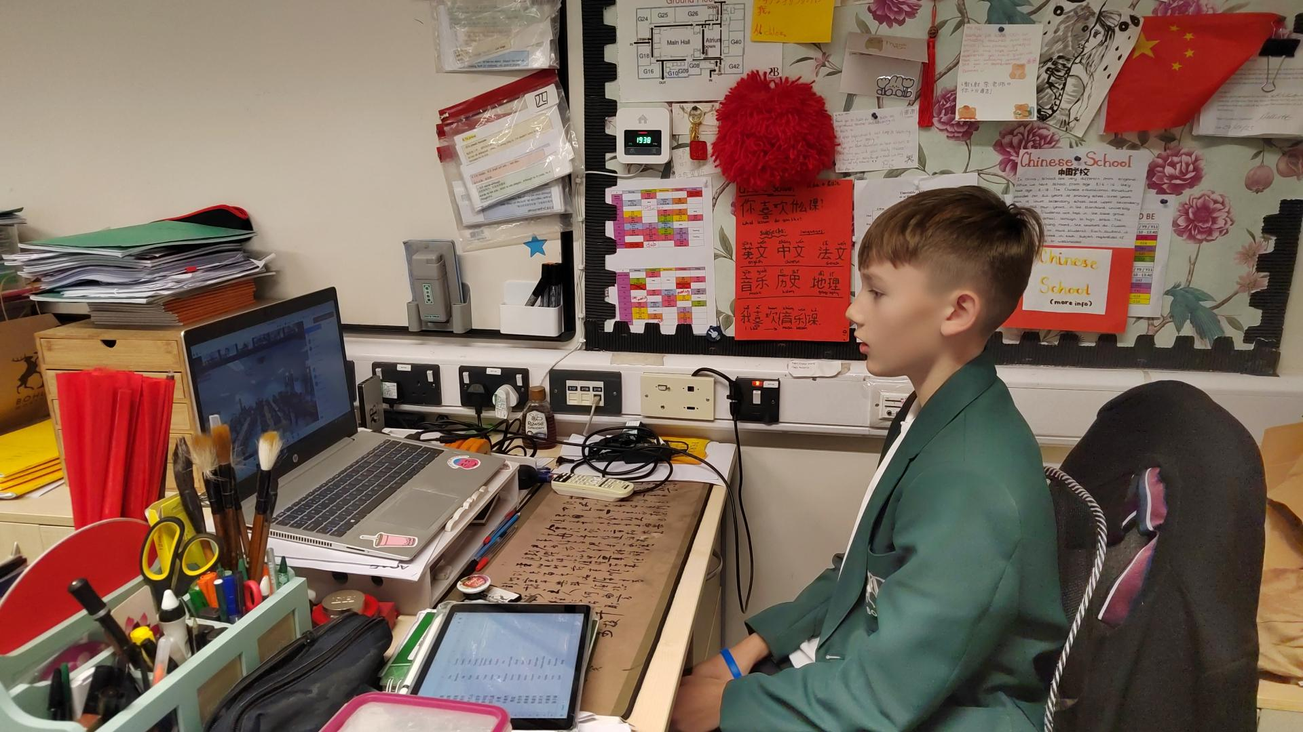
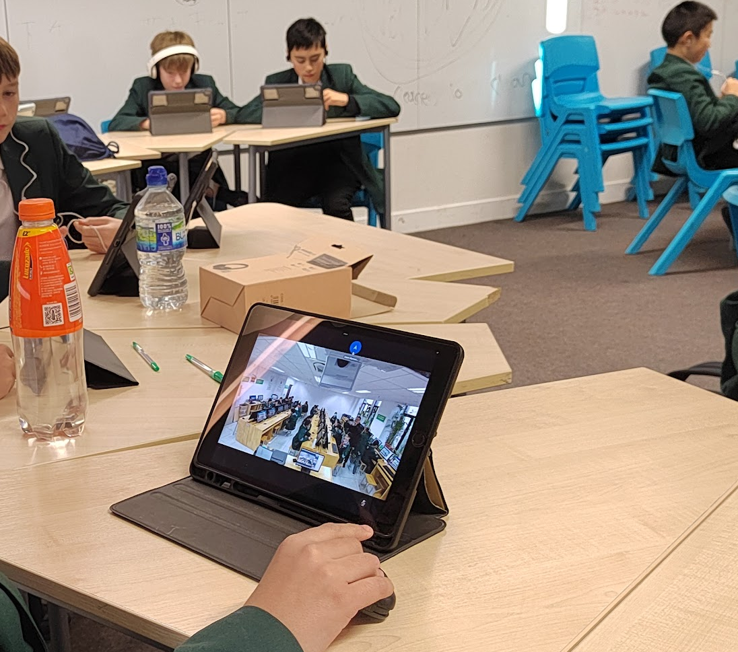


Slide 27
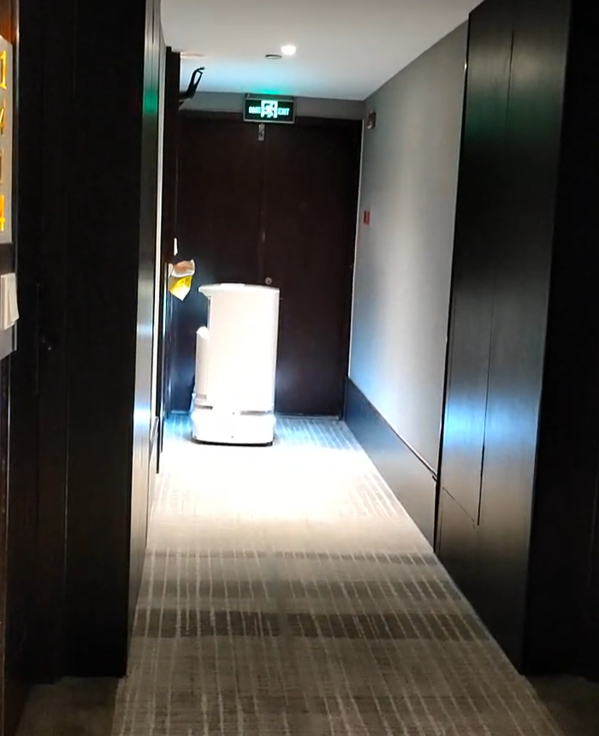
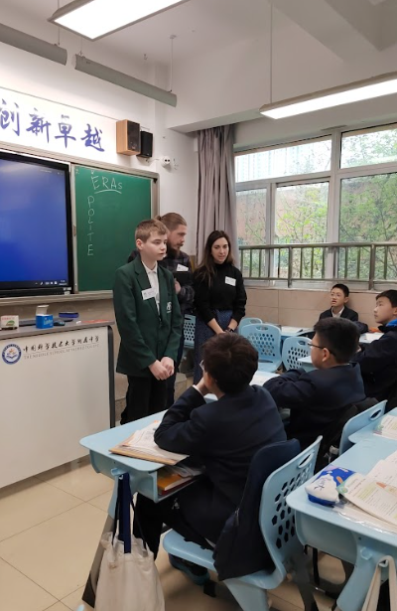
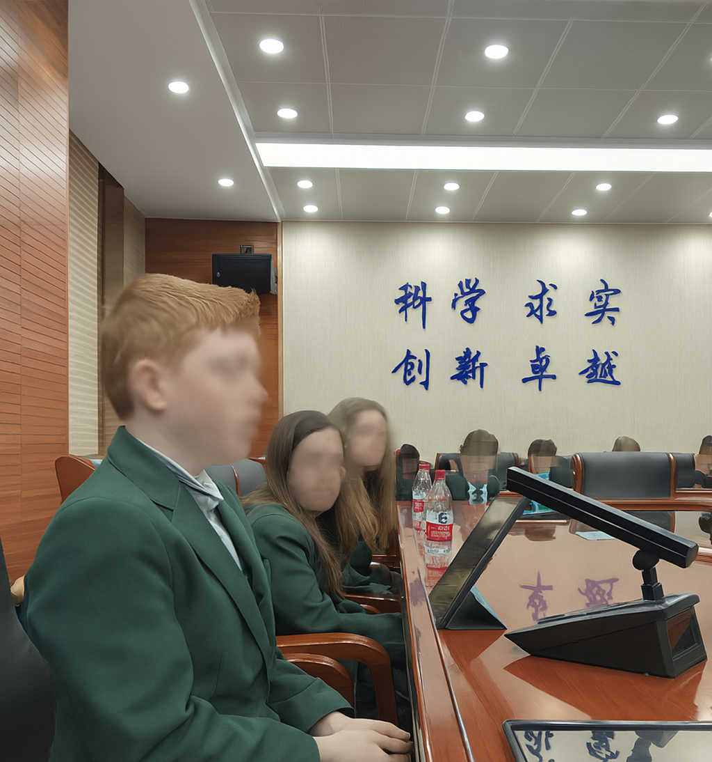
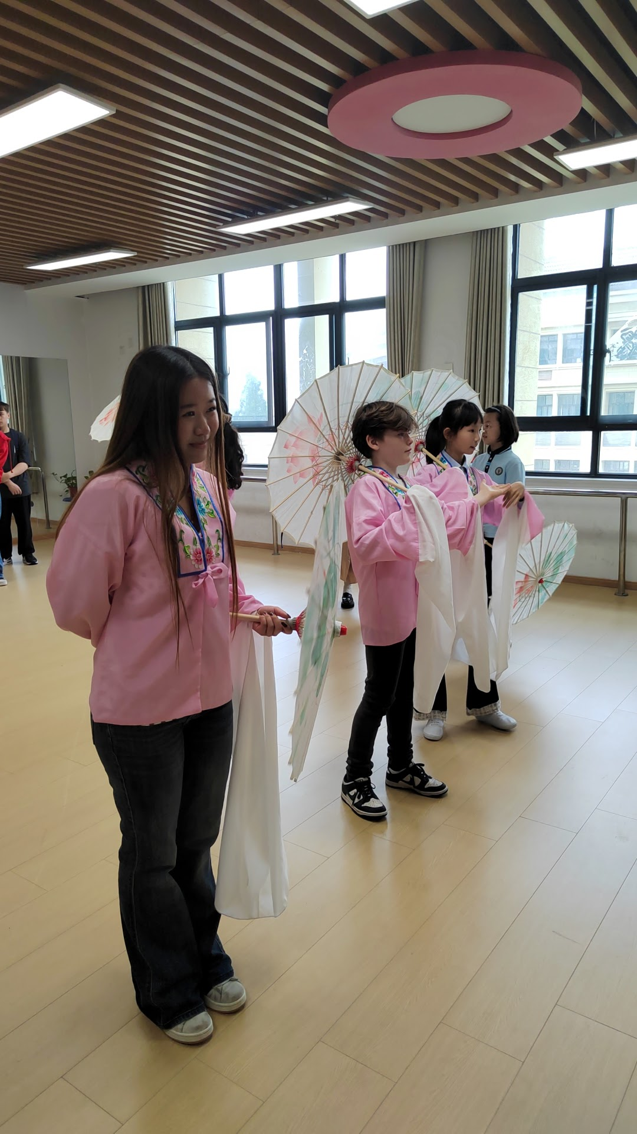
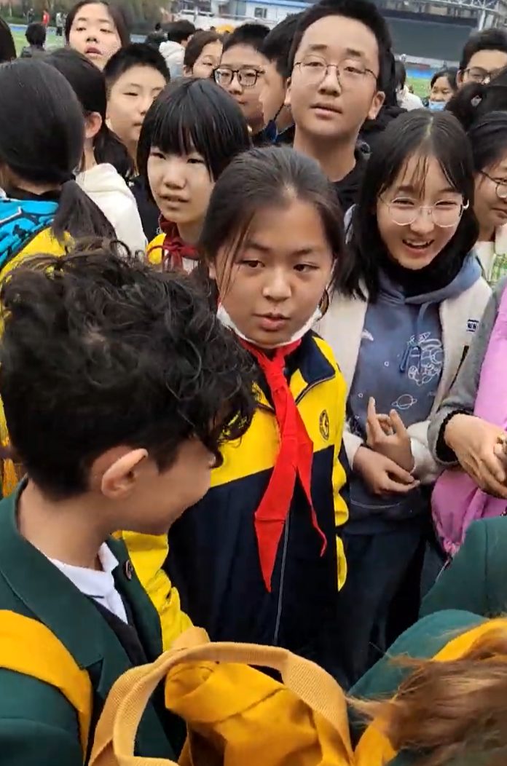
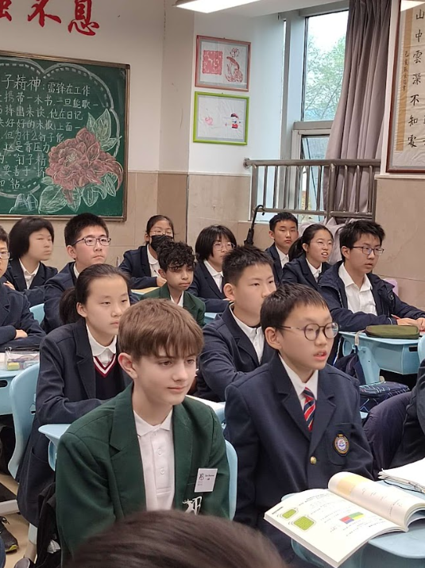
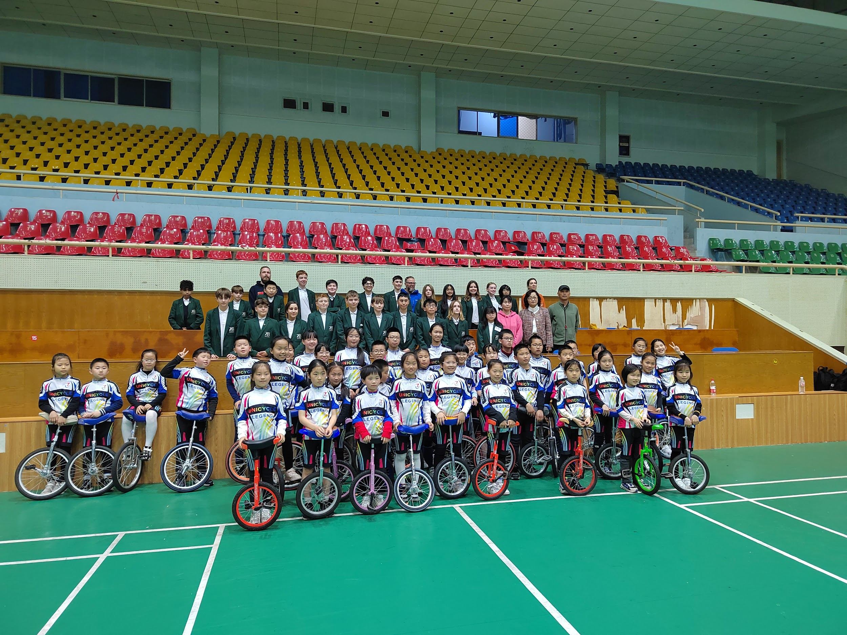

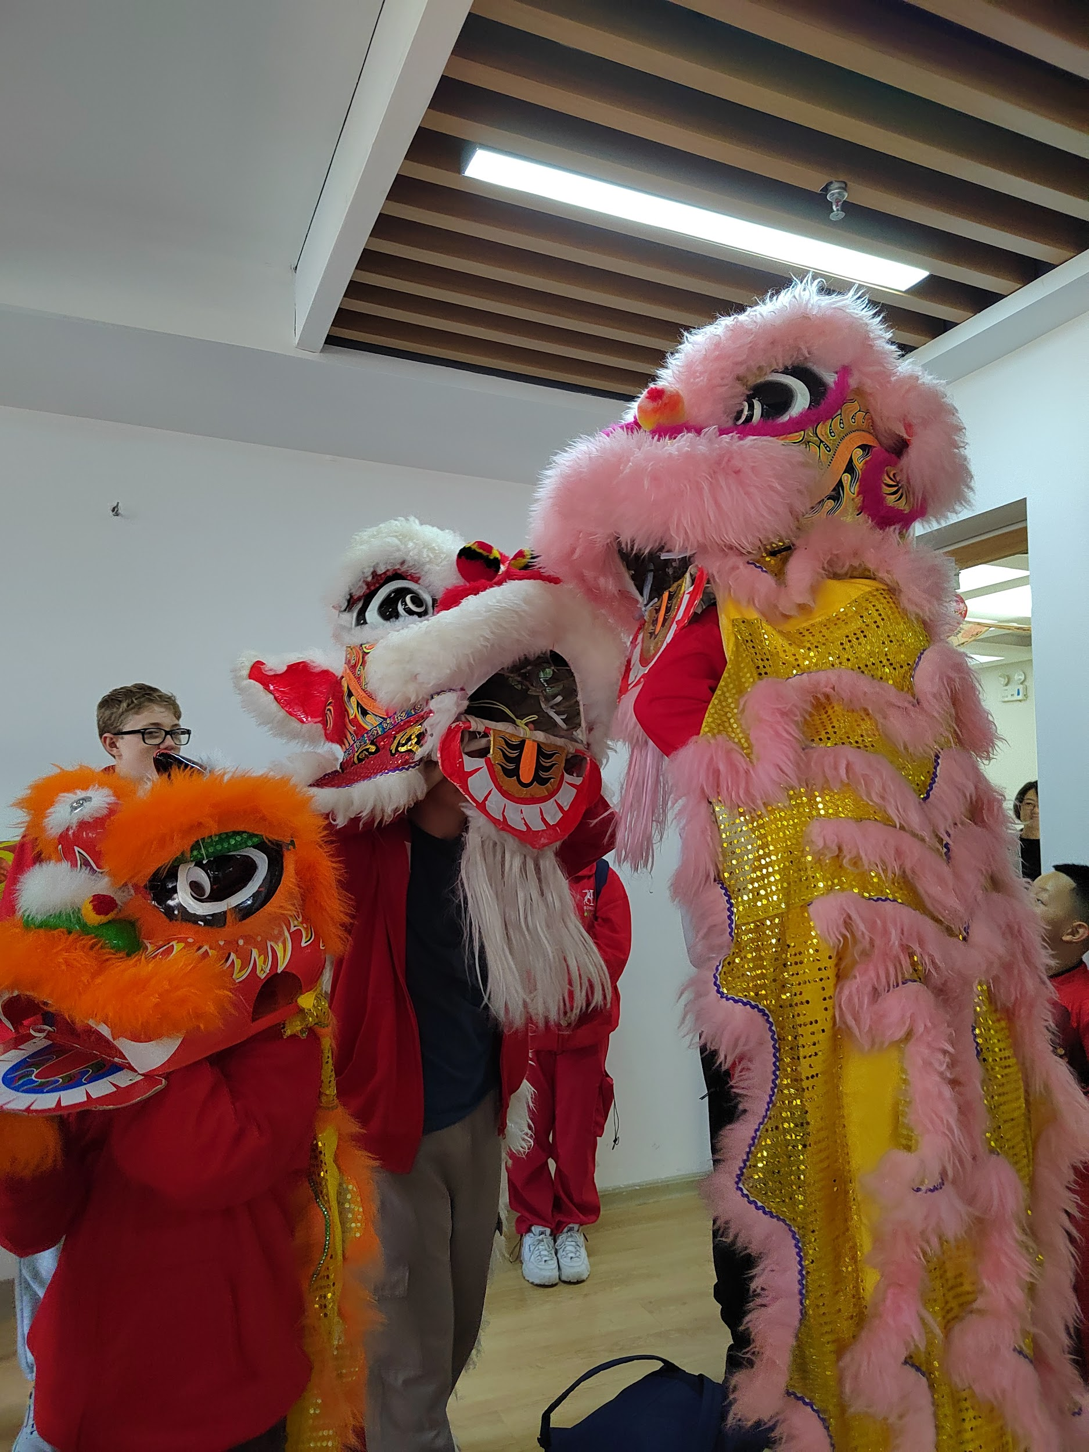
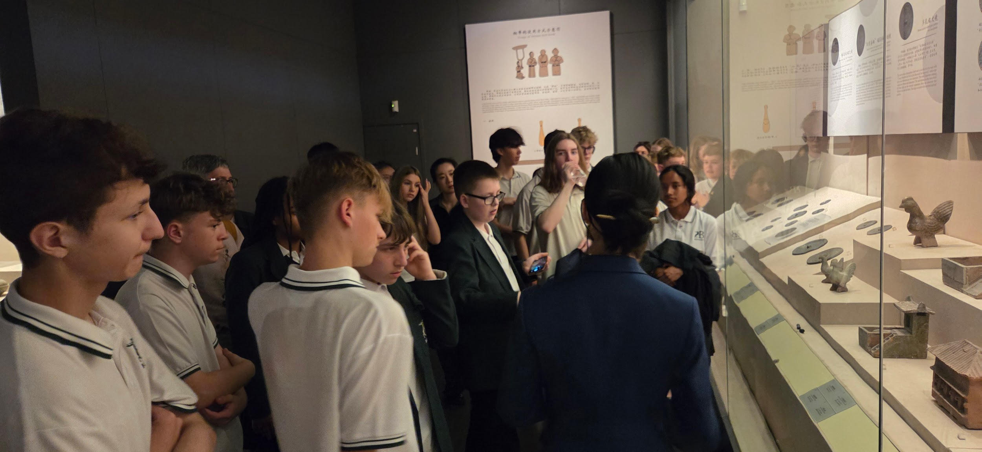
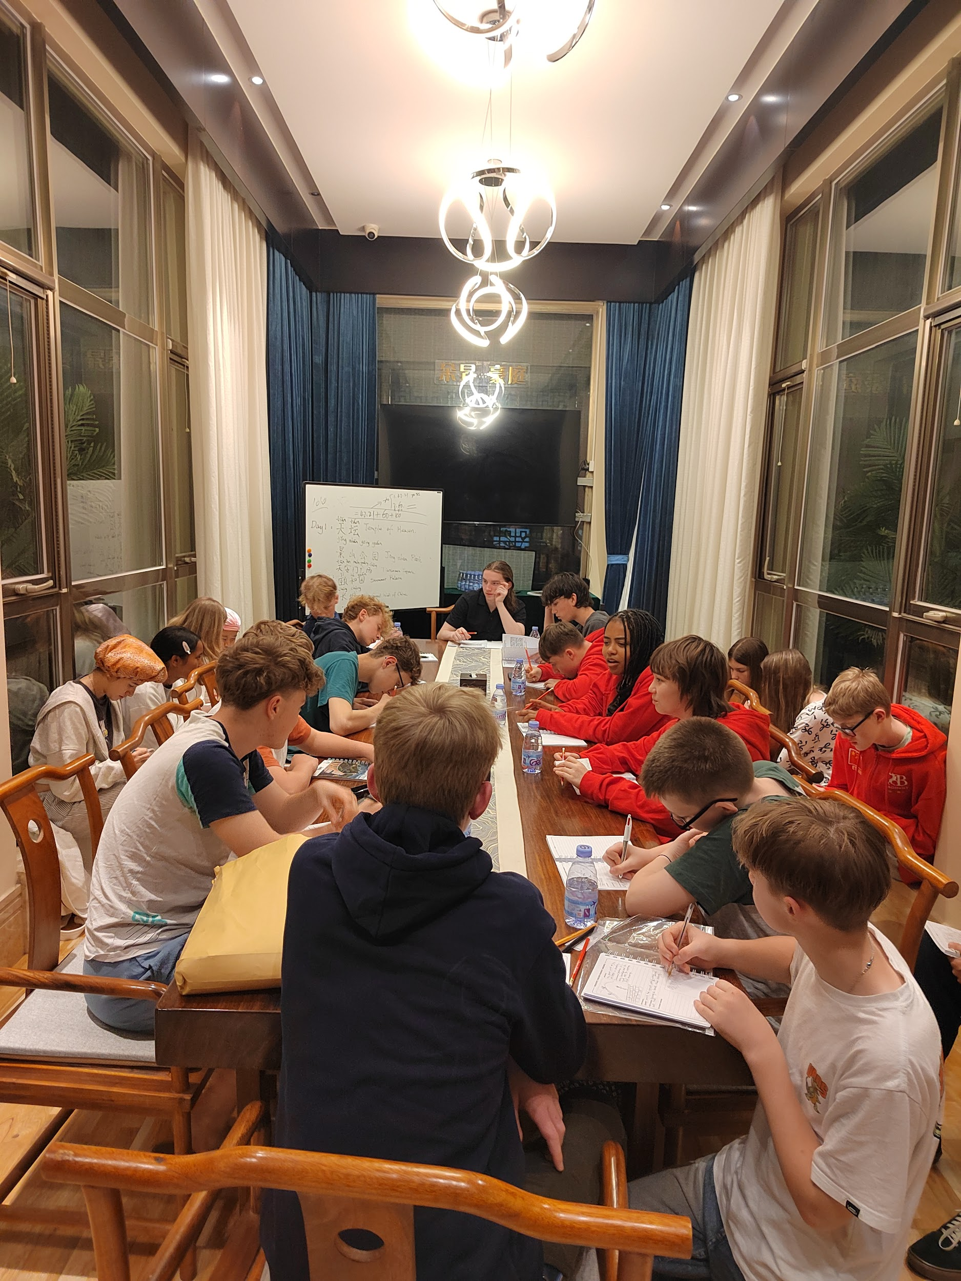
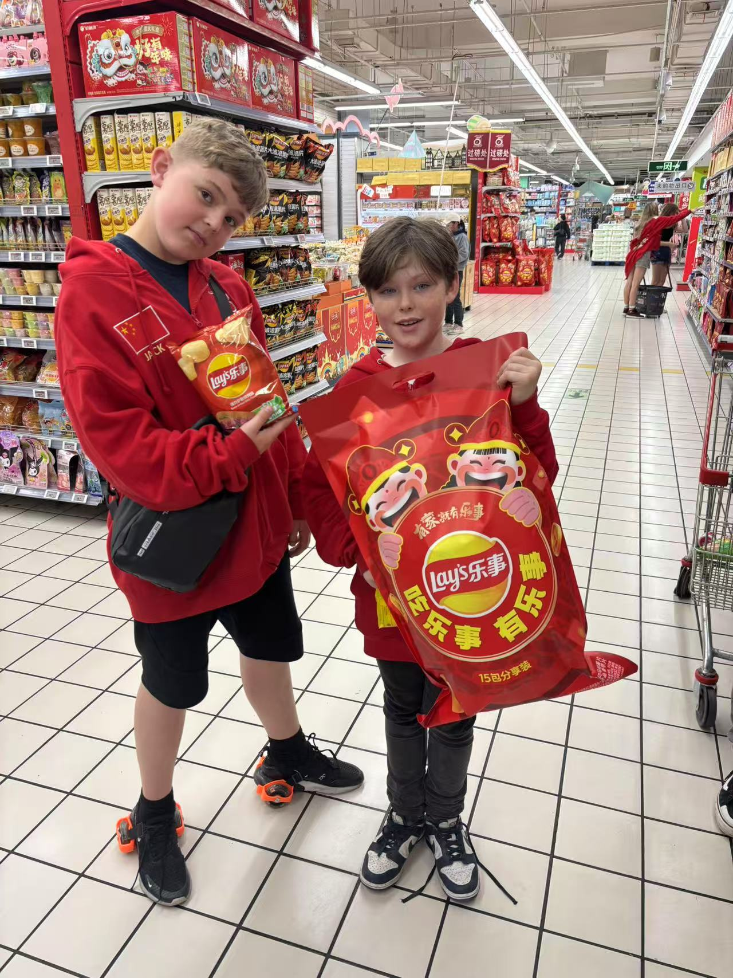
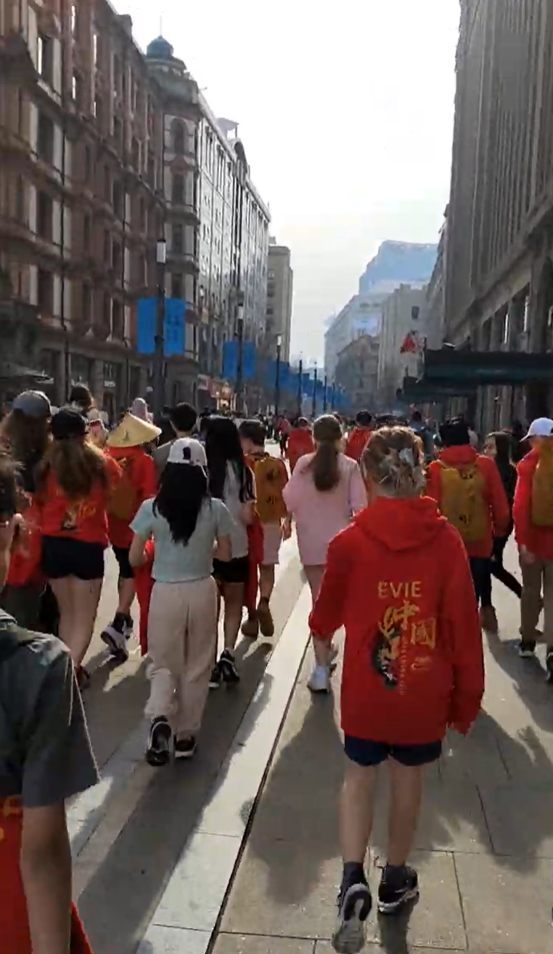
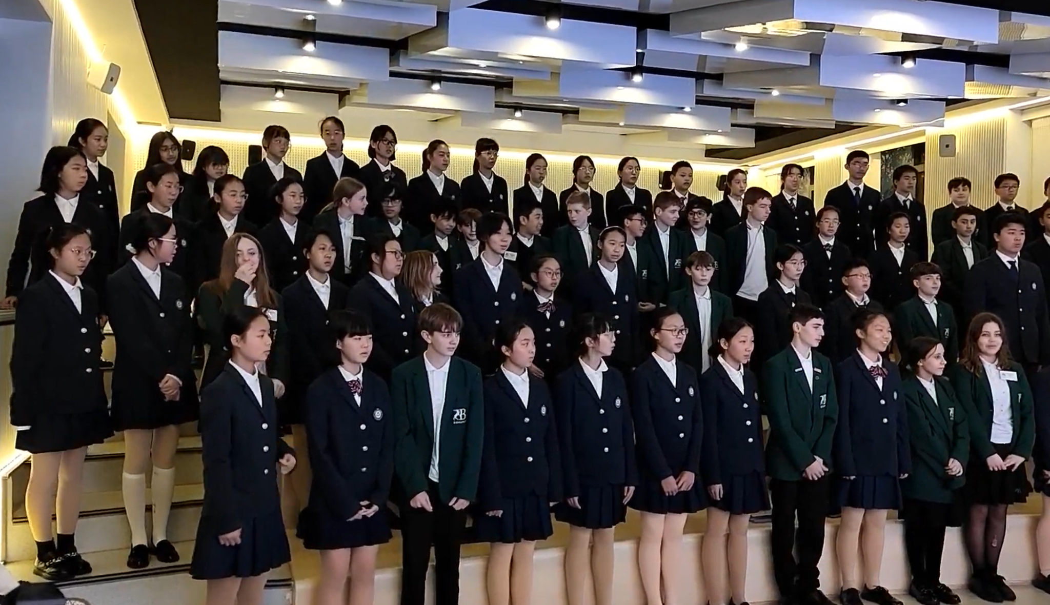
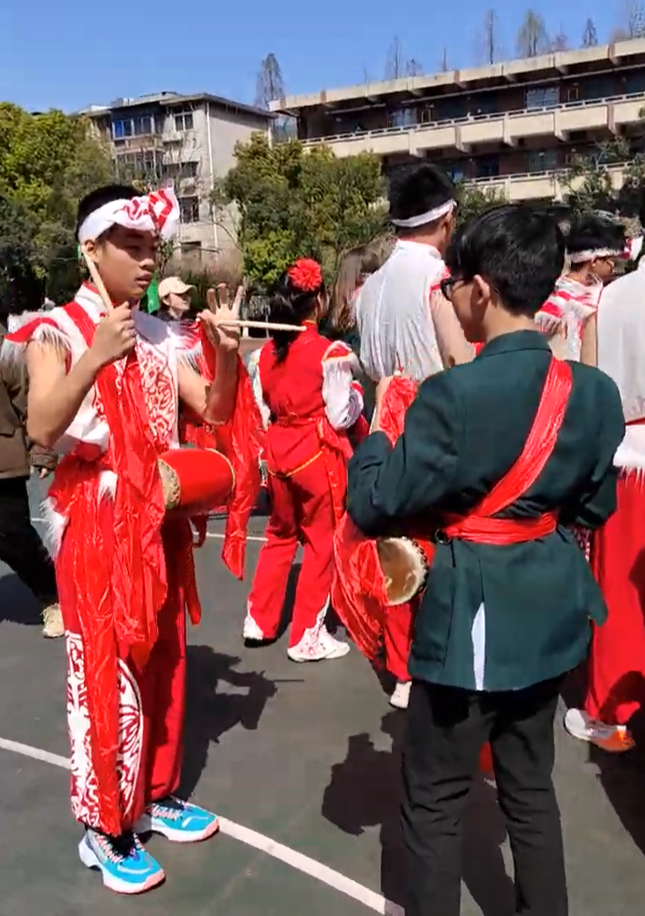
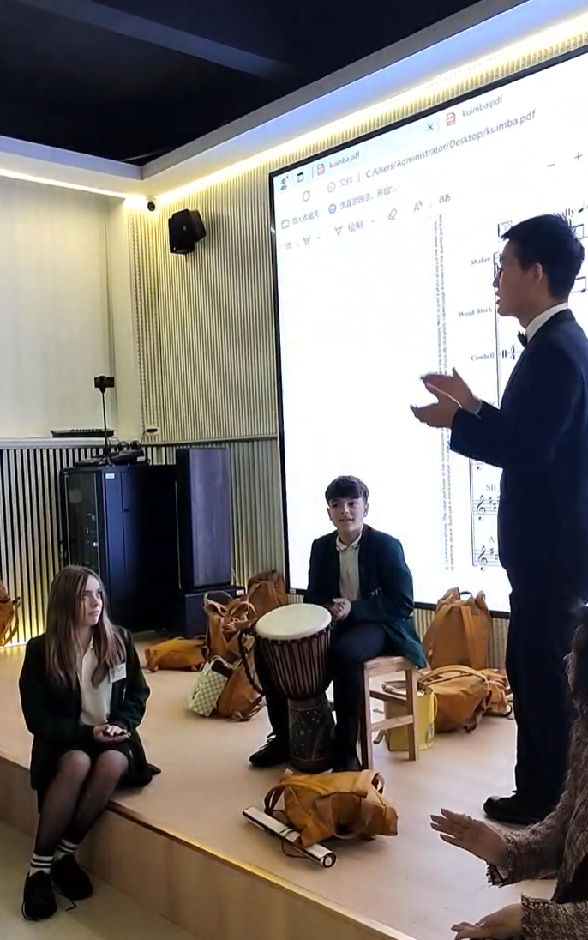
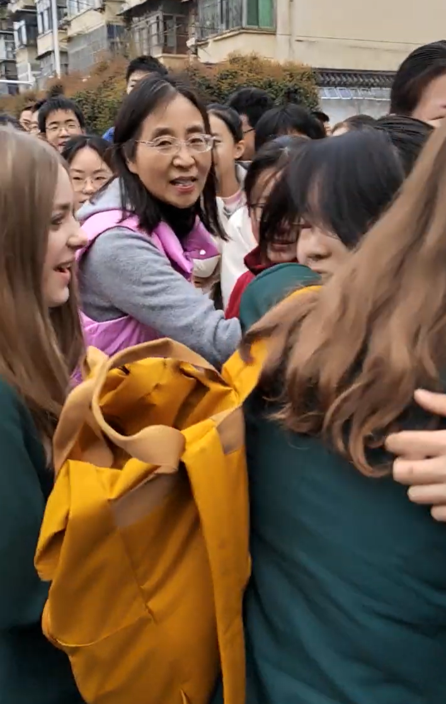
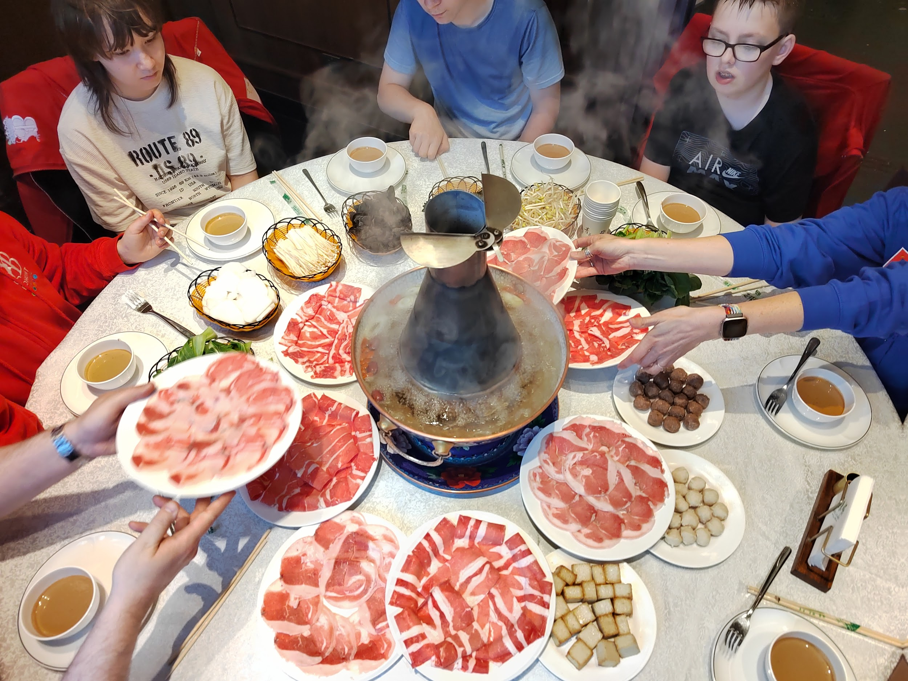
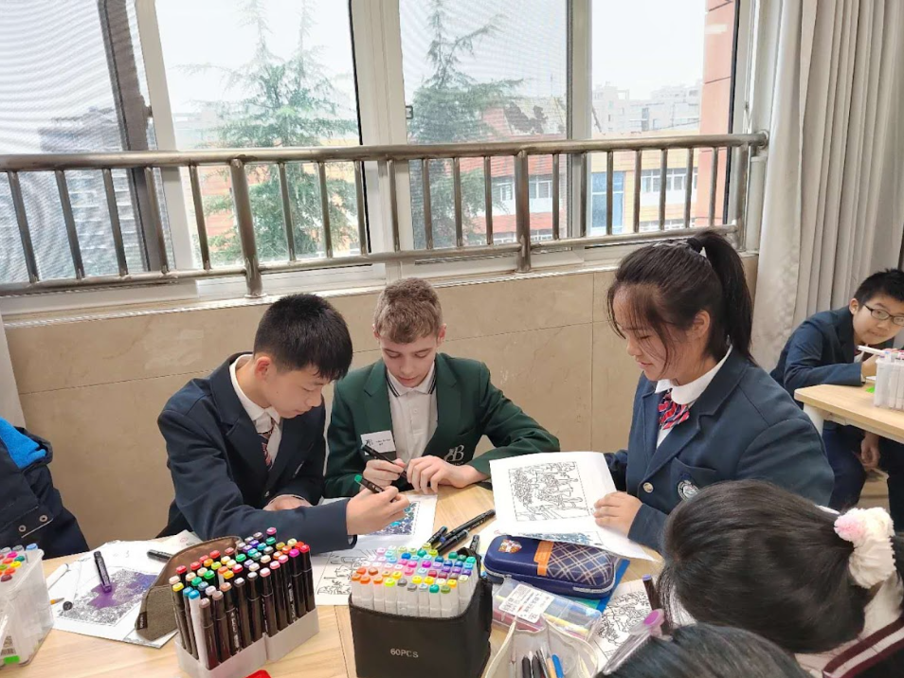
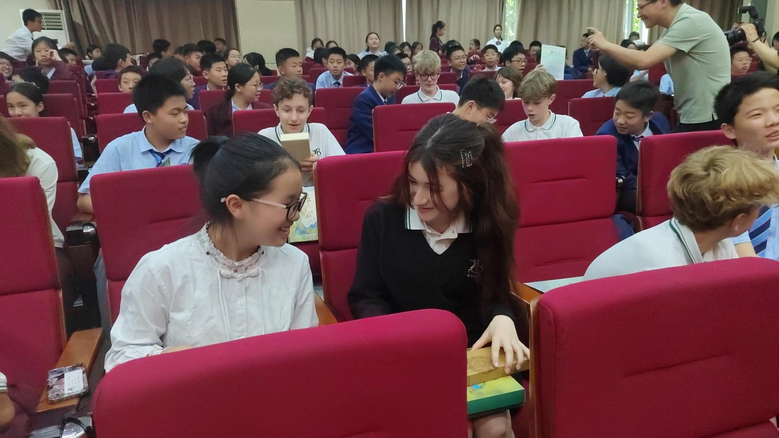
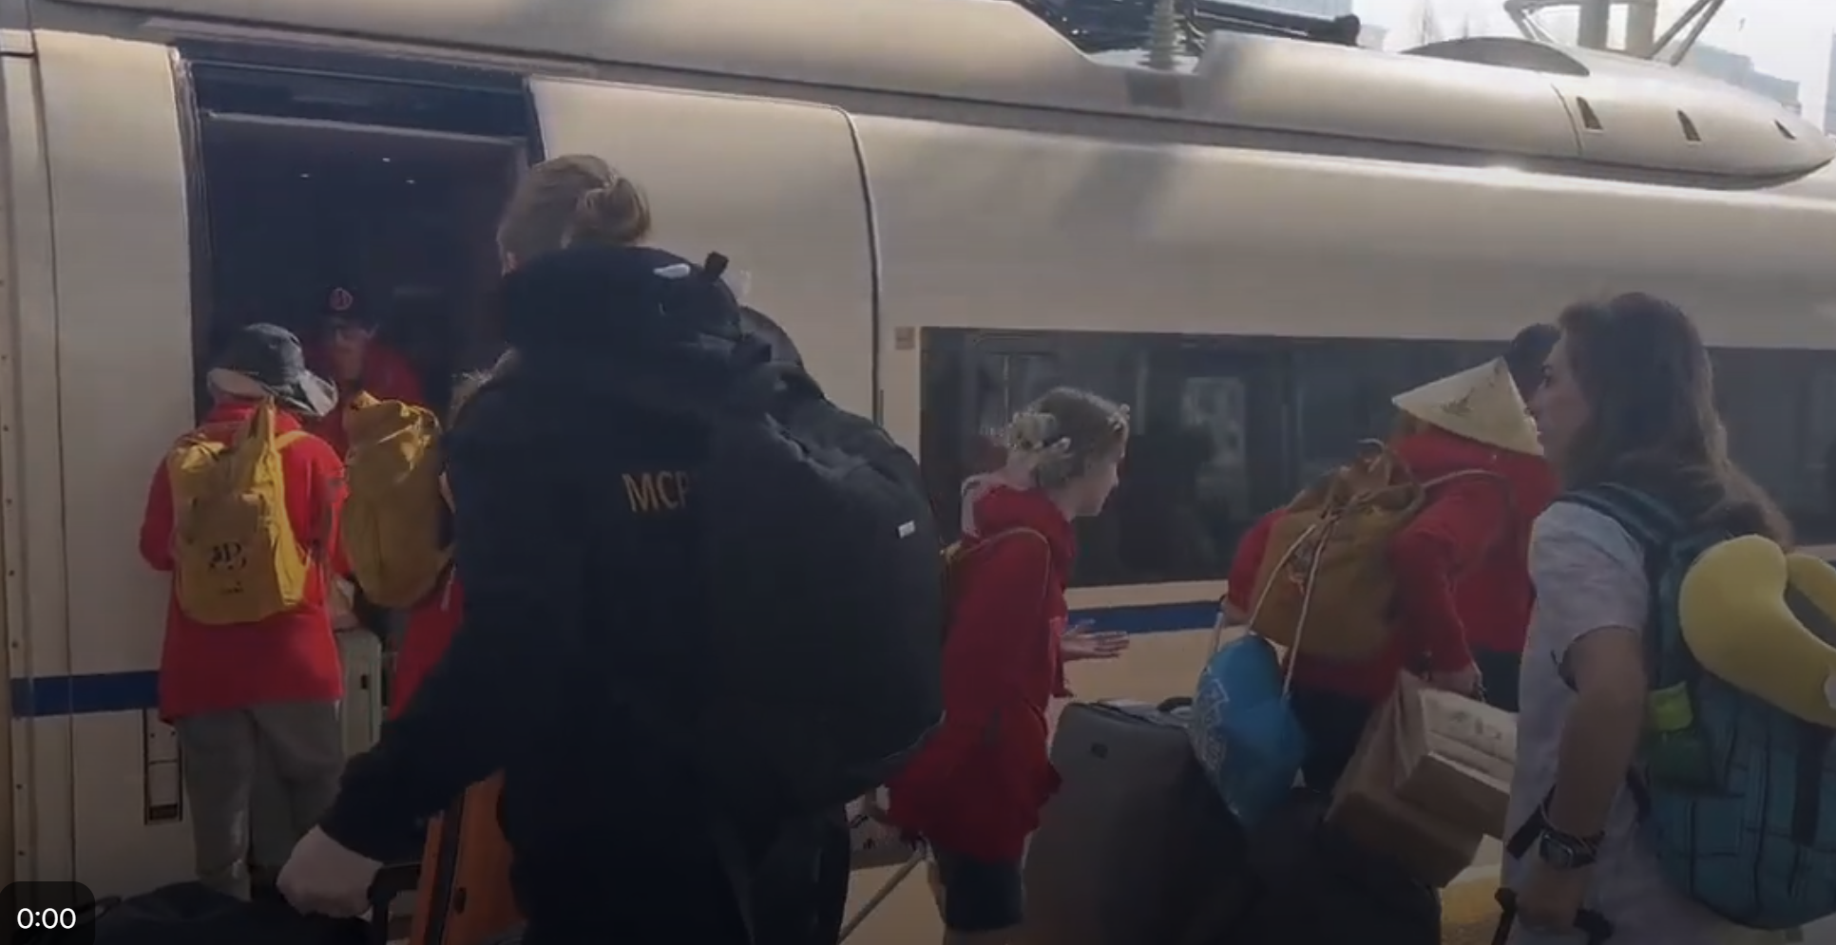
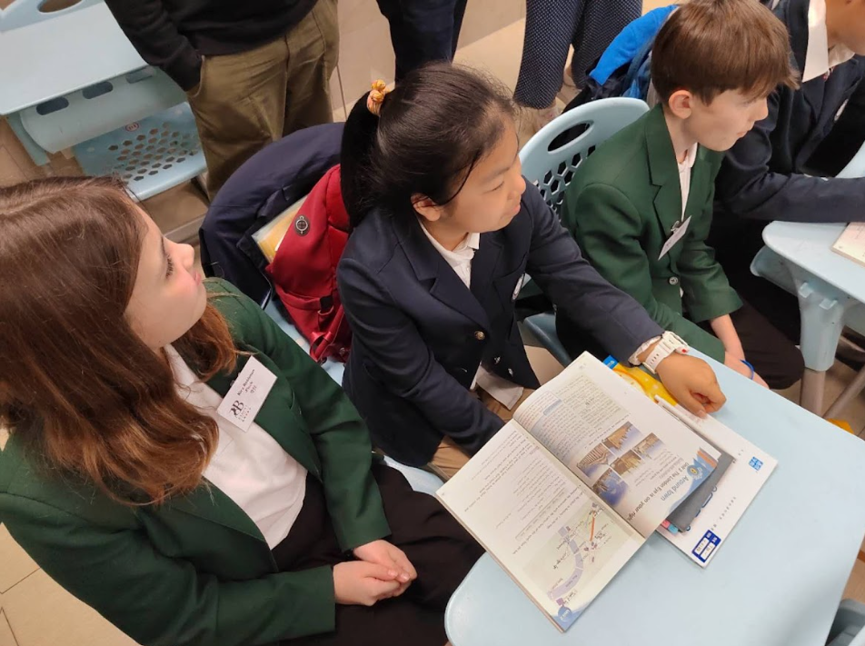
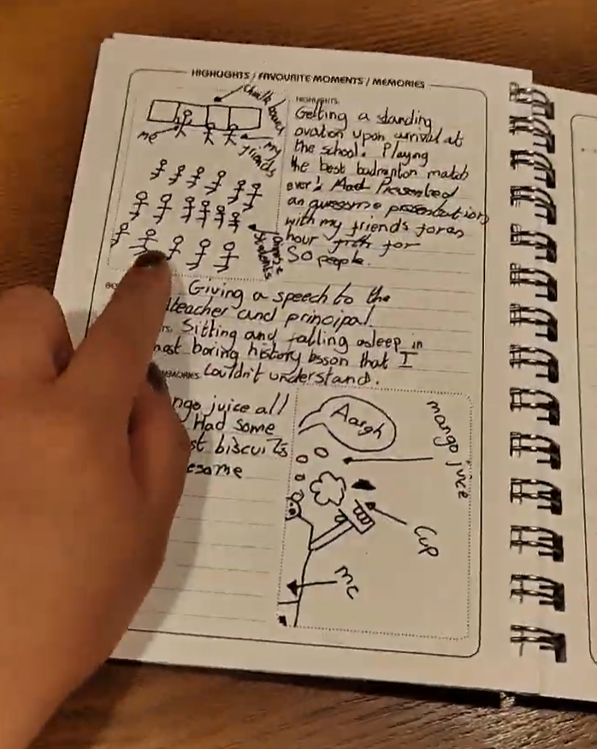
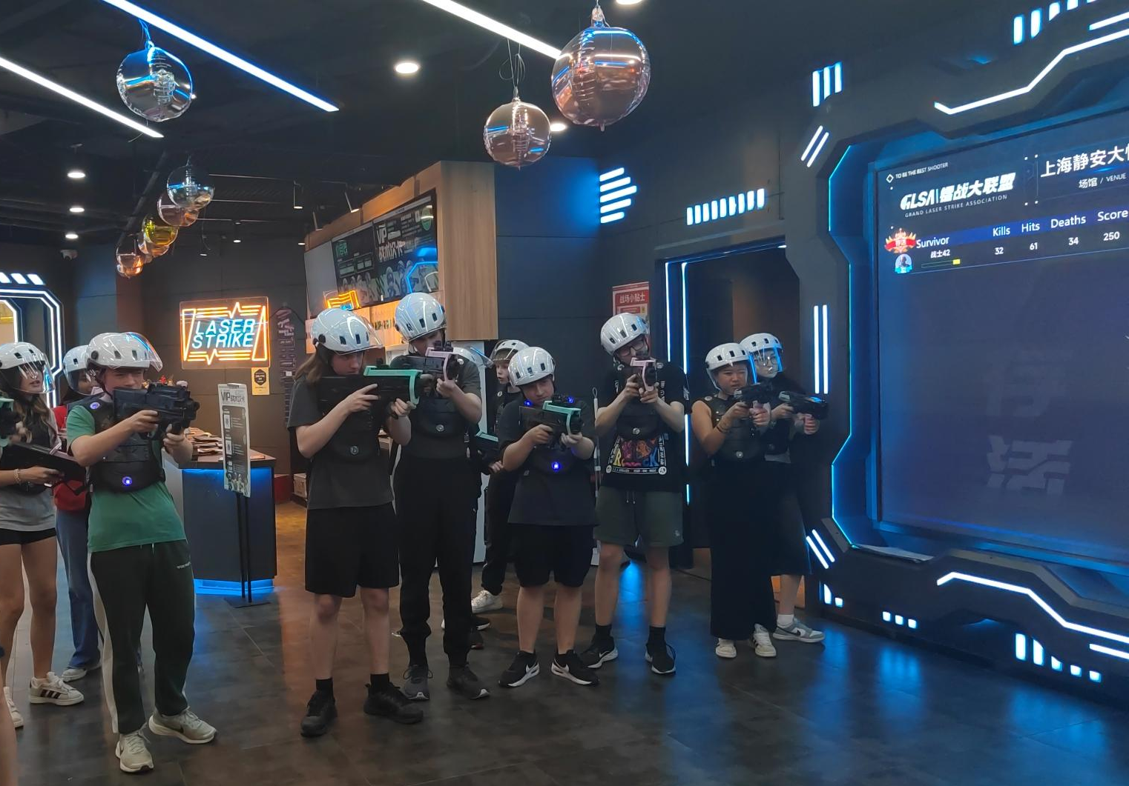

Slide 28




Key Takeaways for Successful Partnerships
Strong Foundations
Begin with clear communication and shared goals between school leaders. Start small with achievable projects that build trust and momentum.
Thoughtful Planning
Develop structured pre-trip activities that deepen connections. Ensure logistics and safeguarding are thoroughly addressed for both contexts.
Transformative Impact
This isn’t just a trip—it’s a turning point. Thoughtful planning and meaningful engagement can ignite a student’s confidence, curiosity, and sense of belonging in the world. For some, it’s the moment everything changes.
Notes:
Wonderful ideas, everyone. You are all creating those lifelong connections already! To summarise our journey today, remember these three key takeaways:
Strong Foundations: It must begin with clear communication and shared goals between school leaders. Get the headteachers talking!
Thoughtful Planning: Your pre-trip and in-country activities must be structured and meaningful. And yes, absolutely ensure the logistics and safeguarding are ironed out.
Transformative Impact: Remember, this isn’t just a trip—it’s a turning point. Thoughtful planning can ignite a student’s confidence, curiosity, and sense of belonging in the world. For some, that simple email exchange is the moment everything changes

Slide 29

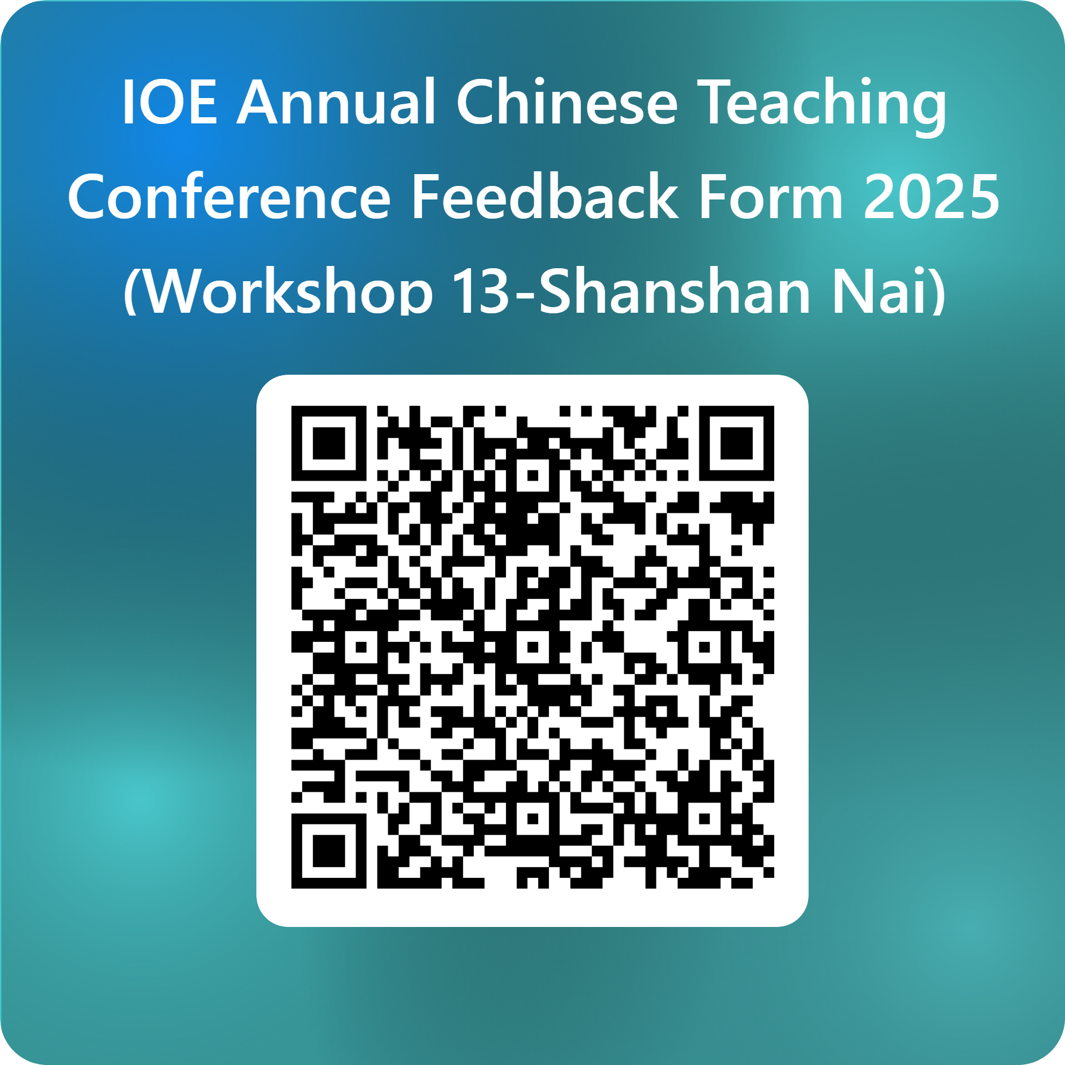

Question
Shanshan Nai
snai@bohuntworthing.com

