Slide 1
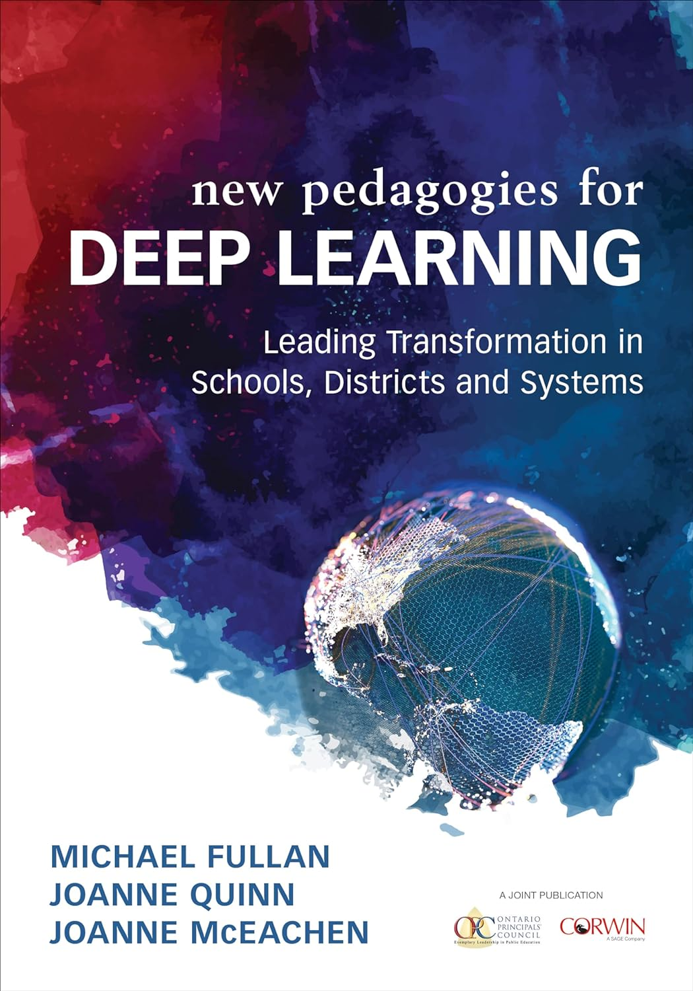


Deeper Learning and Mandarin – an antidote to Duolingo!
Rachel Tiefenbrun
Distinguish between the main features of deep and surface learning;
Consider the importance of deep learning and the advantages of incorporating deep learning into primary (or secondary) Mandarin lessons;
Explore a series of deep learning Mandarin lessons;
Plan a sequence of deep learning Mandarin lessons.
rachel@teachprimarymandarin.com www.teachprimarymandarin.com

Slide 2
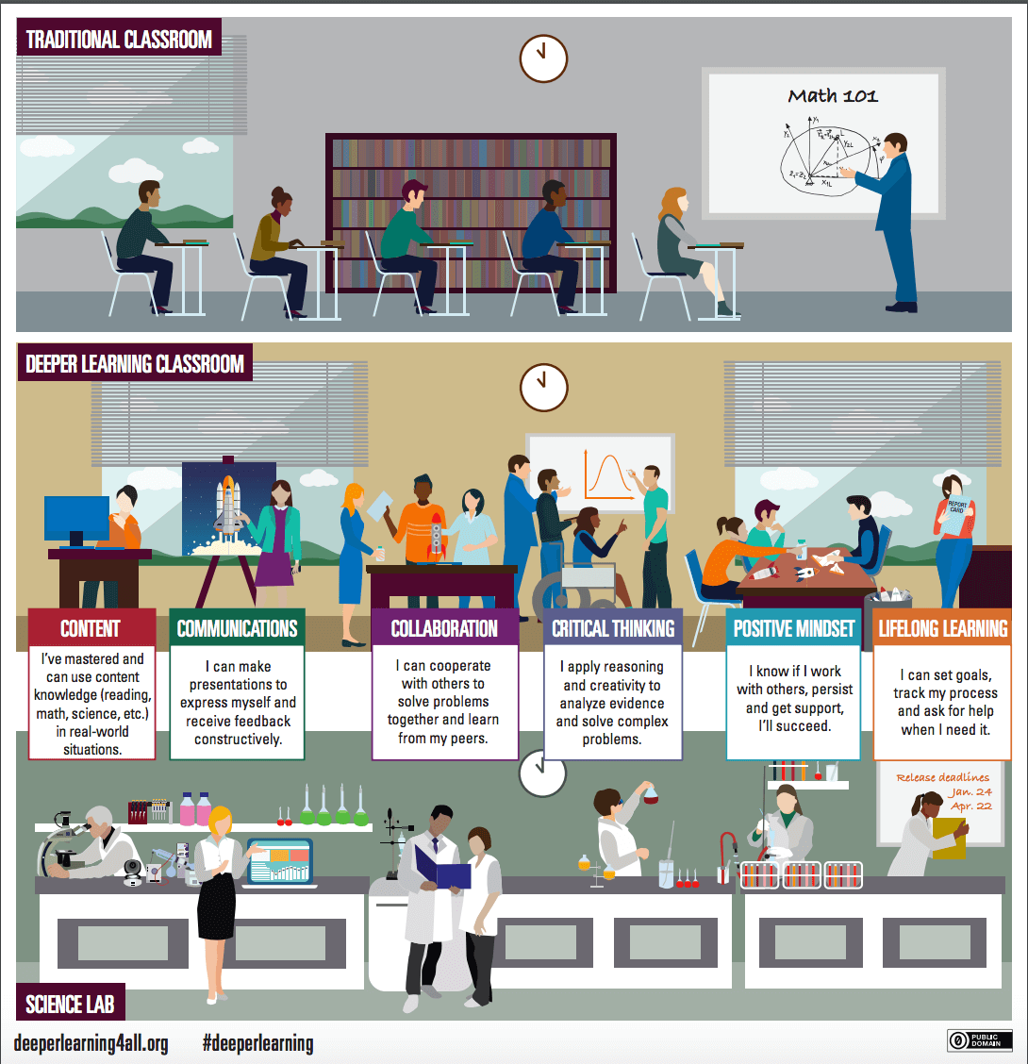
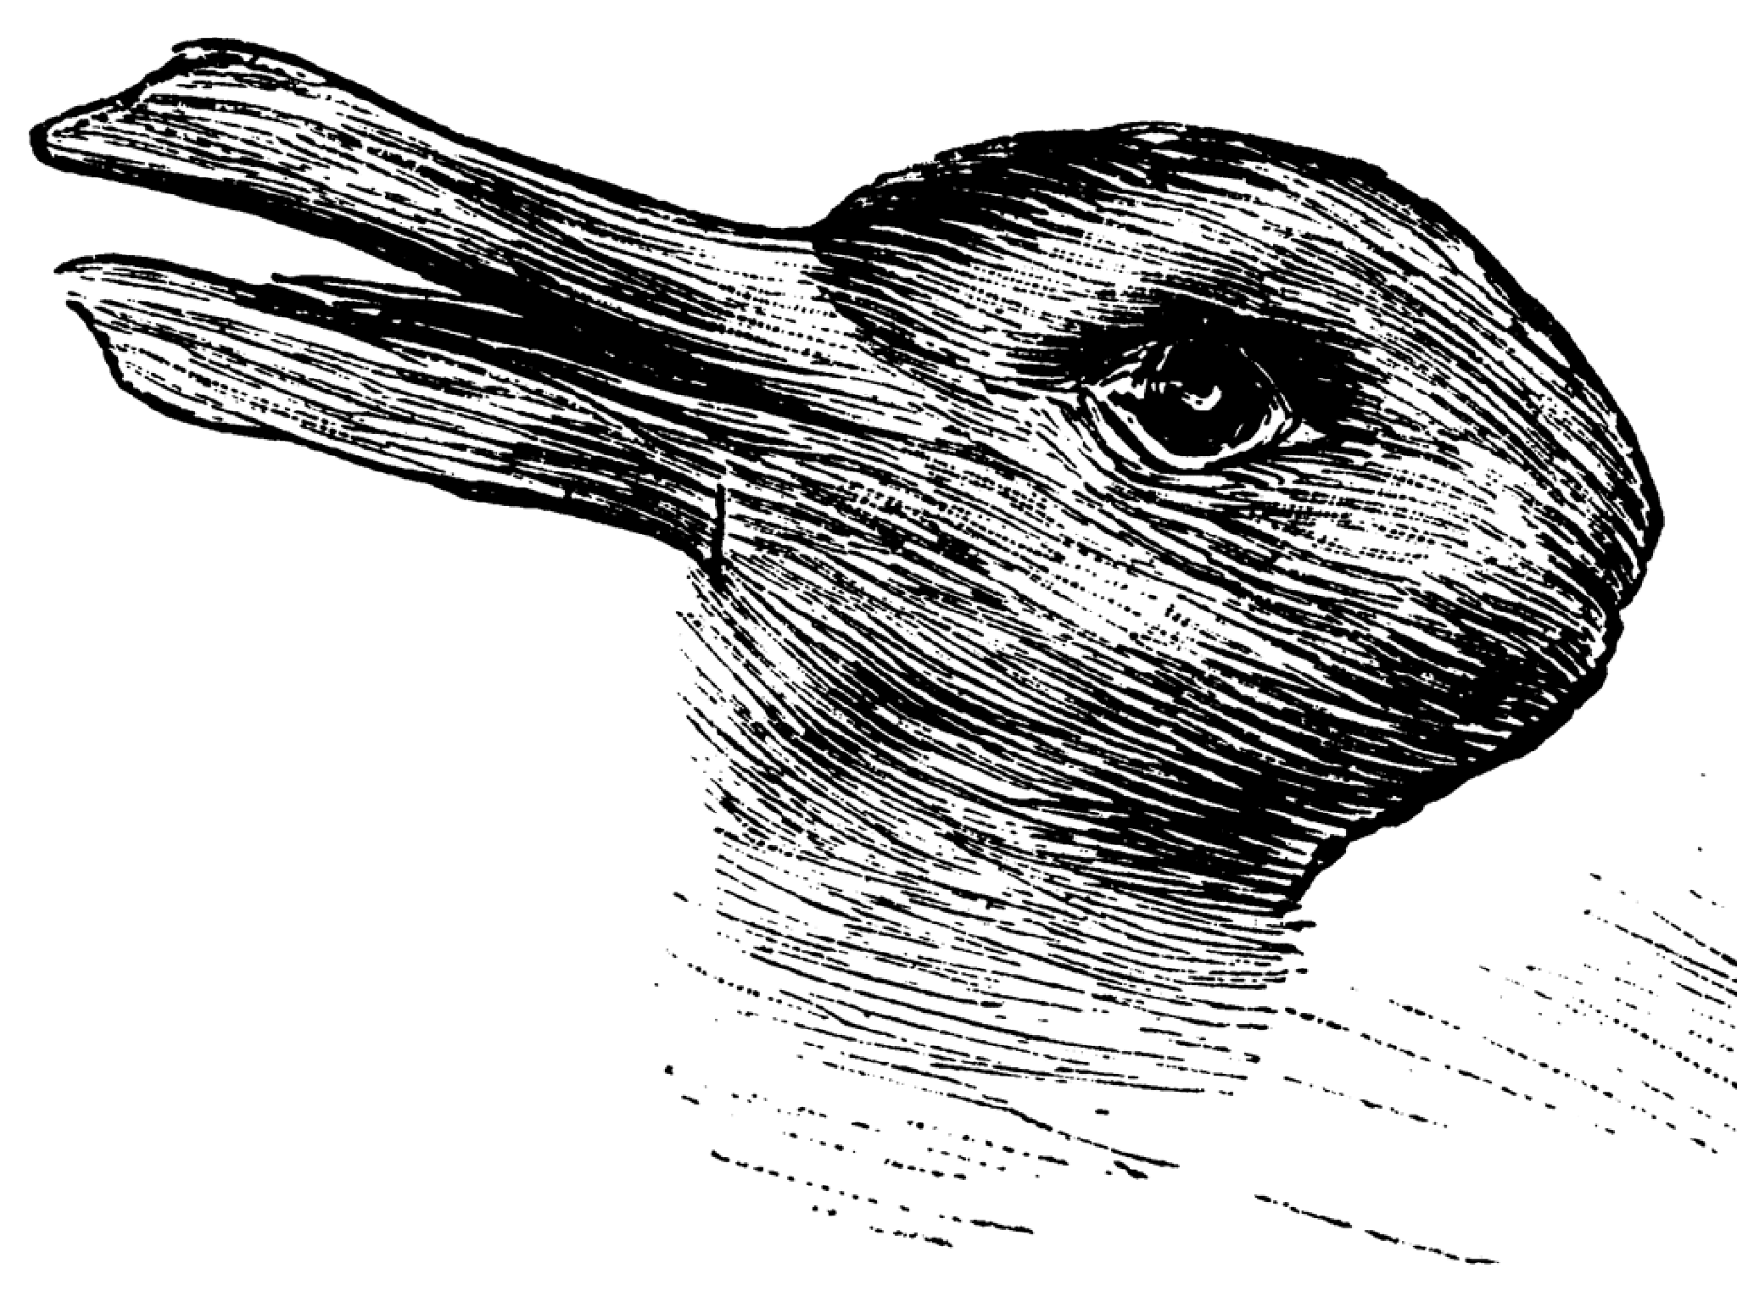
What you believe determines what you see.
Deep Learning is an important part of the new pedagogies.
Fullan and Langworthy, 2014
Notes:
Infographic: Hewlett Foundation

Slide 3

Notes:
Deep learning teacher / learner characteristics sorting activity

Slide 4
1.1 What is Deep Learning?
63 out of 71 publications explicitly connect
deep learning to:
meaningful learning
critical thinking
cross-referencing
intrinsic motivation
analytic skills
imaginative reconstruction
independent thinking
holistic thinking
higher levels of cognitive abstraction
character education
citizenship
communication,
problem solving
collaboration
creativity and imagination
Kovac et al, 2023
Breakthrough research – Marton and Saljo 1976:
Deeper learning develops students’ abilities to think critically and solve complex problems, communicate effectively, work collaboratively, and learn independently.

Slide 5
 | Deep learning | Surface Learning
Method of memorisation | Memorisation through understanding | Rote memorisation
Knowledge System | Build connections between new and old knowledge | Learning fragmented
Focal Point | Focus on core concept for solving a problem | Focus on formulas and external cues when solving a problem
Degree and nature of engagement | Active learning (learner centred) | Passive learning (teacher centred)
Reflection status | Deepen understanding gradually. Think and reflect critically | Lack of reflection during learning process
Transferability | Capable of applying learned knowledge to different contexts | Not capable of applying learnt knowledge flexibly
Level of Thinking | Higher-order thinking: analysing, evaluating, creating | Lower-order thinking: remembering, understanding, applying
Learning Motivation | Intrinsic motivation | Motivated by external pressures eg: exams
Adapted from Ning Yueying , Zhu Xiaodong 2016.

Slide 6

Duolingo and Duolingo For Schools
Course structure | Topic based eg: food, transport, family, colours…
Explicit teaching of pinyin | No
Explicit teaching of tones | No
Explicit teaching on characters | No
Explicit teaching of grammar | No
My rabbit wears my sister’s shoes.
The loch ness monster is drinking whisky.
Excuse me, I am an apple.
Without a doubt, I want to eat ham.
There is a kitten in the trash.

Slide 7
 | Deep learning | Surface Learning
Method of memorisation | Memorisation through understanding. | Rote memorisation.
Knowledge System | Build connections between new and old knowledge. | Learning fragmented.
Focal Point | Focus on core concept for solving a problem. | Focus on formulas and external cues when solving a problem.
Degree of Engagement | Active learning | Passive learning
Reflection status | Deepen understanding gradually. Think and reflect critically. | Lack of reflection during learning process
Transferability | Capable of applying learned knowledge to different contexts. | Not capable of applying learnt knowledge flexibly.
Level of Thinking | Higher-order thinking: analysing, evaluating, creating. | Lower-order thinking: remembering, understanding, applying.
Learning Motivation | Intrinsic motivation. | Motivated by external pressures
Adapted from Ning Yueying , Zhu Xiaodong 2016.

Slide 8
History:
Deep learning could involve a group project on a particular event in history. Children could be challenged to research the event and present their findings to the class in written or oral form.
Math:
In a maths classroom, deep learning could involve a hands-on activity that challenges students to use math skills to solve a real-life problem. For example, students could be asked to calculate the cost of materials for building a house or make a budget for a business.

Slide 9
1.2 Why deep learning?
Personal level
Good and useful for the learner, increases motivation and is “fun.”
(Quinn, McEachen, Fullan, Gardner, & Drummy, 2019)
Societal level
This mode of acquiring knowledge is the best strategy to:
respond to the rapidly changing modern global society,
process the large quantity of incoming new information,
deal with emergent new technologies,
make sense of new forms of knowledge in a complex world. (Norwegian Directorate for Education and Training, 2021).
General message: the future requires deep learning if we are to solve the new modernity problem.
“……not what you know but what you can do” (Director of Education and Skills, OECD, 2016)

Slide 10







OFSTED, School Inspection Handbook 2021: Learning can be defined as an alteration in long-term memory. If nothing has altered in long-term memory, nothing has been learned. However, transfer to long-term memory depends on the rich processes described above. In order to develop understanding, pupils connect new knowledge with existing knowledge. Pupils also need to develop fluency and unconsciously apply their knowledge as skills. This must not be reduced to, or confused with, simply memorising facts. Inspectors will be alert to unnecessary or excessive attempts to simply prompt pupils to learn glossaries or long lists of disconnected facts.
Notes:
Ofsted want you to be deep

Slide 11
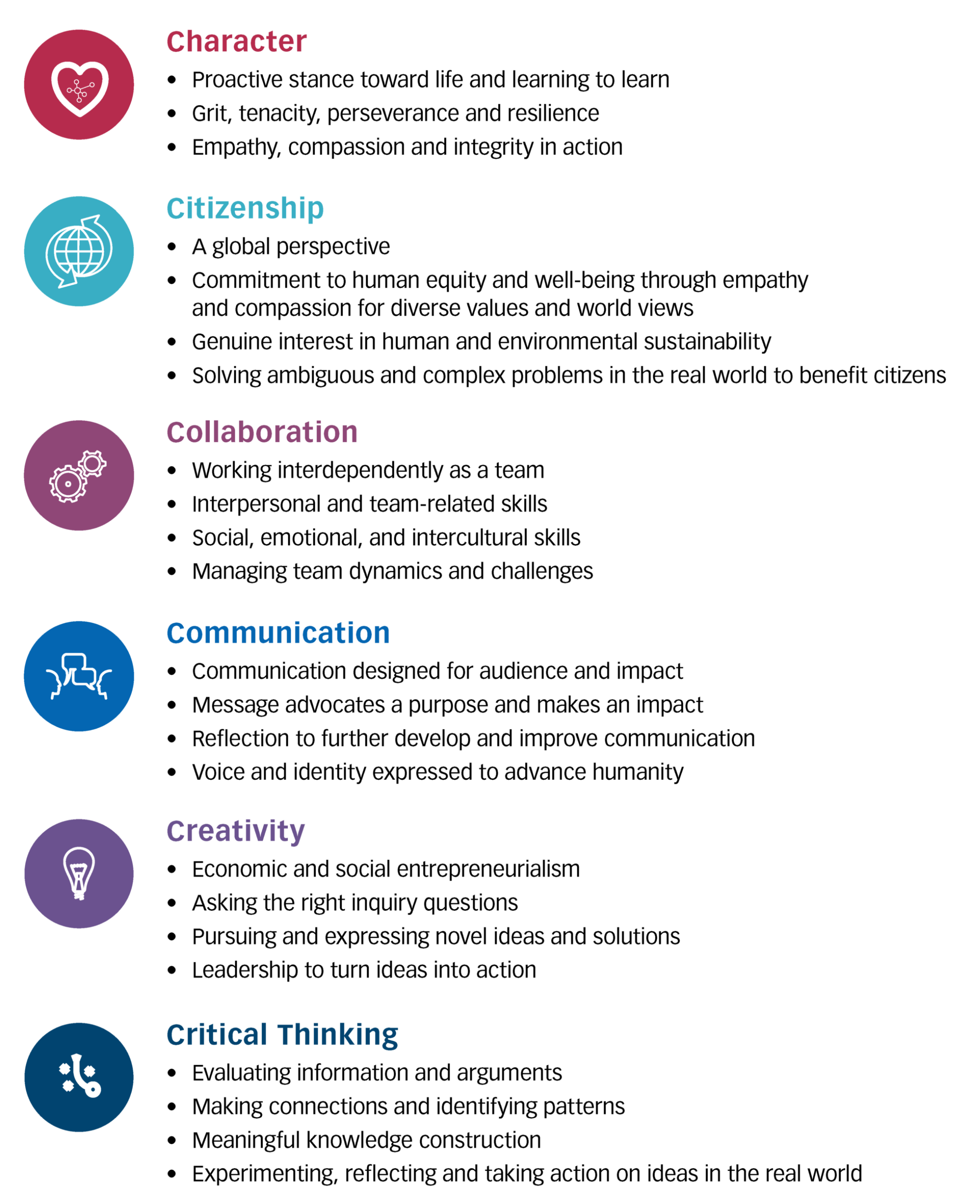
1.3 How to implement deep learning?
Specific “instructions” for the acquisition of human deep learning through teaching: very few, very general.
Kovac et al, 2023
New Pedagogies For Deep Learning, NPDL, 2019

Slide 12
Dimension | Limited Evidence | Emerging | Developing | Accelerating | Proficient
Coherent communication using a range of communication modes | Learners’ skills in communication require significant development. They may struggle with incoherence and/or tend to restrict their communication to one particular mode (e.g., written, texting, verbal, visual). | Learners are starting to understand, select and use a range of communication modes and tools, but still need significant guidance in this area. Their communication makes reasonable sense and uses more than one mode, but some of the ideas may still be lacking in coherence. | Learners understand, select and use a range of communication modes and tools to produce coherent communication i.e. communication that makes sense and reflects coherent and connected ideas, not a single simple thought. | Learners are becoming skilled choosing a range of communication modes and tools to get their messages across. Connected and coherent thought is evident across the full range of communication modes used. | Learners are able to clearly articulate how and why they make smart choices about communication modes and tools to get their message across. They are highly skilled in communicating in a coherent and connected way.
Communication designed for particular audiences | Learners still struggle to put themselves in the shoes of the intended audience. They tend to use styles, modes and tools of communication that are most familiar and comfortable to themselves. | Learners are starting to develop the skills to select the content, communication style, language, modes and tools they will use to tailor their communication to the needs, preferences and context of that specific audience. At this level a lot of guidance is still required, and the design process is quite formalized. | Learners are building a better understanding of the different types of audiences they need to reach. They have good skills to compose and produce communication for a particular audience, designing it appropriately to achieve maximum understanding, relevance and meaning for that audience. | Learners take the time to get to know the audience prior to designing their communication. Learners understand that messages are ‘heard’ differently depending on the life experiences people bring to the message. They have a good understanding of how to tailor communication for a range of audiences so that it is heard, understood, and adds value to each audience. They seek feedback, alter and tailor their communication. | Learners are highly skilled at identifying what excites, motivates, or worries a particular audience, so that they can make the audience care about the message. At this level, they use their knowledge and intuition to work out when and how to challenge the audience to think beyond the status quo. Learners have a range of strategies to create memorable messages that will ‘stick’ in the minds of the audience and change the way they think and/or act.
Substantive, multi-modal communication | Learners are struggling to effectively communicate the findings and implications of their tasks. Communications are likely to be fragmented rather than woven, coherent, and substantive. | Learners are beginning to weave different elements of their thinking and turn them into a more coherent message. They are starting to use more than one mode of communication, such as visual images, soundtracks and spoken word, for example, in film or digital presentations. | Learners are considering and integrating multiple issues, components or perspectives into their content. Their thinking is becoming more substantive because they have to analyze, synthesize and integrate multiple ideas into a coherent whole. They regularly use several modes of communication to get the messages across in the best way. | Learners are skilled at using multiple strategies to weave diverse threads of information together to create an integrated whole that makes sense to their audiences. They leverage the right mix of appropriate tools that will best communicate each kind of idea, designed in ways that will connect with their audience, capture their attention, and leave them with the important messages. | Learners understand the communication task as a synthesis and weaving of interconnected ideas into a coherent and integrated whole. They know what the big idea is and the best way to convey it, utilizing the right mix of tools and ways of communicating. They skilfully blend a mix of surprise, intrigue, fact, humor, and practical elements to connect with, hook, and retain the audience’s attention, and deliver a clear and compelling call to action.
Leveraging Digital | Although learners used some digital elements for communication during the learning process or to present findings, these were very ‘surface level’ and did not substantially contribute to the quality, reach or speed of communication either within the team or with the audience. | Learners used digital opportunities for communication during the learning process and/or to deliver the key messages to intended audiences in ways that could not have been done otherwise. They may have made communication more efficient, broader or faster, but are unlikely to have significantly enhanced the quality of communication. | Learners used digital aspects effectively to improve both the efficiency and quality of communication during the learning process. Digital opportunities were also used to tailor communication of key concepts to different audiences, in ways that enhanced their understanding and retention of key ideas and concepts. | Learners can clearly articulate how infusing a digital element has enhanced the communication aspects of the learning process as well as the quality and value of how key learnings were communicated to specific audiences. Digital was used to create a more memorable message likely to ‘stick’ in the minds of the audience and lead them to take action. | Learners used digital elements ubiquitously throughout the task in powerful ways to deepen the efficiency, reach, quality and value of communication throughout the learning process, both within the team and with other audiences. Learners can articulate in detail how each digital element has enhanced communication in ways that increase the likelihood that the audience would take action and apply the team’s learnings, and be able to apply that understanding to new and different contexts.
Reflection on and use of the process of learning to further develop and improve communication | Learners work together with little or no conscious reflection about their communication and how well it is working. At this level, they are unlikely to use clear protocols for communicating with each other, but rather let the communication process emerge naturally. | Learners are starting to establish and follow good communication protocols for working together. With guidance, they are learning to reflect on their communication processes, learn from what worked well and what didn’t, and make improvements. | Learners are developing the ability to monitor, manage, and improve their communication throughout each task. These learnings result in better and more effective communication as tasks progress, and in successive tasks. | Learners are skilled at monitoring, managing, reflecting on and improving their communication capabilities and skills. At this level, they are able to use multiple perspectives to anticipate and manage for communication challenges before they occur and finding ways to improve the team’s functioning, including diverse and multidisciplinary teams. | Learners are highly skilled and reflective communicators who proactively monitor the effectiveness of communication and reflect on it carefully from multiple perspectives. They find powerful ways to maximize the effectiveness of their communication, especially in diverse and multidisciplinary teams. At this level, teams are skilled and intuitive in finding a synergistic way of working together that helps ideas flow and minimizes communication-related disruptions.
Notes:
New Pedagogies for Deep Learning - Quinn, McEachen, Fullan, Gardner, & Drummy, 2019

Slide 13

How do I define and implement deeper learning?
“An old dog by a new name”
apply learned knowledge to different contexts
We pride ourselves on our topic based learning approach and each term, teachers plan a stimulating and immersive topic for their class using the topic framework as reference. Learning will be integrated as much as possible and link in with the topic so as to make the learning purposeful and engaging for the children. This approach also enables teachers to tailor the learning to their class’s needs and interests.
When planning a topic, teachers' will choose key texts relating to the theme, upon which they can hang a sequence of cross curricular lessons. These texts are carefully researched and teachers collaborate regularly with each other in order to share expertise. We’ve found this approach ensures enthusiasm from the children and gives their learning a real sense of vibrancy and purpose.
As part of each topic, teachers will also plan trips and visits to enhance the learning or provide additional stimulus. We ensure that wherever possible the children are given ample opportunity to experience their learning as part of the wider world.
In order to celebrate each topic, every class performs an assembly for their parents and the rest of the school, showcasing their learning as well as their performance skills. Throughout the term children's learning is shared and praised through our weekly Sharing Assemblies, the newsletter and Twitter.
Each term the topic will either be history, geography or science based with other subjects dovetailing in, to ensure balanced curriculum coverage over the course of the year. Whilst our creative approach enables most lessons to link in with the class’s topic, some lessons will be taught discreetly rather than forced to fit.
intrinsic motivation
autonomous learning
build connections between new and old knowledge
higher-order thinking: analysing, evaluating, creating
active learning
collaborative learning
knowledge linked to real life
deepen understanding gradually and think and reflect critically

Slide 14
Example 1: Teaching Chinese numbers 1-99
Features of Deep Learning
build connections between
new and old
knowledge
higher-order thinking: analysing, evaluating, creating
apply learnt knowledge in different contexts
intrinsic motivation
collaborative learning
active learning

Slide 15
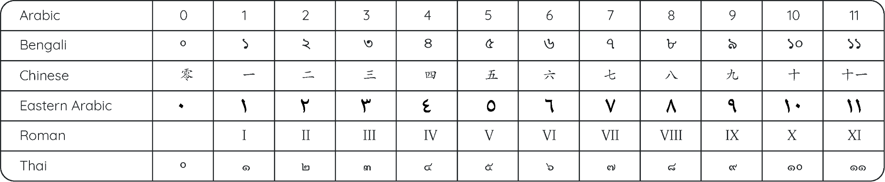
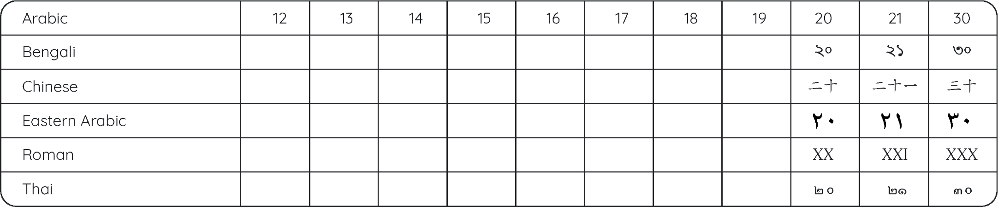

Know that there are different numeral systems in different parts of the world.
Know that Chinese has its own numerals and that both Chinese and Arabic numerals are used in China today.
2.1 Numerals of the World
build connections between
new and old
knowledge.
© Primary Mandarin

Slide 16
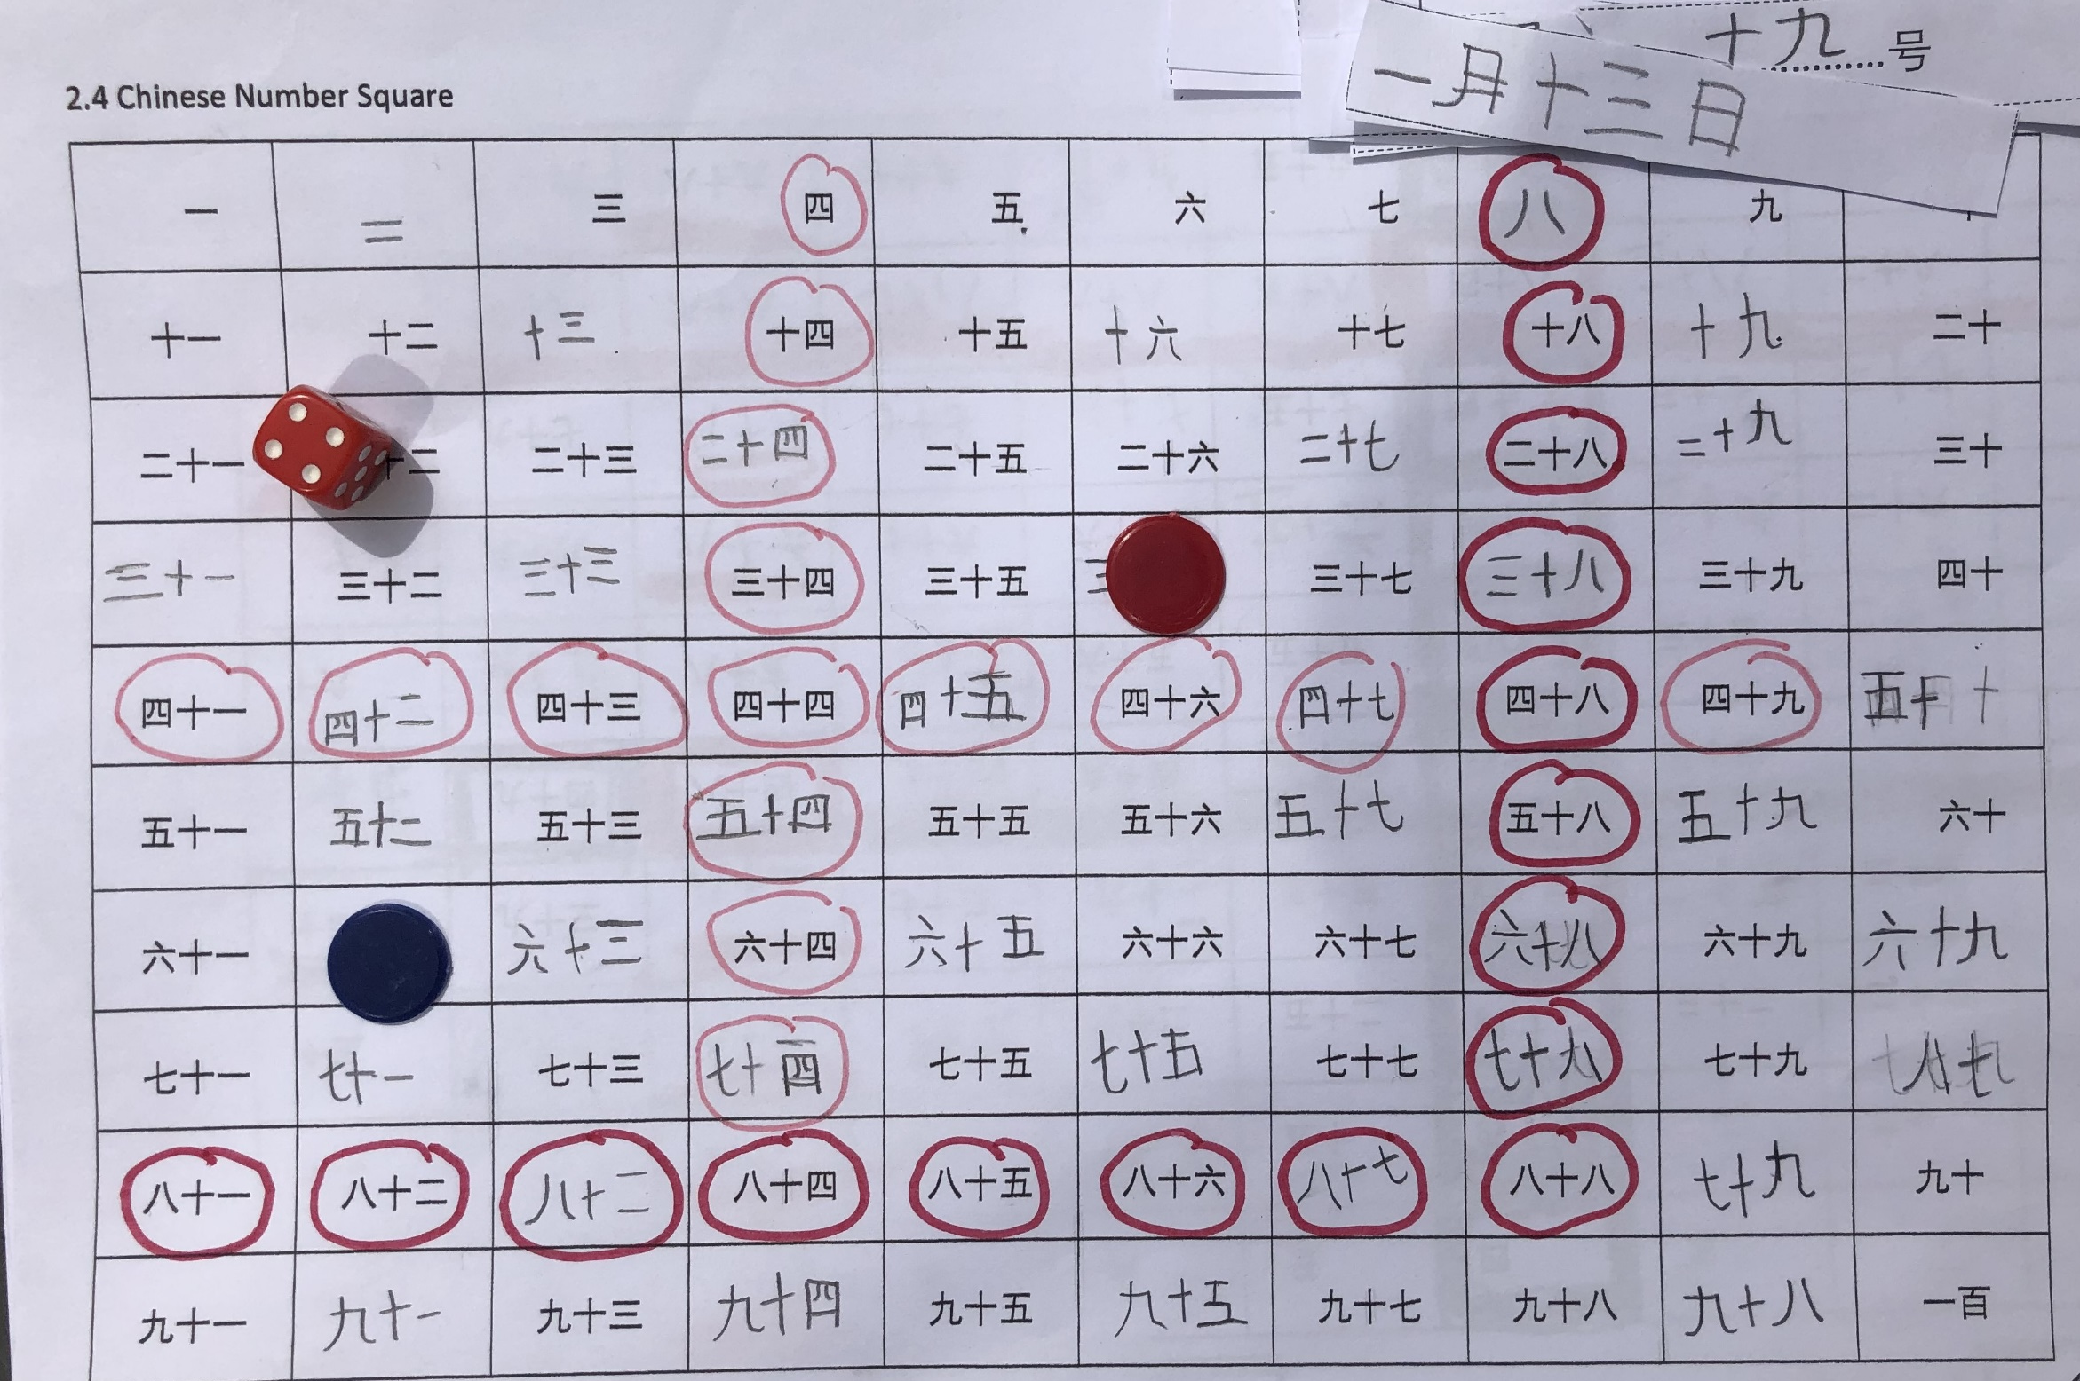
LOs: Use pattern recognition skills to complete 100 number grid.
Work collaboratively to elicit the two rules for for counting from 11-99.
higher-order thinking: analysing, evaluating, creating
active learning
collaborative learning
Extend: create a board game for year group below to consolidate knowledge of numbers and month / day dates.

Slide 17
2.8 Maths In Mandarin- Number Bonds to 10
apply learnt knowledge in different contexts
0
1
2
3
4
5
10
9
8
7
6
5
explore different number systems used around the world today
make connections between and generalisations of number patterns
improve mental calculations for+ and x
explore number bonds to 20 and use commutativity in mental calculations
mentally add 3 one-digit numbers
develop problem solving abilities based upon addition
© Primary Mandarin™

Slide 18
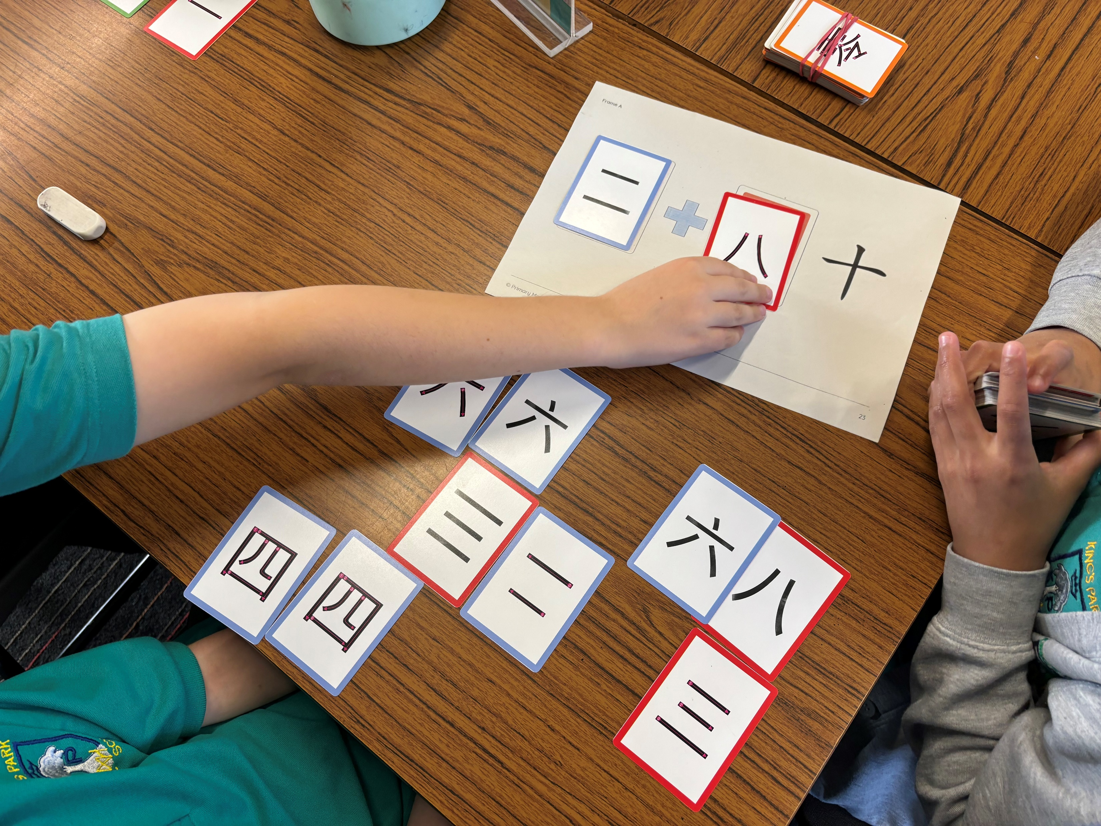

2.8. Maths in Mandarin - Number Bonds to 10
LO: To increase fluency of recognition of Chinese number characters by using them to practise number bonds to 10.
active learning
collaborative learning
intrinsic motivation
Notes:
Explain specific maths LOs and activity:
Set up:
Frame A is placed in the centre of the table.
Remove the lucky and unlucky cards from the pack and split the number card deck roughly in two.
The dealer keeps half the cards.
The dealer deals out the other half of the cards evenly amongst the players.
The players (not the dealer) look at their hands.
Instructions:
The dealer places the top card from their half of the deck into the first box.
The players look at that number and select from their hand the correct card to create the number bond to ten.
The first player to get the correct bond number down (judged by the dealer) wins and the cards from the frame are then removed to the
bottom of the dealer's deck.
In the event of a tie between the children, the bottom card or the card the most within the box on the frame wins.
The winner is the first child to get rid of all their cards - that child then becomes the dealer.

Slide 19
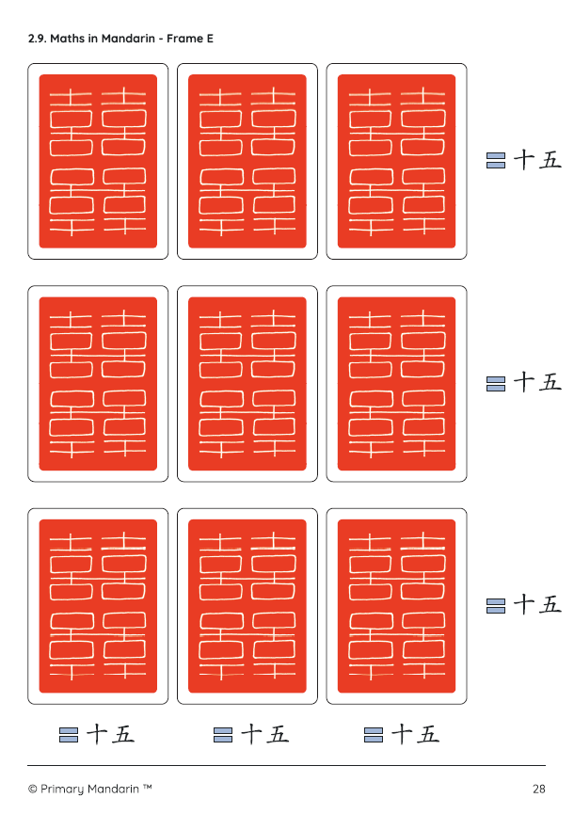
2.9 Maths in Mandarin – Magic Squares
LOs: Increase fluency of recognition of Chinese numbers from 1-15 by using them in mathematical games and puzzles.
higher-order thinking: analysing, evaluating, creating
active learning
Magic Squares
The legend of Emperor Yu and the Tortoise
collaborative learning
Notes:
Explain maths LOs – mental addition of x 3 single digit numbers.
Primary Mandarin® Images ©Annabel Wright

Slide 20
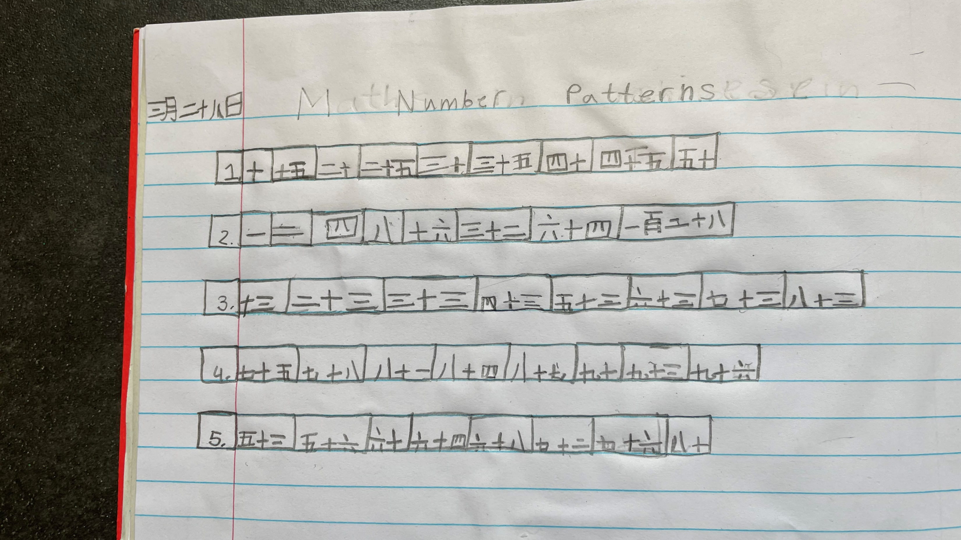
higher-order thinking: analysing, evaluating, creating

Slide 21
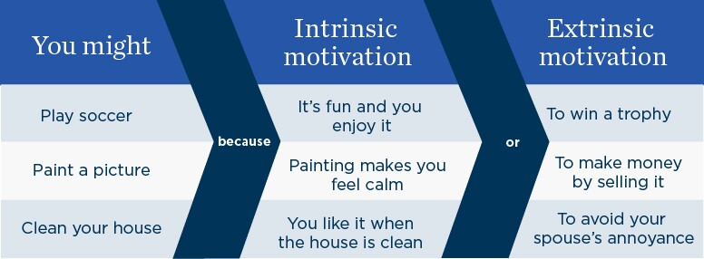
Intrinsic motivation
Notes:
Intrinsic motivation – learn through game play.
Infographic: © 2024 University of Kansas - School of Education and Human Sciences

Slide 22
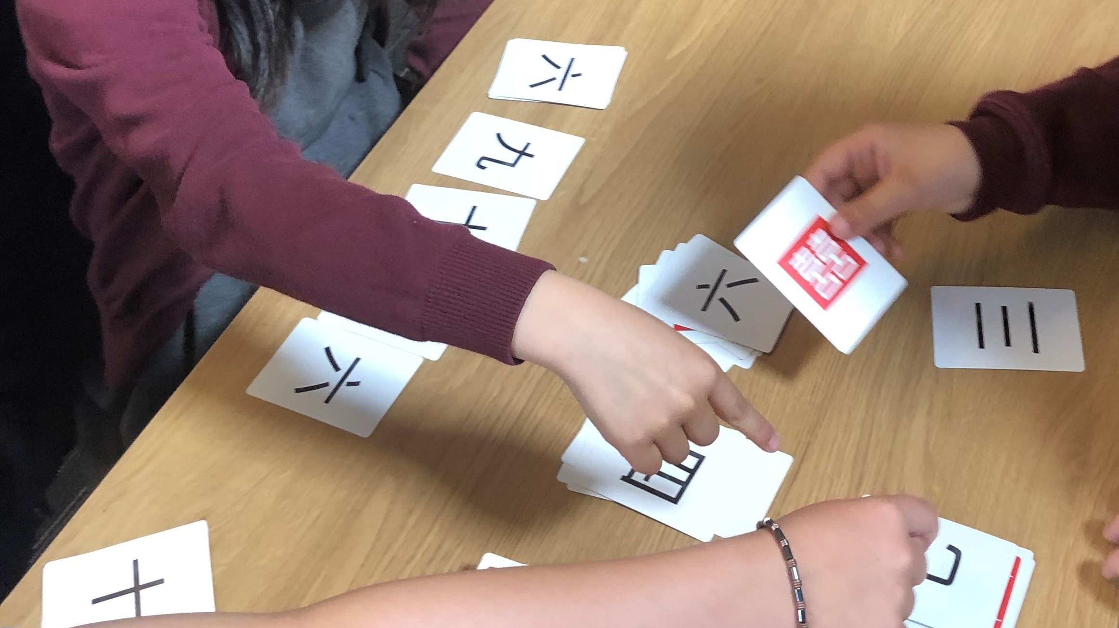
intrinsic motivation
Notes:
Games create intrinsic motivation

Slide 23
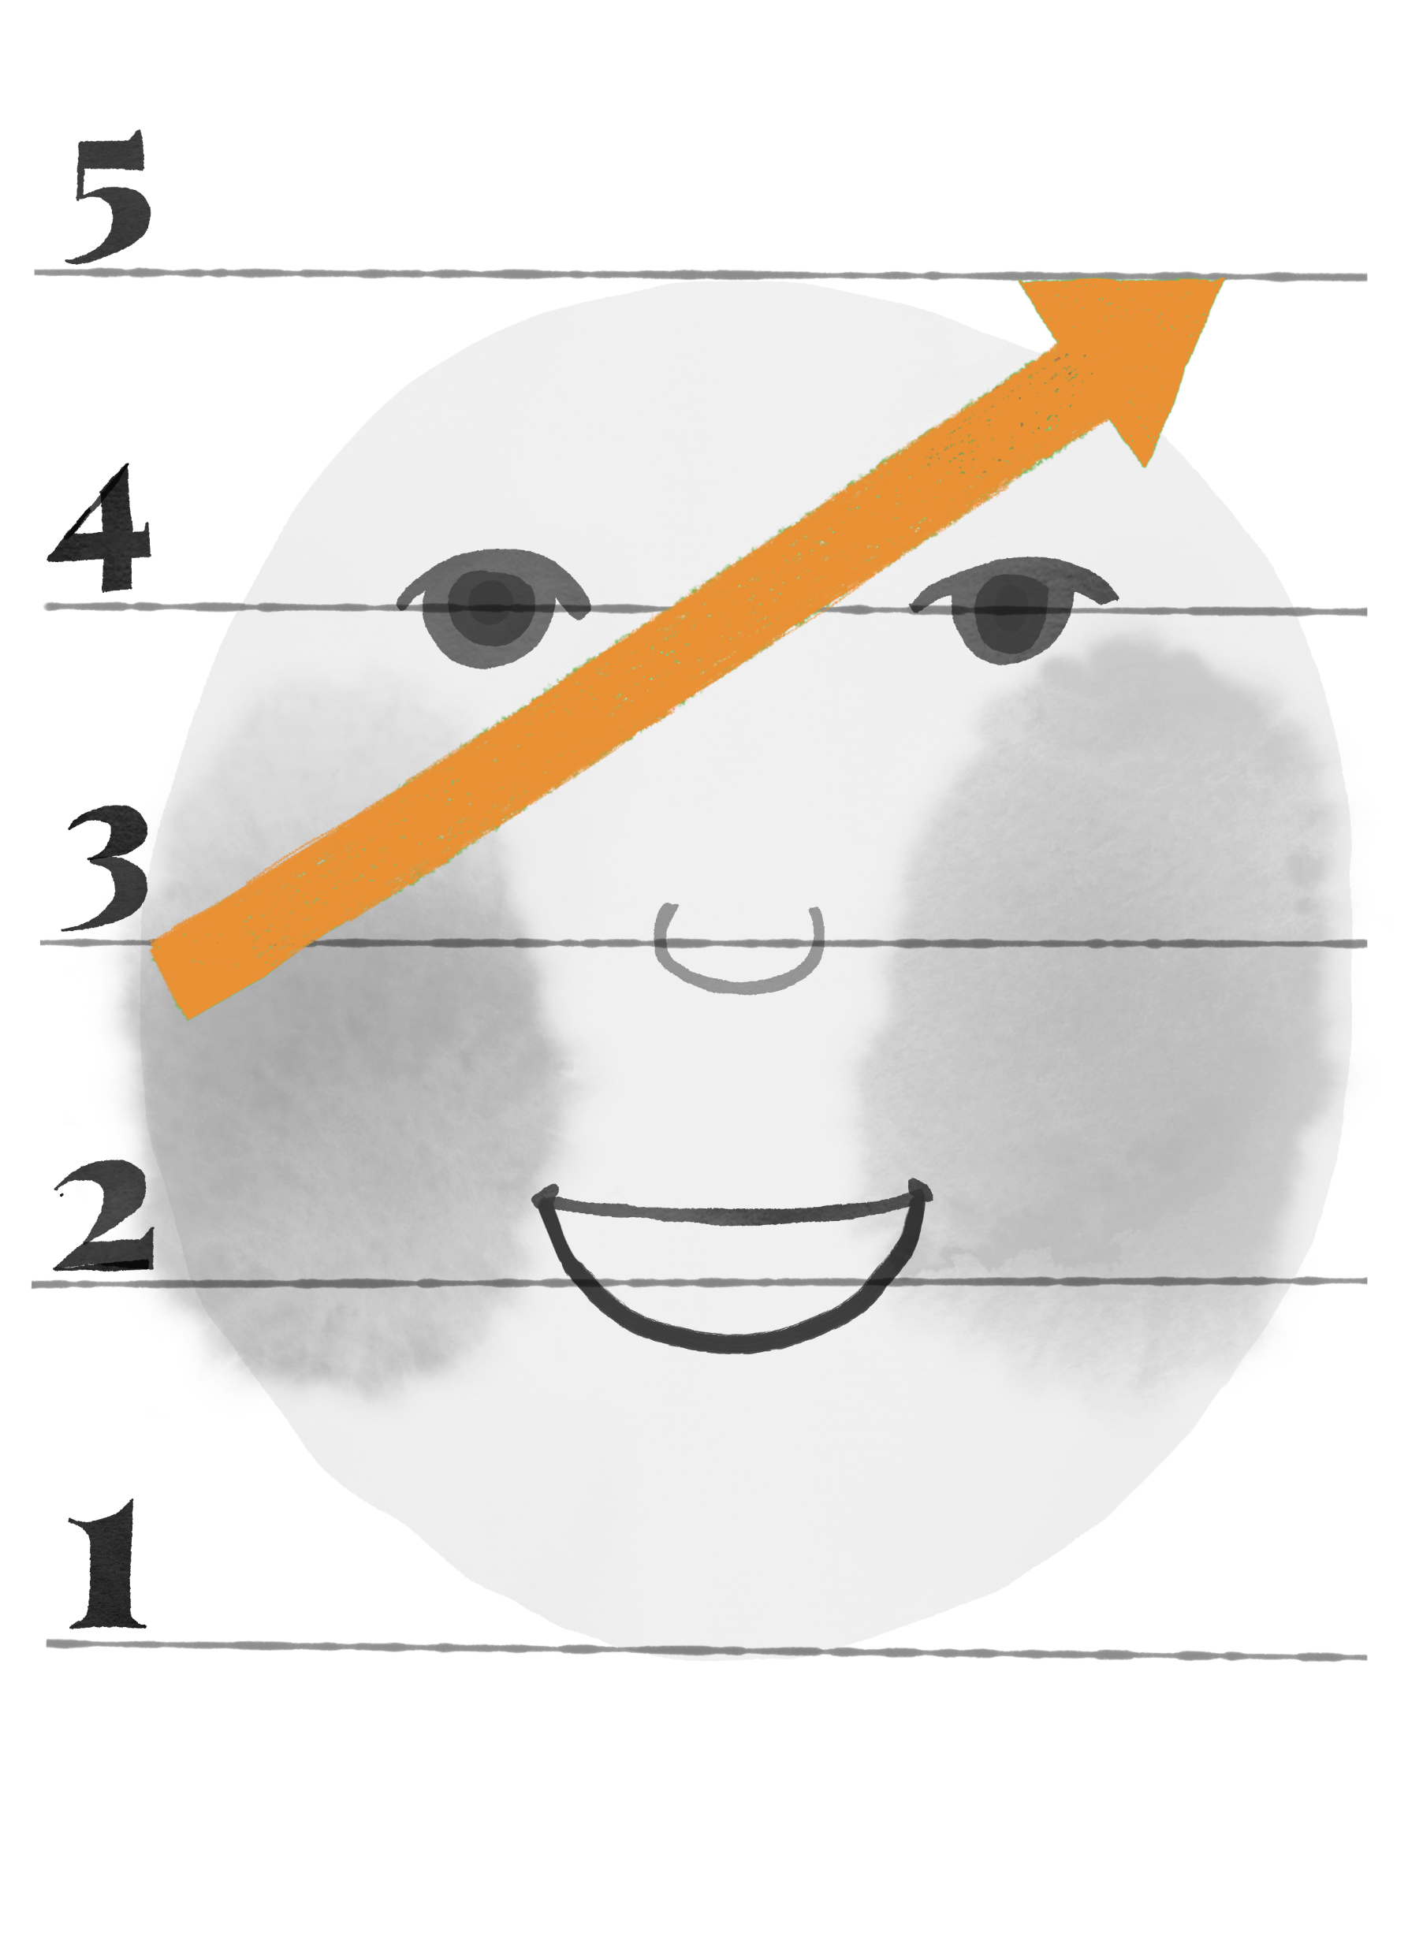
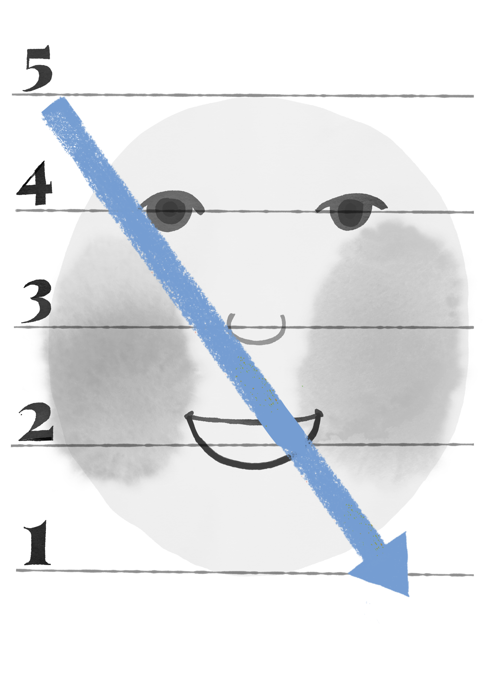
Catchy phrases children can use spontaneously as they play:
wǒ yíng le!
hǎo pái!
fā pái
kuài kuài kuài
bú yào kàn
bú duì

Slide 24
Catchy phrase bingo - game within a game
bú yào kàn 不要看 | wǒ yíng le! 我赢了！ | fā pái 发牌
kuài kuài kuài 快快快 | hǎo pái! 好牌 | bú duì 不对

Slide 25

Example 2: learning Chinese characters
Features of Deep Learning
higher-order thinking: analysing, evaluating, creating
apply learnt knowledge in different contexts
build connections between
new and old
knowledge
collaborative learning
intrinsic motivation
knowledge linked to real life
deepen understanding gradually and think and reflect critically
active learning
technology as an enabler
autonomous learning
Notes:
Used a more general example of teaching characters rather than specific LOs so more relevant to KS3..

Slide 26
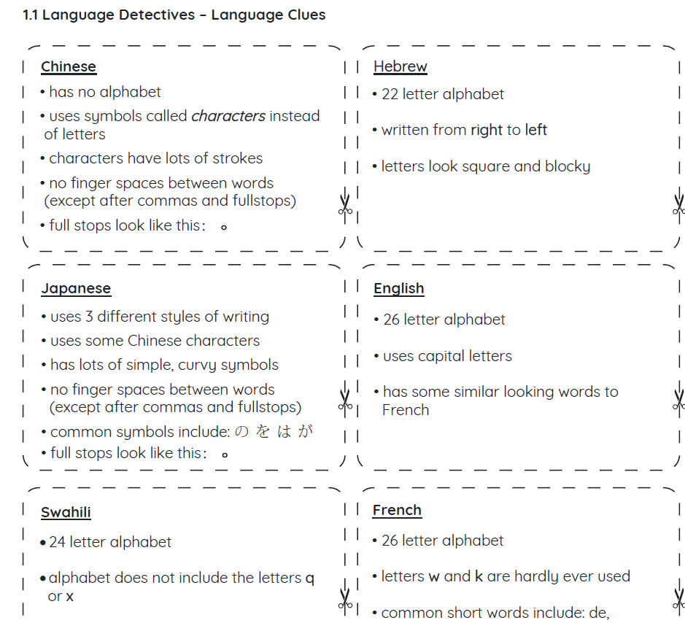
Language Detectives - Writing From Around the World
Example 2:1 Asking big questions about the Chinese writing system
build connections between
new and old
knowledge.
Know that there are many different writing systems at use in the world today.
Know that not all languages have an alphabet.
Know that Chinese does not have an alphabet and uses characters instead of letters.
Mr. and Mrs. Dursley, of number four, Privet Drive, were proud to say that they were perfectly normal, thank you very much. They were the last people you’d expect to be involved in anything strange or mysterious, because they just didn’t hold with such nonsense.
家住女贞路四号的德思礼夫妇总是得意地说他们是非常规矩的人家，拜托，拜托了。他们从来跟神秘古怪的事不沾边,因为他们根本不相信那些邪门歪道。
higher-order thinking: analysing, evaluating, creating
A English
B
C
M. et Mme Dursley, du numéro quatre, Privet Drive, étaient fiers de dire qu’ils étaient parfaitement normaux, merci beaucoup. C’étaient les dernières personnes à qui on s’attendrait à être impliquées dans quelque chose d’étrange ou de mystérieux, car ils ne tenait pas avec une telle absurdité.
プリベットドライブの4番目のダーズリー夫妻は、彼らが完全に正常であると誇りを持って言ってくれて、ありがとうございました。彼らはただの理由で、奇妙なことや神秘的なことに関与することを期待する最後の人々でした そのようなナンセンスに耐えられませんでした。
E
F
G
© Primary Mandarin

Slide 27
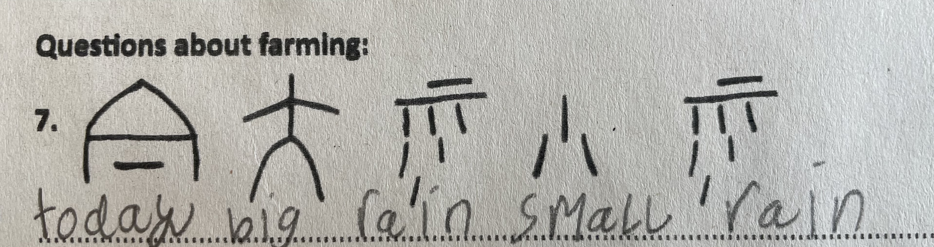




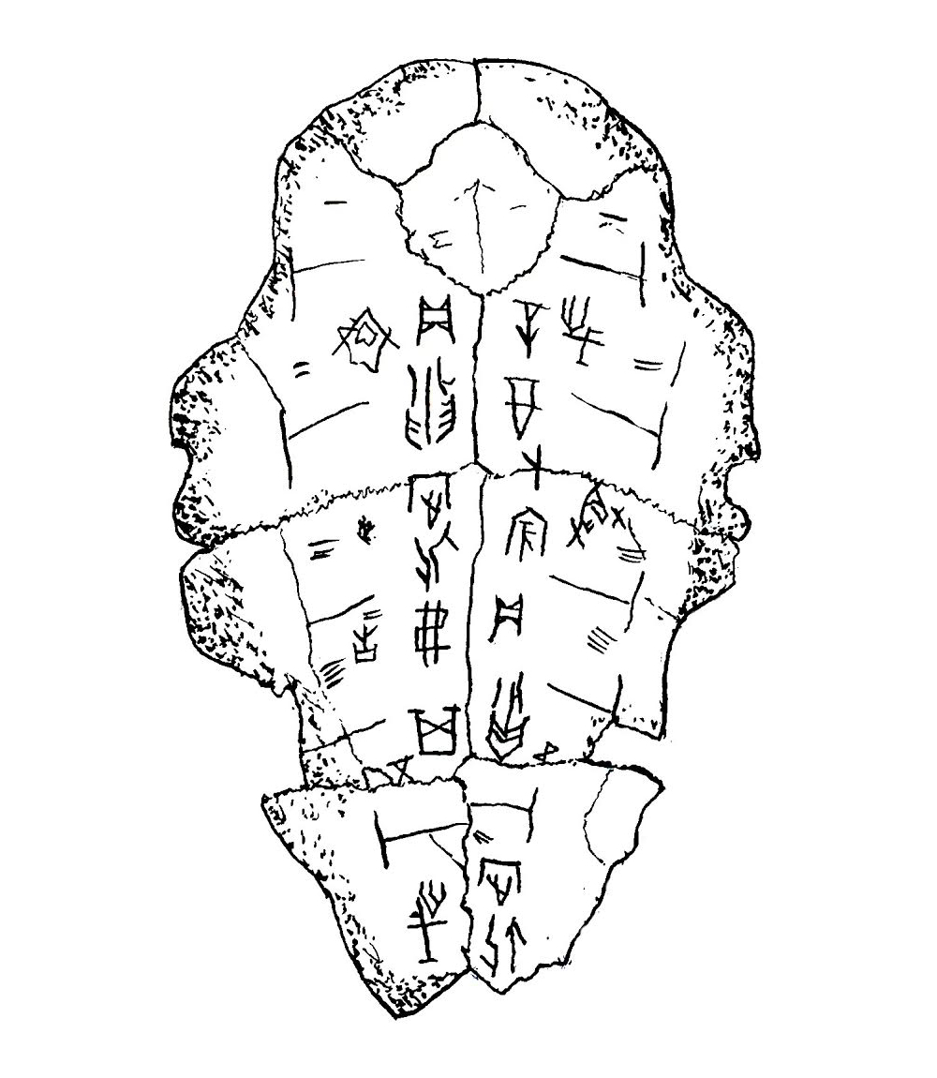









Oracle Bones Code Cracking
deepen understanding gradually and think and reflect critically
1.
2.
3.
apply learnt knowledge in different contexts
© Primary Mandarin

Slide 28
Example 2: 2 – How can we remember Chinese characters?
active learning
deepen understanding gradually and think and reflect critically
higher-order thinking: analysing, evaluating, creating
autonomous learning
collaborative learning
World famous memory athletes:
2002 - Dominic O’Brien (Britain) used mnemonics to remember a random sequence of 2808 playing cards (54 packs) after looking at each card once! He made just 8 mistakes and was able to correct 4 of them immediately.
2015 - Marwin Wallonius (Sweden) memorized 5,040 random numbers in 30 minutes.
2016 - Alexander Mullen (USA) memorised a deck of cards in under 20 seconds.
http://www.world-memory-statistics.com/championships.php
© Primary Mandarin™

Slide 29
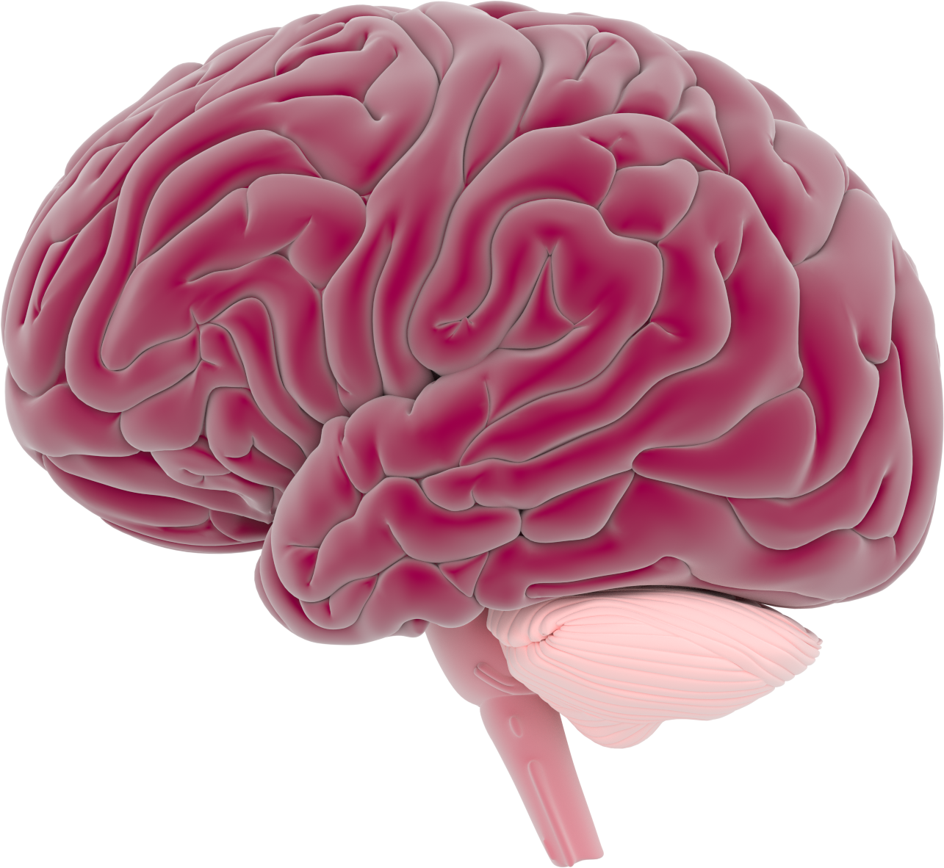
What do you know about the brain?
knowledge linked to real life
autonomous learning
deepen understanding gradually and think and reflect critically
technology as an enabler

Slide 30
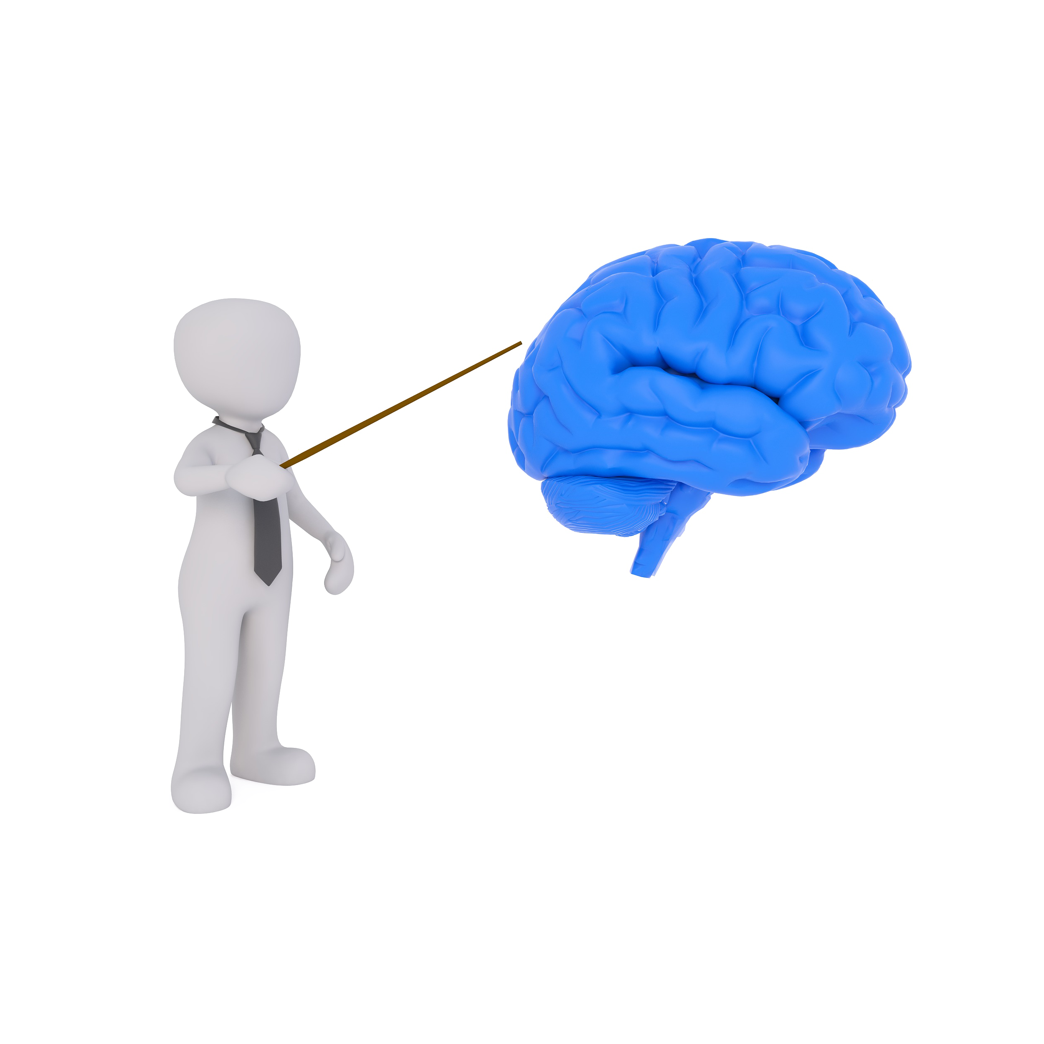

What is learning and memory?
Memory is…
the way in which our brain stores information
Learning is…
the process of gaining new information and skills

Slide 31
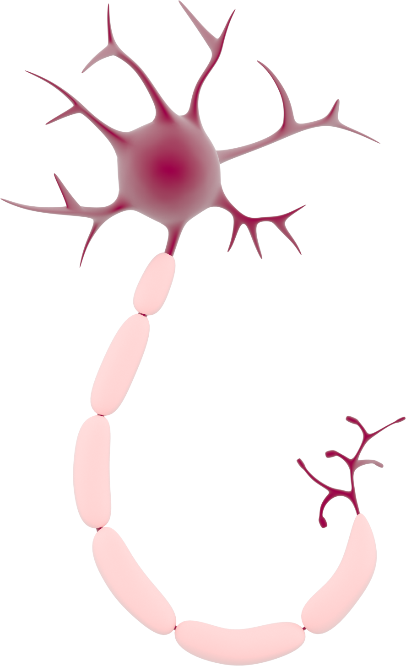
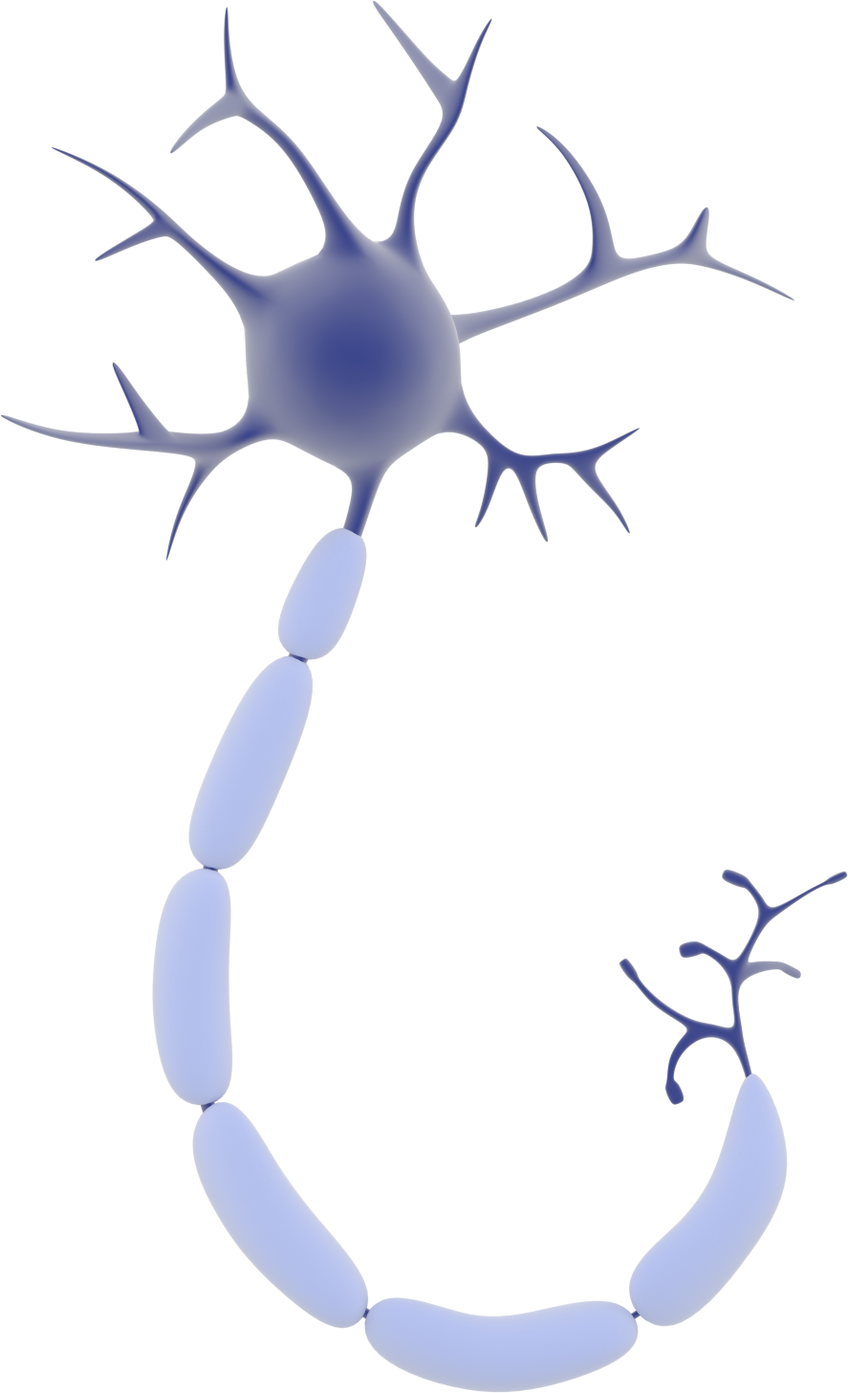
How does memory work?
and networks…
Connections
Notes:
Briefly Introduce myself

Slide 32
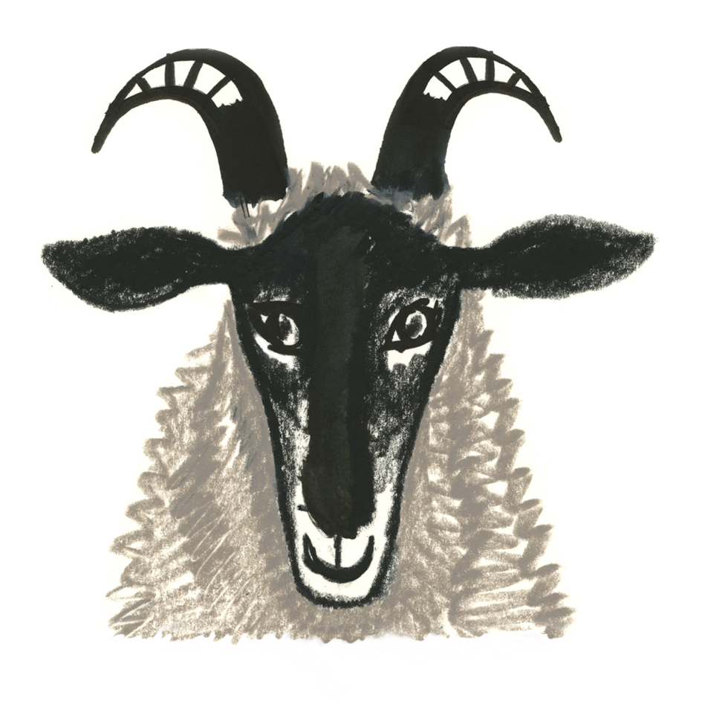
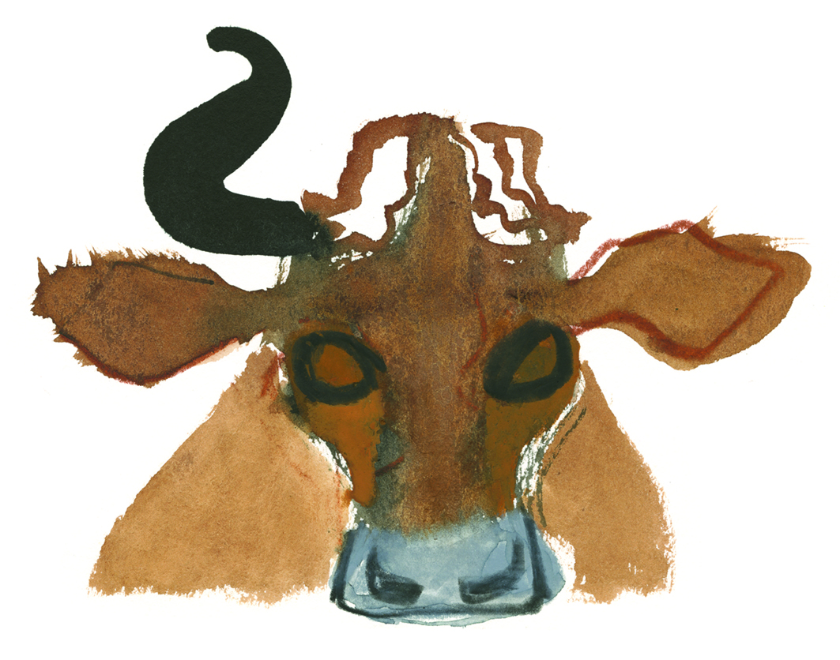
 | 羊
 | 牛
Week 1 – visual mnemonics and memory hooks
sheep/
goat
cow
Notes:
Primary Mandarin® Images ©Annabel Wright

Slide 33
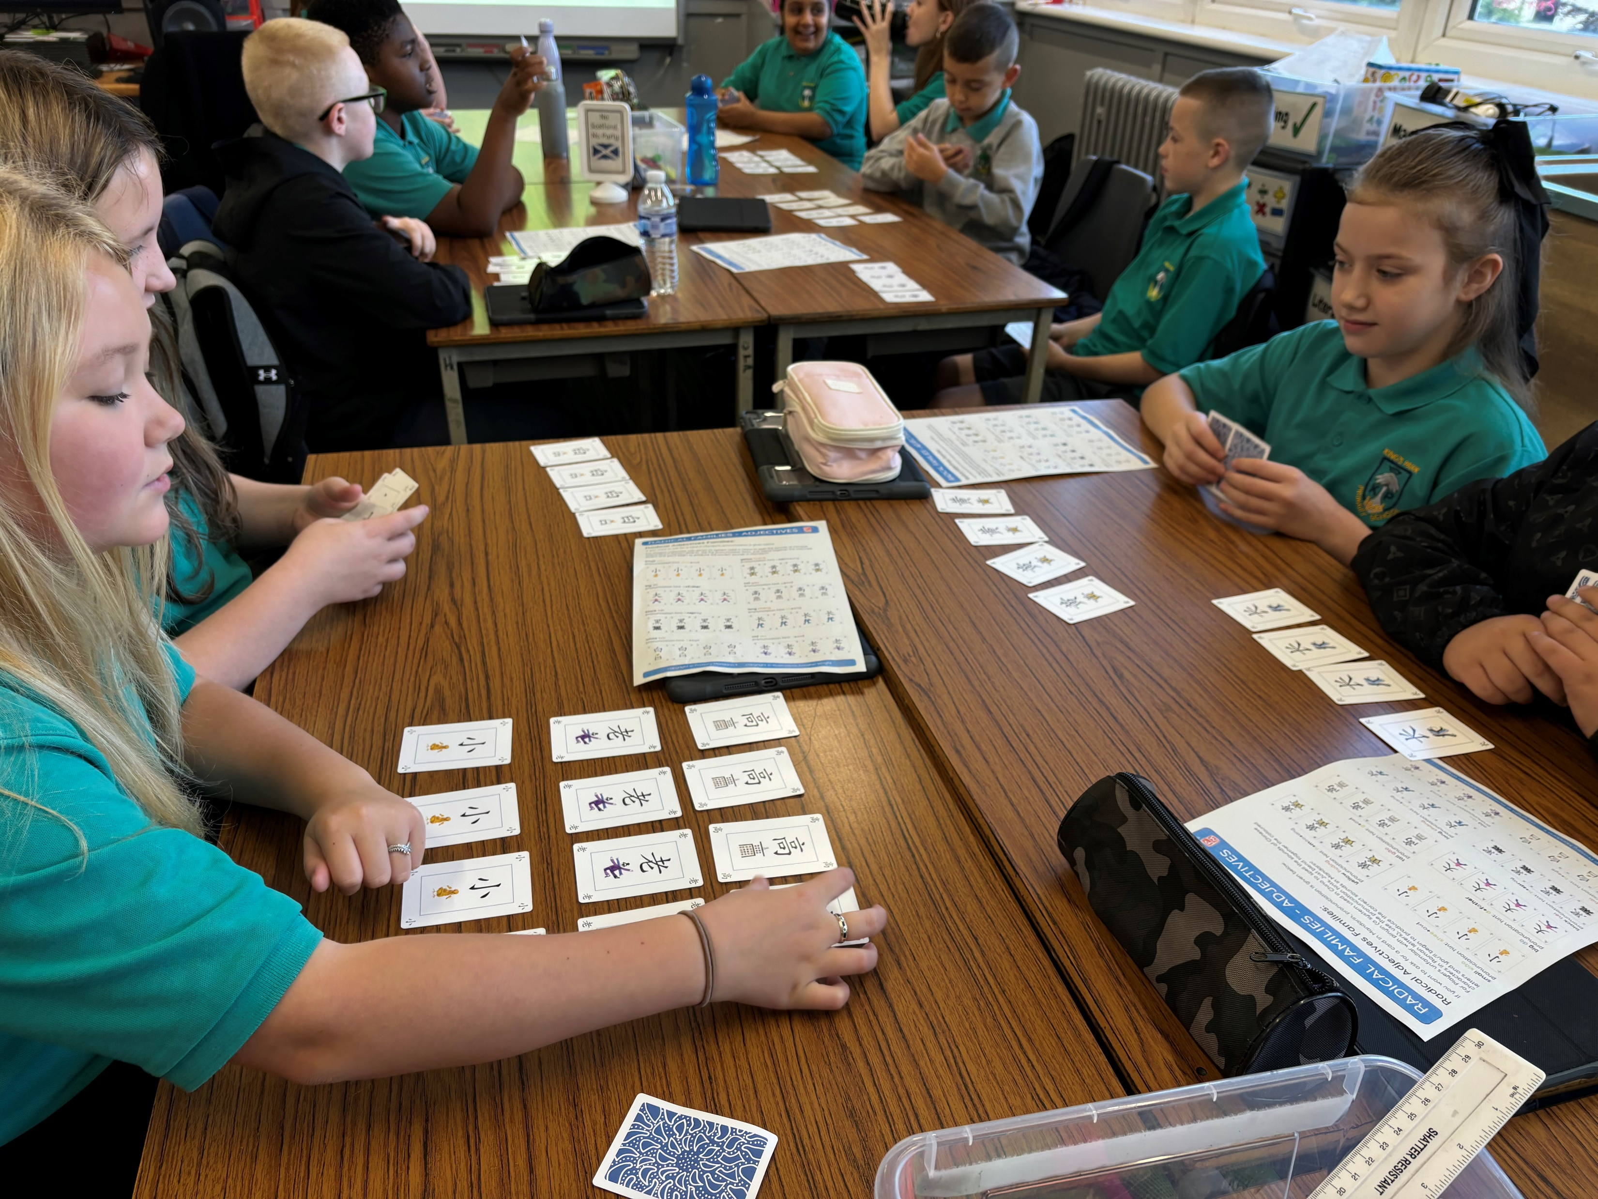
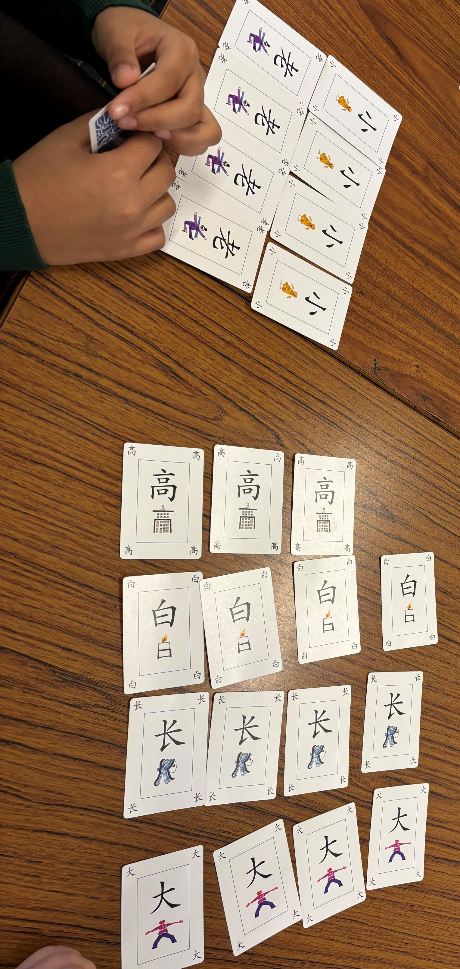

Slide 34

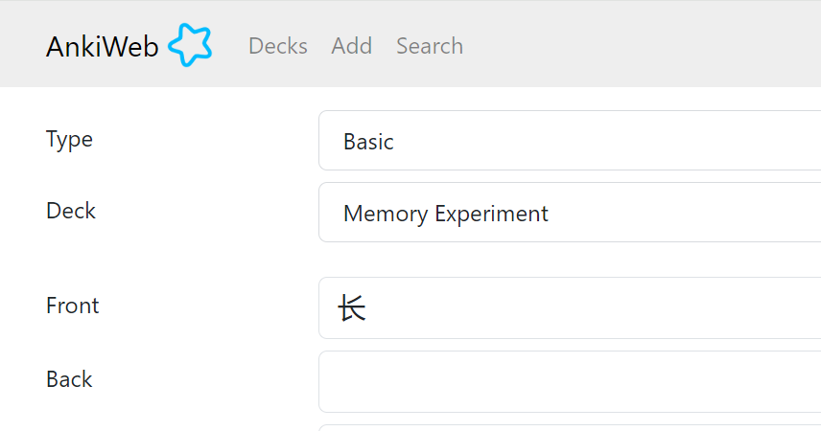
Week 2 – writing to remember
Week 3 – spaced repetition memory app /
other language app
Notes:
https://www.chineseworksheets.info/product/chinese-character-writing-practice-nose/

Slide 35
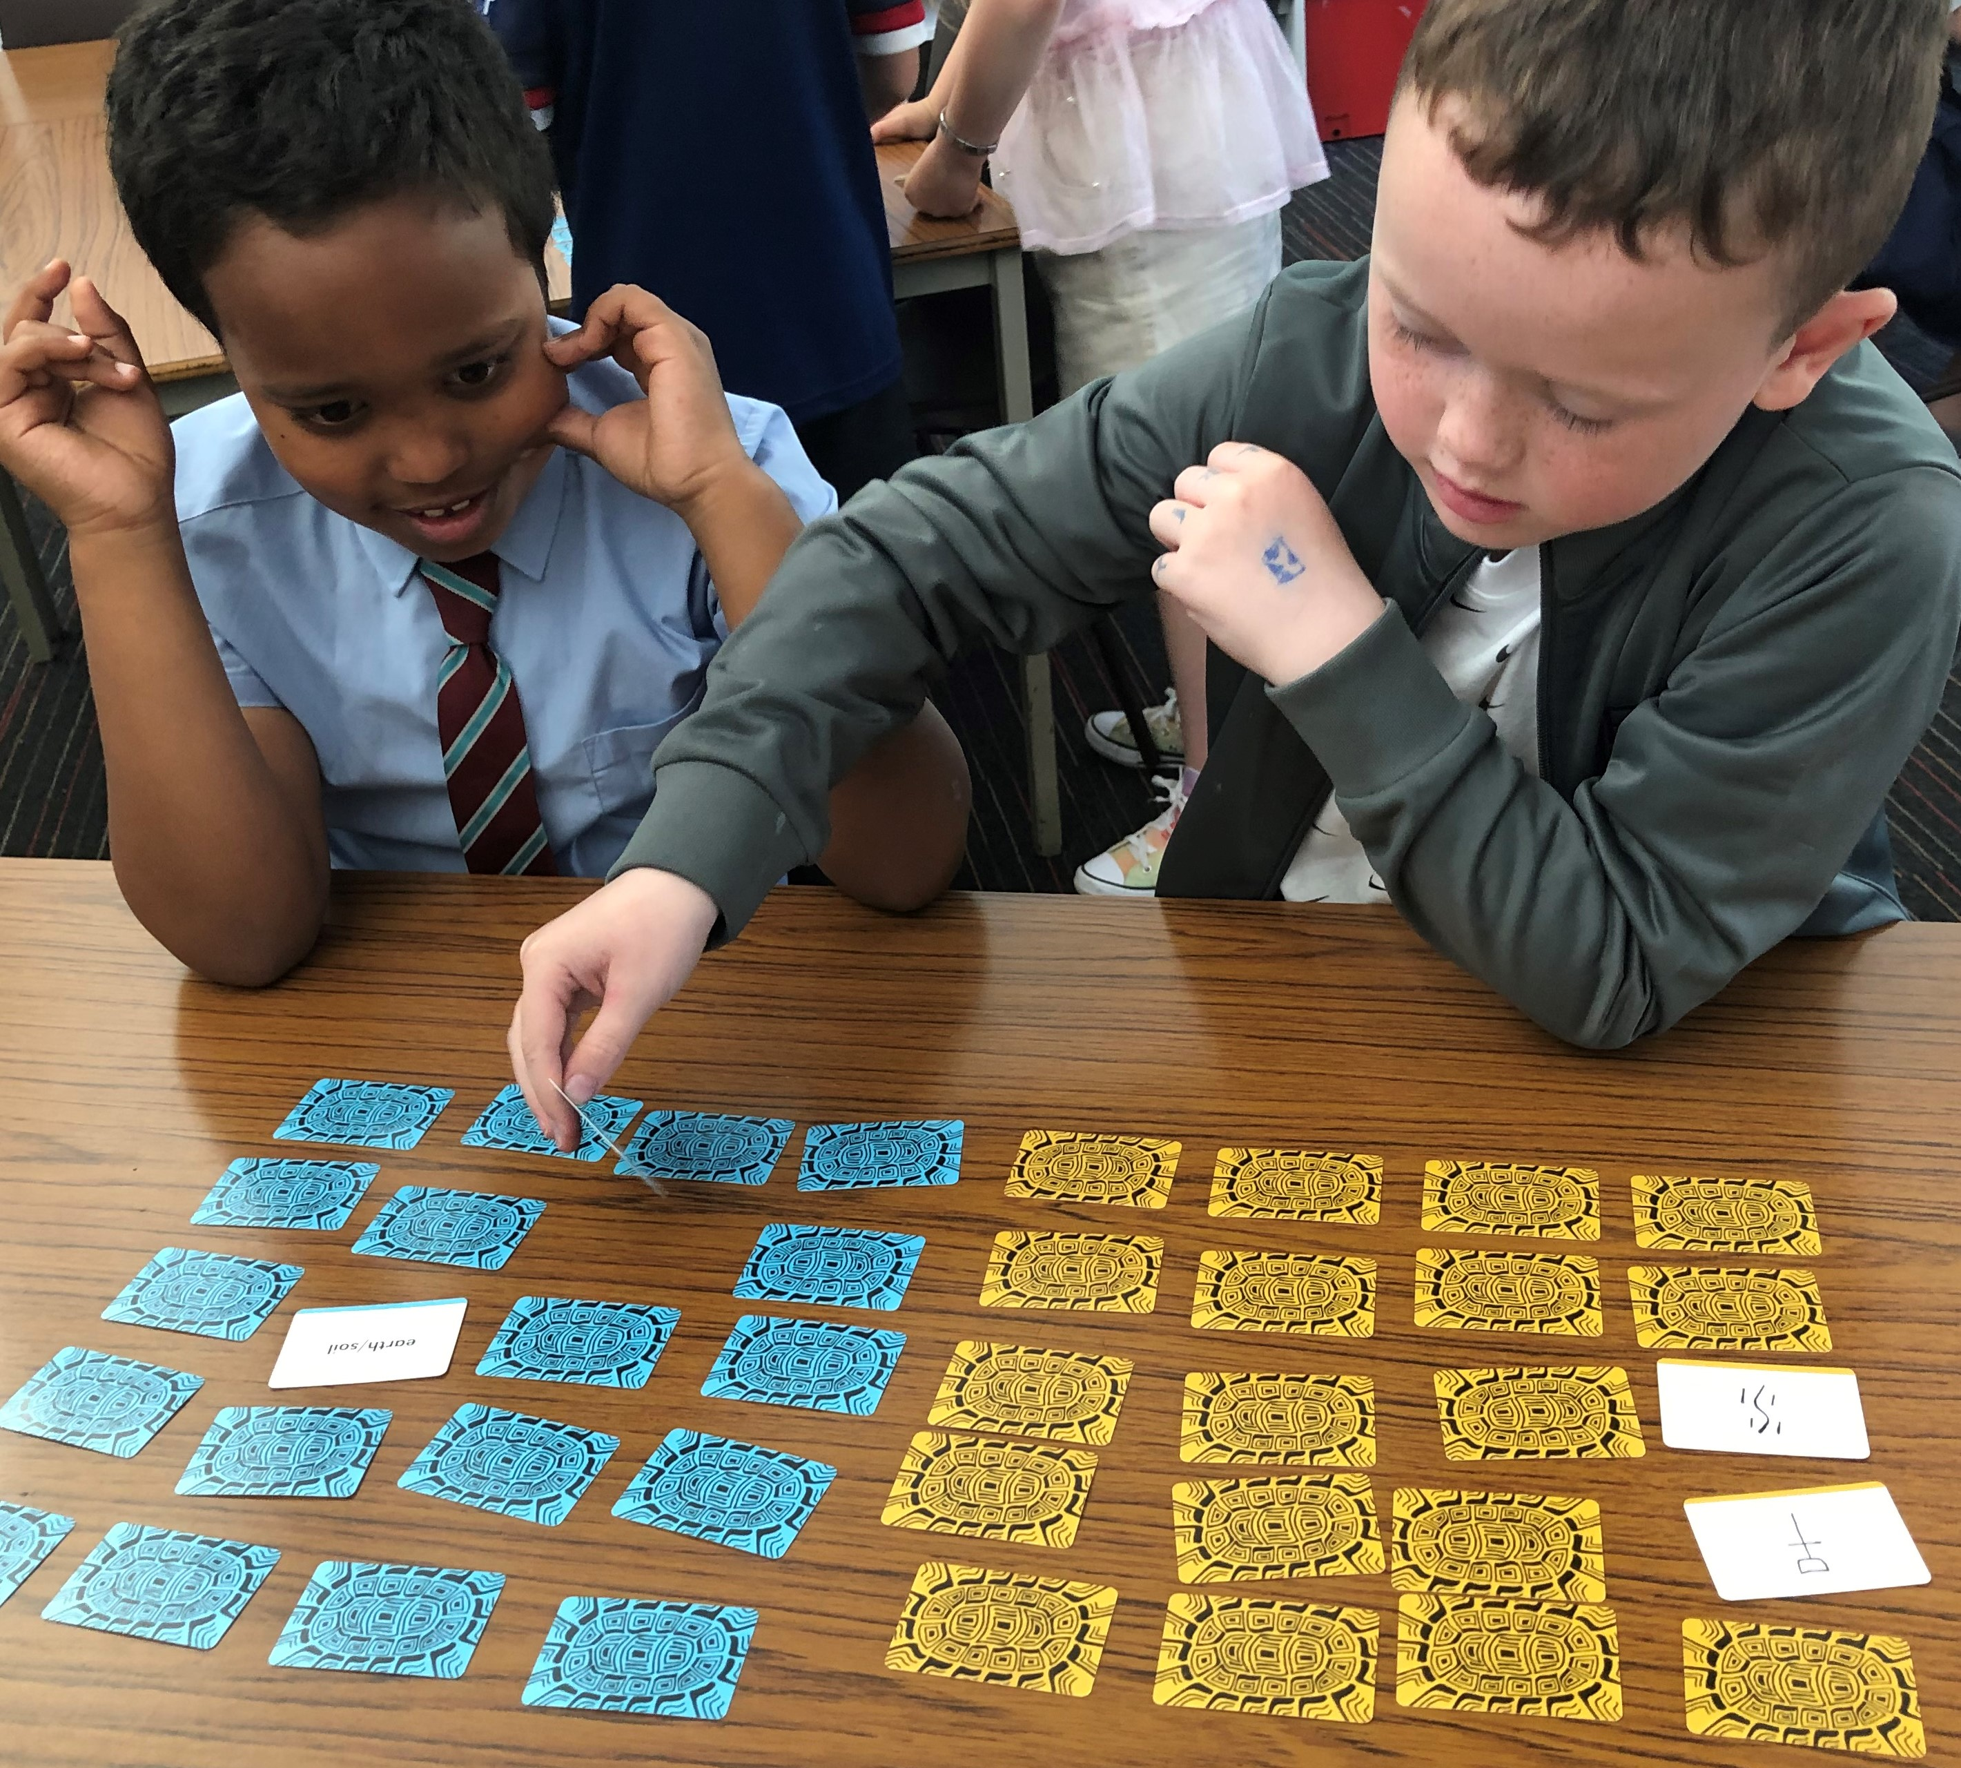
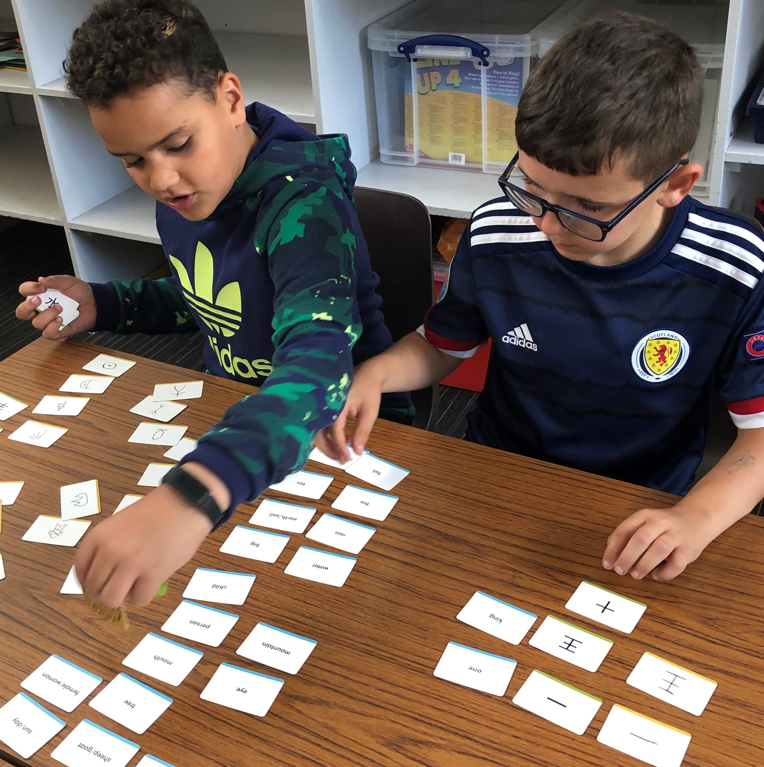
Example 2.3 - Using games
intrinsic motivation
collaborative learning

Slide 36
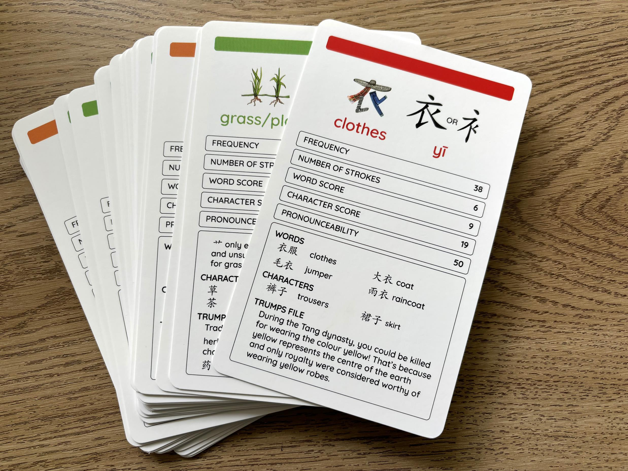
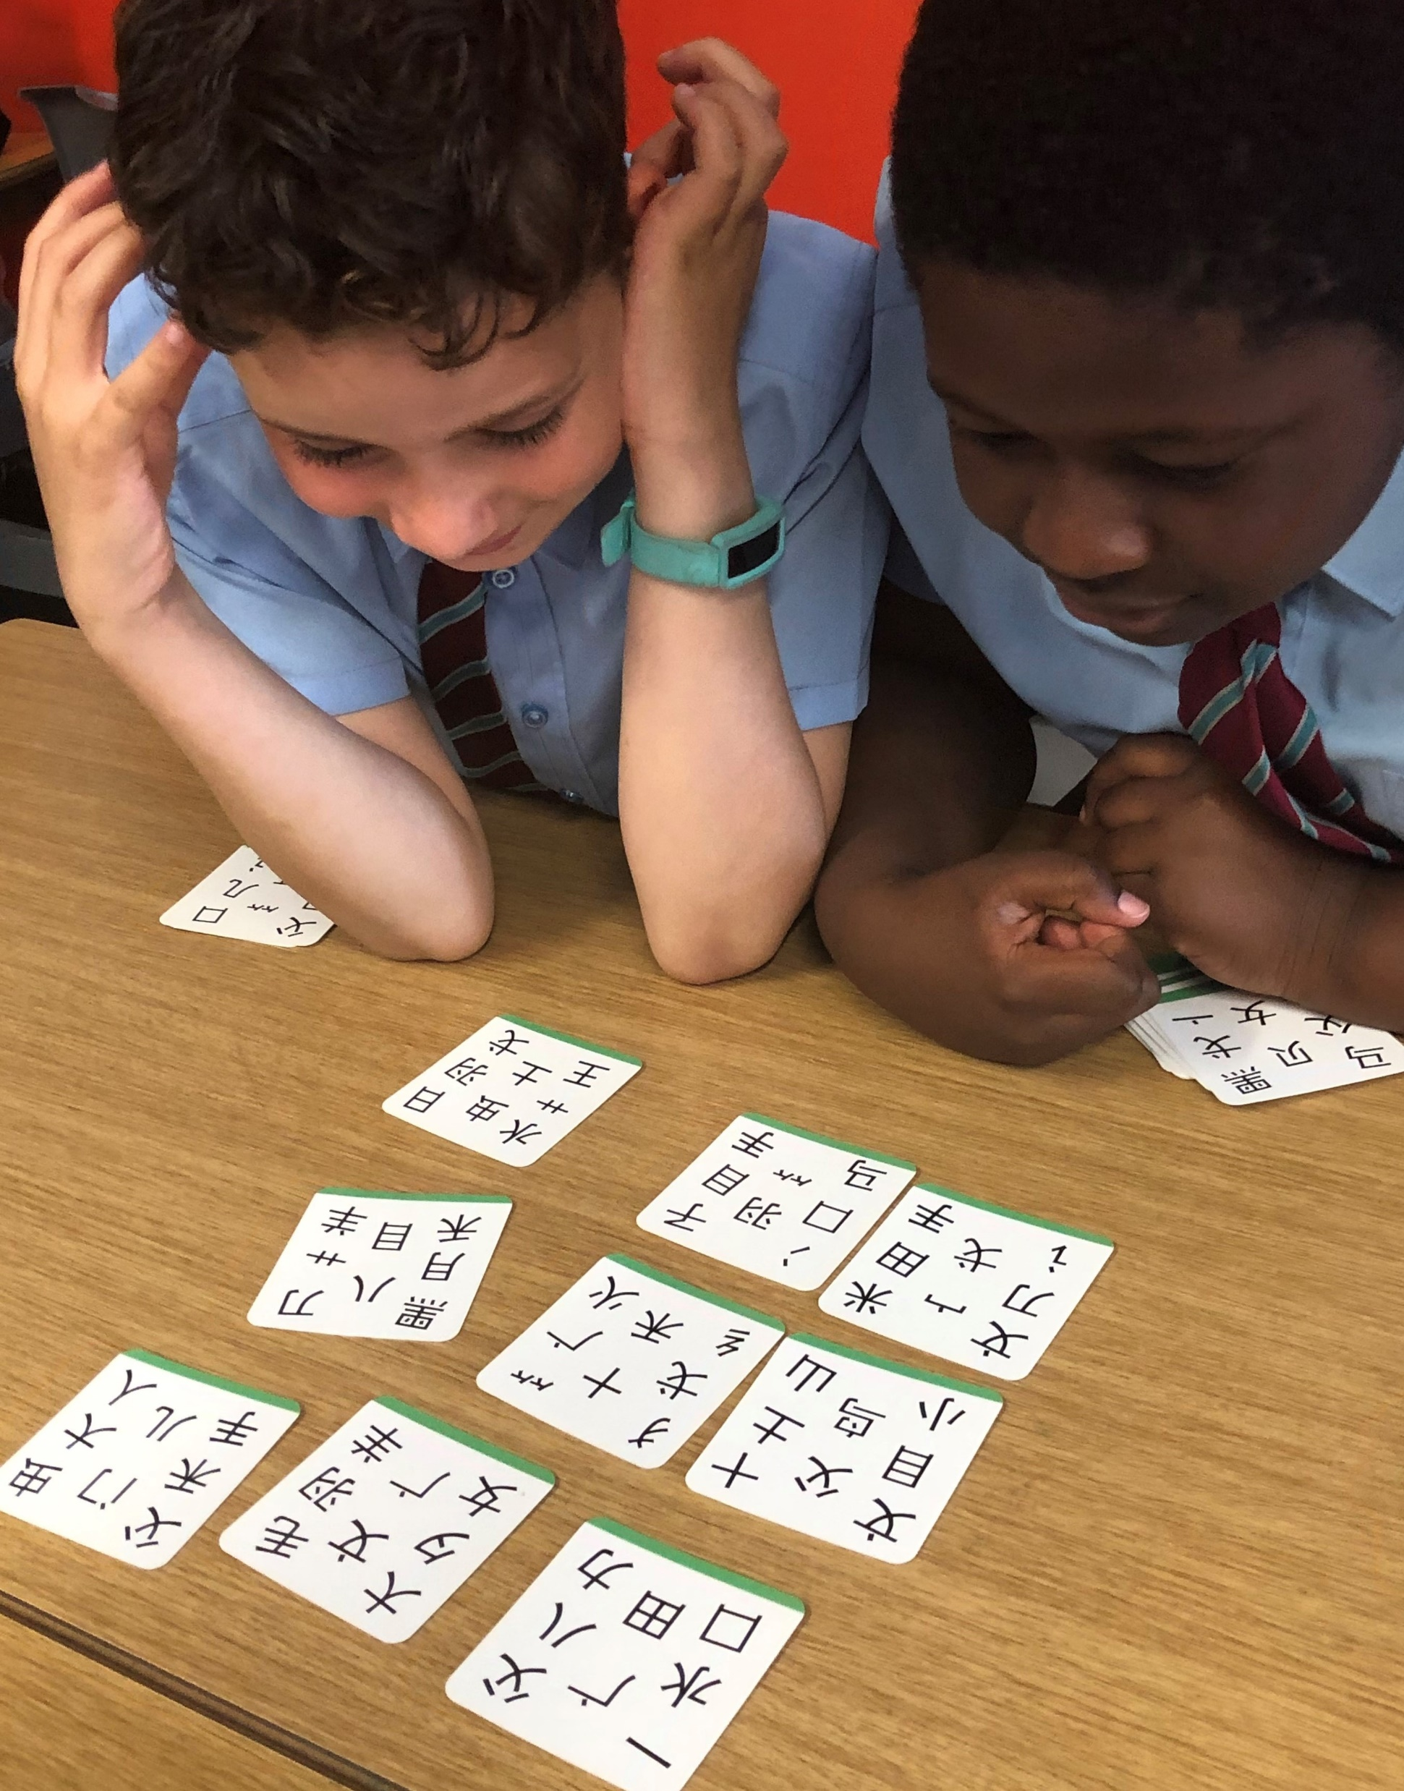
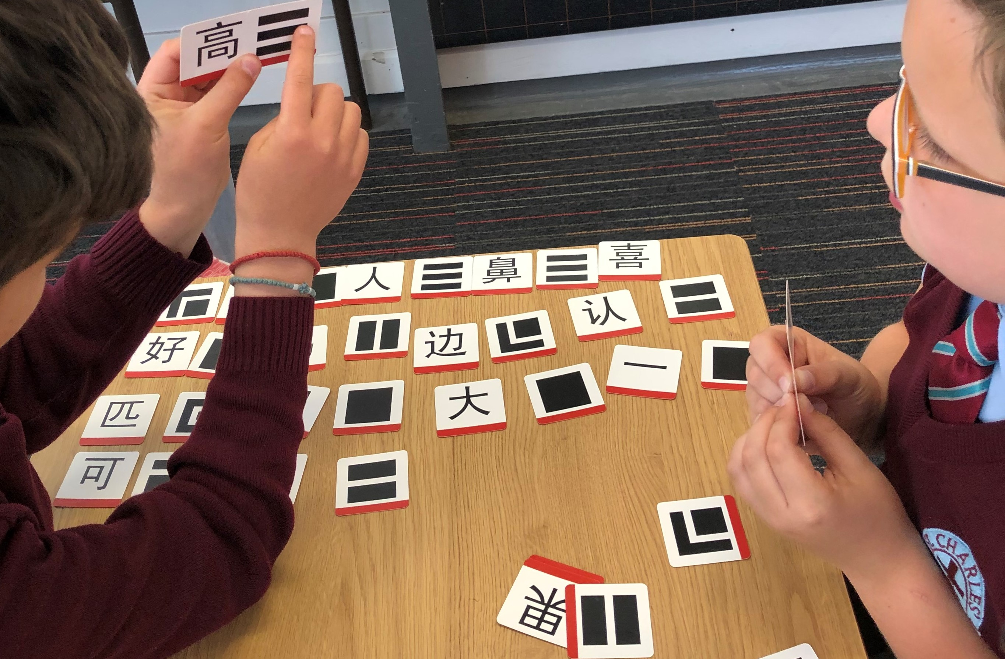

Slide 37
Moving Towards Deeper Learning….
reaches outside the classroom walls
links to other curriculum areas
uses technology as a tool and enabler, not
as the main event
encourages student agency / autonomy
allows time for curiosity
requires critical thinking, collaboration
and creativity
Chinese New Year
enquiry based activity…*
*enquiry-based learning is a form of active learning that starts by posing questions, problems or scenarios. It contrasts with traditional education, which generally relies on the teacher presenting facts and their knowledge about the subject.

Slide 38
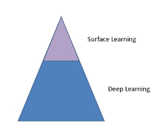
Is Surface Learning Ever Superior?
The “Chinese Paradox”

Slide 39
rachel@teachprimarymandarin.com
www.teachprimarymandarin.com

Slide 40
References:
Deep Learning in Effective English Teaching Strategy of Senior High, Ning Yueying, Zhu Xiaodong, 4th International Education, Economics, Social Science, Arts, Sports and Management Engineering Conference (IEESASM 2016)
New Pedagogies For Deep Learning, Fullan et al (2019)
Teaching Chinese as a Second Language, Orton and Scrimgeour, (2019)
Bringing deep learning to the surface: A systematic mapping review of 48 years of research in primary and secondary education, Øystein Winje Knut Løndal , NJCIE, Vol. 4(2), 25-41 (2020)
Evaluating the reading and listening outcomes of beginning‐level Duolingo courses, Jiang et al, Foreign Language Annals. 2021;54:974–1002 (2020)
Deep Learning In Language Teaching and Learning, Ahmed Hussein Eid (2022)
The why, what and how of deep learning: critical analysis and additional concerns, Kovac et al, (2023)
Enacting deep learning in foreign language pedagogy, Joseph Shaules and Troy McConachy, The Warwick Research Archive Portal (WRAP), (2023)

