Slide 1
Unlocking Success from Day One:
Insider Top Tips for
New/Early-Career Mandarin Teachers
By Zakary Twist
zgt@whitgift.co.uk

Slide 2
What most excites you about starting as a Teacher of Mandarin?
What makes you most worried about being a Teacher of Mandarin?
For brand new teachers:
What do you enjoy most about the job?
Which aspects of the jobs do you find most difficult?
For early-career teachers:

Slide 3
Unlocking Success from Day One:
Insider Top Tips for
New/Early-Career Mandarin Teachers
By Zakary Twist
zgt@whitgift.co.uk

Slide 4

Who am I?
BA Chinese and Russian – University of Leeds (2015)
Shanghai Jiao Tong University
MA Translation and Interpreting – University of Manchester (2020)
PGCE Mandarin and Spanish – UCL Institute of Education (2021) – Grey Court School and Seven Kings School
Teacher of Mandarin, Spanish, and Russian at Whitgift School

Slide 5
Purpose of presentation
To share my insight from the inside
To save you time
To maximise the effectiveness of your teaching and resources
If not my own idea, to credit the sources of these tips throughout my career so far
Notes:
- Four years in, I have been mentored and supported by a large number of experts
- Planning my first lessons used to take me a long time
- Looking back, there was a lot I wish I had known from the start to make the job easier and better support students

Slide 6
Presentation content
1. Pinyin and Characters: how to bridge the gap
2. Support the weaker students early
3. Thinking smartly about your resources
4. The Power of Pedagogy
5. “Culture Shock”
6. Organise trip/activities to give it context
7. Teach to your strengths
Notes:
- Presentation will cover the following 7 points
- Together, I believe these 7 points can significantly benefit teachers at the beginning of/or early into their teaching journey.

Slide 7
1. Pinyin and Characters: how to bridge the gap
Cognitive load required to learn three pieces of information too high
How can we support our students to bridge the gap?
Vocabulary tests in two parts
Josh Ma
Notes:
- My current mentor, Josh Ma, presented here a number of years ago on the difficulty for students of learning Chinese vocabulary
- Unlike other language, three skills need to be combined, with the added difficulty of character and tones
- This has revolutionised my teaching and students say that this approach has made the language more manageable

Slide 8
LISTENING
SPEAKING
READING
WRITING
Listening comprehension
Chinese sounds to English meaning
Spoken response
English ideas to Chinese sounds_
Reading comprehension
Chinese characters to English meaning
Writing Skill
Character practice_
Written response
English ideas to Chinese characters_
Character acquisition
Chinese sounds to Chinese characters
Sound acquisition
Chinese characters to Chinese sounds _
Dictation (听写)*
Chinese sounds to Chinese Characters and English meaning _
Notes:
- Discussion of different skills of learning Mandarin – Green done before Red

Slide 9
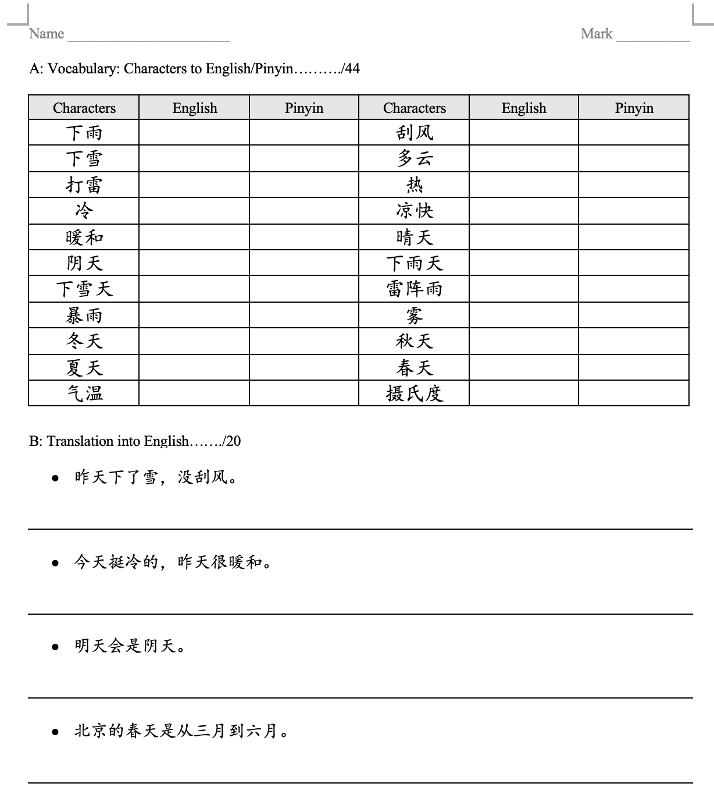
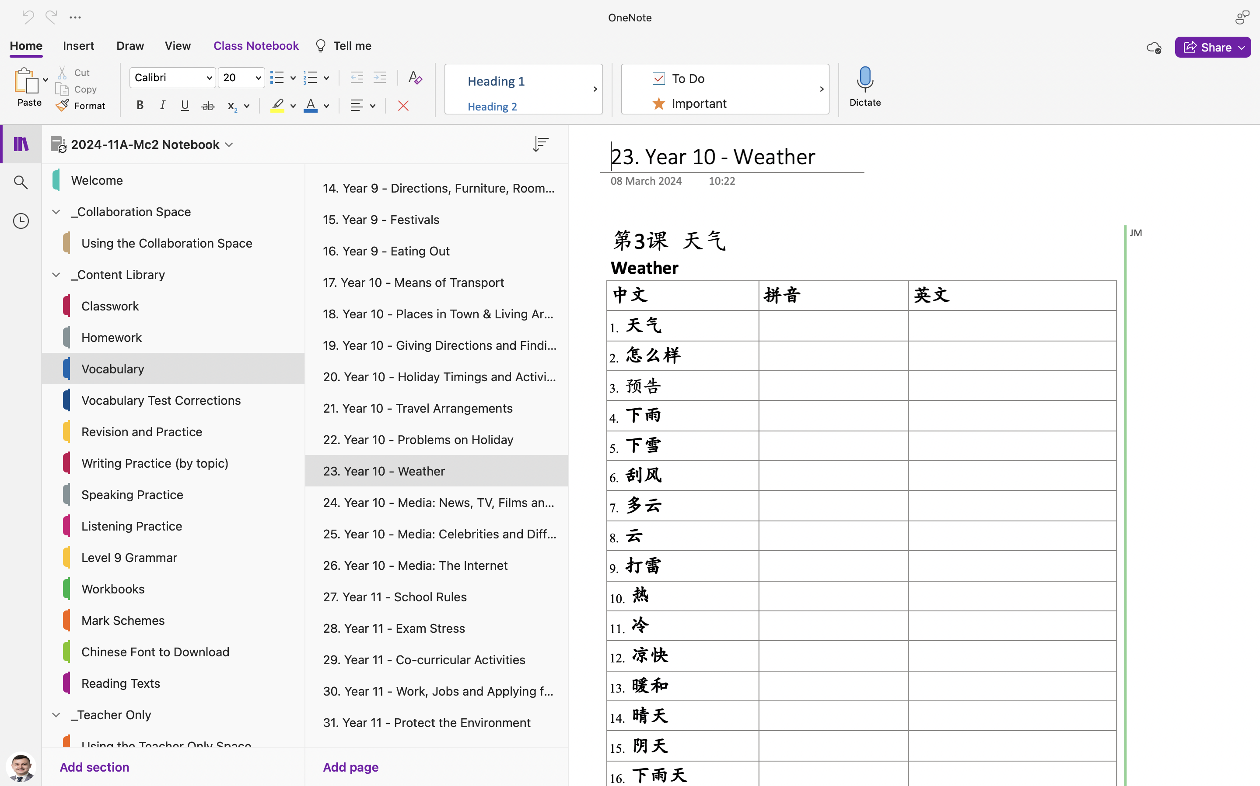
Notes:
Vocabulary tests purely for recognition

Slide 10
2. Support the weaker students early
Weekly support sessions: are they struggling or are they not giving enough time to the subject?
Xiaoming Zhu
Notes:
- Chinese is not an easy language to cram revision for
- People that are weak from the off will be weak throughout without proper, timely support
- Many students simply do not give enough time to vocabulary practice
- Vocabulary the backbone of the language – all skills fall into place when vocabulary is secure

Slide 11
2. Support the weaker students early
Thematic writing support
Myself
Notes:
- Getting ideas for the writing exam very hard for some students
- Thinking how the language they know can be used in an essay difficult
- Showing them:
dn’t need every word to write an essay
Ideas do not need to be overly complicated

Slide 12
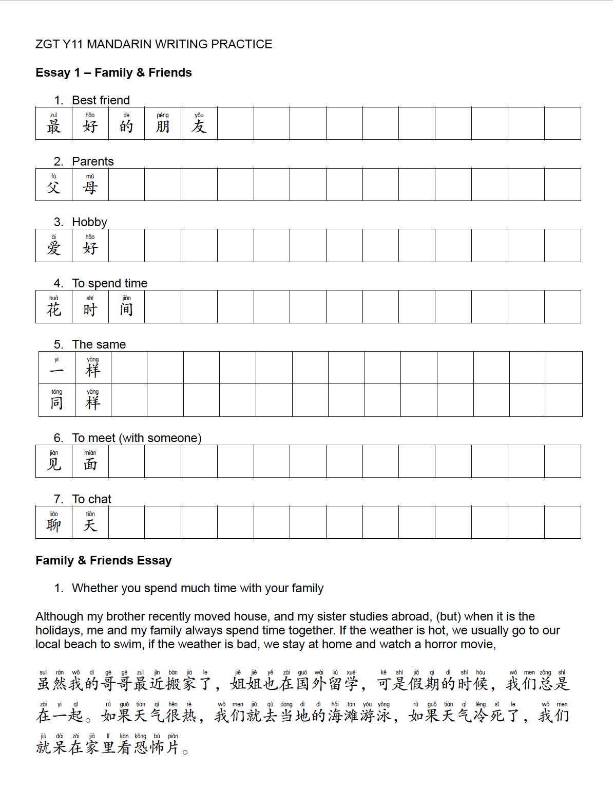
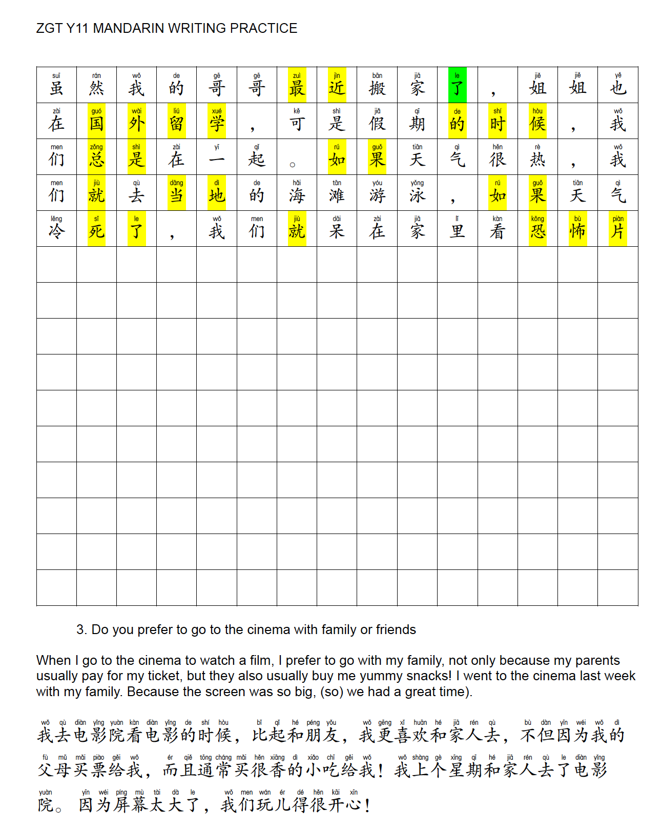
Yellow = easy, high-scoring grammar points
Green = examples of different tenses

Slide 13
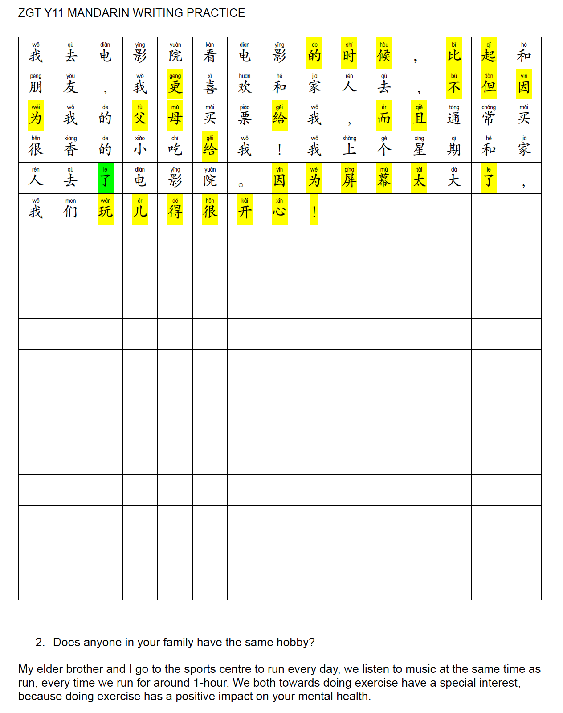
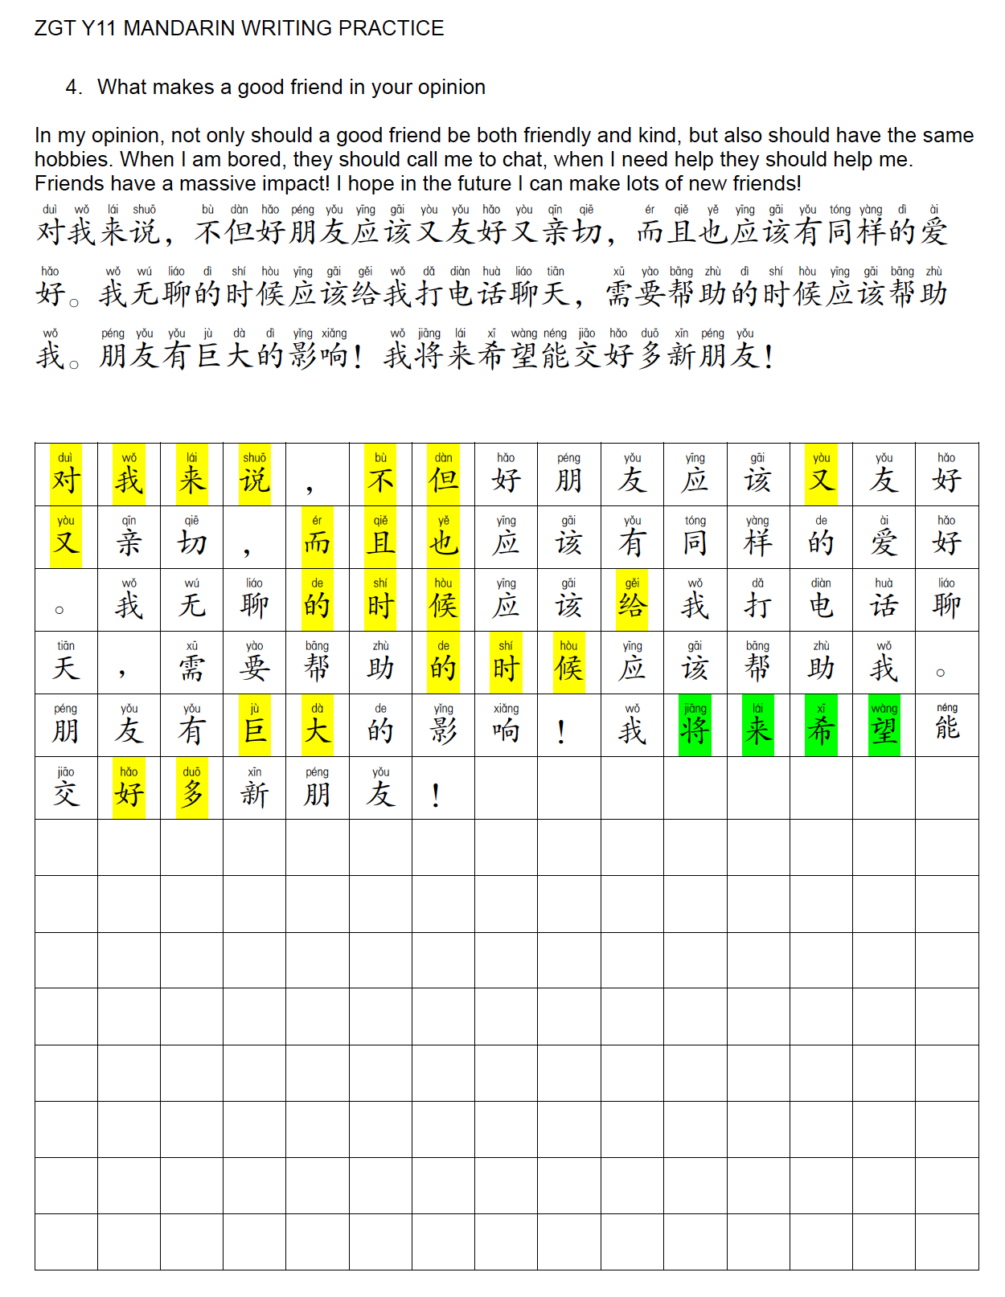
Yellow = easy, high-scoring grammar points
Green = examples of different tenses

Slide 14
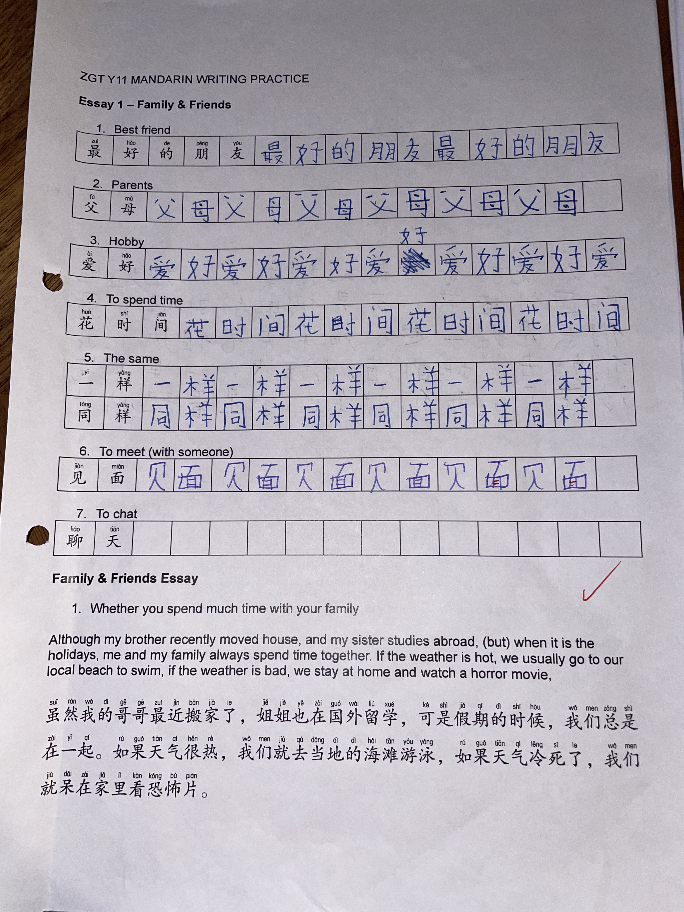
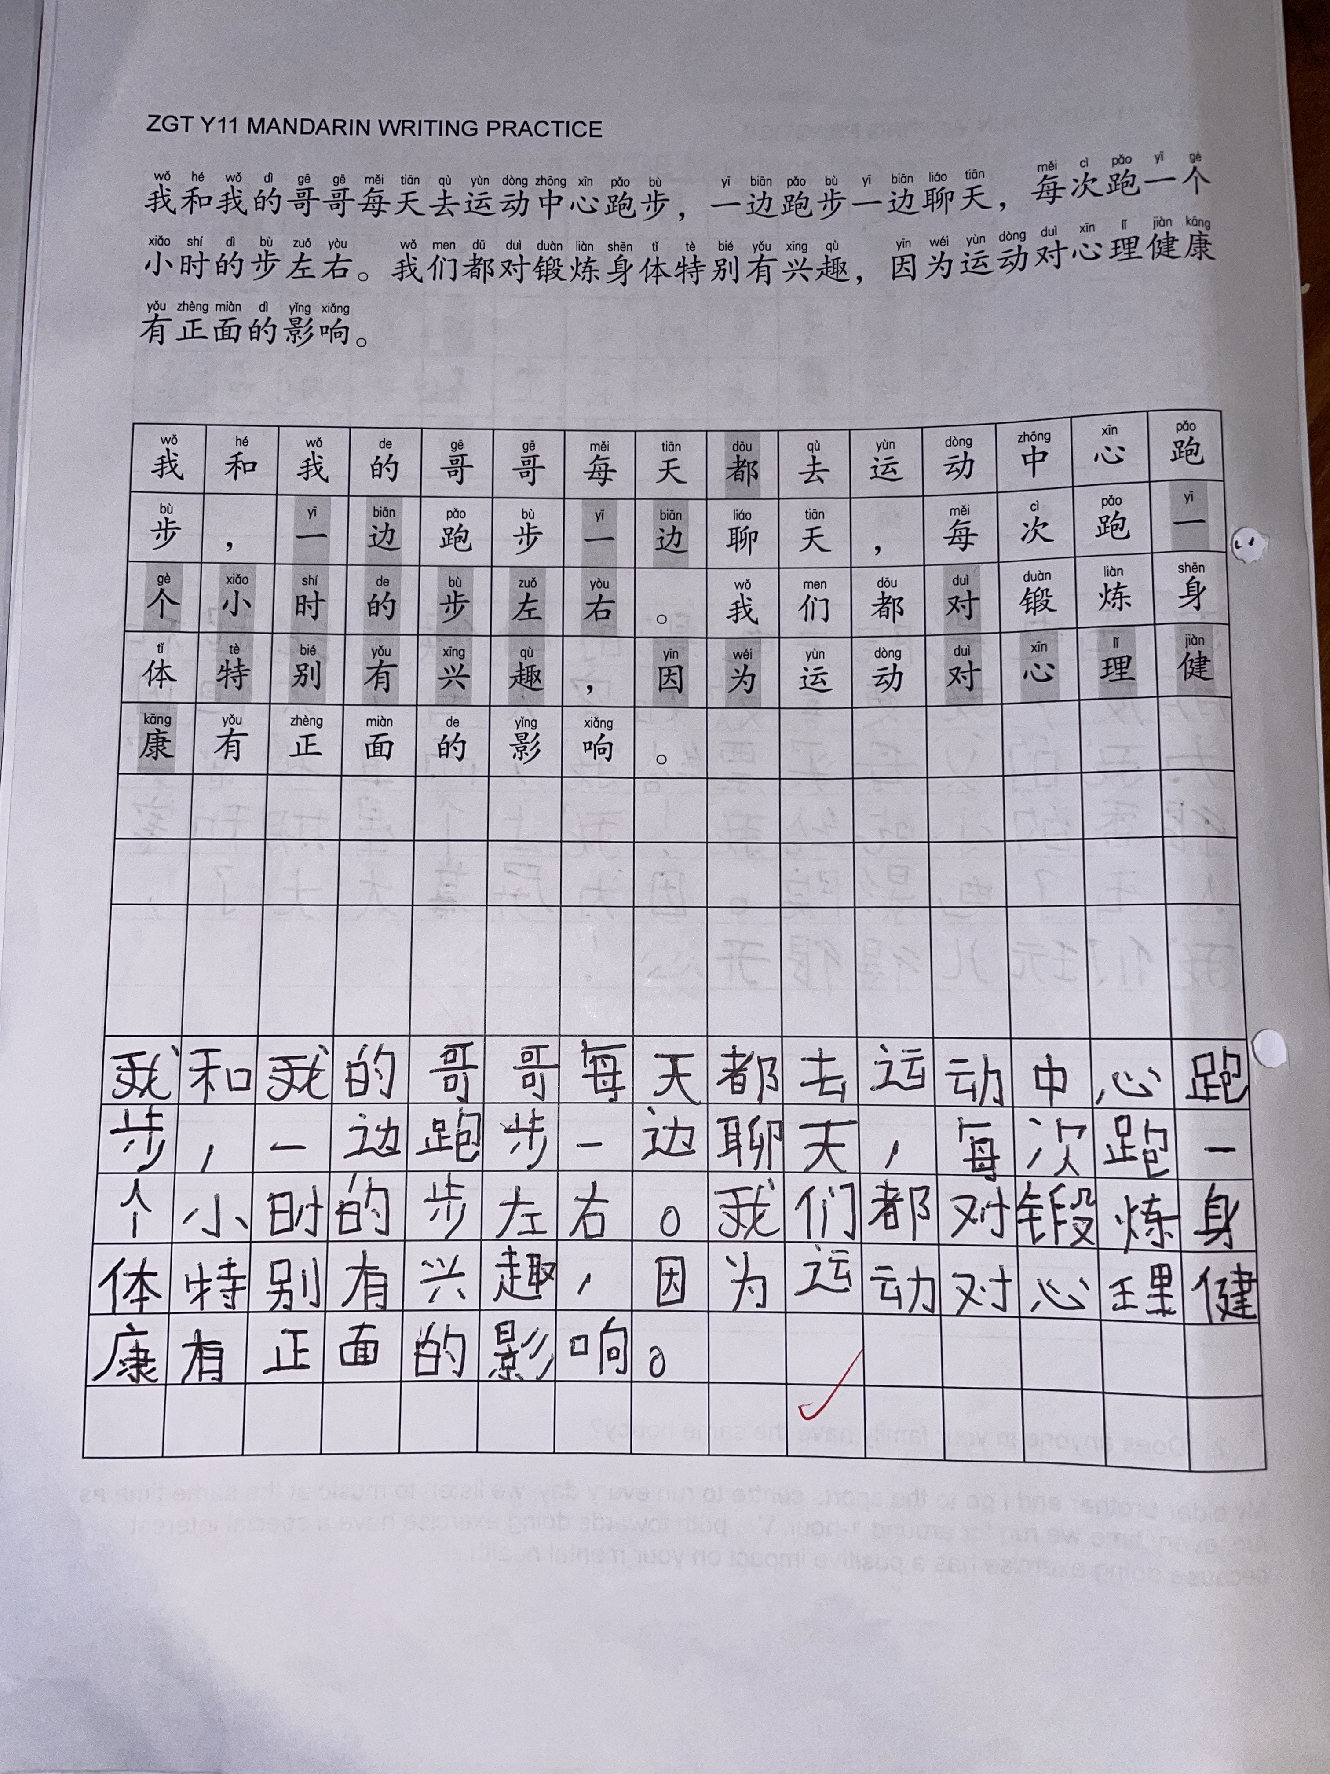
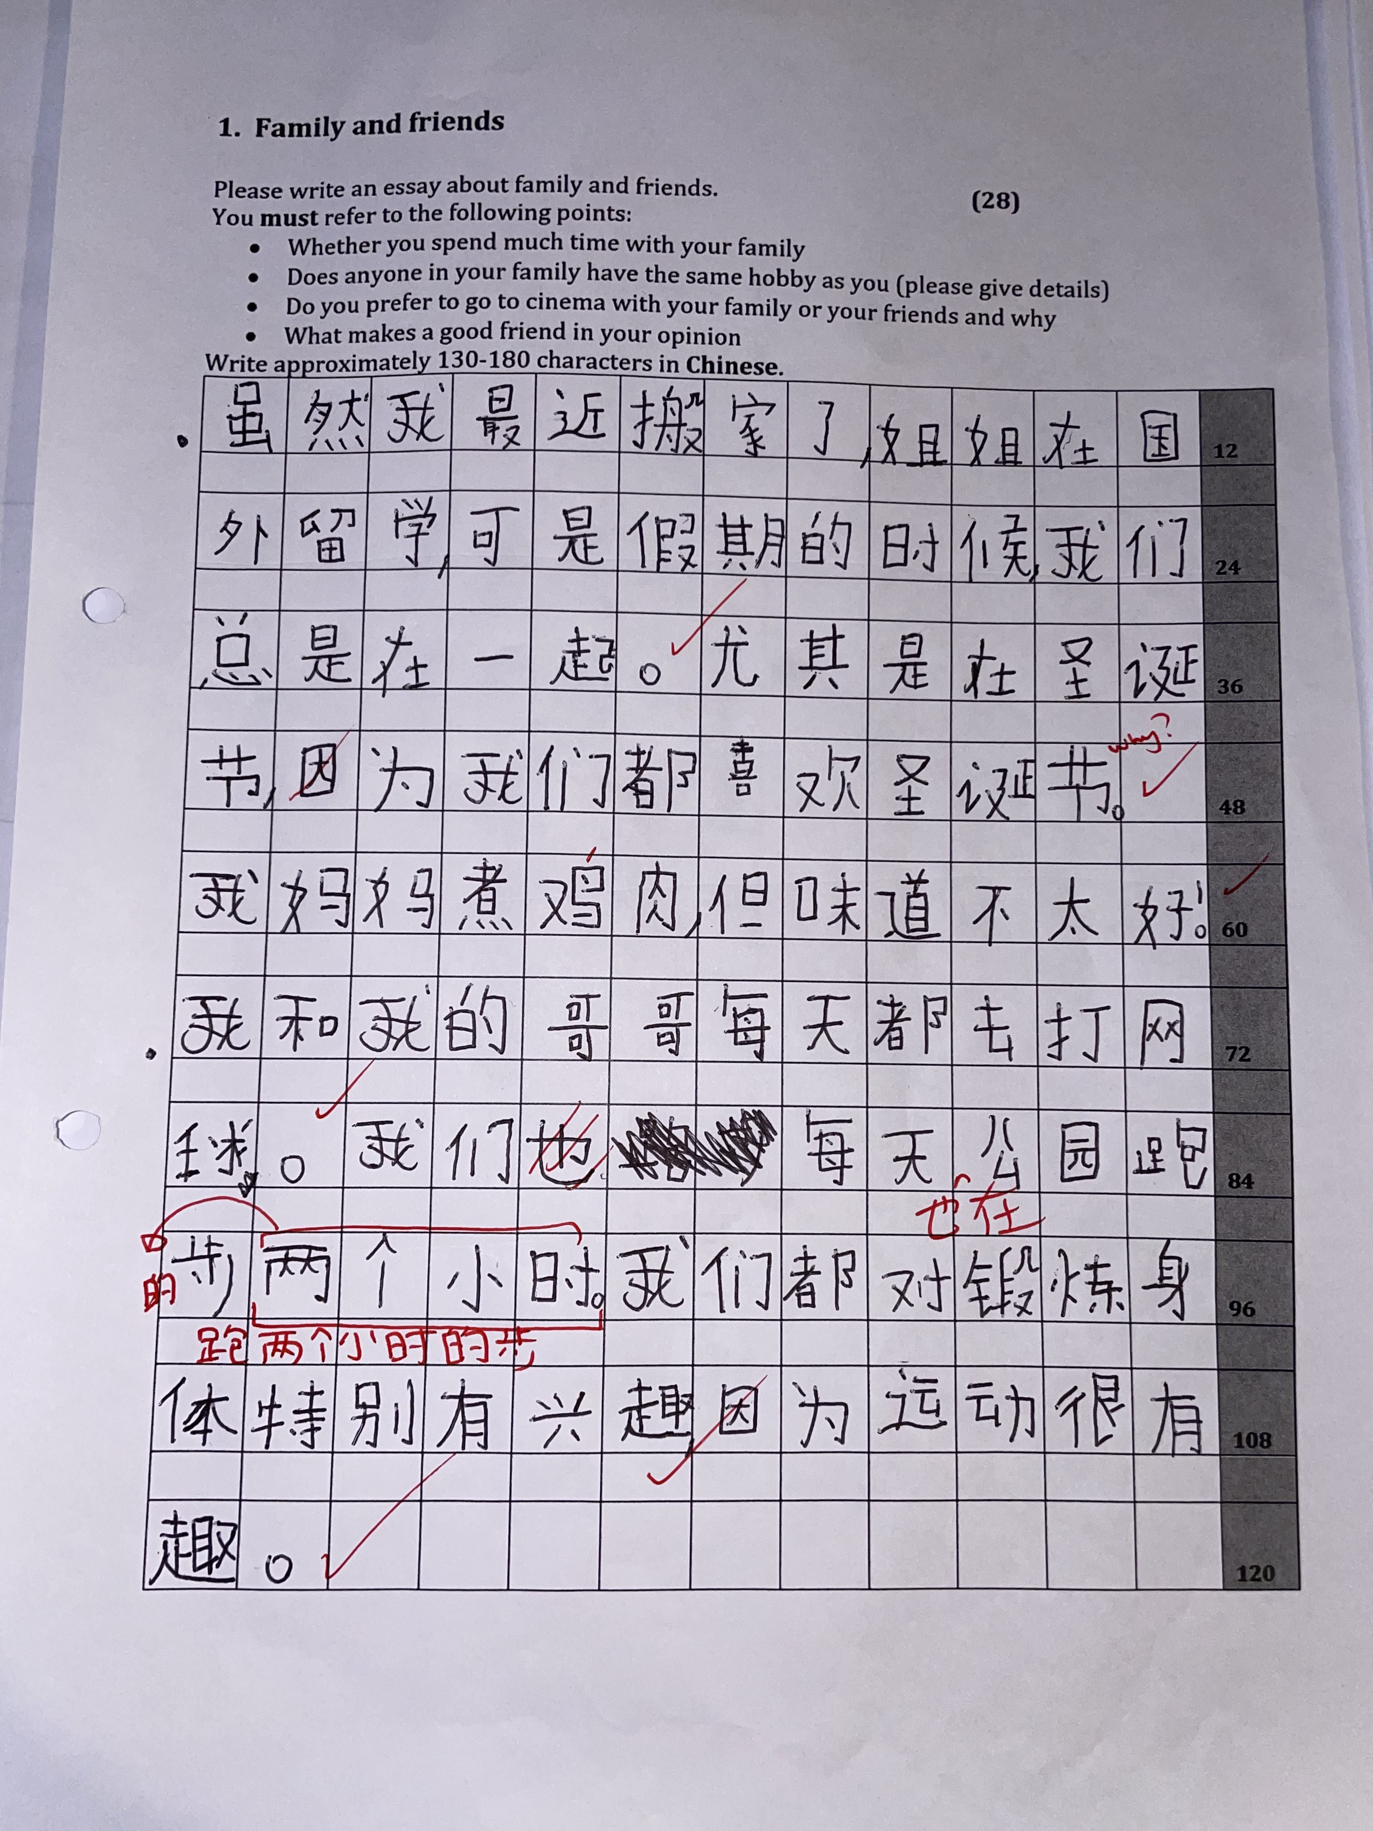
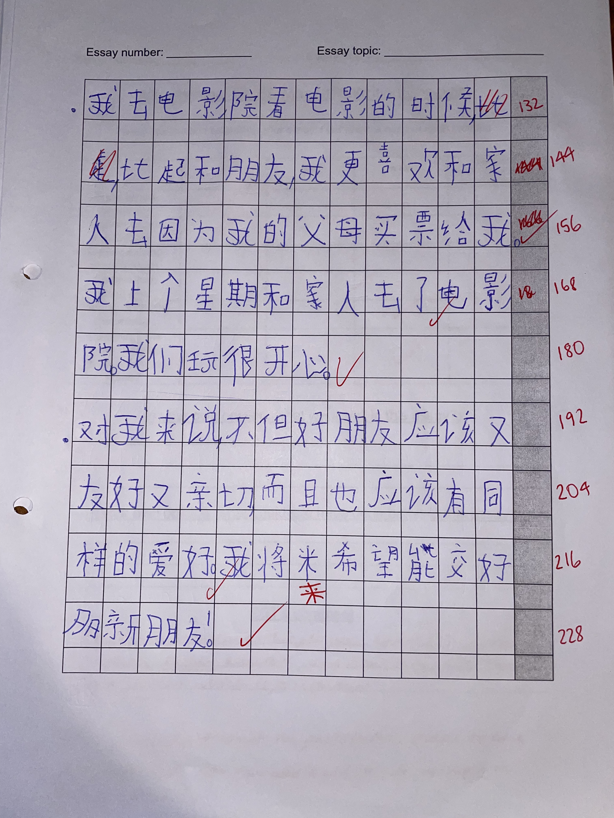

Slide 16
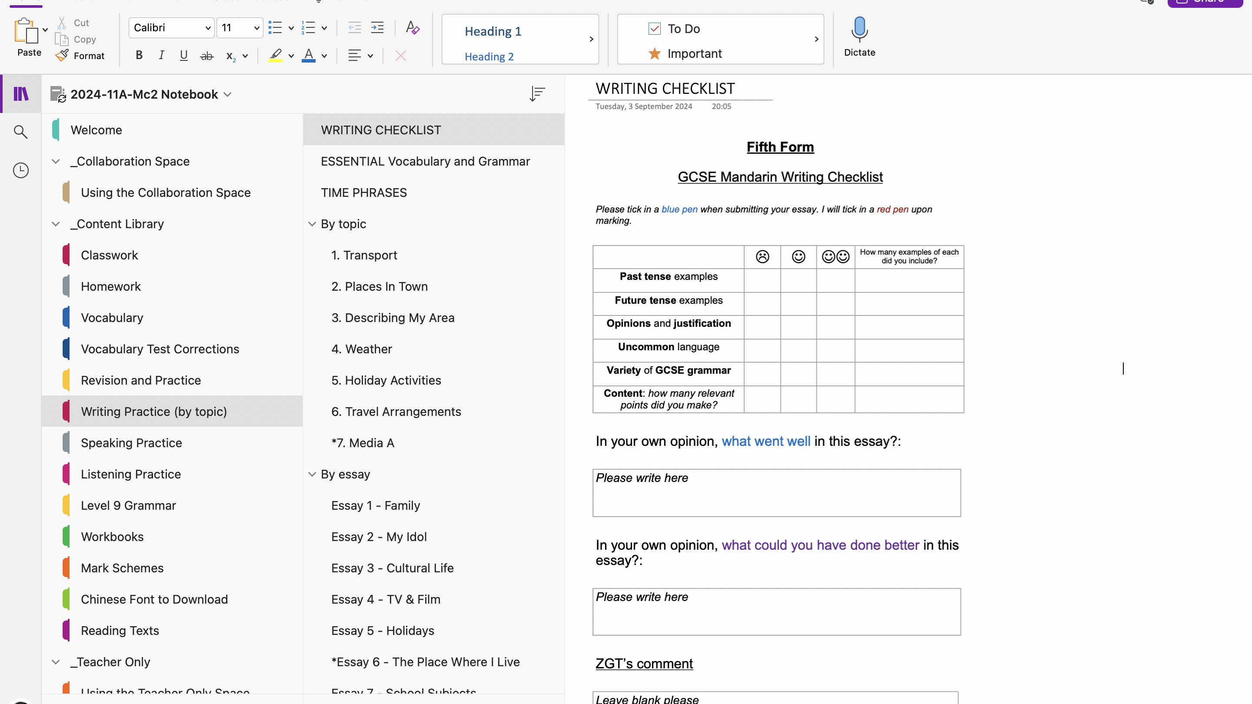
Notes:
- All available online
- Checklist for writing

Slide 17
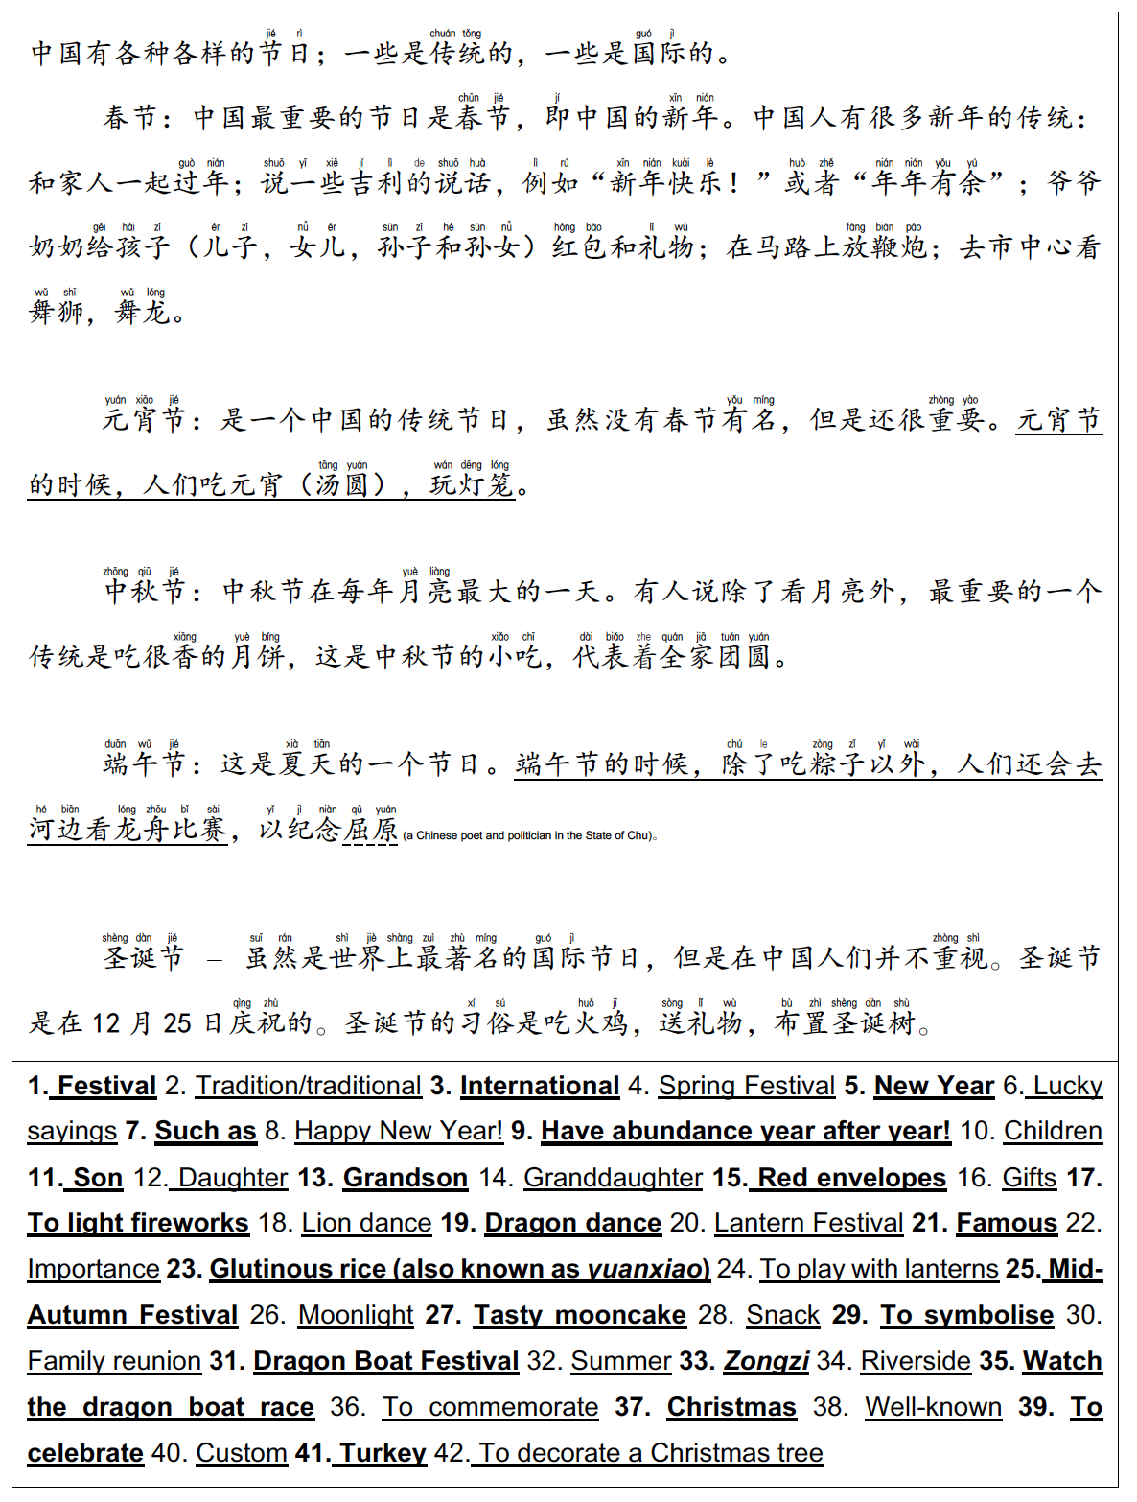
3. Thinking smartly about your resources
High-quality, multi-use resources with longevity
Myself
Notes:
- texts with vocabulary in context
- recorded for listening file
- lots of grammar in it to study and unpick (implicit)

Slide 18
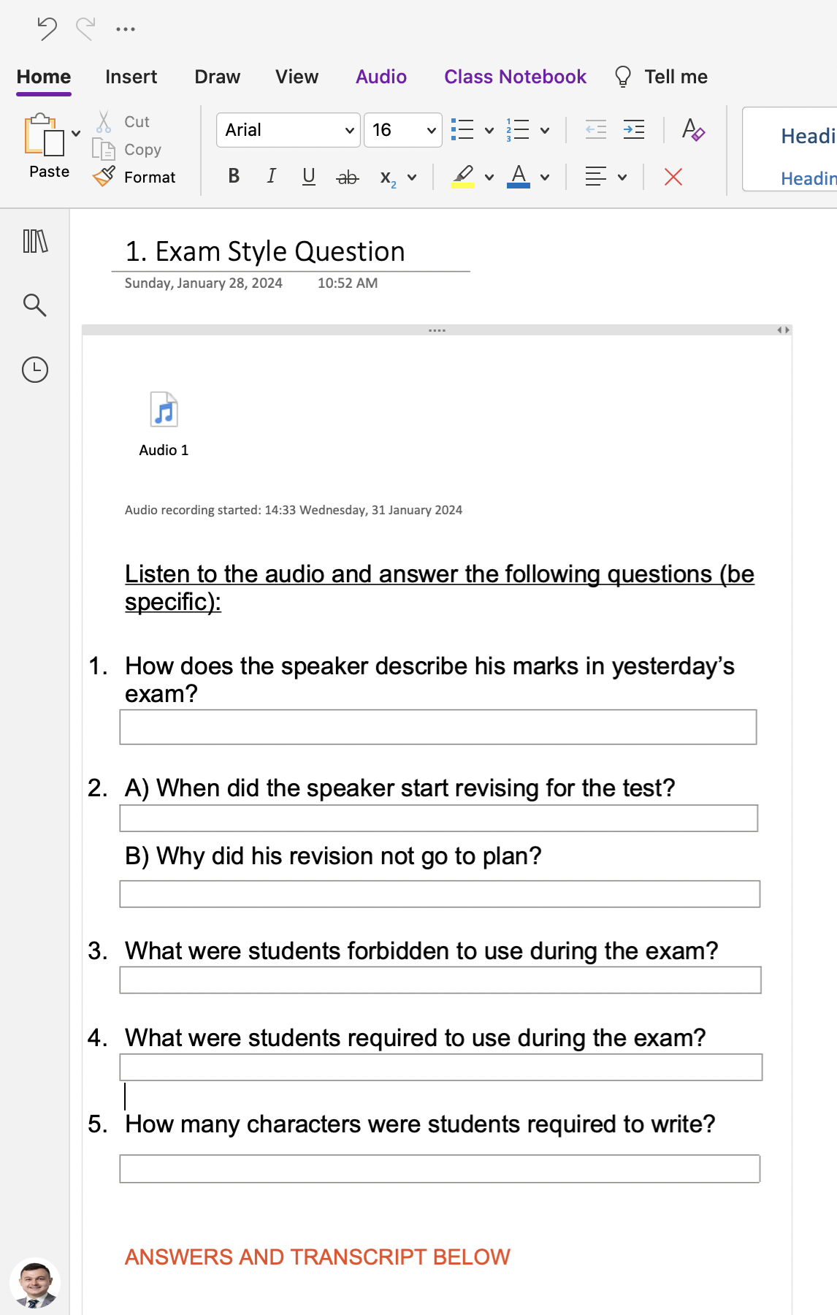
3. Thinking smartly about your resources
Tailor-made listening exercises centred around grammar
Myself
Notes:
- Listening exam very difficult for students
- Marks nationally very low in this paper
- Grammar increasingly being used to conceal answers
- My own listening activities teach them to hear how grammar impacts meaning, just like Edexcel

Slide 19
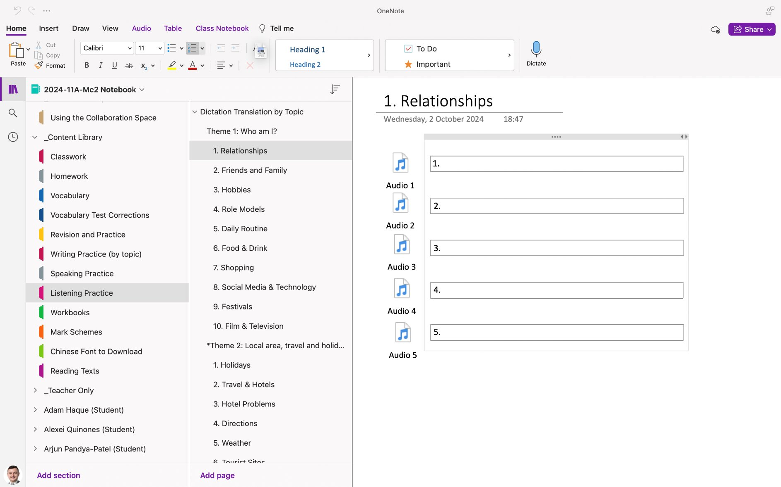

Slide 20
3. Thinking smartly about your resources
Resource banks
Josh Ma
Notes:
- Once aware of what skills need to be tested, can create resource bank
- Saves time and you can rely on the efficacy of the tasks

Slide 21
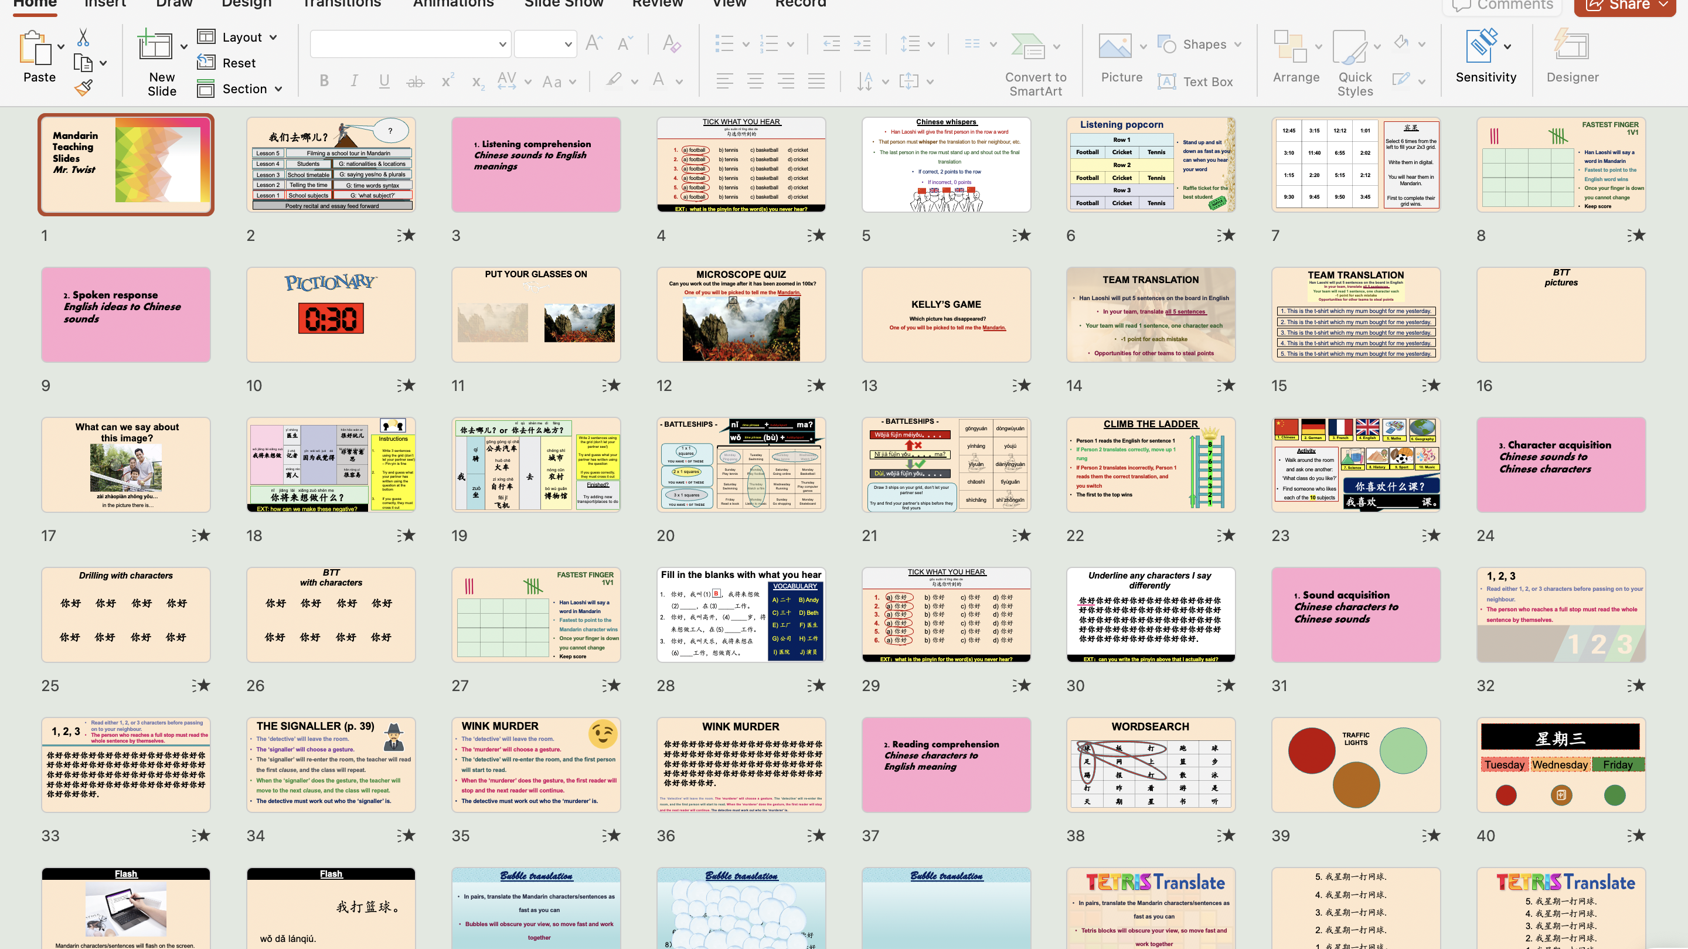
IN ORDER OF DIFFERENT LANGUAGE ACQUISITION SKILLS
Notes:
- simply copy and paste vocabulary into the activities
- Makes keeping your lessons engaging and varied easy

Slide 22
– the “Big Picture”
Lesson Plan
Listening comprehension
Chinese sounds to English meaning
Spoken response
English ideas to Chinese sounds_
Character acquisition
Chinese sounds to Chinese characters
Homework
Typing work
(vocab or texts)
Week 1
Character acquisition
Chinese sounds to Chinese characters
Sound acquisition
Chinese characters to Chinese sounds_
Reading comprehension
Chinese characters to English meaning
Homework
Writing (vocab)
Week 2
Reading comprehension
Chinese characters to English meaning
Writing skill
Character practice_
Written response
English ideas to Chinese characters_
Homework
Writing (texts)
Week 3

Slide 23

Planning a lesson
Listening comprehension
Chinese sounds to English meaning
Spoken response
English ideas to Chinese sounds_
Character acquisition
Chinese sounds to Chinese characters
Homework
Typing
(vocab or texts)
Week 1
activity 1
activity 2
activity 3
activity 4
activity 5
activity 1
activity 2
activity 3
activity 4
activity 5
activity 1
activity 2
activity 3
activity 4
activity 5
Lesson 1
Lesson 1
Lesson 2
Lesson 2
Lesson 3

Slide 24
3. Thinking smartly about your resources
Speaking exam resources
Myself
Notes:
- Understanding the questions one of the biggest difficulties for weaker students

Slide 25
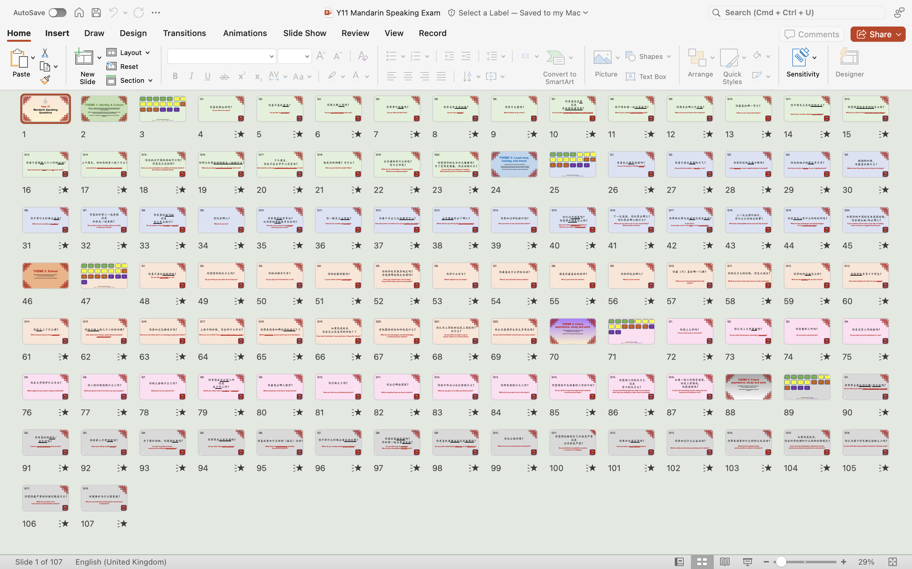
Notes:
- Record them for their practice

Slide 26


Year 11
Mandarin Speaking Questions
ZGT – Whitgift School

Slide 27
THEME 1: Identity & Culture
Who am I? - relationships; when I was younger; what my friends and family are like; what makes a good friend; interests; socialising with family and friends; role models
Daily life - customs and everyday life; food and drink; shopping; social media and technology (uses of, advantages and disadvantages)
Cultural life - celebrations and festivals; reading; music; sport; film and television
ZGT – Whitgift School

Slide 28
1
2
3
4
5
6
7
8
9
10
11
12
13
14
15
16
17
18
19
20
Click a panel to hear a question
Green = * / Yellow = ** / Red = *** / Purple = Level 8/9

Slide 29

Q1.
你喜欢做运动吗？
Do you like to do sport?

Slide 30
4. The Power of Pedagogy
Keep up-to-date
Don’t get too stuck in your ways
Caroline Conlon
Notes:
- Theory, by its definition, will not always work
- One theoratical approach that works with one class may not work with another
- Keeping up-to-date on pedagogy keeps your teaching fresh, prevents you from getting stuck in your ways
- You could find something that works very well
- Lots available now on Twitter and Tes

Slide 31
Modelling writing
ME
WE
YOU
Notes:
- One such theory that works well with my KS4 students

Slide 32
Write 130-180 characters on the following points:
Describe your local area (Croydon)
The advantages and disadvantages of living in Croydon
A recent commute in Croydon
Do you plan to live in Croydon when you are older?

Slide 33
Describe your local area
Ideas | Vocabulary | Structures
郊区
市中心
凯顿
各种各样
奥林匹克球场
Introduction to Croydon (location/distance/duration)
KS4 locations
What you can do at these places
离
将近
的 (attributive)
又 又
ME

Slide 34
Describe your local area
ME
Ideas | Vocabulary | Structures
Introduction to Croydon (location/distance/duration)
KS4 locations
What you can do at these places
郊区
市中心
凯顿
各种各样
奥林匹克球场
离
将近
的 (attributive)
又 又
我住在伦敦的郊区《凯顿》，离市中心不太远，坐火车要将近二十分钟。
在凯顿的附近有各种各样的地方：比如，有奥林匹克球场，
是看运动
比赛的地方，还有又大又美的公园，每天许多人去那儿玩儿。

Slide 35
The advantages
of living in Croydon
Ideas | Vocabulary | Structures
对我来说
贵
方便
环境
安静
好处
虽然
但是
几
极了/挺。。。的
Transport
Scenery
ME

Slide 36
ME
The advantages of living in Croydon
Ideas | Vocabulary | Structures
对我来说
贵
方便
环境
安静
好处
虽然
但是
几
极了 / 挺。。。的
Transport
Scenery
对我来说，凯顿的好处是虽然交通挺贵的，但是非常方便，因为
有十几个火车站。
此外，公园有很大的湖，在湖上有很可爱
的鸭子， 空气新鲜极了。

Slide 37
The disadvantages
of living in Croydon
Ideas | Vocabulary | Structures
WE

Slide 38
A recent commute in Croydon
Ideas | Vocabulary | Structures
YOU

Slide 39
Do you plan to live in Croydon when you are older?
Ideas | Vocabulary | Structures
YOU

Slide 40
4. The Power of Pedagogy
Implicit Grammar Teaching
Is the time needed worth it?
Camilla Smith
Notes:
- Let them work out the grammar for themselves
- More memorable if they have had to problem solve to understand it
- More reflective of how we naturally learn languages

Slide 41
5. “Culture Shock”
Bargaining – Y8
Feng shui for furniture – Y9
MEP – dumplings recipes – Y9
Brand name translation – Y13
Alex Ferraby
Notes:
- Explicit teaching of culture
- Culture and language inextricably linked
- Gives context to the language
- Great for inspiring students who are not so keen on the language
- Great for retention and ideas for speaking/writing

Slide 42

6. Organise activities/trips to give it context
Olivia Song
Notes:
To increase motivation amongst students
Good for student retention
Gives students context for what they are learning
Makes China not seem quite so far away

Slide 43
What anyone can do…

Slide 44
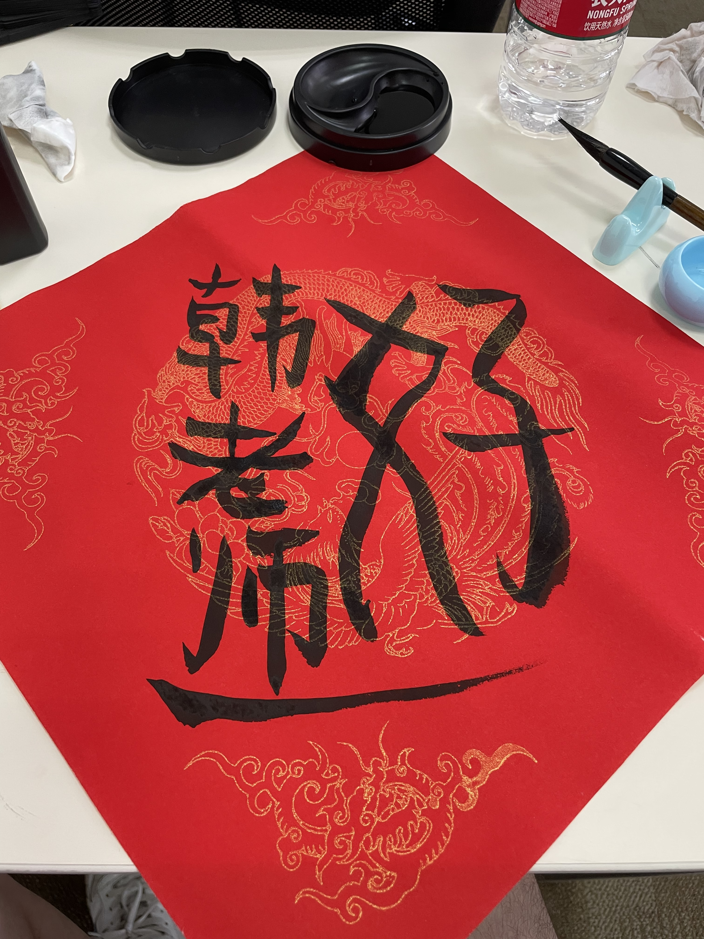
Extra- and cross-curricular: cooking, music, poetry, culture, calligraphy
Notes:
- Fairly easy to organise
- Once organised once, can be reused year after year
- All departments want cross-curricular involvement – languages well placed to do so

Slide 45

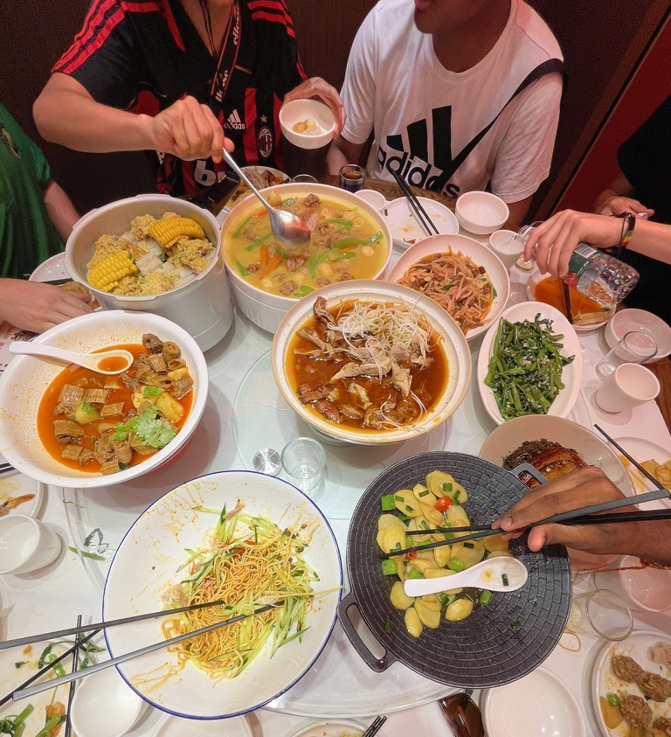
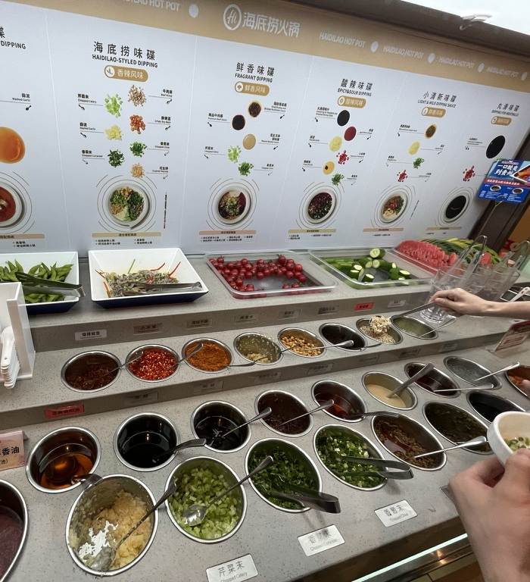
Go to a Chinese restaurant, Wing Yip, bubble-tea store…
Notes:
- Eating out can be such a culturally significant activity for students
- Many students will never have been to a Chinese restaurant/eaten with chop sticks
- Great for retention

Slide 46
External providers coming into school
Notes:
- Lion/dragon dance
- Calligraphy classes
- Let someone else do the hard work

Slide 47





Going to China!
Notes:
- This will be the best school trip they have ever been on
- The language immersion is second-to-none
- Retention
- If affordable, external agencies can do the organisation for you

Slide 48
What London-based teachers can do…

Slide 49



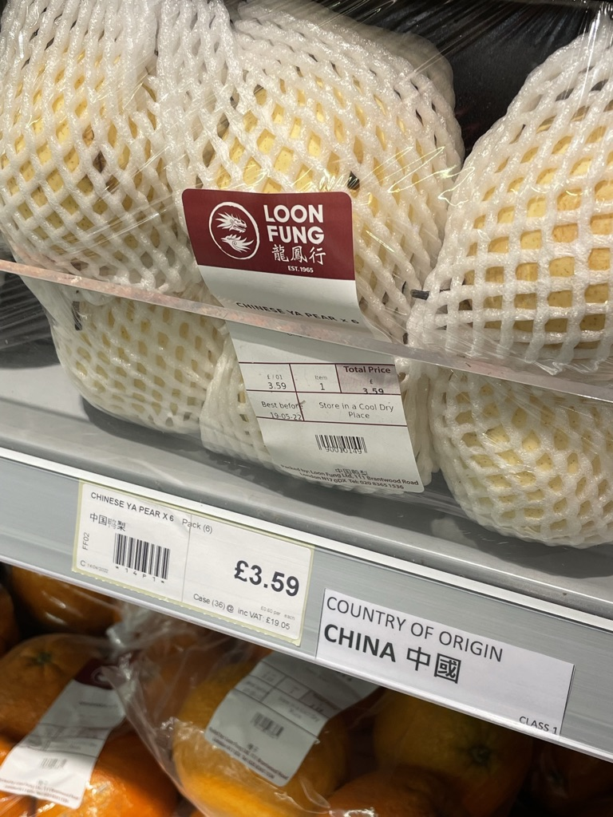
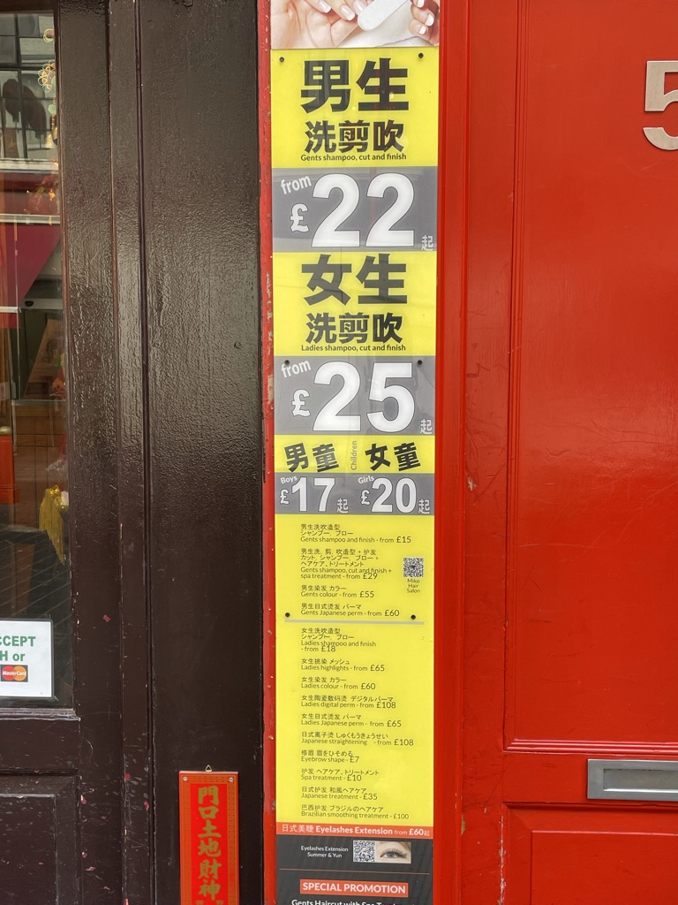
Going to China Town and the British Museum
Notes:
- China Town very easy trip to organise
- China Exchange (tours)
- photo competitions
- treasure hunts
- Restaurants
- Bubble tea
- Many students will never have been, despite living in London
- British Museum has fantastic China section
- Make them see Chinese more than just a language but tied to a culture

Slide 50
7. Teach to your strengths
What interests do you have?
How can you include it into your lessons?
Children are more likely to be inspired if you are enthusiastic!
Andy Hunt
Notes:
- My translation and interpreting MA large part of my teaching
- Can talk about it in great depth but in a way they understand
- They love hearing about this area of the language as it isn’t a part of the GCSE / A-Level courses
-

Slide 51
1. Pinyin and Characters: how to bridge the gap
2. Support the weaker students early
3. Thinking smartly about your resources
4. The Power of Pedagogy
5. “Culture Shock”
6. Organise trip/activities to give it context
7. Teach to your strengths

Slide 52
Myself
Caroline Conlon
Alex Ferraby
Olivia Song
Xiaoming Zhu
Josh Ma
Camilla Smith
Andy Hunt

Slide 53
Please discuss in your tables:
Do you have any ideas that could benefit everyone else in the room?
Have you tested them out? If so, what were the results?
Time-saving tips
Trip ideas
Club/society ideas
Pedagogical theories
Ways to support the bottom band
Ways to support the top band
Useful resources
Sources with longevity

