Slide 1





Story Listening and Story Asking Lucy Wicks, Head of Chinese and SLE Didcot Girls’ School, Oxfordshire lwicks@didcotgirls.oxon.sch.uk
First, an introduction… A bit about me ☺
19+ years of teaching German, Spanish, Mandarin and French (also Business Studies) in 3 UK comprehensive schools
1 year of teaching English in Beijing (and many years of self-study of Chinese since then)
Currently teach on Oxford University MFL PGCE programme, leading the CFL strand
SLE – assisting other schools to set up and teach Chinese, develop curriculums for KS2 to KS5

Slide 2


Compelling and Comprehensible Input
Research: (Mason, 2023)
70 Hours of comprehensible Input = 286 Hours of Traditional Instruction
WHAT
WHY
HOW
Take part OR use checklist
Watch videos
Discuss pros/cons
Later
further research
Practice (on friends and family)
Try out on a KS3 class and get their feedback. . refine, continue
Story Listening (in Spanish)
Story-Asking ("TPRS" and circling) –In Mandarin
Reflect/discuss

Slide 3
Conference: Session PLan
What-Why-How
Part 1: Story Listening
- GET Trial class – warm up – Choco-La-Te
Story Listening – la vaca que decía oink
Quiz on words (multi-choice?) –other options to follow up
Highlight methods use (see checklist) –Q+A?
Part 2: Story Asking /TPRS
‘new’ class – pre-teach Qu words (take signs)
co-create a story –No – Yes – OR – Qu word
Write the story?!
Methods used (checklist)

Slide 4
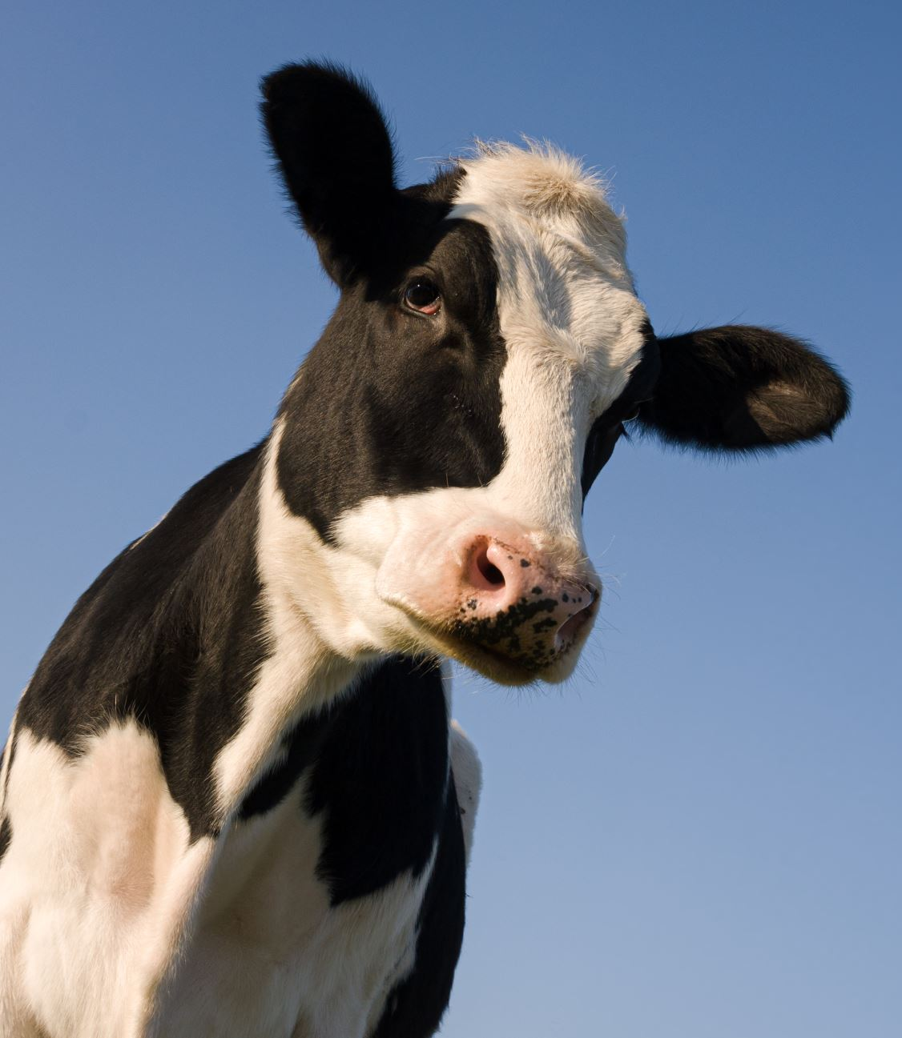
Story Listening – La Vaca que decía Oink!

Slide 5


L.E.S.S. is more!!
Listen and Look to understand
Enjoy the present moment
Show me that you get it
Show me when you don't

Slide 6

WARM UP

Slide 8
Story Listening: La vaca que decía “oink”
Which of these words can you now translate into English? (talk with a partner)
Vaca decía
Granja se reían
Gato escucha
Pato attentamente
Cerdo hablan
Triste/ contenta idiomas

Slide 9
Story Listening: La vaca que decía “oink”
Which of these words can you now translate into English? (talk with a partner)
Vaca cow decía says
Granja farm se reían laughed
Gato cat escucha listen
Pato duck attentamente carefully
Cerdo pig hablan speak
Triste/ contenta sad/happy idiomas languages

Slide 10
Story Listening: La vaca que decía “oink”
CHALLENGE: how do you say?
Cow
Pig
Farm
Happy
speak

Slide 12
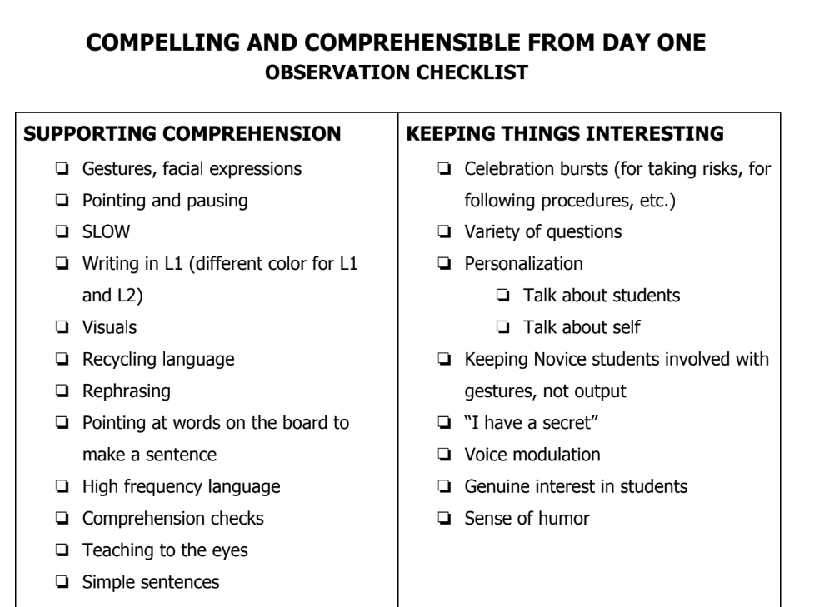

Slide 13
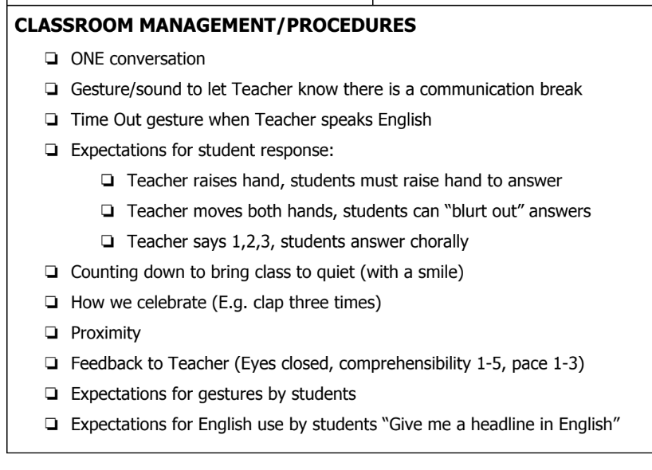

Slide 14
Story-Asking / TPRS
Teach Qu words and key verbs from story in advance (gestures)

Slide 15

¿Qué?
¿Quién?
¿Dónde?
shénme?
shéi?
nǎlǐ / nǎr?
What?
What?
Who?
Where?
Who?
Where?
ma 吗 | ?
hái shì 还是 | or
Notes:
Tong xue men
Yes-duì
No- bù duì
Or-hai shi
And-huh
Also-ye
With-gen
Because-yin wei
But-ke shi

Slide 16
¿Qué?
¿Quién?
¿Dónde?
shénme?
shéi?
nǎlǐ / nǎr?
What?
What?
Who?
Where?
Who?
Where?
jiào
叫
shì
是
to be called
is
zài
qù
xiǎngyào
在
去
想要
to be at/in
goes to
wants
(Méi) yǒu
shuō
说
没有
says
Has/have (not)
Notes:
Tong xue men
Yes-duì
No- bù duì
Or-hai shi
And-huh
Also-ye
With-gen
Because-yin wei
But-ke shi

Slide 17
Story-Asking / TPRS
Teach Qu words and key verbs from story in advance (gestures).
2) Say a statement and ask questions ('circle') until you're sure that they understand.

Slide 18


¿Qué?
¿Quién?
¿Dónde?
shénme?
shéi?
nǎlǐ / nǎr?
What?
What?
Who?
Where?
Who?
Where?
ma 吗 | ?
hái shì 还是 | or
可口可乐
Duì Bú duì
Notes:
Tong xue men
Yes-duì
No- bù duì
Or-hai shi
And-huh
Also-ye
With-gen
Because-yin wei
But-ke shi

Slide 19
Circling –with each part of the sentence
NO question e.g. ¿ es un chico? (no)
YES question e.g. ¿ es una chica? (si)
OR question e.g. ¿ es un chico o una chica? (es un chica)
Qu word e.g. ¿ Quién es? (Es una chica)

Slide 20
¿Qué?
¿Quién?
¿Dónde?
shénme?
shéi?
nǎlǐ / nǎr?
What?
What?
Who?
Where?
Who?
Where?
有 一 个 男 孩。
Yǒu yī gè nánhái.
There is a boy.
yǒu有 | there is
méi yǒu没有 | there is not
可口可乐
wǒ = I | wǒmen = we
nǐ = you | nǐmen = you all
tā = s/he/it | tāmen = they
ma 吗 | ?
hái shì 还是 | or
Notes:
Tong xue men
Yes-duì
No- bù duì
Or-hai shi
And-huh
Also-ye
With-gen
Because-yin wei
But-ke shi

Slide 21
¿Qué?
¿Quién?
¿Dónde?
shénme?
shéi?
nǎlǐ / nǎr?
What?
What?
Who?
Where?
Who?
Where?
有 一 个 男 孩。
Yǒu yī gè nánhái.
There is a boy.
没有 女 孩。
yǒu有 | there is
méi yǒu没有 | there is not
méi yǒu nühái
可口可乐
wǒ = I | wǒmen = we
nǐ = you | nǐmen = you all
tā = s/he/it | tāmen = they
ma 吗 | ?
hái shì 还是 | or
Notes:
Tong xue men
Yes-duì
No- bù duì
Or-hai shi
And-huh
Also-ye
With-gen
Because-yin wei
But-ke shi

Slide 22
Story-Asking / TPRS
Teach Qu words and key verbs from story in advance (gestures).
2) Say a statement and ask questions ('circle') until you're sure that they understand.
3) Allow their INPUT into the story, they can choose names/ages/details of appearance and people the person meets along the way...

Slide 23
¿Qué?
¿Quién?
¿Dónde?
shénme?
shéi?
nǎlǐ / nǎr?
What?
What?
Who?
Where?
Who?
Where?
他 叫 ....
Tā jiào ....
He is named …..
可口可乐
wǒ = I | wǒmen = we
nǐ = you | nǐmen = you all
tā = s/he/it | tāmen = they
ma 吗 | ?
hái shì 还是 | or
Notes:
Tong shuo men
Yes-shì
No- bù shì
Or-hai shi
And-huh
Also-ye
With-gen
Because-yin wei
But-ke shi

Slide 24
¿Qué?
¿Quién?
¿Dónde?
shénme?
shéi?
nǎlǐ / nǎr?
What?
What?
Who?
Where?
Who?
Where?
...........是 男 孩。
…........shì nánhái.
.............is a boy.
.......不 是 女 孩
bu shì nühái.
可口可乐
wǒ = I | wǒmen = we
nǐ = you | nǐmen = you all
tā = s/he/it | tāmen = they
是 | is/yes
不是 | is not/no
Notes:
tóngxuémen
Yes-duì
No- bù duì
Or-hai shi
And-huh
Also-ye
With-gen
Because-yin wei
But-ke shi

Slide 25

¿Qué?
¿Quién?
¿Dónde?
shénme?
shéi?
nǎlǐ / nǎr?
What?
What?
Who?
Where?
Who?
Where?
….........在 California.
...........zài California.
可口可乐
…............is in California.
ma 吗 | ?
hái shì 还是 | or
wǒ = I | wǒmen = we
nǐ = you | nǐmen = you all
tā = s/he/it | tāmen = they

Slide 26
Story-Asking / TPRS
Teach Qu words and key verbs from story in advance (gestures).
2) Say a statement and ask questions ('circle') until you're sure that they understand.
3) Allow their INPUT into the story, they can choose names/ages/details of appearance and people the person meets along the way...
4) Give them chance to recap periodically. (n.B. comprehension is more important than production.)

Slide 27


There is a boy.
There is no girl.
He's called …..
He is a boy.
He is not a girl.
He is in California.
He is not in Didcot.

Slide 28

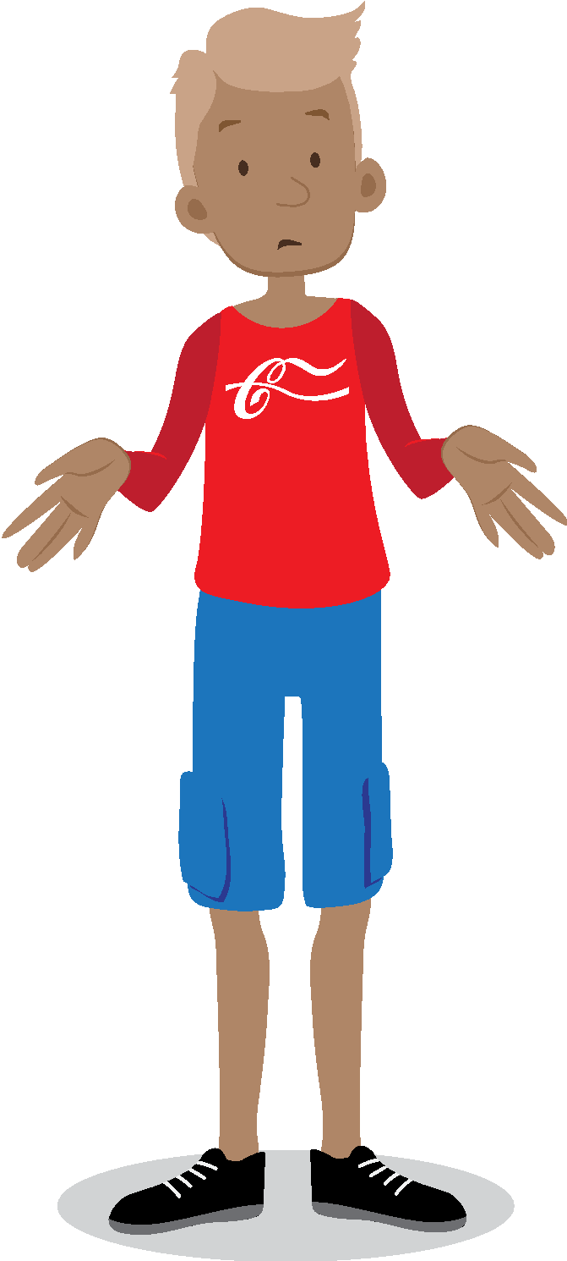
¿Qué?
¿Quién?
¿Dónde?
shénme?
shéi?
nǎlǐ / nǎr?
What?
What?
Who?
Where?
Who?
Where?
.............. 想要 可乐。
xiǎngyào kělè.
可口可乐
wǒ = I | wǒmen = we
nǐ = you | nǐmen = you all
tā = s/he/it | tāmen = they

Slide 29

¿Qué?
¿Quién?
¿Dónde?
shénme?
shéi?
nǎlǐ / nǎr?
What?
What?
Who?
Where?
Who?
Where?
George 不 高兴。
George bù gāoxìng.
George is not happy.
可口可乐
wǒ = I | wǒmen = we
nǐ = you | nǐmen = you all
tā = s/he/it | tāmen = they
¿Cómo?
¿Cuántos?
¿Por qué?
zěnme...?
jǐ gè?
wèishénme?
How?
How many?
Why?
How?
How many?
Why?

Slide 30

¿Qué?
¿Quién?
¿Dónde?
shénme?
shéi?
nǎlǐ / nǎr?
What?
What?
Who?
Where?
Who?
Where?
George 没 有 可乐。
George méi yǒu kělè.
George doesn’t have a Cola.
yǒu有 | have/yes
méi yǒu没有 | don’t have/no
可口可乐
wǒ = I | wǒmen = we
nǐ = you | nǐmen = you all
tā = s/he/it | tāmen = they
¿Cómo?
¿Cuántos?
¿Por qué?
zěnme...?
jǐ gè?
wèishénme?
How?
How many?
Why?
How?
How many?
Why?

Slide 31


¿Qué?
¿Quién?
¿Dónde?
shénme?
shéi?
nǎlǐ / nǎr?
What?
What?
Who?
Where?
Who?
Where?
George 去 Chicago.
George qù Chicago.
George goes to Chicago.
wǒ = I | wǒmen = we
nǐ = you | nǐmen = you all
tā = s/he/it | tāmen = they
可口可乐
¿Cómo?
¿Cuántos?
¿Por qué?
zěnme...?
jǐ gè?
wèishénme?
How?
How many?
Why?
How?
How many?
Why?

Slide 32
Story-Asking / TPRS
Teach Qu words and key verbs from story in advance (gestures).
2) Say a statement and ask questions ('circle') until you're sure that they understand.
3) Allow their INPUT into the story, they can choose names/ages/details of appearance and people the person meets along the way...
4) Give them chance to recap periodically. (n.B. comprehension is more important than production.)
5) Have skeleton story in mind but go where they want to...

Slide 33
TPRS Top Tips
Don’t tie vocab to the curriculum
Have a problem that is solved the third time
5-10 min bursts of input followed by comprehension check
Don’t force output (i.e. speaking)
Take time to practice/do research before you start

Slide 34


Watch video example / further research later
Diane Neubauer
https://www.youtube.com/@DianeNeubauer
Dr. Terry Waltz
https://www.youtube.com/@terrywaltz9167
Comprehensible Chinese
https://www.youtube.com/@ComprehensibleChinese
Cecile Laine
https://www.youtube.com/@TowardProficiency
Alice Ayel
https://youtube.com/playlist?list=PLD0666ZhOzwhyOzXQN7lxY8-K_UIRakJL&si=hmCkPHNe5dPVCHIg
Megan Hayes
https://www.youtube.com/channel/UCO8pXWUthVr4tSsqvqDU87A
Adriana Ramirez
https://www.youtube.com/@learningthroughreading
Haiyun Lu
https://www.youtube.com/@haiyunlu9759
Blabla Chinese
https://www.youtube.com/@blablachinese7526
TIPS on these techniques:
Martina Bex
https://www.youtube.com/@comprehensibleclassroom
Liam Printer
Kathrin Shechtman
https://www.youtube.com/@kathrinshechtman
Naturlich German
https://youtu.be/34bTlvYw8AE?si=1EDH-0Y9idDnxNoI

Slide 35

Some examples (use checklist)
Story Listening
https://youtu.be/N0ICDg4fsIM?si=tLPCtlTvyCbV9Ezw
MOVIE TALK – Snack Attack
https://youtu.be/Q7G8oVAlgBU?si=gtT65_r76gTFSUJM

Slide 36
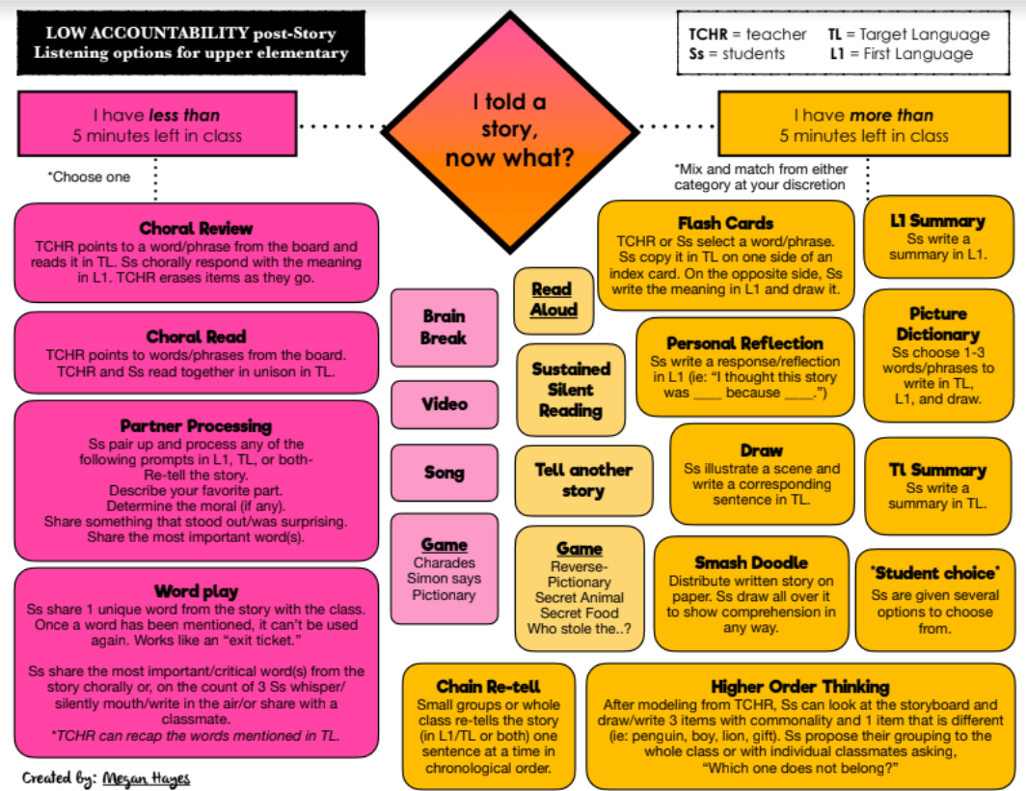
S volunteer to Rub off words they can pronounce and translate
Gallery Walk
-Students are given phrases from the story, mixed up.
They move round the class in pairs, matching the sentences on their sheet to the pictures on walls
Timed Write
Students aim to write as many relevant sentences from the story (or creating their own stories) as possible. Count words. Compare with last time. This should NOT be corrected.

