Slide 1
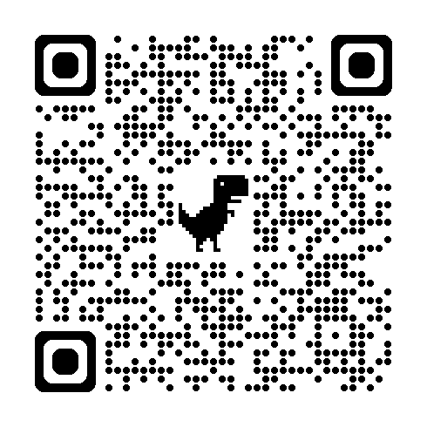
A few questions for Year 11 teachers:
How do we know what topic(s) students need to work on?
How do students know?
How can students revise for the last few weeks?
How do you help ALL students revise for the final exams?
Please use the QR code to share your answers/practices.
Please log into your Google Drive for this session.

Slide 2

In my ideal world, there should be a system that ...
has topic-based vocabulary
provides appropriate grammar points
assesses reading/listening skills
assesses writing/speaking skills
runs retrieval practice
collects cumulative data
offers targeted practice

Slide 3
WHAT IS QLA AND HOW CAN IT HELP YOUR STUDENTS REVISE FOR GCSE?
Andrew Zhang
mandarinresourcesharing@gmail.com

Slide 4
Question Level Analysis (QLA)
A question level analysis sheet (QLA) is a spreadsheet for recording individual question scores on an assessment to achieve an overall analysis of a student or a class performance.
You can generate personalised student reports to give to each student for use in revision.
--- Sparx Maths

Slide 5
DEMO

Slide 6
Validity
What if it is only a careless mistake?
What if students are not feeling well on that day or just being nervous?
What about a longer or shorter question on the same topic?
There are not enough evidence – only a few questions on the certain topic.
standard tests only
a starting point
gives students something to work on for the last few weeks

Slide 7
How to create one?
Each year’s test papers are different, therefore we need to adapt every year

Slide 8
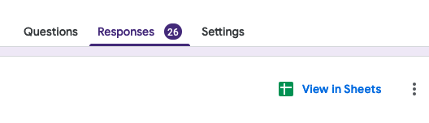
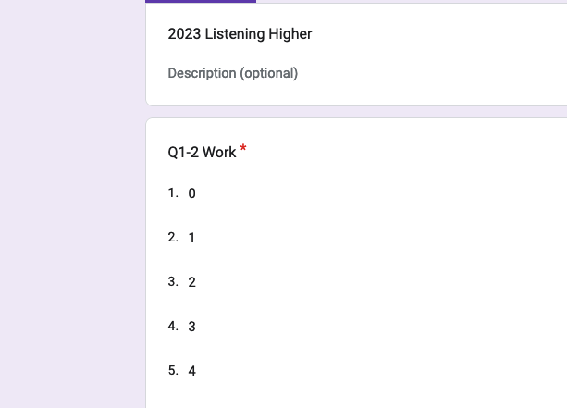
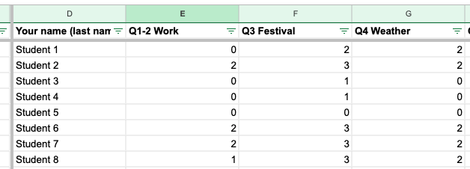
Step 1 Collect data
Create a Google form based on each test paper (question type: drop down)
Share via link or QR code
View Responses in Sheets

Slide 9
Step 2 Copy and paste data to template
Copy names
Copy data from individual test paper

Slide 10
Step 3 Print student copy
Check printout before printing

Slide 11


DIRT Lesson
Whole-class explanation
Individual work with DIRT videos

Slide 12
WHAT NEXT?
How do we help all students revise?

Slide 13
QLA + MISSING TOPICS + KNOWLEDGE ORGANISER
= INDIVIDUALISED REVISION PLAN
after the 2nd mock

Slide 14
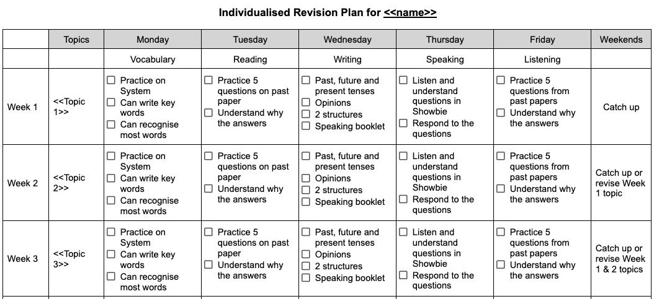
Sample

Slide 15
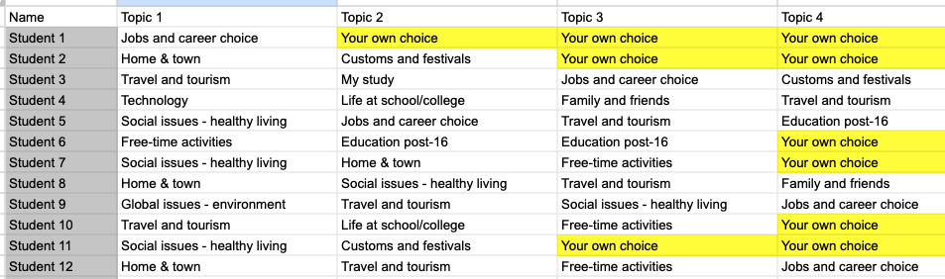
Step 1 Identify topics in Google Sheets
Topics for improvement
Topics that are not in the tests

Slide 16
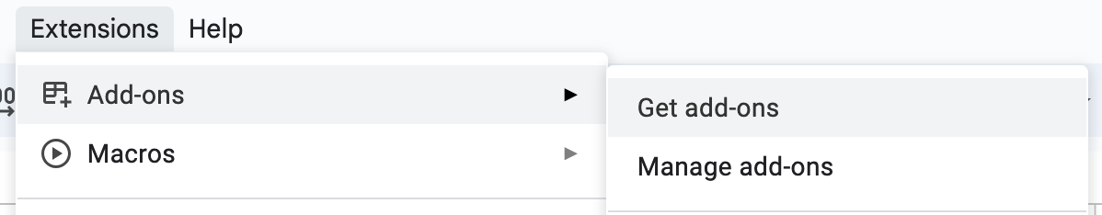
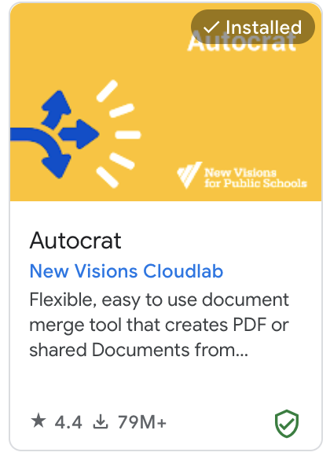
Step 2 Add Autocrat to Google Sheet
New Google Sheet 🡪 Extensions 🡪 Add-ons 🡪 Get add-ons

Slide 17
Step 2 Design revision plan in Google Docs
<<>> used to show what you would like to map to

Slide 18
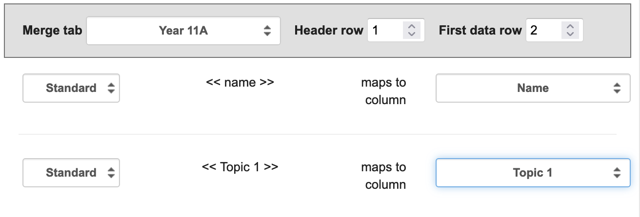
Step 4 Generate individualised revision plan
Open Revision Plan Google Sheets
Extensions 🡪 Autocrat 🡪 Open
New Job 🡪 Name your merge job 🡪 Choose template (Revision plan template) 🡪 Map source data to template: Merge tab, <<>> maps to column
File setting then Next all the way
Existing job

Slide 19
Reminder
Adapt for students who are really struggling
  Should be more specific
  Easy to achieve

Slide 20
Q & A
and Thank you!

