Slide 1
Inclusive Practices within the Diverse 21st Century Chinese Classroom.
2024
Declan Arden (he/him), MEd, GradDipTeach, BA

Slide 2
Reflective Thinking and Practice
2024
In this presentation, we will aim to:
reflect critically on our own practice in how we can improve it,
challenge our preconceptions rather than focus on what we do ‘wrong’,
learn and build on from each other's ideas and experiences,
respect others’ views, opinions, and experiences,
create a safe-space for all to share and grow.

Slide 3





OVERVIEW SLIDE
2024
Why EDI?
Inclusive Praxis
Confronting Bias
What does the research show us?
How can we action EDI pedagogy and praxis in the classroom?
How does what we say and do influence inclusive praxis?
Celebrating Diversity
Question and Answer
What are our teachers doing already?
An opportunity for open dialogue and discussion.

Slide 4
Why EDI?
2024
What does the research show us?

Slide 5
Heritage and Ethnicity
2024
Student Heritage by Ethnicity (2023/24)
Student Heritage and Ethnicity
36.6% of secondary school pupils in the UK are from a minority ethnic background (1.2% increase from 2021/22).
18.6% of state-funded secondary school pupils’ first language is known or believed to be other than English.
Source: (Office for National Statistics, 2021, 2023, 2024)

Slide 6
Family Life
2024
UK Families by Family Type (2023/24)
Family types of the UK
Married or civil-partnered couple families only made up 66% of families in 2023; remaining 18% cohabiting and 16% lone-parent families.
2.4% of families are lone-father, 13.9% are lone-mother.
Source: (Office for National Statistics, 2021, 2023, 2024)

Slide 7
Other Considerations
Over 1.6 million pupils in the UK are identified as having SEND.
LGB+ identifying people make up 3.2% of the UK population, with numbers likely higher.
Across both England and Wales, 17.8% (10.4 million) of the population is disabled.
Of all families living in households: 43% had 1 or more children (19.35% 1-child, 17.63% 2-children, 6.02% 3+ children), 42% had no children, and 16% had only adult children.
Source: (Office for National Statistics, 2021, 2023, 2024)
2024

Slide 8
What does the research show?
2024
LGBTQ+ Representation in British Chinese Language Textbooks.
Reinforcement
Book | Opposite Sex Couple | Same Sex Couple | Lone Parent Unit | Other Parental Unit | Total
Jìn bù 1 | 36 | 0 | 4 | 12 | 52
Jìn bù 2 | 37 | 0 | 5 | 5 | 47
Edexcel | 42 | 0 | 19 | 18 | 79
Mandarin B | 24 | 0 | 7 | 0 | 31
The use of textbooks within classrooms can unintentionally reinforce gender and sexuality stereotypes, often reiterating the notion of binary gender assignment and heteronormative familial disposition (Nemi Neto, 2018) centred on the Western nuclear family (Sarkisian & Gerstel, 2012), despite a noted decline in recent years across Western countries (Pilkauskas & Cross, 2018; Saggers & Sims, 2005).
Source: (Arden & Pillay, 2024).
Notes:
Changes in understanding of gender and sexuality – no long a binary system.
Effects of section 28 – while slowly changing, are still being felt 20 years on.

Slide 9
Inclusive Praxis
2024
How can we action EDI pedagogy and praxis in the classroom?

Slide 10
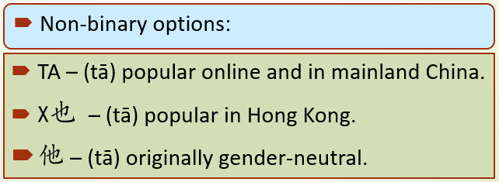
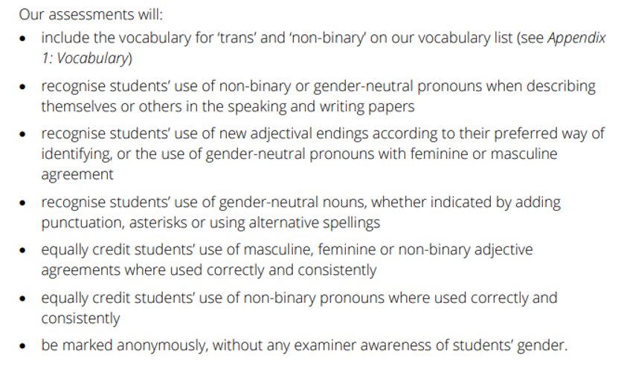
Gender Neutral Language
2024
Options originating from Queer individuals in Chinese-speaking countries and communities:
伊 – popular in Shanghai.
Notes:
Movements are already underway in GCSE for teaching in 2024, with first assessments in 2026, to allow for more inclusivity surrounding assessments in European languages.

Slide 11

Authentic Representation
While this requires queer teachers and students to act on behalf of the community, their authenticity and representation of the community will be largely influenced by their own identity and experiences.
Additional caution must also be taken to reduce legitimacy issues if inauthentic texts promote values and voices not shared by the minority or queer students (Morgan & Clarke, 2011).
Sources from authentic lives and experiences that can be adapted into the classroom/content.
Avoidance of reliance on stereotyping.
2024
Notes:
Can a heterosexual man authentically represent a gay character?

Slide 12
Confronting Bias
2024
How does what we say and do influence inclusive praxis?

Slide 13
Bias in the Classroom
Student: Initials (Gender) – Nationality | GAJ (F) – BR | 3 | Number of times selected to answer question.
 | BA (M) – NG | 3
 | TP (F) – BOT | 3
 | FG (M) – POL | 3
 | KM (M) – LIT | 3
 | SS (M) - SIK | 3
 | KJ (M) - LIT | 3
 | DI (M) – BR | 3
 | SB (F) - IND | 2
 | MD (M) – FRE | 2
 | DG (F) – BR | 2
 | PU (F) - IND | 2
 | AB (F) – TH | 2
 | MB (F) - RUS | 2
 | AW (M) – TH | 2
 | LA (M) - BR | 1
 | AQS (M) – GER | 1
 | VK (M) – BG | 1
 | HOR (M) – HK | 1
 | RP (M) – HK | 1
 | HC (M) – BR | 1
 | MT (F) – HK | 0
 | JCS (M) – SP | 0
 | IS (F) - IT | 0
2024
Bias can take the form of:
Bias towards low/high achievers,
Bias towards ethnicity/nationality,
Bias towards perceived ability,
Bias regarding student-teacher relationships,
Bias towards certain gendered-students,
Bias towards those who put their hands up all the time vs. those who don’t.
Example:
Write the correct adjective next to the person
My step-dad is ________ (strict)
My mother is ________ (kind)
My brothers are ________ (noisy)
My sister is ________ (quiet)
My grandmother is ________ (thoughtful)

Slide 14
Reducing Bias in the Classroom
2024
What we can say:
What we can do:
Use of non-binary language (they/them instead of he/she),
Positive reinforcement (you can do this),
Avoid making overarching or all-encompassing statements,
Reducing heteronormative language usage,
Providing opportunities for students to share, but not expecting them to.
“Random” methods of calling on students (eg; popsicle sticks, random name/number generator, etc.),
Inclusion of a range of diverse material,
Avoiding reinforcing stereotypes,
Give all students the chance to succeed in all areas – don’t just rely on the high-achievers to complete extension tasks,

Slide 15
Celebrating Diversity
2024
What are our teachers doing already?

Slide 16

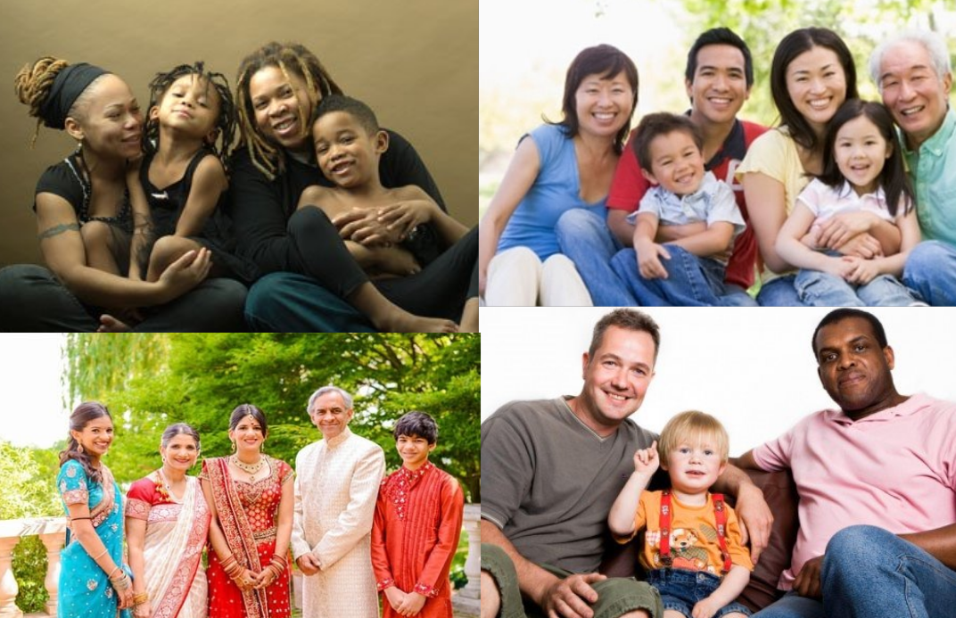
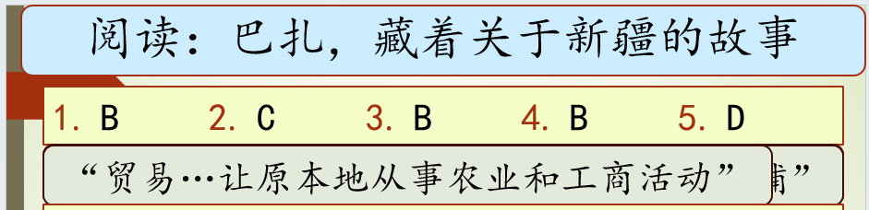

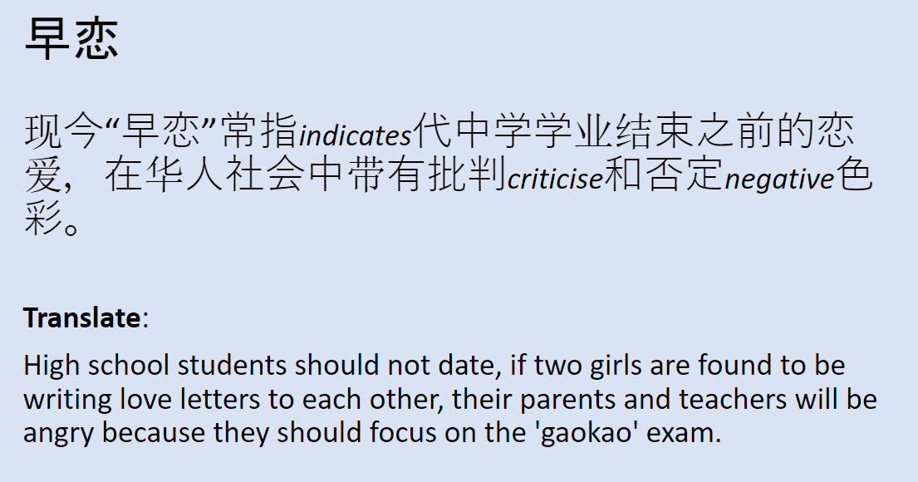
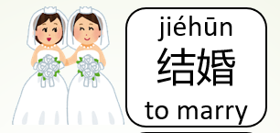


Examples of Inclusive Teaching
2024

Slide 17
Helpful Links
2024
Japanese Illustrations (Irasutoya):
World: https://www.irasutoya.com/search/label/%E4%B8%96%E7%95%8C
LGBT+: https://www.irasutoya.com/search/label/LGBT
Wheelchair: https://www.irasutoya.com/search?q=%E8%BB%8A%E6%A4%85%E5%AD%90
Stonewall LGBT+ Lives: https://www.stonewall.org.uk/young-futures/lgbtq-stories
The Classroom – LGBT+ Teaching: http://the-classroom.org.uk/
National College: https://nationalcollege.com/library?q=EDI

Slide 18
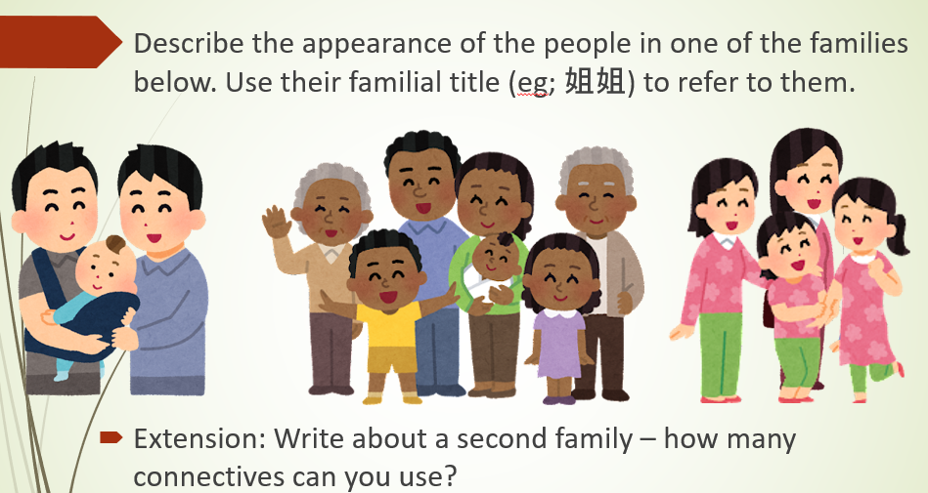
Plenary Activity
Pick a resource you have created or used at any key stage of your curriculum.
Think about the diversity of people presented within the material (Gender/Sexuality/Ethnicity, etc.).
Produce an idea of how you could make this more diverse for use in the future.
2024
What can you do?
Notes:
Inclusion of blended or disabled families.

Slide 19
Questions and Answers
2024
An opportunity for open dialogue and discussion.

Slide 20
References
2024
Arden, D., & Pillay, M. (2024). Queer Representation in Mandarin Chinese Language Learning Textbooks of the United Kingdom. International Journal of Educational Research, 127, 102433.
Morgan, B., & Clarke, M. (2011). Identity in second language teaching and learning. Handbook of research in second language teaching and learning, 835-854.
Nemi Neto, J. (2018). Queer pedagogy: Approaches to inclusive teaching. Policy Futures in Education, 16(5), 589-604.
Office for National Statistics. (2021). Sexual orientation, England and Wales: Census 2021. Sourced: https://www.ons.gov.uk/peoplepopulationandcommunity/culturalidentity/sexuality/bulletins/sexualorientationenglandandwales/census2021.
Office for National Statistics. (2023). Families and households in the UK: 2023. Sourced: https://www.ons.gov.uk/peoplepopulationandcommunity/birthsdeathsandmarriages/families/bulletins/familiesandhouseholds/2023.
Office for National Statistics. (2024). Schools, pupils and their characteristics. Sourced: https://explore-education-statistics.service.gov.uk/find-statistics/school-pupils-and-their-characteristics.
Saggers, S., & Sims, M. (2005). Diversity: Beyond the nuclear family. Family: Changing families, changing times, 66-87.
Sarkisian, N., & Gerstel, N. (2012). Nuclear family values, extended family lives: The power of race, class, and gender.
Pilkauskas, N. V., & Cross, C. (2018). Beyond the nuclear family: Trends in children living in shared households. Demography, 55(6), 2283-2297.

Slide 21
THANK YOU!
2024
Declan Arden (staggdt@gmail.com)

