Slide 1
AL Theme 3
演变中的华人社会
通讯与科技: 互联网和社交媒体
经济与环境: 经济发展；环境保护

Slide 2

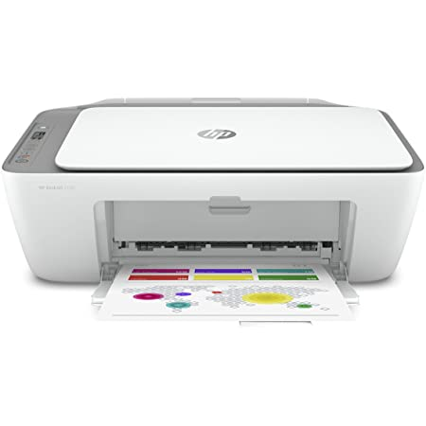



Subtheme 1
通讯和科技
A
B
平板电脑
智能手机
打字机
计算器
打印机
C
D
E
https://mandarinbean.com/stop-using-smartphone-for-one-year/
https://mandarinbean.com/internet-and-cellphone/

Slide 3
演变中的华人社会利用各种各样的创新科技用品。到处都有__________网络，所以随时随地能________与__________。
如果在路上看到新鲜的事就记录，然后发给网友们看。有________的话能一边________看电影，一边_______微博查新闻，另一边玩游戏。
线上
无线
宽带
上载
下载
登入
记录
Online
Wireless
Broadband
Upload
Download
To login
To record
无线
上载
下载
宽带
线上
登入

Slide 4
Yesterday I went to the town centre
with my best friend
around 4.30.
I bought a new smartphone
because I wanted to connect to the wifi.
First I sent a text to a friend
then I watched a news broadcast.
Finally, I downloaded weixin
I think technology is so useful.
Connect 连接 Text 短信

Slide 5
互联网弊大于利？ (IB book reading)
坏处 （负面）
好处 （正面）
Grammar stuffz
在…中
离不开 and 起不来
沉迷于…
由于…因而…

Slide 6
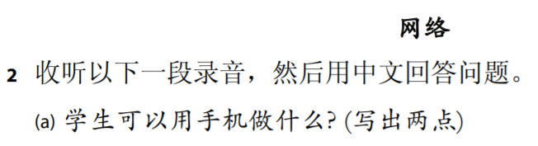


SAMS Listening Q2 网络 (3:20)
发展
电子课本
趣味
随时
任何
查看
时间表
情况

Slide 7
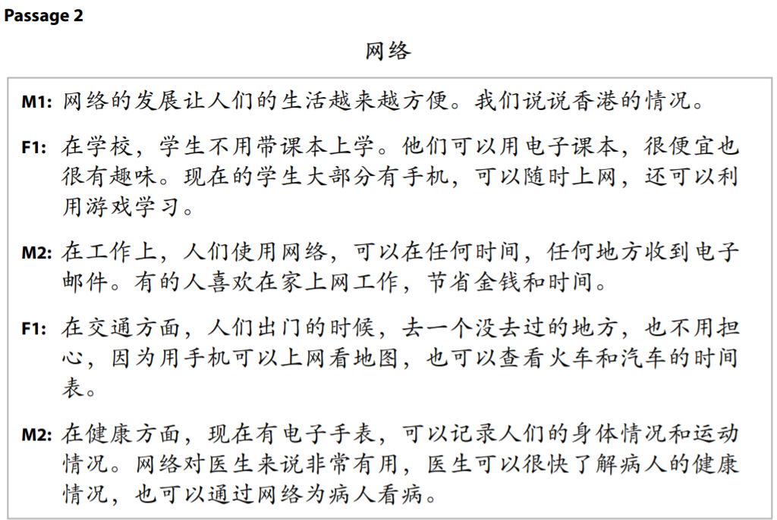

Slide 8
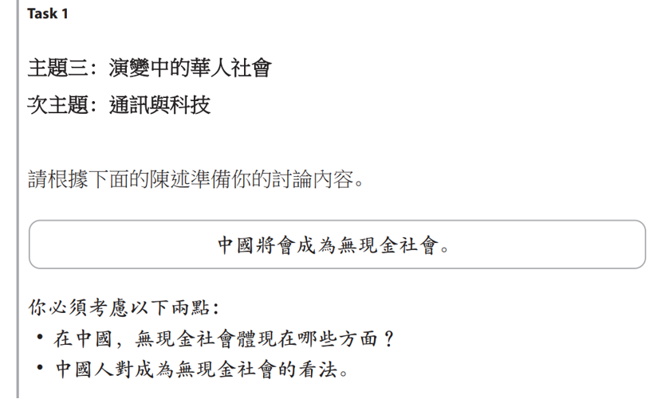
无现金社会

Slide 9
Automatise sentences with vocab and grammar

Slide 10

互联网
Subtheme 1
中国人利用互联网来….
网民经常…
https://mandarinbean.com/world-internet-conference-in-wuzhen/
Listen and read
Recite what you can remember
reread

Slide 11
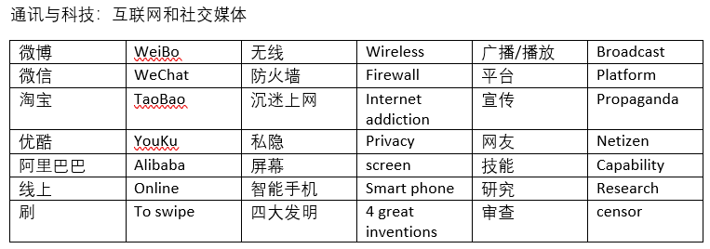
Vocab to learn immediately

Slide 12
网上购物为什么很受欢迎？（2022）如果购物中心消失，这会对当地经济造成什么影响？（2022）
网上购物
阿里巴巴
淘宝
小红书

Slide 13
通讯与科技
以我所知
一我来说
大家都知道
我的想法是
从我的角度来看
年轻人的通讯方法…
最新鲜的科技发展…
用科技来通讯的好处是…
因此…
所以…
总之而言…
结果是…

Slide 14
SAMS Reading Q1 网上购物

Slide 15
2019 AS Reading Q1 网络阅读

Slide 16

防火墙 防火长城 网络长城
BBC
CNN
Facebook
Gmail
Google Apps (e.g. Calendar, Docs, Hangouts, Maps, etc)
Instagram
OneDrive
New York Times
Pinterest
Reddit
Reuters
Snapchat
Spotify
Twitch
Twitter
Wall Street Journal
Wikipedia
WhatsApp
YouTube

Slide 17
Online politics
小粉红 - 'Little pinks' are mostly young women online. Unpaid. Likened to the Red Guards 红卫兵 of the Cultural Revolution.
五毛党 - '50 cent party' are paid by the CCP to spread pro-CCP propaganda.
网络水军 - are paid by private companies to promote them online or spread false information.

Slide 18
Speaking Qs
中国年轻人怎么用互联网？
你觉得中国的网络发展比西方的快吗？为什么？
网络在中国有什么特点？什么优点？

Slide 19
Subtheme 2 社交媒体
How does it affect young people's lives? What 挑战 does it bring?
Go viral 疯传 share 分享
Conman/conned 骗子、被骗 a post (发)帖子
Addicted 沉迷于、成瘾 fans 粉丝
Lower self-confidence自信下降
Distort life 歪曲生活

Slide 20

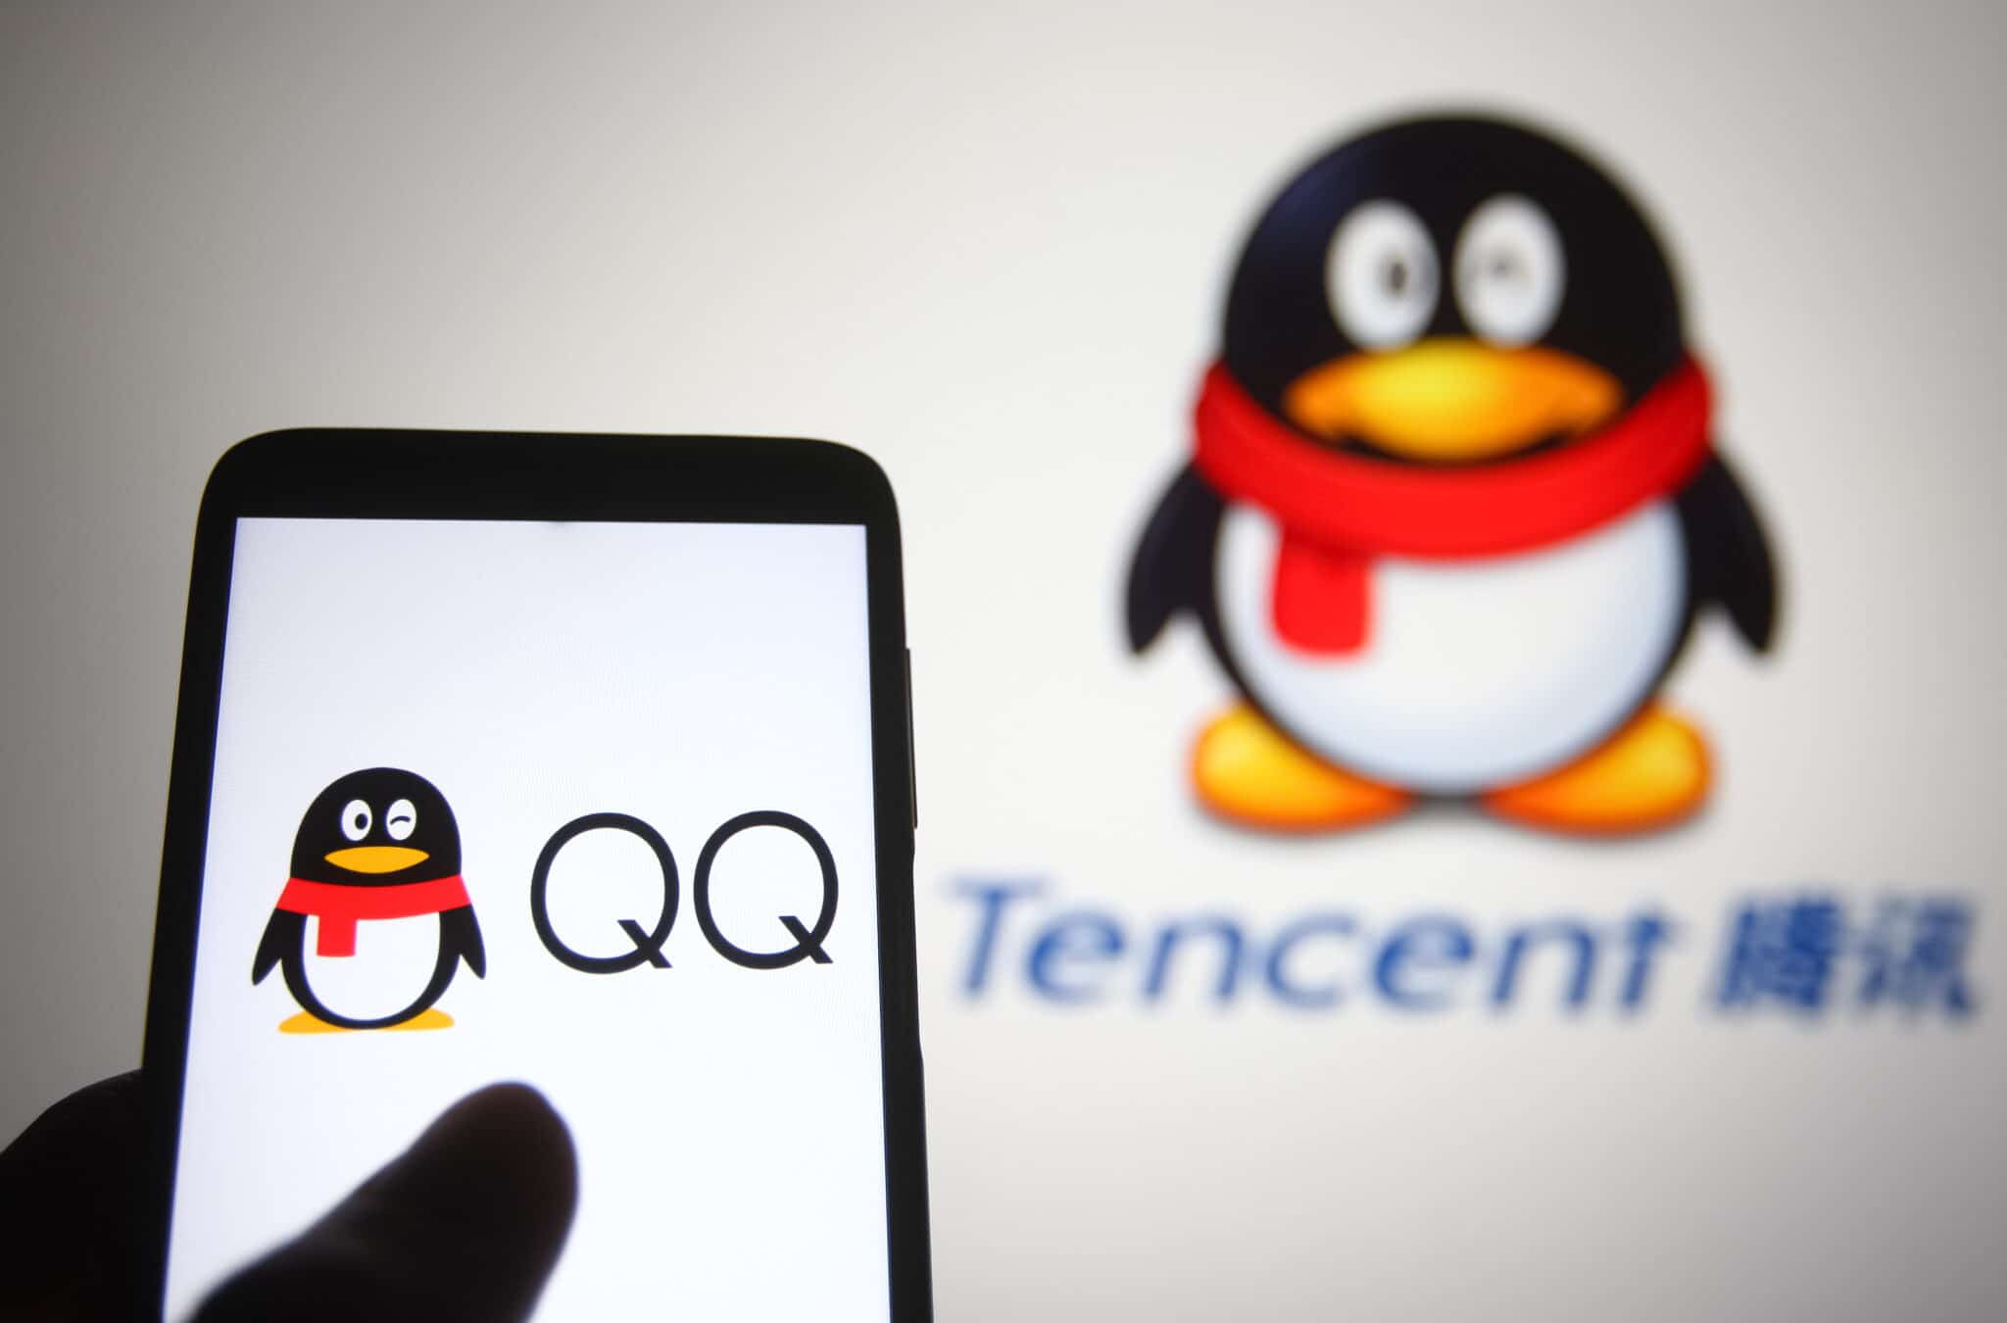








网络购物网站
视频分享网站
记录生活好事

Slide 21



百度 阿里巴巴 腾讯

Slide 22
为什么中国人的生活离不开手机？（2019）

Slide 23
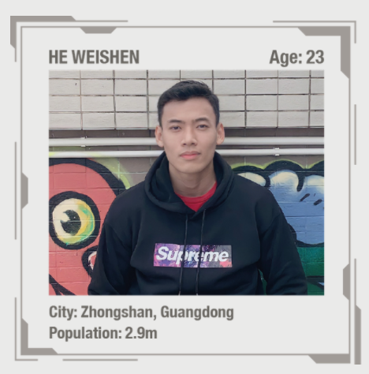
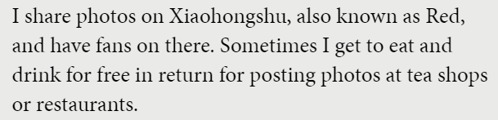


Use for research and translation
https://magazinebailliegifford.com/trust43/investing-in-chinas-future/?utm_campaign=trust-february-22&utm_medium=email&utm_source=marketo-individual&utm_content=article&mkt_tok=MTM4LVhJSi04NjcAAAGCz4O6ZpzfkEcgvw4AH1cIMO-NzFr7fr6RIZpMP8Yveo0B1ELILTF1uJoJ_INoYFIVJVw9DcbBgPYRL1mwcMIfntSGH7yjsWqLN1UUMBkkLua-6TCGXA
匿名 anonymous
约会软件

Slide 24
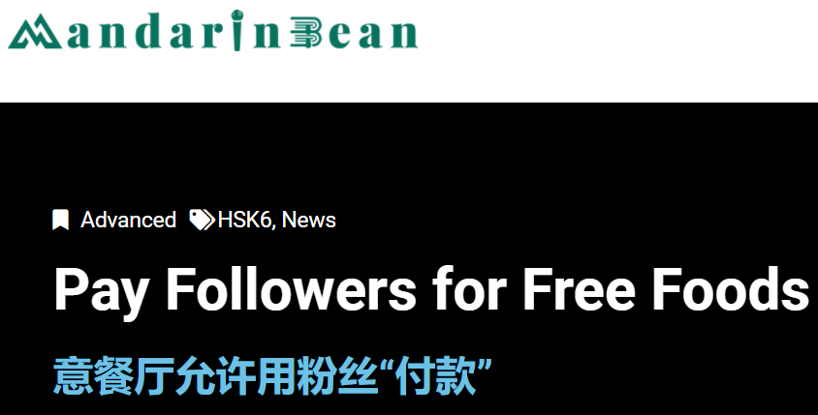
Prosody ☺
https://mandarinbean.com/pay-followers-for-free-foods/

Slide 25
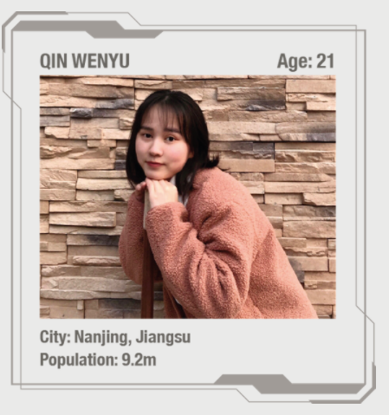
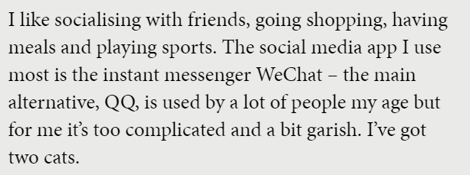
Use for research and translation
https://magazinebailliegifford.com/trust43/investing-in-chinas-future/?utm_campaign=trust-february-22&utm_medium=email&utm_source=marketo-individual&utm_content=article&mkt_tok=MTM4LVhJSi04NjcAAAGCz4O6ZpzfkEcgvw4AH1cIMO-NzFr7fr6RIZpMP8Yveo0B1ELILTF1uJoJ_INoYFIVJVw9DcbBgPYRL1mwcMIfntSGH7yjsWqLN1UUMBkkLua-6TCGXA
扎眼garish
另外的选择Alternative
Instant messenger 即时通讯

Slide 26
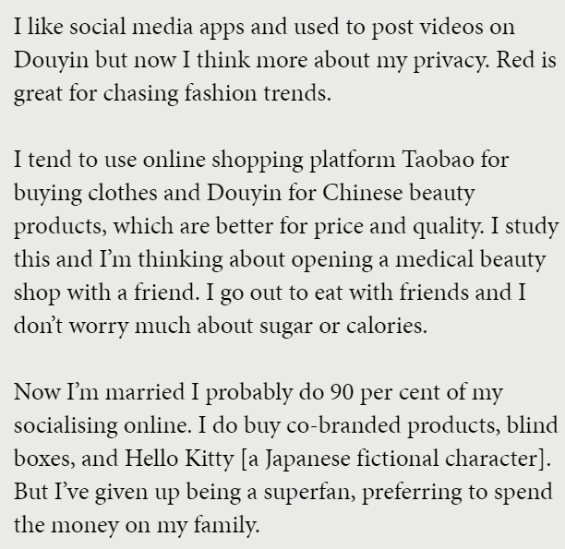
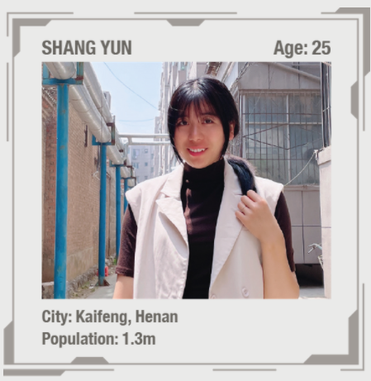
Use for research and translation
https://magazinebailliegifford.com/trust43/investing-in-chinas-future/?utm_campaign=trust-february-22&utm_medium=email&utm_source=marketo-individual&utm_content=article&mkt_tok=MTM4LVhJSi04NjcAAAGCz4O6ZpzfkEcgvw4AH1cIMO-NzFr7fr6RIZpMP8Yveo0B1ELILTF1uJoJ_INoYFIVJVw9DcbBgPYRL1mwcMIfntSGH7yjsWqLN1UUMBkkLua-6TCGXA

Slide 27
Scaffolded speaking
华人 | 用… | 来… | 因为… | 这代表…
现代社会
目前年轻人
….

Slide 28
Automatise sentences with vocab and grammar

Slide 29
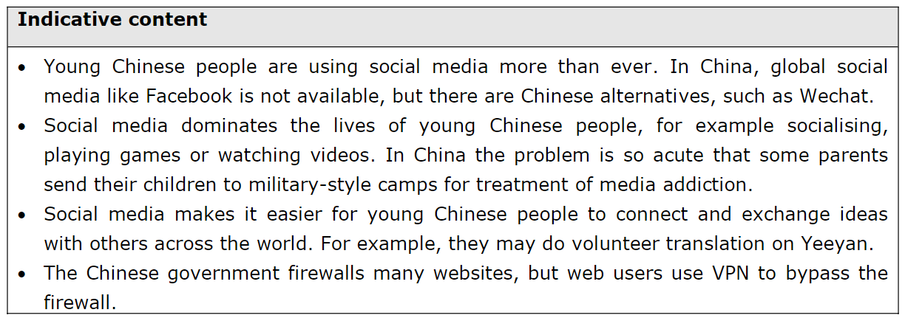
SAMs Indicative Content Translation

Slide 30
Speaking Qs
中国有哪些社交媒体？你用过哪些？
社交媒体怎么影响年轻人的生活？
带来什么挑战？
为什么跟其他的国家不一样？

Slide 31
Subtheme 3 economic dev 经济发展
More in Theme 4
Match and note down:
发达
衰退
强 / 弱经济情况
经济增长
发展中
税
贸易
金融危机
Economic growth
Developed
Developing
Strong/weak economy
Recession
Financial crisis
Trade
Taxes

Slide 32
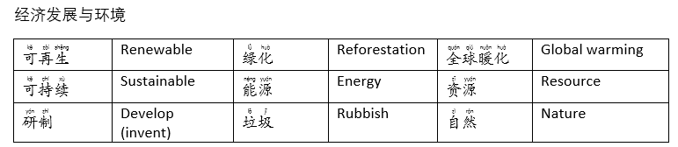
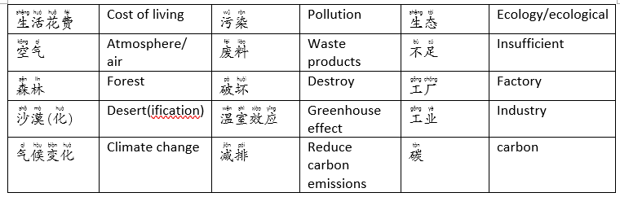
Vocab to learn immediately

Slide 33
中国制造
技术制造业

Slide 34
Look up how may ways to say 'increase' 'decrease'
增强
增加
增长
增大
下降
减小
减少
缩小

Slide 35
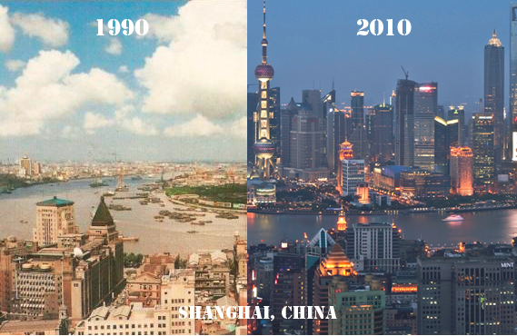
经济快速发展

Slide 36
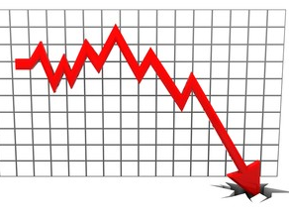
Great Leap Forward + Cultural Revolution
毛泽东 = 毛主席 Chairman Mao
大跃进 1958-62
Agricultural and industrial units
Accelerate using manpower
Backyard furnaces
Communes to free up labour
Quotas, lying, low-quality
20 million starved
文化大革命1966-76
Ideological purity
Denouncements
Struggle meetings
Sent to the countryside 上山下乡
Red guards
Little red book
Destroyed artefacts

Slide 37
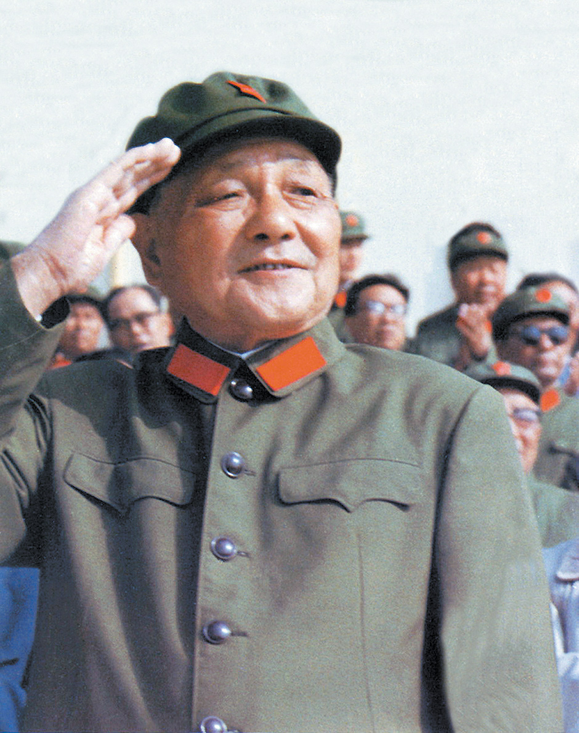
1978 邓小平 and 拨乱反正
最高领导人
supreme leader (unofficial)
Rehabilitation
Deconstructing Maoist policies
Economic stabilisation
Modernisation

Slide 38

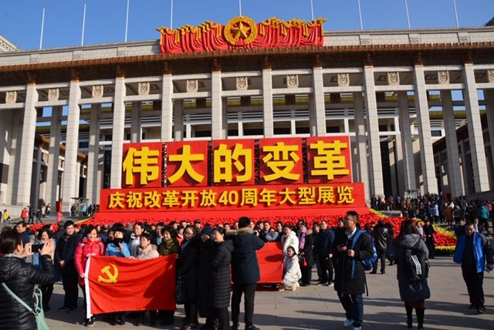
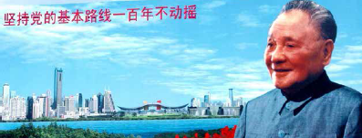
改革开放 or 中国特色社会主义
毛泽东时代的共产主义是计划经济，由政府进行计划
1978年的改革开放
社会主义市场经济
邓小平

Slide 39
经济增长
收入 工资
财富
全球化
设立特区

Slide 40
What actually happened?
First stage (70s-80s)
de-collectivization of agriculture + cash crops (cotton, silk etc)
open to foreign investment (SEZs)
small private businesses = market competition
Second stage (80s-90s)
Privatization of much state-owned industry
Expertise in manufacturing (steel, textiles, cars)
lifting of price controls
Remove protectionist policies and regulations
International services （finance, insurance, telecom)
2001, China joined the World Trade Organization (WTO)
Now: export led

Slide 41
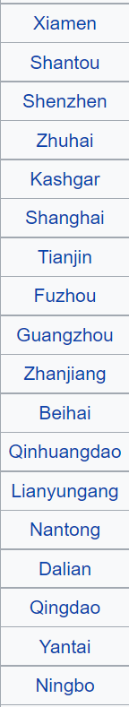
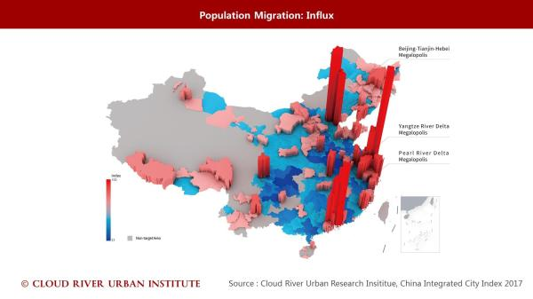
SEZs 经济特区
More trade
Employment
Investment
Job creation
Simpler administration.
Better taxation (incl tax holidays)
quotas
(lenient) customs and labour regulations

Slide 42
Modern economy ??
外国名牌产品为什么在中国受欢迎？(2019)
政府应该不应该鼓励中国人购买中国牌子的产品？（2019）

Slide 43
现代的经济情况如何？
意识形态
Ideology
伙伴
Partner
财经
Financial
集成电路
Electronic circuits
原油
Oil/petrol
政治方面还是共产主义，极左思想，但是经济方面是资本主义的自由市场。 这是不是意识形态矛盾？
中国的出口比进口多。出口伙伴国家是美国及日本。而进口从韩国及其它亚洲国家。
中国的经济于商品、财经服务、电子业、集成电路、汽车、原油都产生。

Slide 44































Slide 45
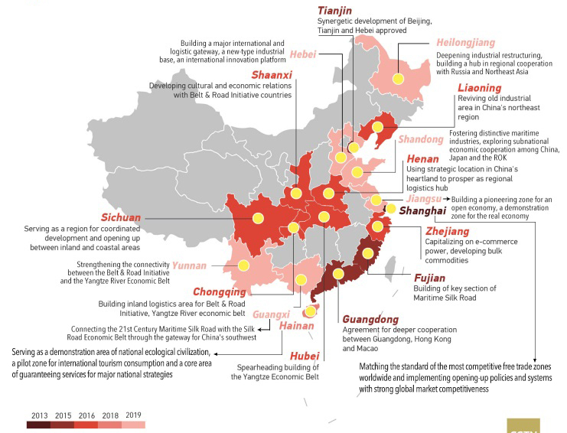
Free Trade Zones now?

Slide 46
Now? 习近平 is backtracking…
个人崇拜的宣传：海报、歌、文章
央视春节晚会政治意味太浓
毛泽东时代的极左思想
网上表达不同看法被批判
新文革
对思想文化和媒体的控制
例如: 任志强的微博账号关闭了

Slide 47
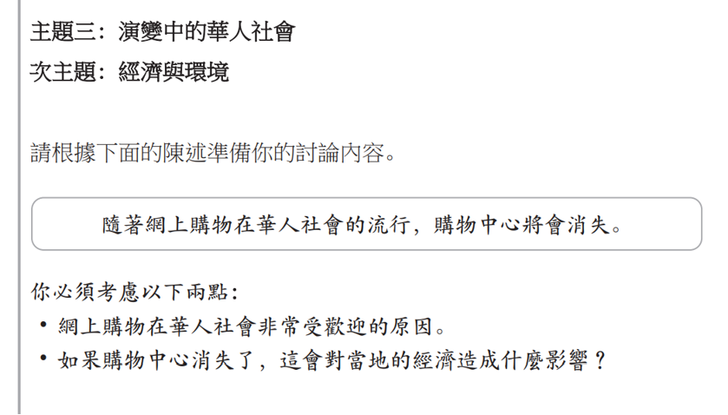

Slide 48
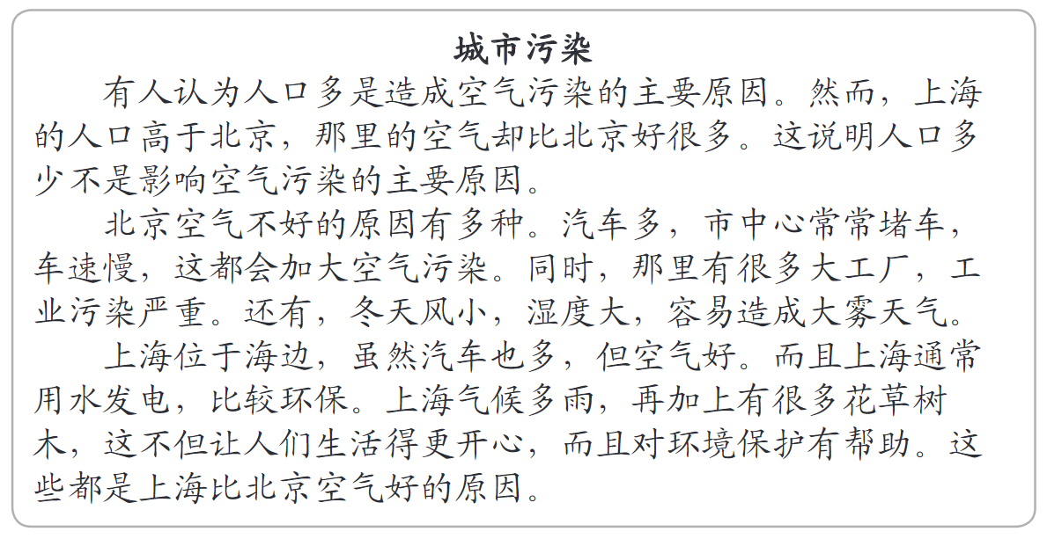
2019 AL Reading Q1 找名词、动词等等 – 然后回答问题

Slide 49
来自贪腐的腐败

Slide 50
Automatise sentences with vocab and grammar

Slide 51
Speaking Qs
请介绍中国几十年来的经济发展。
中国的经济发展怎么那么快，那么成功？
这种发展是可继续的吗？
有什么缺点？

Slide 52
Vocab - problems
Subtheme 4 保护环境
Global Population 全球人口
Serious 严重
Waste water + electricity 浪费水电
Environment 环境
Pollution 污染
Global warming 全球变暖

Slide 53
Vocab - solutions
少用 再用 健康 水瓶
To protect 保护
protect the env. 环保
Recycle 回收
Rubbish 垃圾
Collect 收取
Sort 分类
Save/reduce 节约
Fresh air 新鲜空气

Slide 54


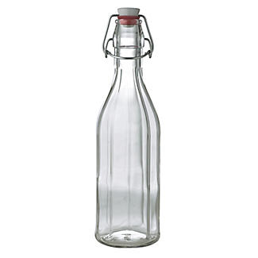

可以回收的东西
植物
饮料瓶
塑料瓶
玻璃瓶
扔 throw away
电池

Slide 55
全球变暖对天气的影响是全球人口应该面对的问题。环境的情况越来越严重，尤其是空气污染。为了环保我们最好把扔掉的垃圾细细的分类和回收，节约资源别浪费水电。

Slide 56
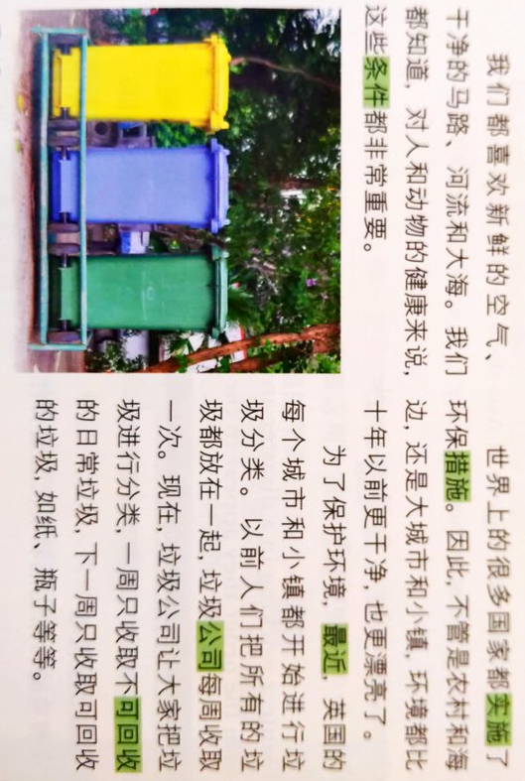
reading
What 3 clean things do we all like?
Who protects the environment?
Which 4 places are cleaner/beautiful than 10yrs ago?
What kind of measures have been implemented?
Where did people put their rubbish before?
How is rubbish collecting different now?
条件 condition
实施measure/step
措施put in place
最近recently
公司company

Slide 57
不断地
持续
连续
逐渐
渐渐

Slide 58
碳排 carbon emissions （煤炭）
产生 to produce
造成 to make
来源 source
资源 resource
臭氧层ozone layer
制造业而来的污染

Slide 59
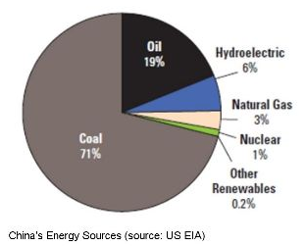
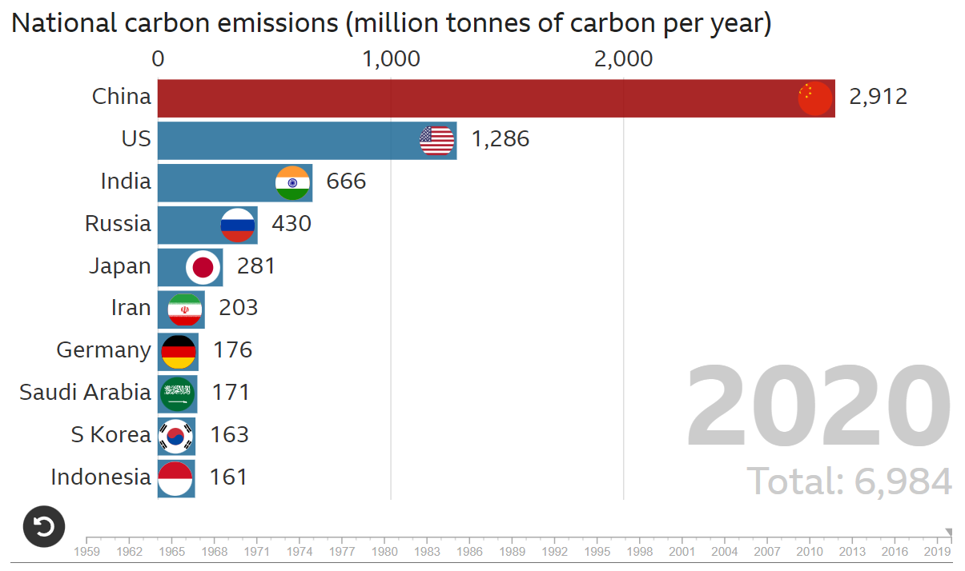
全国碳排估计
煤炭
石油
水电
燃气
核电
其它再生能源
But, China also produces more wind and solar energy than any other country. Also making and selling more electric cars, although the population % is comparatively low.

Slide 60
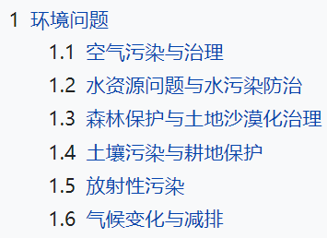




中华人民共和国环境污染
沙漠化 desertification
土壤 soil
耕地 arable land
放射性 radioactive
减排 reduce emissions
What is each? Example in PRC?

Slide 61
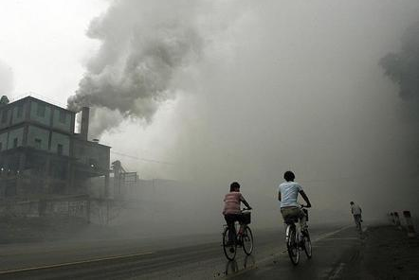
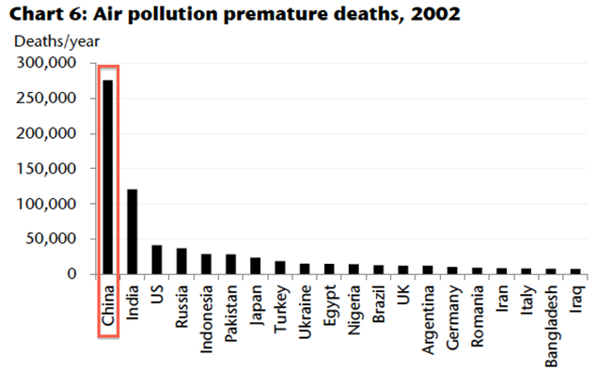
空气污染
因空气污染的早死
癌症
肺癌
烟雾
口罩
Lung cancer is the most common cancer in the world
with an estimated 1.8 million new cases
1.6 million deaths in 2020.
More than one-third of such cases occurred in China
三分之一多了是在中国出的
一百八万新的病例
二零二零年有一百六万的死亡
肺癌

Slide 62
Chinese Case Studies
3 Gorges Dam
High Speed Railway
Pearl River Delta megacities
Eco Cities (DongTan)

Slide 63
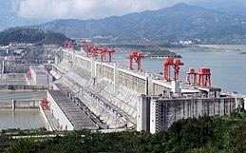
Three Gorges Dam 长江三峡坝工程项目
利与弊？
用水力发电
效率高
洪水
生态影响
农民被迫搬迁
腐败 – 贪腐
资本家
官员
官老爷 government grandpa
官迷 political social climber

Slide 64
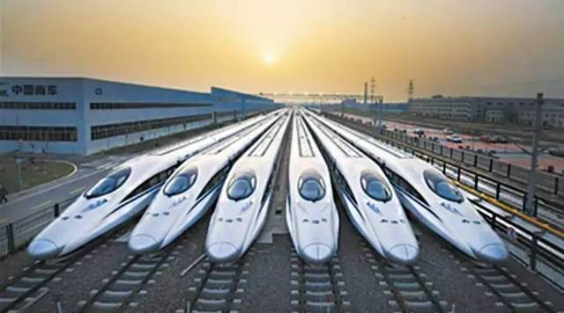
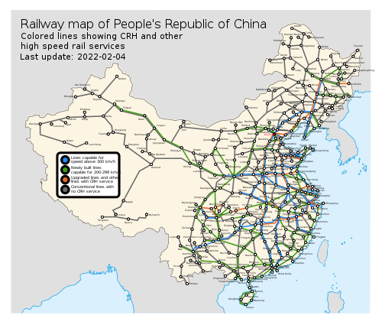
High Speed Railway 高铁 （高速铁路）
中国的是世界上规模最大的高铁网，占世界三分之二的。2008年京津城际铁路是第一打开的。
Corruption,embezzlement leading to safety concerns
High ticket prices
Relocation
Encourages 鼓励 economic development in smaller cities
Electric trains 电力动车 better than normal trains
Strengthen national manufacturing

Slide 65
利大于弊 碳排 鼓励

Slide 66
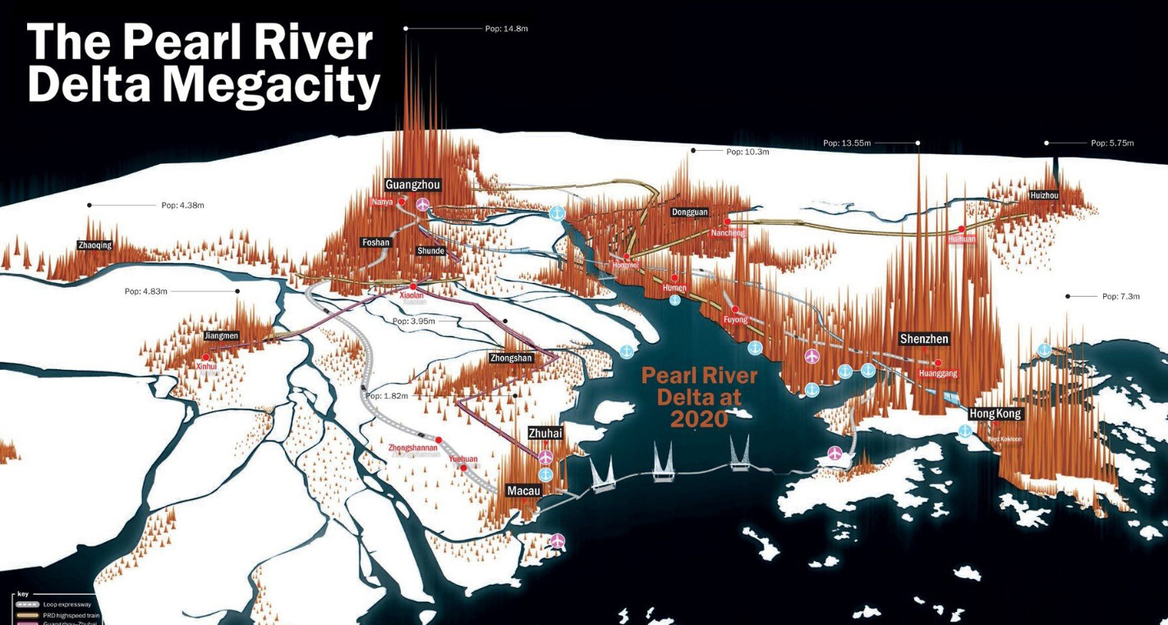
Pearl River Delta 珠江三角洲城市圈 环境问题
广州
深圳
地区的环境问题包括：
空气污染
水污染
森林砍伐
原因是…
- 大量制造工厂
- 具有汽车的人口快速增长了
澳门
香港

Slide 67
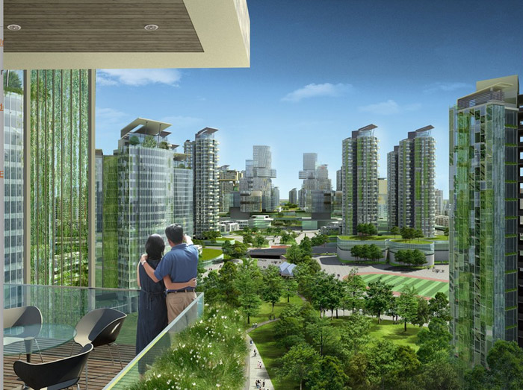
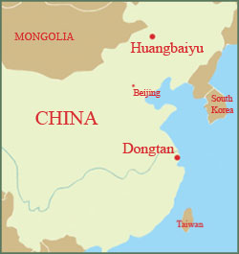
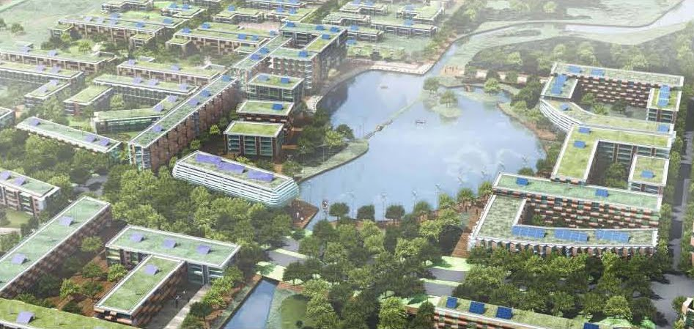
Sustainable cities: Dongtan Eco city
东滩生态城项目已经失败
“The world’s first purpose-built eco city,” Dongtan will be powered entirely by renewable energy sources Located near Shanghai, it will house up to half a million people by 2050. Dongtan will use half the water and create one-sixth the waste of a comparable city, even with land for producing native foods like corn, rice, and fish.

Slide 68
But!
Dongtan consists today of 10 wind turbines - no buildings, water taxis, water cleansing plant or energy centres.
Construction was to have started in 2006 but nothing has happened yet.
The project's project coordinator in the Communist Party has been jailed, charged with corruption, and consultants Arup have since been criticised for participating in numerous dodgy sustainable construction projects.
The Dongtan project seems to have lost its momentum, and because of the delay it has been given a mixed reception.
Although the project involves construction of a sustainable city, further doubts have arisen as to whether it can be defined as sustainable, taking into consideration the fact that it would sit on a disappearing green area outside Shanghai.
The most sustainable use for this vital area, which constitutes one of China's largest bird reserves, would be for it to remain undeveloped.

Slide 69
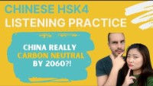
Listen from 1:00 to 3:35
碳排放 carbon emissions
碳中和 carbon neutrality
难以相信 hard to believe
投资 invest
燃煤 burn coal
核电 nuclear

Slide 70
Automatise sentences with vocab and grammar

Slide 71
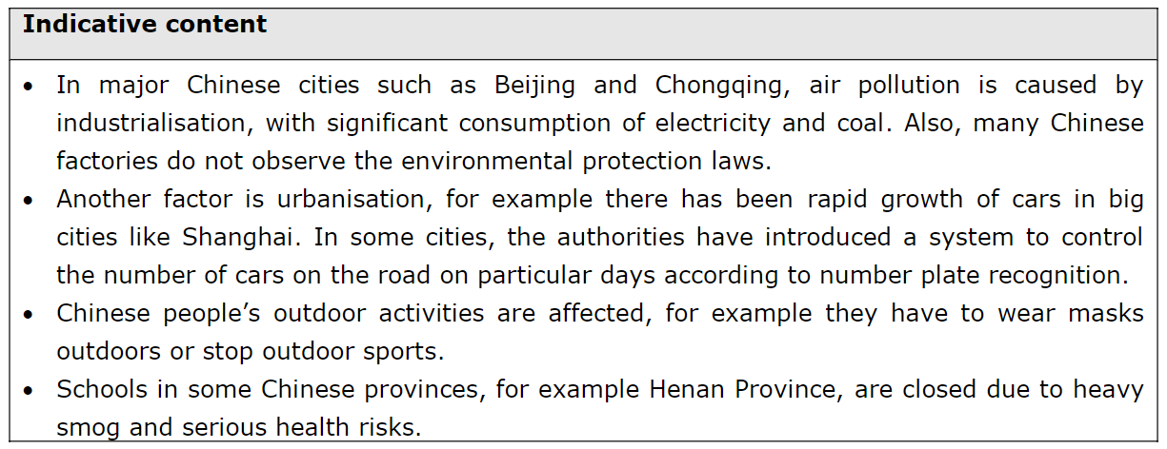
SAMs Indicative Content Translation

Slide 72
Speaking Qs
中国的空气污染的原因是什么？
大城市的空气污染怎么影响市民？
中国政府近年来有哪些环保政策吗？
你觉得环保是谁的责任？

