Slide 1
Alevel Theme 2 中国文化
传统： 节日（春节；端午节； 中秋节；清明节）和习俗。
文化活动： 电影；电视；音乐和阅读。 (与中国文化有关)

Slide 2
Festivals 节日
Subtheme1 Festivals
Related to the 4 seasons –agricultural past
Match the Festival names and traditions 传统
A MidAutumn Festival | 1 跟家赏月，吃汤圆
B Tomb-Sweeping Festival | 2回家过年，吃饺子
C Spring Festival | 3 龙赛，吃粽子
D Dragon Boat Festival | 4扫墓，祭祖，吃青团
春节
端午节
中秋节
清明节

Slide 3
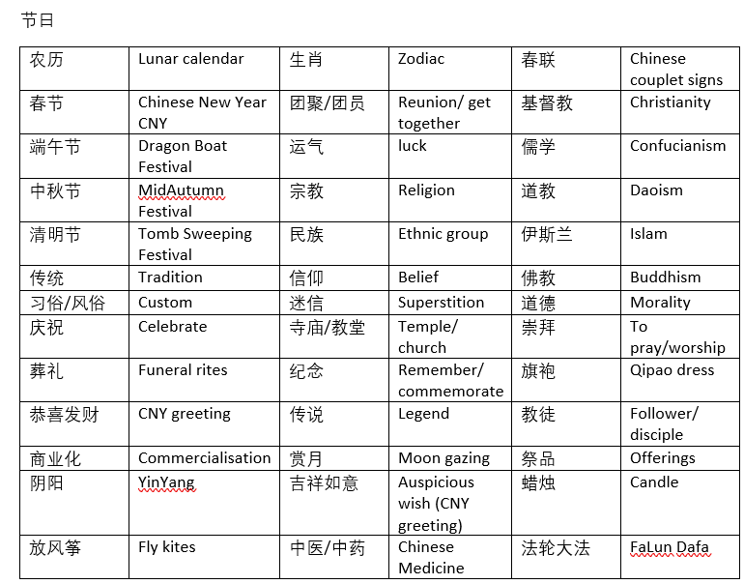
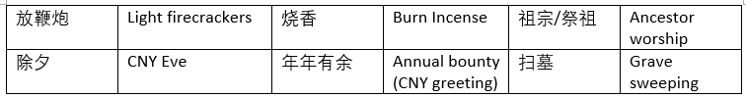
Vocab to learn immediately

Slide 4
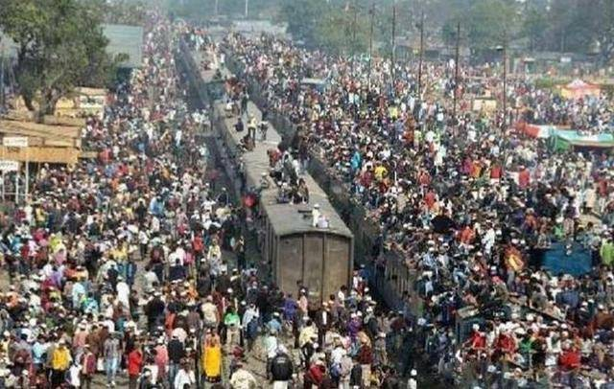
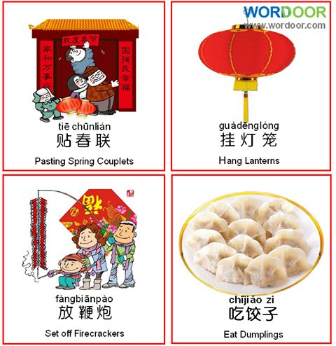
春节 Jan/Feb
Winter
恭喜发财
生肖 zodiac (我属蛇)
春运 – 每年，因为所有住在大城市的移民都要归根，火车动弹不得(满满当当)。
因为是最重要的节日所以传统习俗一成不变，每年都一样。

Slide 5
全家团圆为什么是传统习俗？应该回家团聚吗？

Slide 6
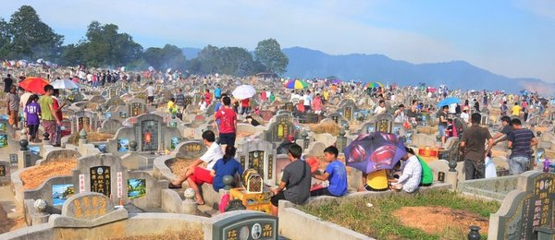
清明节的习俗 habit+custom April
Spring
扫墓 grave sweeping
祭祖 worship ancestors
吃青团 eat ‘qingtuan’
放风筝 fly kites
庆祝清明节的时候，大部分的中国人___,___和___。但是有的不参加活动，实际上百分之___说____。

Slide 7
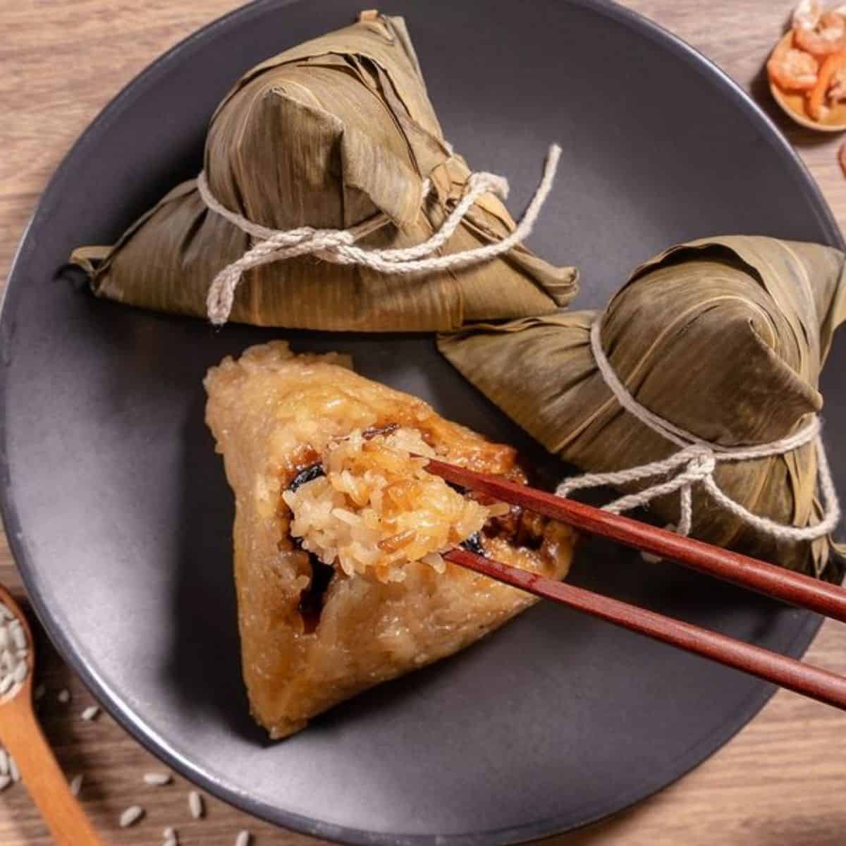
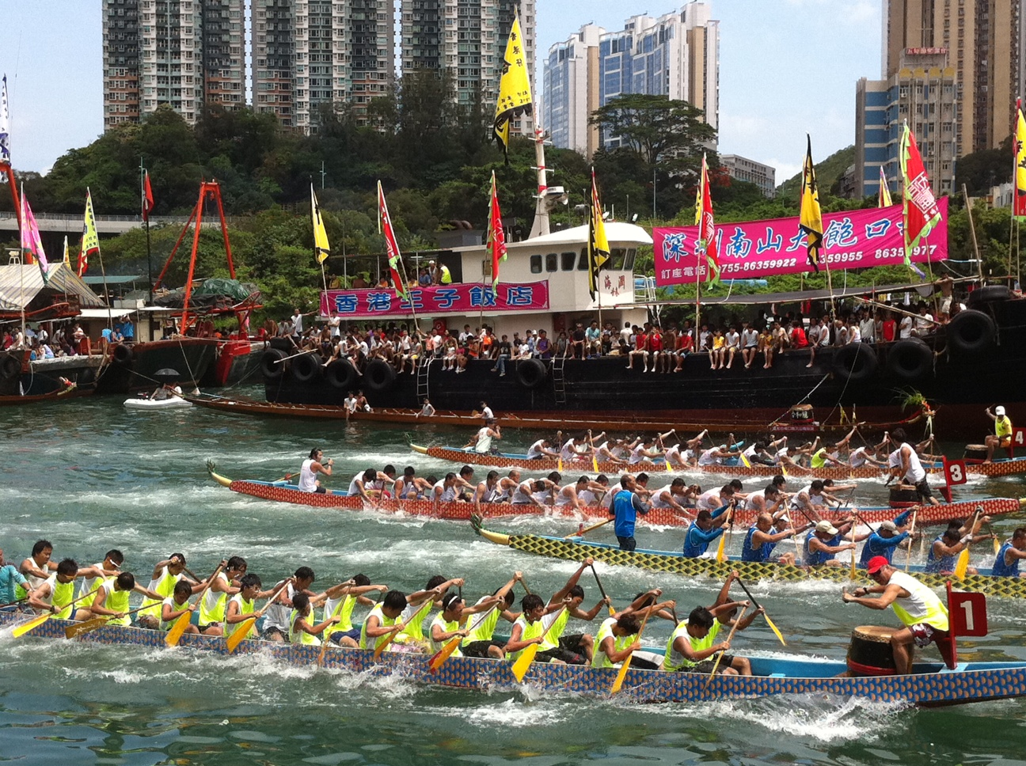
端午节 June
粽子
小鼓
龙舟
端午节必须跟朋友一起做____吃，看___赛，听___。以我来看…
Summer
现代的改变，越像运动比赛，没有传统节日的意义。因为假期很短，没有期望跟朋友团聚。在农历的传统节日中，端午应该算是最没存在感的那个。

Slide 8
translation
在今天，采摘艾草的人或许少了，但结伴出游爬山，却成为越来越多人的选择；手工包的粽子或许越来越少，但粽子经历商业社会的塑造，人们却有了更多的口味、风格的选择；而划龙舟从过去的仅限于端午节的民间仪式，逐渐与现代竞技体育相结合，更加推动了其文化的传播。总体而言，这些都指向于一种更丰富与现代的过节方式。

Slide 9

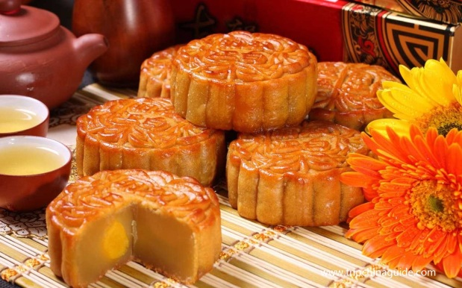
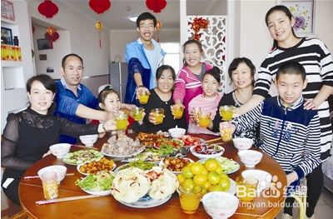
中秋节 September
Autumn
赏月moon-gazing 月饼moon cake
嫦娥lives on the moon 玉兔jade rabbit
根据统计，百分之…。这表现…
According to …… shows ….

Slide 10
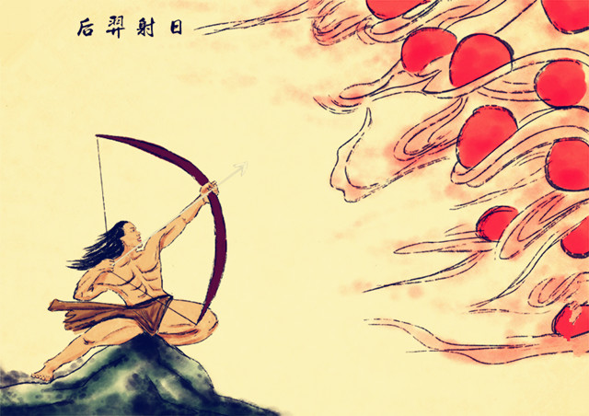
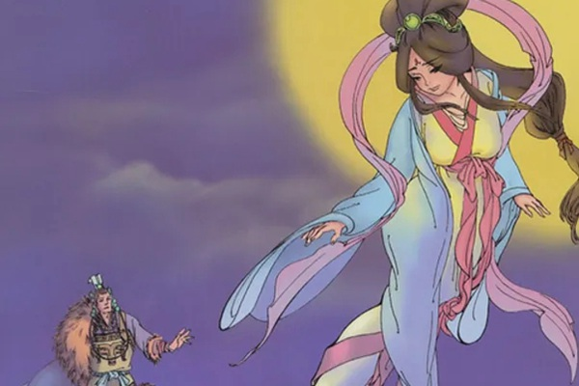
后羿射日嫦娥奔月的传话
这个版本是最为正常的版本，也就是天上有10个太阳，后羿射下9个，百姓都很敬重后羿，西王母还送给后羿一颗长生不死仙丹，但是后羿不想和嫦娥分开，所以就没吃。但是这事被小人逄蒙知道了，乘后羿出门的时候就想去偷。后羿的妻子嫦娥不让，但是又打不过逄蒙，所以嫦娥想一定不能让逄蒙这样的小人长生不死了，所以选择自己吃了不死药。最后和后羿天地永隔。百姓为了纪念他们每年的八月十五都会献上美食祝福他们。

Slide 11
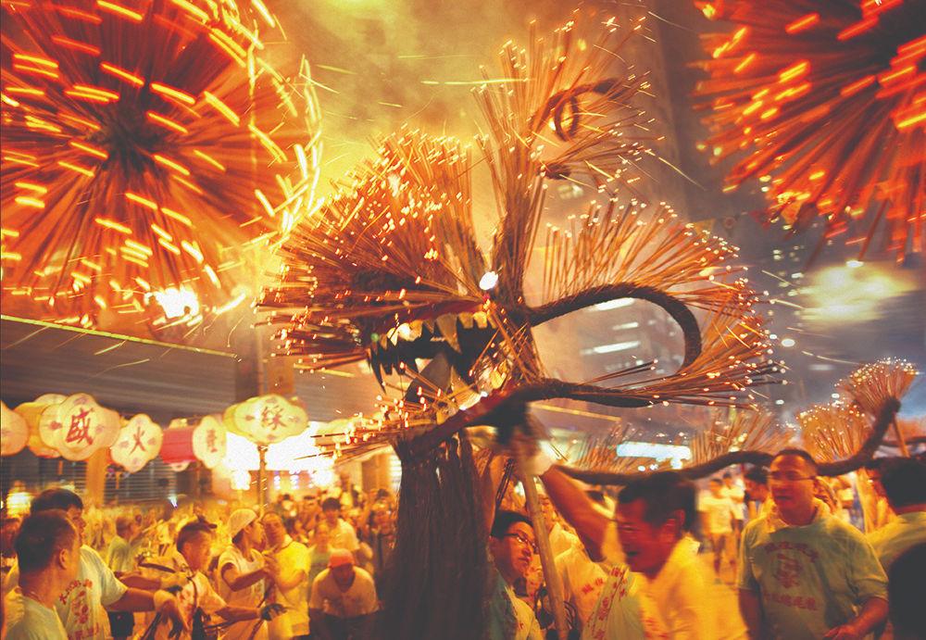
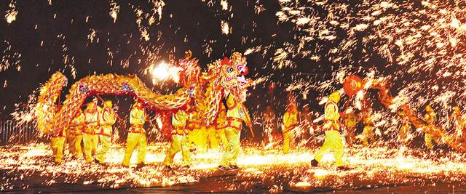
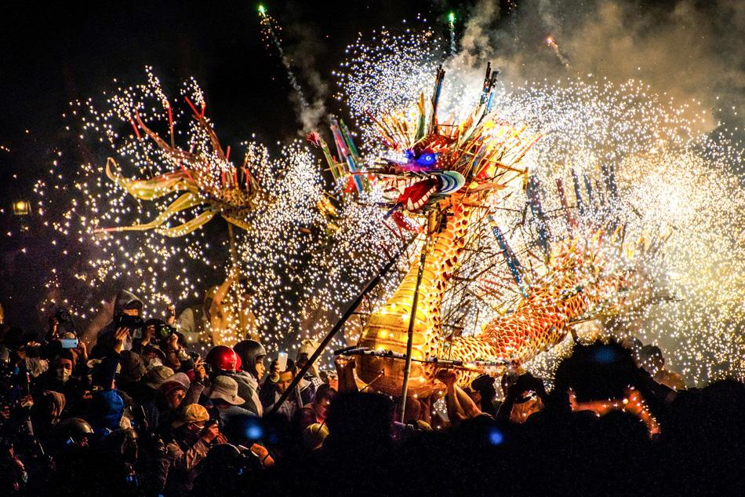
Also HongKong's 舞火龙 to scare off illness
Do SAMS listening 1

Slide 12
https://www.youtube.com/watch?v=ytFpoq-4bqM
Which other festivals does she mention?
元宵节
重阳节

Slide 13
年轻人失去兴趣吗？要不要改变情况？
Ms.doc
Statistics and examples

Slide 14
Speaking Qs

Slide 15
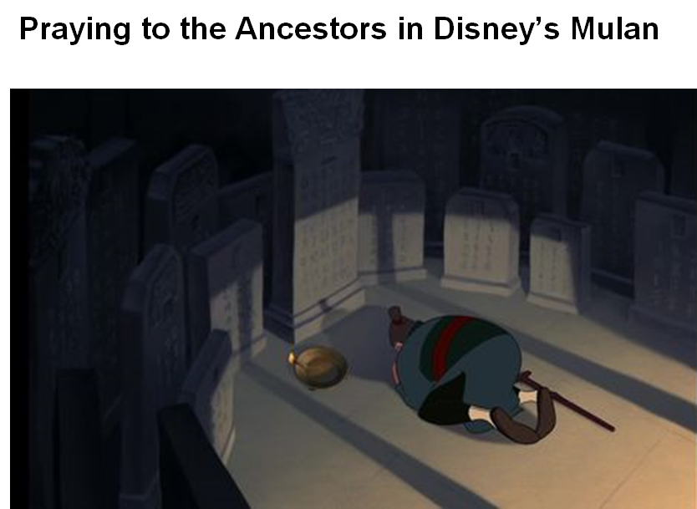
Ancestor Worship 祭祖
Subtheme 2 Customs
Contact the divine/gods/heroes
Confucian beliefs
孔子,儒家
(piety孝顺, heirarchy等级制度)
Links to Buddhism佛教, Taoism道教, folk religions民族宗教
More in the south, TW and HK. Linked to 清明节

Slide 16
孔子与儒家
Match up...
仁 | humaneness
义 | kindness
礼 | sincerity
智 | trustworthiness
信 | rituals
恕 | Filial piety to parents
忠 | loyalty to emperor
孝 | knowledge
悌 | respect an older brother
He lived in a time of war so promoted stability and order
儒家学说有九个核心思想：仁、义、礼、智、信、恕、忠、孝、悌。有四个是最重要的：忠、孝、仁、义。仁的意思是仁德或者善心，如果一个人有仁德，就回归所有人都非常好；义的意思是对朋友很忠诚；忠指的是对皇帝的忠 心；孝的意思是对父母的孝顺。

Slide 17
Religion in China https://www.youtube.com/watch?v=5wsAsmcQPXA

Slide 18
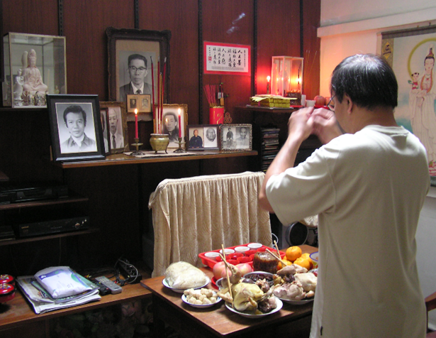
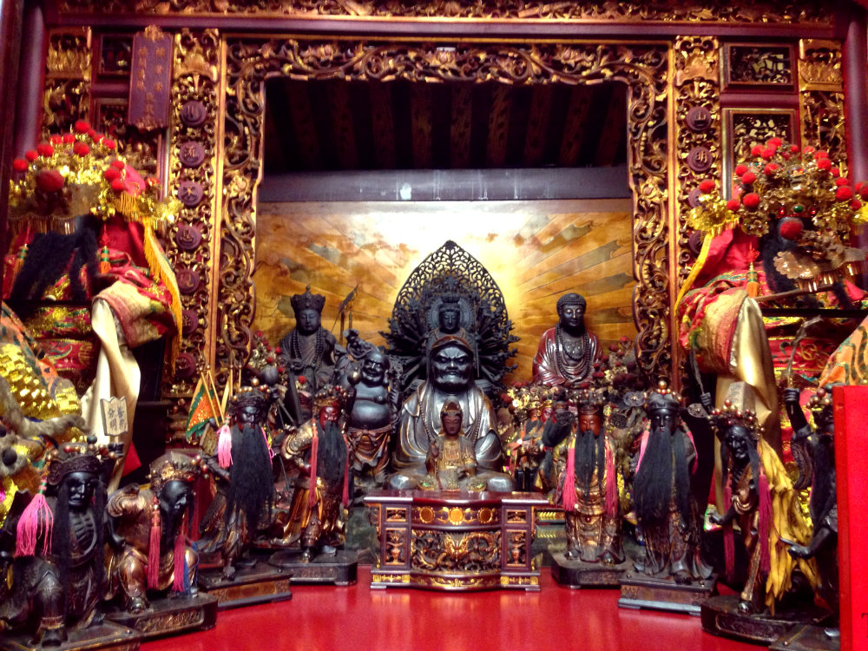
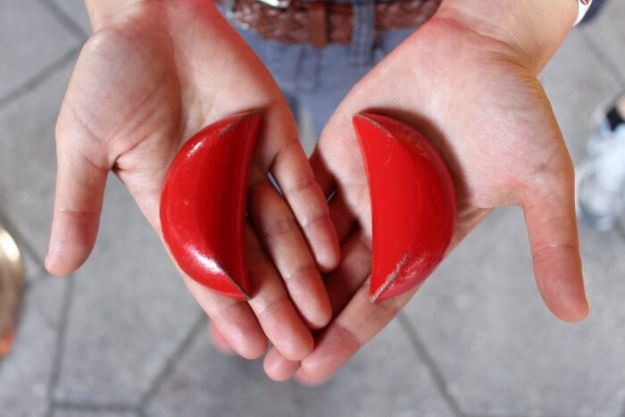
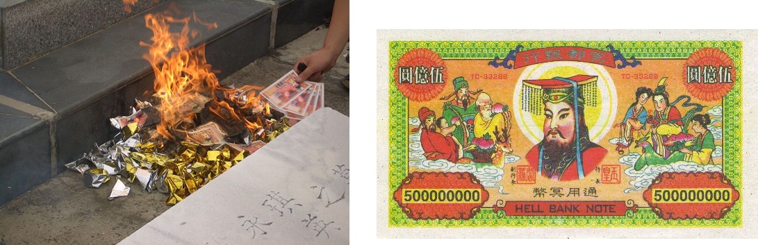
Modern day – some in homes, some at temples
More common in the South, Hong Kong and Taiwan

Slide 19
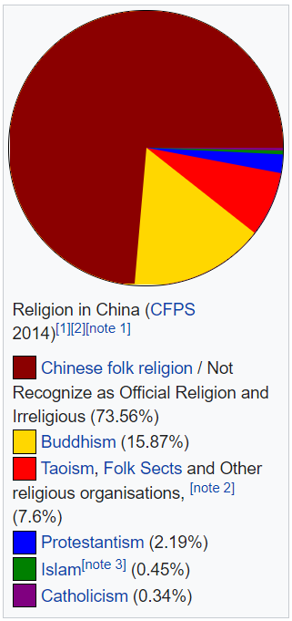
Religions in 'aetheist' China
Confucianism 儒教 500BCE from 孔子 = humanism, structured society to cultivate virtue, meritocracy and governance, filial piety, heirarchy, rites and ancestors
Daoism/Taoism 道教 400BCE from 老子 = live in harmony with the dao, the I Ching 易经, balance, divination through objects, self-cultivation, afterlife, alchemy and longevity, 阴阳
Buddhism 佛教 500AD from 达摩 = legends, Buddha and Bodhisattavas, offerings, meditation, ancestors, karma and reincarnation, Journey to the West
Daoism promotes harmony with nature, Confucianism promotes harmony within society.

Slide 20
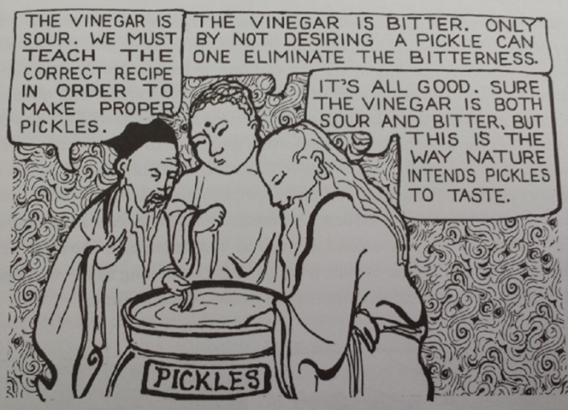
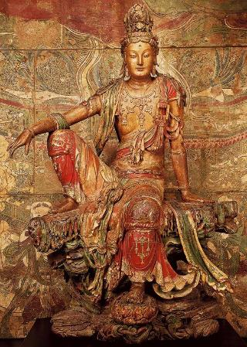
One reason the three coexist so well may be that none has an all-powerful God that claims superiority over the others.
Confucius, Laozi and the Buddha are wise men and moral teachers - not Gods.
They complement each other and share elements like Guanyin - a Buddhist saint and Daoist goddess.

Slide 21
Tibet and Xinjiang
Buddhism and the Dalai Lama
佛教与达赖喇嘛
流亡印度 exiled to India
Islam and the Uighur minority
伊斯兰与维吾尔族

Slide 22
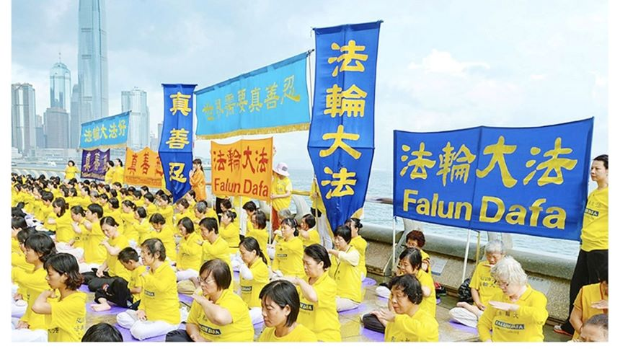
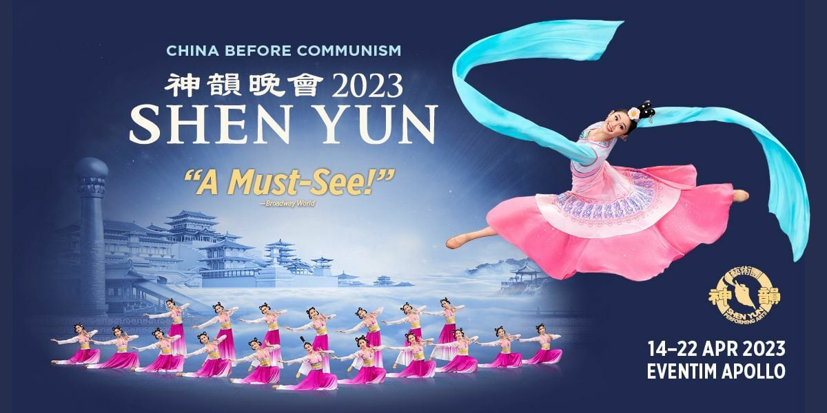
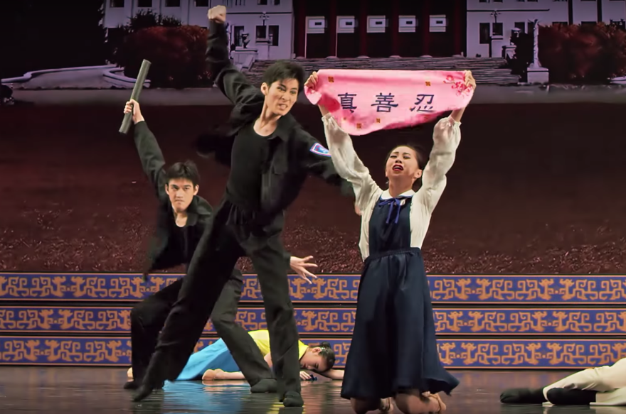
法轮大法 (法轮功的镇压supression）
Falun "Law Wheel Practice“ is a new religious movement, founded by Li Hongzhi in China in the early 1990s. Falun Gong has its global headquarters in New York.
They have a performing troop called Shen Yun and a media organization called The Epoch Times both promote the spiritual and political teachings of Falun Gong.

Slide 23
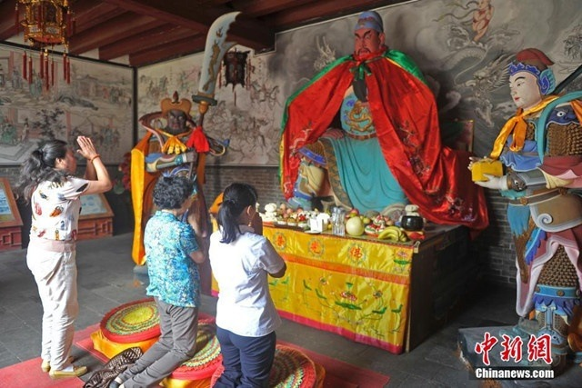
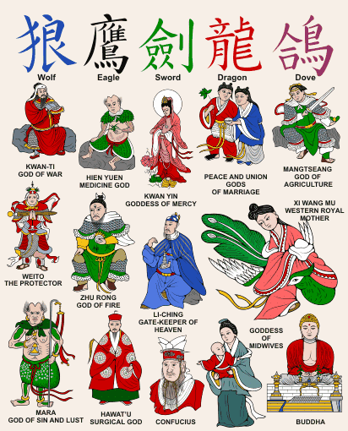
All smushed together with history and legend
Martial arts
Fengshui
Qigong
Herbal medicine
Astrology
Numerology

Slide 24
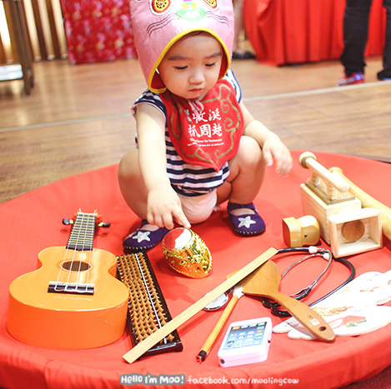
抓周
抓周是一种预定婴儿前途的习俗。当新生儿满岁时，将各种物品摆放于小孩面前。
传统上常用物品有笔、墨、纸、算盘、钱币等。现在也有些会放滑鼠、牙刷等现代物品。
如果小孩先抓了文具，长大以后好学，如是小孩先抓算盘，将来长大善于理财。如是女孩先抓剪、勺子等用具就长大善于料理家务。

Slide 25
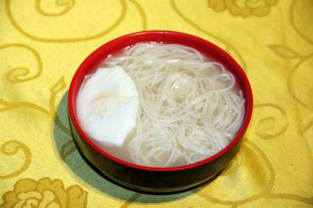
长寿面
在中国民间汉族历来就有生日吃长寿面的习俗 。长寿面代表人们对未来的一种美好愿望。
于是人们就借用长长的面条来祝福长寿。渐渐地，这种做法又演化为生日（节日）吃面条的习惯，称之为吃“长寿面”。

Slide 26
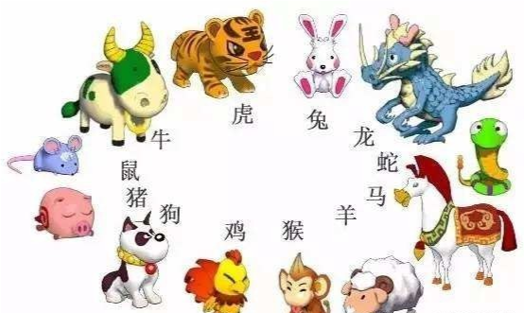
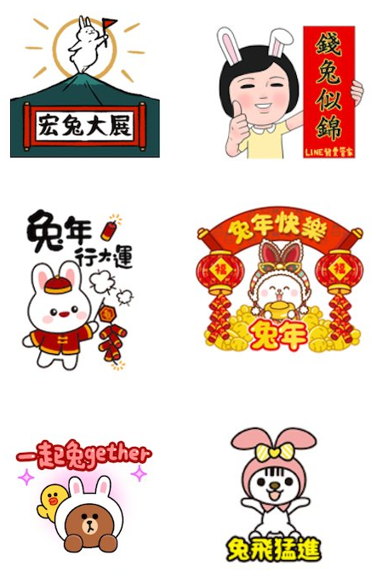
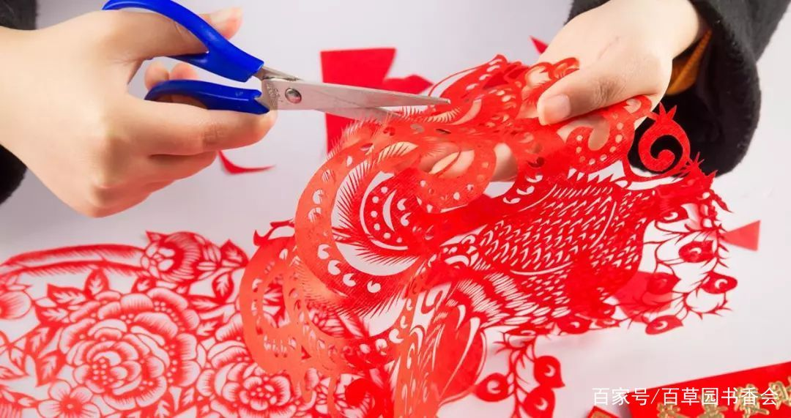
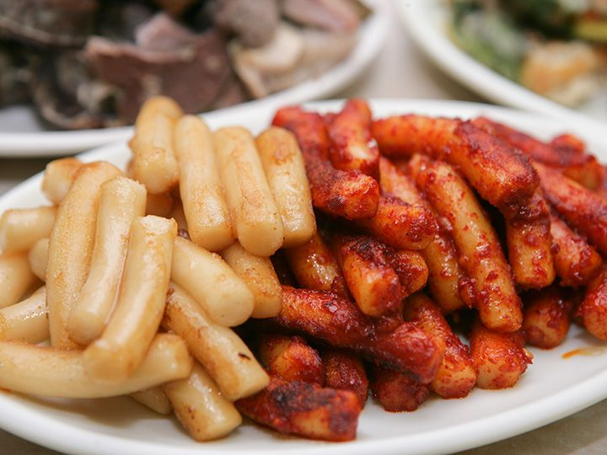
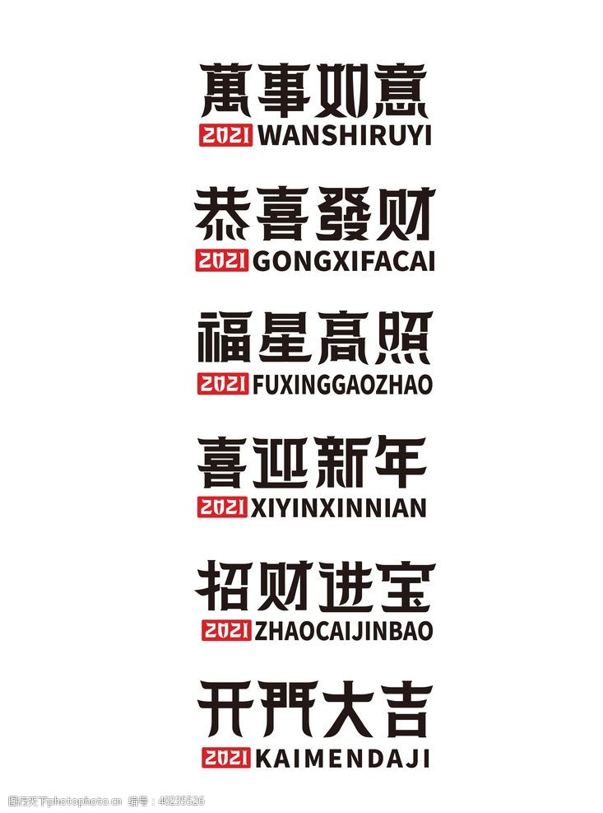
生肖（属相） 一轮十二年 以出生年份相配动物。 我属蛇。 兔年快乐
剪纸
跟春联一样贴在墙上
用于装点生活或配合其他民俗活动的民间艺术
吉祥话
是用于向他人或自己表示祝福的词语
年糕
中国汉族的传统食物，属于农历新年的应时食品

Slide 27
Customs/Habits
Drink warm water 喝热水
Acupuncture 针灸
cupping拔火罐
Shower before bed 洗澡
Take shoes off 拖鞋
no vertical chopsticks 插在米饭上
Gift exchanging 换礼物
Compliments 哪里、没有
Giving face 给面子 丢面子
Split trousers for children 开裆裤
Covering up in the sun 怕黑多穿一点
Naps at school and work 打盹
Exercise in the park 在公园运动
Park dancing 跳广场舞

Slide 28
Speaking Qs

Slide 29
Automatise sentences with vocab and grammar

Slide 30
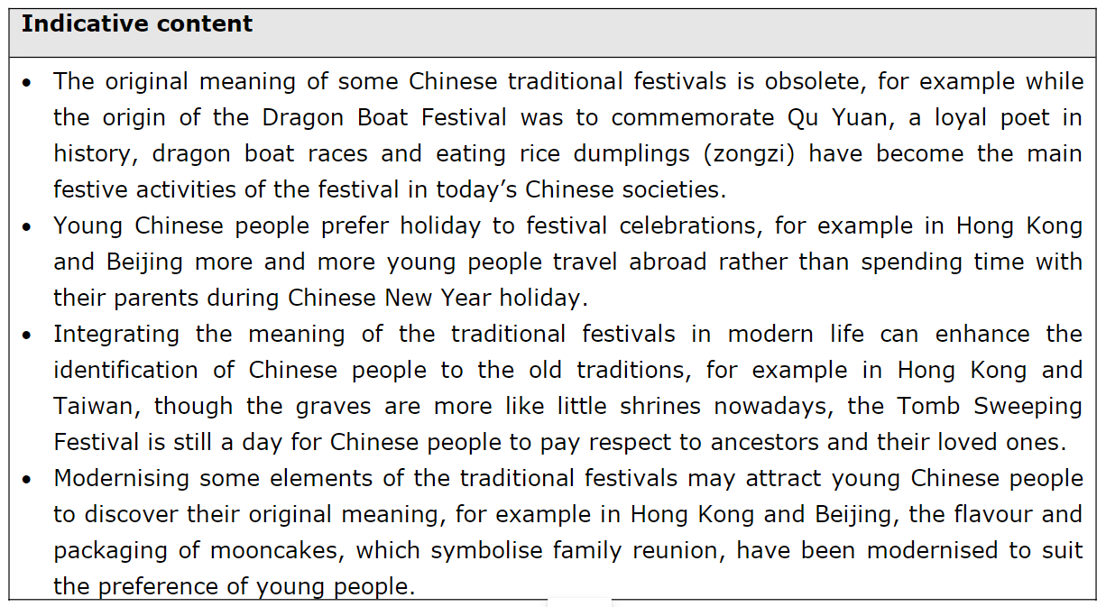
SAMs Indicative Content Translation

Slide 31

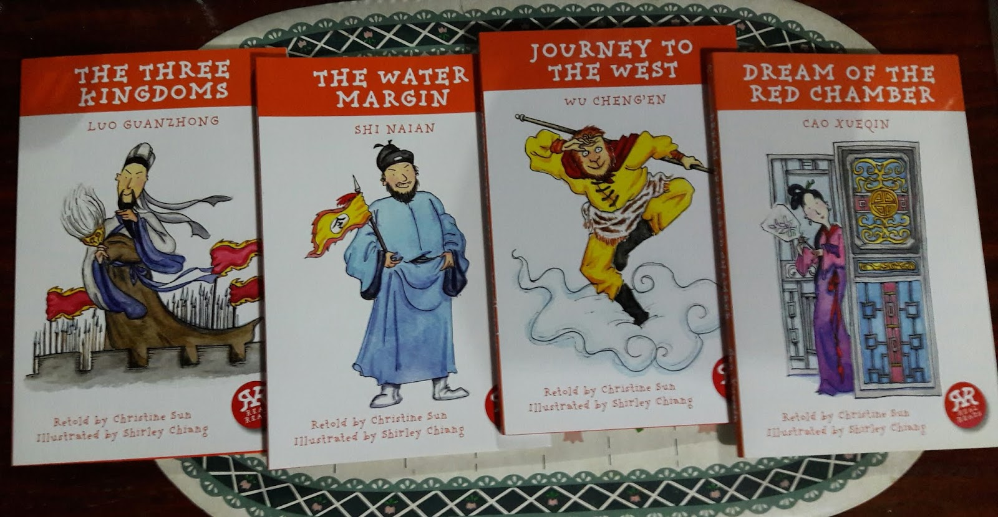
Reading 读书 4 eras: classics mao-era 80s 90s golden age modern online selfpublishing
Subtheme2 – cultural activities

Slide 32
4 classic novels
三国演义
Battles and intrigues of three kingdoms: Shu Han, Cao Wei and Eastern Wu
- “Oath of the Peach Garden.” Liu Bei (honest, loyal) sworn to Zhang Fei and Guan Yu
- CaoCao (ambitious and evil)
- ZhugeLiang Taoist sage and genius strategist
- Sunquan...forgettable.
English | Simplified Chinese | Century
Romance of the Three Kingdoms | 三国演义 | 14th
Water Margin | 水浒传 | 14th
Journey to the West | 西游记 | 16th
Dream of the Red Chamber | 红楼梦 | 18th
西游记
A monk and three disciples travel to get Buddhist scripture
The monk Tang Sanzang (唐三藏）
Monkey King - Sun Wukong (孫悟空)
Pigsy Zhu Bajie (豬八戒)
Sandy Sha Wujing (沙悟淨)

Slide 33
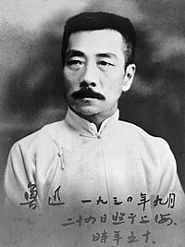
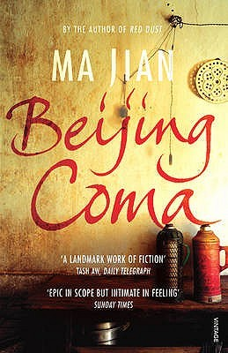



鲁迅 and 五四运动 （白话） 呐喊and 阿Q正传
毛时代 Communist era: propaganda 宣传
Socialist realism 社会主义实现主义
1956-7 百花运动 to 批评 the 共产党 (a trick)
80s and 90s Golden Era

Slide 34
Mao era
Fiction during the first years after the 1949 Communist revolution depicted the great social transformations taking place. Party leaders advocated socialist realism, which was marked by strict adherence to party doctrine and by a narrow emphasis on the credible depiction of external reality; it inhibited writers' creativity and led to stagnation.
The Hundred Flowers Campaign (1956–57) encouraged writers and other intellectuals to voice criticisms of party policy. Those who did so were soon punished during the 1957 antirightist campaign, when they were denounced and either imprisoned or sent to labor reform camps. Many, such as Wang Meng and Zhang Xianliang, were to remain confined for over two decades. Even harsher was the 1966–76 Cultural Revolution, during which thousands of intellectuals were sent to work on distant farms. Some writers, such as Lao She, were either murdered or committed suicide.
Following Mao Zedong's death in 1976 and Deng Xiaoping's consolidation of power in 1979, strictures on literary freedom were relaxed. The first stories from this period relate the nightmarish experiences of the Cultural Revolution—the literature of the wounded. Despite a crackdown on bourgeois liberalism and spiritual pollution, writing continued to flourish in the 1980s. Many works struggled with general social issues, such as official corruption and overcrowding; feminist issues were treated in novels by women writers such as Zhang Jie and Wang Anyi. Reportage literature, a hybrid of journalism and fiction, grew popular. Novelists experimented with stream of consciousness and other narrative techniques, while the Misty School of poets, exemplified by Bei Dao, Duo Duo, and Gu Cheng, developed a fusion of various modernist styles.
Han Shaogong, Ah Cheng, and others developed a seeking roots literature, characterized by rural settings, geographical and botanical descriptions, and the incorporation of local dialects and folklore. Zhang Xianliang, Gu Hua, and Can Xue were prominent among the regional writers who emerged, most notably from China's far west and south. After the massacre of prodemocracy demonstrators in Tiananmen Square (June 4, 1989), many writers fled China, fearing government reprisals for their support of the democracy movement. Most continue to write in exile, publishing their work in literary journals in Hong Kong, Taiwan, and overseas.

Slide 35
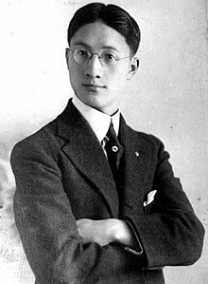

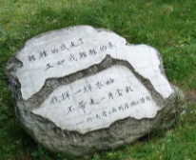
徐志摩 剑桥的诗人
再别康桥
轻轻的我走了，
正如我轻轻的来；
我轻轻的招手，
作别西天的云彩。
1910-20年的新文化运动是批评古代文学，而鼓励现代西方的文学。也推动科学，民主等等
特别反对孔子主义，特别支持白话与女权

Slide 36
Online – self publishing 自行出版
Most publishers are state-owned 国有出版商 – if not they are definitely censored 审查 and even harassed 骚扰
Online publishing using fake names is safe-ish 笔名
Super weird :) (BL, XianXia, WuXia, XuanHuan)
Drama adaptations 改写 – The Untamed!! 陈情令

Slide 37
Wuxia (武俠 wǔxiá) – literally means “Martial Heroes”. Fictional stories about regular humans who can achieve supernatural fighting ability through Chinese martial arts training and internal energy cultivation. Themes of chivalry, tragedy, revenge & romance are common.
Xianxia (仙侠 xiānxiá) – literally means “Immortal Heroes”. Fictional stories featuring magic, demons, ghosts, immortals, and a great deal of Chinese folklore/mythology. Protagonists (usually) attempt to cultivate to Immortality, seeking eternal life and the pinnacle of strength. Heavily inspired by Daoism.
Comparison: If Wuxia is “low fantasy”, then Xianxia is “high fantasy”.
Xuanhuan (玄幻 xuánhuàn) – literally means “Mysterious Fantasy”. A broad genre of fictional stories which remixes Chinese folklore/mythology with foreign elements & settings.
https://immortalmountain.wordpress.com/glossary/wuxia-xianxia-xuanhuan-terms/

Slide 38
https://www.globaltimes.cn/page/202110/1236613.shtml
More than 10,000 Chinese internet literature works have been released overseas as of 2020, becoming the biggest IP source for Chinese cultural works introduced to the world,
The success of so many Chinese online literature works overseas is mainly due to China's improved cultural confidence. Most of the works tell about the traditional Chinese culture, which has always been very popular among readers overseas
Due to this success overseas, some Chinese dramas adopted from these literature works have also become highly popular among audiences overseas. For example, the drama Legend of Fuyao adapted from the novel of the same name debuted on many mainstream streaming platforms in Europe and North America; The Rise of Phoenixes, adapted from the novel Huang Quan, became the first Chinese ancient costume drama to be purchased by Netflix and is being translated into over a dozen languages; the TV series Joy of Life landed on a variety of media platforms and TV stations in 27 countries and regions on five continents to great reviews.

Slide 39

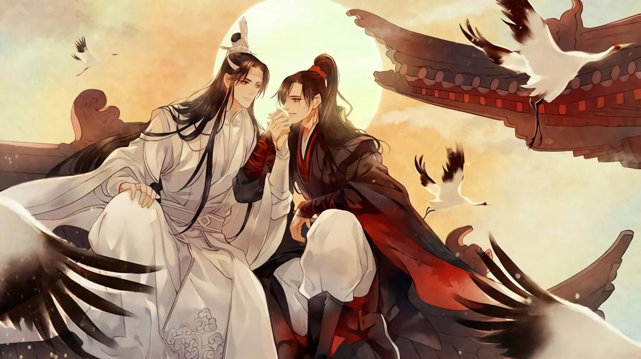
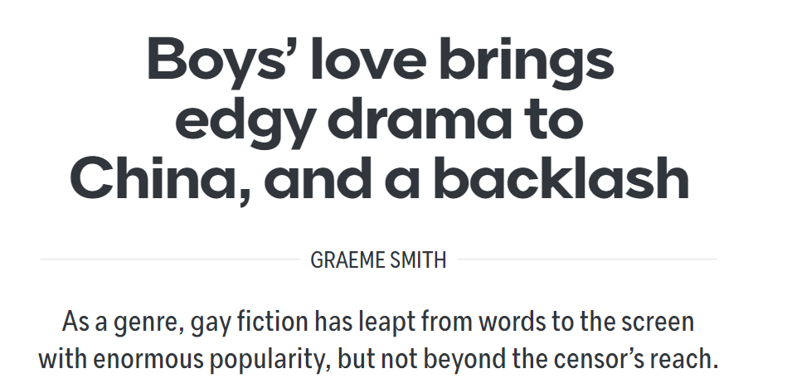
https://www.lowyinstitute.org/the-interpreter/boys-love-brings-edgy-drama-china-backlash
耽美是女人写的书，关于男人同性恋的关系。是1990年代从日本带过来的
https://www.vice.com/en/article/7k95mg/boys-love-drama-china-tv-untamed-lgbtq
Censorship due to fears that they are negative male role models, and that it leads to women not having children (het women writing and reading gay literature turns them gay?!) in a demographic crisis.
Anti-western and anti-Japanese sentiment, nationalism... all related.

Slide 40

漫画 mainland/TW/HK imported from Japan https://www.nickstember.com/dont-call-manga-short-introduction-chinese-comics-manhua/

Slide 41
Speaking Q
近年来中国年轻人为什么阅读中国文学作品？（2022）
对中国文学作品的兴趣增加有什么好处？(2022)

Slide 42
Automatise sentences with vocab and grammar

Slide 43
电影
Subtheme2 – cultural activities
Cultural revolution – 样板戏 revolutionary operas
Awesome 80s and 90s – promotion abroad
Modern era – Internationalisation. Idol culture. Investment.

Slide 44
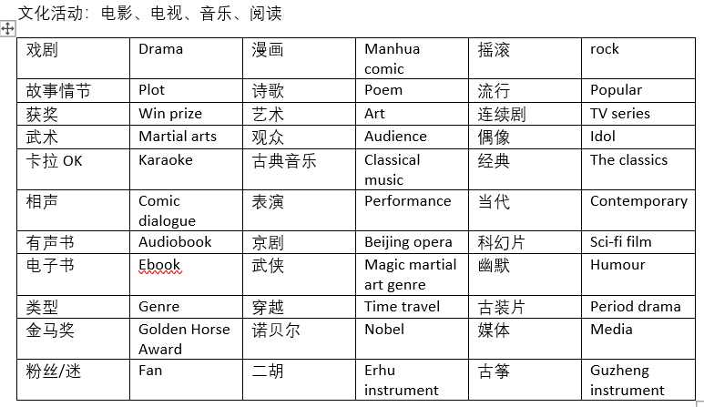
Vocab to learn immediately

Slide 45
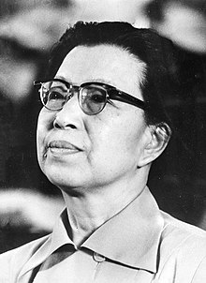
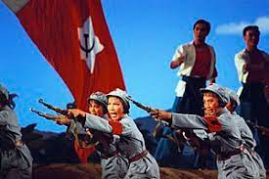
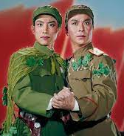
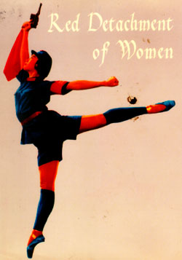
文化大革命 - 样板戏 江青
https://www.npr.org/sections/deceptivecadence/2013/04/24/178900162/explore-madame-maos-hollywood-fantasies?t=1643728344522

Slide 46
clip

Slide 47
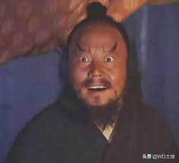
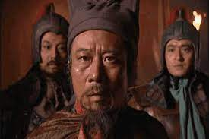
Awesome 80s and 90s
Some scar dramas 伤痕文学of the difficulties of the CR
Rejection of Socialist Realism in favour of depth and real people’s lives
Filming the classics:
Water Margin
Monkey King
True Story of Ah Q

Slide 48
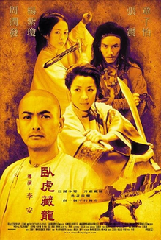

Modern Era
卧虎藏龙
Joint Sino-American
Ang Lee (李安) 4 Oscars
Filmed in Mandarin
卧虎藏龙：青冥宝剑
Netflix
Yuen Woo-Ping
ABC cast and filmed in English

Slide 49



Chinese Actors in Hollywood 好莱坞的华人演员
Chow Yun Fat
Jackie Chan
Michelle Yeoh
I’m pretty sure they are all from HK…why?

Slide 50



The casting of ‘Asians’ as each other
Ken Jeong 韩国人演了中国人
Simu Liu 演过韩国人的华人
Zhang Ziyi 被请演日本女人的中国人

Slide 51
Automatise sentences with vocab and grammar

Slide 52
Speaking Qs

Slide 53

https://www.wipo.int/wipo_magazine/en/2016/02/article_0004.html

Slide 54


https://variety.com/2021/film/asia/china-box-office-champion-1235142005/

Slide 55

https://www.statista.com/topics/5776/film-industry-in-china/#dossierKeyfigures

Slide 56
电视
- 电视剧
- 综艺节目
- 新闻CCTV

Slide 57

电视剧 - 白蛇传
《新白姑娘的传奇》是中国大陆神话古装连续剧。

Slide 58






Meteor garden 流星花园

Slide 59
华人社会的电视剧为什么越来越多样化？有什么好处？

Slide 60

Sound effects 音效 fastpaced 快节奏 noisy 吵 content 内容
综艺节目： 快乐大本营

Slide 61



Monopolies 垄断企业
CCTV 中国中央电视台 – 全国家
湖南卫视 – 快乐大本营、超级女声
https://w.mgtv.com/
客人
明星
主持人 – 何炅
在背景的大裤衩

Slide 62

华人社会电视剧多样化！
2017年电视剧立项题材情况统计
http://market.chinabaogao.com/chuanmei/11IN1D2018.html
Vocab:
连续剧
放映
普及
Qs
比如说？
为什么？
好处？坏处？
制作理念也从“以量取胜”向“以质取胜”转变，

Slide 63
由上可知，2017年当代题材电视剧占比达59%；近代题材电视剧比例逐年下降，2017年近代题材电视剧更是下降至17%。古代题材电视剧占比也出现了近年来的首次下滑，基本与近代题材占比持平。 可以看出，电视剧制作理念也从“以量取胜”向“以质取胜”转变。越来越多的制作方追求精品化策略，寻求多样化的发展。

Slide 64
https://m.xzbu.com/7/view-4460770.htm article
随着我国经济的不断发展、人们生活水平的不断提高，人们的消费观念和消费水平也有了很大的转变与提升。在这个契机下，电视剧制作行业也得到了快速发展
http://baogao.chinabaogao.com/yingshidongman/375400375400.html
There is a whole 2019 report

Slide 65
https://www.cnbc.com/2019/05/10/netflix-has-a-china-strategy-it-doesnt-involve-launching-there-soon.html
Netflix is still not available in China
Instead, the U.S.-based streaming company has recently been spending more money on acquiring rights to Mandarin-language content and producing its own originals.
In September, the technology giant unveiled the cast for its Mandarin-language original TV series called “Nowhere Man.” In January, it kicked off production for two more originals, called “Triad Princess” and “The Ghost Bride.” Two of the shows will be filmed in Taiwan and one in Malaysia. (note not mainland China)
The aim is to create shows for the millions of Mandarin speakers outside of China. It’s also looking to create or acquire shows that have global appeal.
Netflix has also turned to partnering with Chinese streaming companies. On Thursday, Alibaba-owned streaming platform Youku said Netflix had bought the exclusive distribution rights outside of China for “I Hear You,” a 24-episode romantic comedy.
Former partnership with iQiyi, a streaming service which is majority-owned by Chinese search giant Baidu. In 2017, Netflix agreed to license some of its original content to iQiyi to access the Chinese market. Now discontinued.

Slide 66

https://www.scmp.com/lifestyle/entertainment/article/3128441/chinese-tv-series-grow-popularity-overseas-movies-are

Slide 67
Speaking Qs
你看过什么电视剧？
最近中国的电视剧在西方越受欢迎，为什么?
华人社会的电视剧越来越多样化 - 为什么？
大家还看电视吗？还是在线看电视剧比较流行？

Slide 68
音乐
Classical
Peking Opera 京剧
Instruments 二胡、古筝、琵琶、笛子
Communists and crooners
样板戏
月亮代表我的心
Rock legends
Political student life
Taiwan and 五月天
Pop era and idols
TFBoys and M subgroups of Kpop, Jpop
周杰伦、王力宏、邓紫棋
Classical 古典（音乐）
Pop 流行
Rock 摇滚
Indie 独立
Hip hop 嘻哈
Jazz 爵士
Disco 迪斯科

Slide 69


京剧
Qing Dynasty
Unprecedented
Flourish
Quintessence
Accompaniment
京剧形成后在清朝宫廷内得到了空前的繁荣。京剧主要用胡琴和锣鼓等伴奏，被视为中国国粹。
https://www.youtube.com/watch?v=ka5z3uYctug
https://www.youtube.com/watch?v=TDD3AnPmU7o

Slide 70

传统乐器
Match
琵琶
笛子
二胡
古筝

Slide 71
Communists and crooners
共产时代
完全没有外国音乐
江青的样板戏
收音机上的红歌
政治歌以及宣传
第一浪歌手
上海1920 – 时代曲
共产党的审查 – 逃跑到香港、台湾
有点外国影响
更多广播电台
由于没有宣传的用意所以更多爱情歌曲
80年代是明星的时代
00s音乐组合比较受欢迎
电视上的比赛节目

Slide 72

月亮代表我的心
Theresa Teng （卡拉OK）
MayDay
Jon Bon Jovi

Slide 73


Rock legends
Political student life
Taiwan and 五月天
摇滚乐队
抗议活动
政治意义
崔健的一无所有 https://www.youtube.com/watch?v=KuoEBUtZIJQ
1997 – now
五月天

Slide 74






周杰伦
王力宏
邓紫棋
流行音乐与偶像时代
TFBoys and M subgroups of Kpop, Jpop

Slide 75






世界博览会 上海2010
参展者向世界各国展示当代的文化、科技和产业上正面影响各种生活领域的成果。

Slide 76
中国流行音乐在哪些方面影响中国年轻人的生活？（2019）
向外国人介绍中国流行音乐的方法有哪些？（2019）

Slide 77

SAMs Indicative Content Translation

Slide 78
Automatise sentences with vocab and grammar

Slide 79
Speaking Questions!!
中文音乐好不好听？
传统的音乐还红吗？
你最喜欢哪些中国歌手？
歌手或音乐对一定是偶像吗？

