Slide 1
Phonics: Integrating teaching and assessment across KS3 and KS4 Lucy Wicks, Head of Chinese and SLE Didcot Girls’ School, Oxfordshire lwicks@didcotgirls.oxon.sch.uk
First, an introduction… A bit about me ☺
17 years of teaching German, Spanish, Mandarin and French (also Business Studies) in 3 UK comprehensive schools
1 year of teaching English in Beijing (and many years of self-study of Chinese since then)
Currently teach on Oxford University MFL PGCE programme
SLE – assisting other schools to set up and teach Chinese, develop curriculums for KS2 to KS5

Slide 2
AIMS OF THIS SESSION:
Why does Ofsted value phonics teaching as highly as vocabulary and grammar? What does the research say about teaching phonics?
Find out other advantages can teaching and assessing phonics bring to students, aside from better pronunciation?
Look at some fun and engaging ways of integrating phonics into regular lessons and schemes of work?
Hear from students –do they like learning phonics?

Slide 3
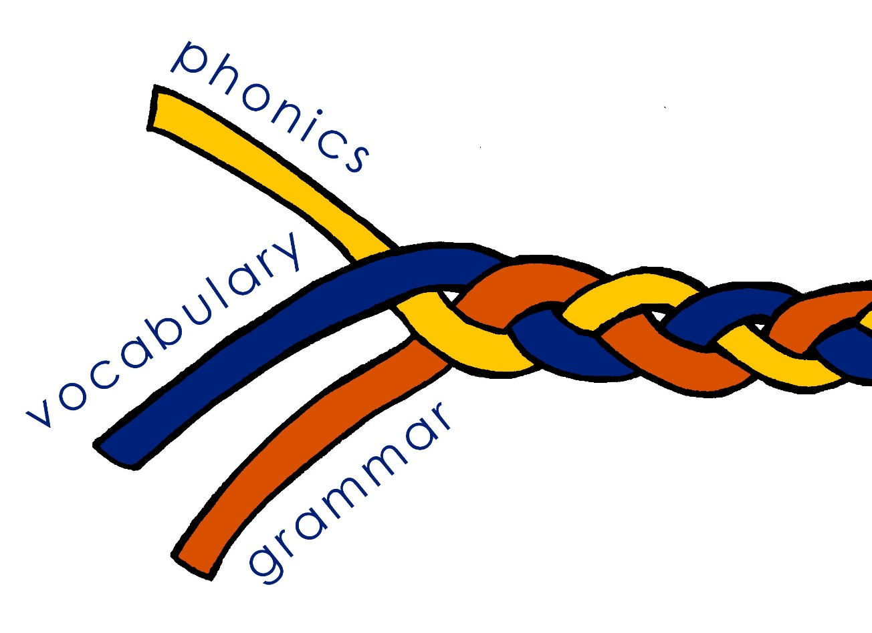
Teaching Schools Council MFL Review 2016
https://ncelp.org/resources/mfl-review/
Pupils need to gain systematic knowledge of the vocabulary, grammar, and sound and spelling systems (phonics) of their new language, and how these are used by speakers of the language. They need to reinforce this knowledge with extensive planned practice and use it in order to build the skills needed for communication. (MFL Pedagogy Review, p.3)

Slide 4
Me previously…. “Phonics? Isn’t that what PINYIN is for?” “I’ll just do some intro lessons in Year 7 (2 or 3 should do it) then they’ll get it and be able to pronounce new words they learn without my help…
Me,5 years later during GCSE speaking exams….
This Photo by Unknown Author is licensed under CC BY-SA

Slide 5
Group discussion: Why teach phonics?
1) Read through the rationale document on the table, discuss the 12 reasons to teach phonics in pairs/groups and come up with your top THREE reasons.
Extension task ;) Come up with MORE reasons!?!
2) Discuss: When/ how do you currently teach phonics?
How long does it take?

Slide 6
My top 3…
Teaching phonics develops phonological decoding (the ability to sound out accurately), and without explicit phonics teaching, decoding is limited.
Decoding is positively associated with motivation and improves confidence in production (speaking and writing).
Phonics teaching supports vocabulary learning, which is key to making progress in language learning.
Decoding enables learners to access new language autonomously; learners can engage with vocabulary learning more successfully in and beyond the classroom, even ahead of the lesson (flipped learning), allowing more lesson time to focus on language practice and use.
Teaching phonics teaches phonemes and each phoneme carries meaning; the function of the different sounds really matters. This links not only to vocabulary but also to grammar (je vs j’ai, aller vs allait, hablo vs habló).

Slide 7
My top 3…
6. Without teaching the sound-writing relationship, teachers logically confine themselves to presenting vocabulary first orally to their beginner learners, and only subsequently provide the written forms, which limits variety in teaching methodology.
7. Teaching phonics teaches the sound system; learners do not have enough exposure to become familiar with the sound system incidentally (i.e., without intentionally trying to learn it). Even an ‘all oral’ approach at primary would only give them a maximum of 120 hours (the equivalent of a few weeks in the womb in L1 acquisition!). So, explicit decoding teaching allows teachers to ‘short-cut’ to teaching the sound and writing at the same time.
8. The ability to sound out words accurately on first exposure supports errorless learning, avoiding an inaccurate initial representation which, if persistent, can lead to problems later.
9. Accurate decoding may allow learners to see that a written word is in fact a word that they already know orally.

Slide 8
My top 3…
10. Alternatively, learners’ ability to spell an unknown word they hear means that they can then find out its meaning (via a dictionary, peer, teacher, books); having the correct or nearly (possibly) correct spelling unlocks the meaning!
11. In addition, learners can ask orally about the meaning of a word that they have read; you need to be able to pronounce a word to ask about it confidently in class (What does ‘XXX’ mean?).
12. The time spent on teaching phonics does not seem to delay progress in other areas (e.g., reading comprehension).

Slide 9
Definitions
Erler and Macaro 2012
Woore et al, 2018
Porter, 2014
Goswami, 2005
Phonics teaching
explicit teaching of the relationships between letters and their sounds in written words
Sound-symbol correspondences (SSCs)
the systematic relationships between the written symbols and sounds
Phonological decoding (or ‘recoding’)
“the ability to convert the visual print into its corresponding spoken form” Nassaji (2013)
Word recognition / identification (or ‘lexical access’)
“the skill with which readers process the visual symbols in the print in order to recognize and access its meaning in the mental lexicon” Nassaji (2013)
Orthographic depth
A measure of how consistent and transparent the mappings are between graphemes and phonemes in a given writing system.

Slide 10
What does the Science say?
Many L2 learners do try to sound out words they don’t know when reading (Erler & Macaro, 2011)
The ability to decode accurately in L2 may additionally support:
vocabulary learning (Hamada & Koda, 2008, 2011; Li, 2019; Li & Woore, in progress)
learner autonomy
grammar learning (Erler, 2003) → je / j’ai parle/ parlé
motivation (Erler & Macaro, 2011)
speaking; listening; writing (Macaro, 2007)

Slide 11
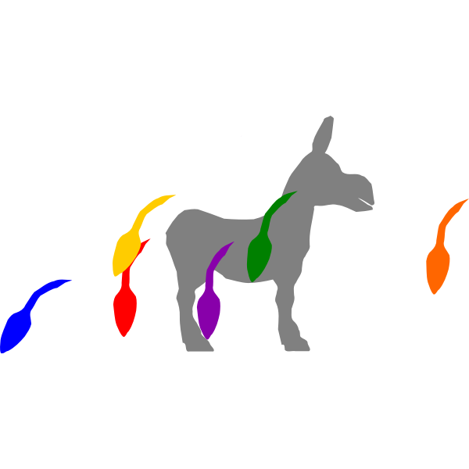
Why teach phonics? [3/3]
Research in UK MFL classrooms (mainly L2 French) suggests that without explicit instruction:
students are not very good at phonological decoding (reading aloud);
they seem to make little progress in this area;
English spelling-sound links remain stubbornly entrenched;
students may know that words should sound different to English, but not know how they should sound.
Sources: Erler, 2003, 2004; Erler & Macaro, 2012; Porter, 2014, forthcoming; Woore, 2009, 2010, 2011, 2014, 2018

Slide 12
Progression
Curriculum plans show clear logic behind progression in phonics, including around when to teach differences between English sound–spelling correspondences and those of the target language.
Planned practice and review of phonemes and how these link to graphemes is in place.
Curriculum plans show how small differences in sound can unlock meaning for pupils.
Main resources used:
- McGraw-Hill Chinese Pronunciation
- Yoyo Chinese (Youtube clips and interactive pinyin chart)
- Microsoft Teams for ‘Reading Progress’ assignments
- Various poems and songs with lyrics (incl. Pinyin Learner on Youtube)

Slide 14
First lesson in Sequence
Taken from McGraw-Hill book "Chinese Pronunciation"

Slide 15
2nd lesson

Slide 16
Left-Right Game “左右 游戏”
ná 1 má
yī 2 lì
fá 3 fă
3rd lesson
mò 4 mō

Slide 17
4th : Retrieve, sing

Slide 18
5th: Low Stakes Assessment (warm up – sing song from previous task)

Slide 19
Follow up homework: Reading Progress with Teams assignment
Student Name
Student Name

Slide 20
How to use Reading progress on Microsoft Teams
https://youtu.be/UCZUAfRW3H0
Tips for using Reading Progress:
1) Only characters are allowed to be uploaded, so give them the text with pinyin on paper to read from.
2) Encourage students to not 'um' and 'ah' -they can listen back and have another go!
3) If students find they cannot access microphone/camera, tell them to do it on a smartphone
4) If they don't want to be on camera, just tell them film the table.

Slide 22
Poetry: 咏鹅 yǒng é (“An Ode to the Goose”, by Luo Binwang) Written by Tang Dynasty poet Luo Binwang when he was only seven years old, “An Ode to the Goose” is a particularly simple and easy to memorize poem, resulting in it often being one of the very first famous Chinese poems to be learned by Chinese children.
Goose, goose, goose,
You bend your neck towards the sky and sing.
Your white feathers float on the emerald water,
Your red feet push the clear waves.
鹅、鹅、鹅， É, é, é,
曲项向天歌。qū xiàng xiàng tiān gē
白毛浮绿水，Bái máo fú lǜ shuǐ,
红掌拨清波 hóng zhǎng bō qīng bō
Tasks:
1) colour initials and finals in different colours
2) look for certain sounds you've been learning, eg. Zh, Q
3) find the rhyme (before you listen)
4) hear a youtube clip of someone reading it (often with background music) -relaxing!
5) read with a partner / read in your head / fill gaps when listening etc etc etc

Slide 23
Speaking aloud class challenge: Beat the Wave!!
É, é, é,
qū xiàng xiàng tiān gē
Bái máo fú lǜ shuǐ,
hóng zhǎng bō qīng bō

Slide 24
听写Dictation
Nǐ hǎo! Wǒ jiào Lucy. Wǒ de jiā yǒu wǔ kǒu rén; māmā, bàba, jiějiě, dìdì hé wǒ.
N_ h_ _ ! W_ j _ _ _ Lucy!
W_ d_ j_ _ y_ _ w_ k_ _ r_n;
m_m_ , b_b_, j_ _j_ _ , d_d_ h_ w_
Answers：（1 mark for EACH letter!)
Nǐ hǎo! Wǒ jiào Lucy.
Wǒ de jiā yǒu wǔ kǒu rén;
māmā, bàba, jiějiě, dìdì hé wǒ.

Slide 25
Any questions?

Slide 26
References
Erler, L.,& Macaro, E. (2011). Decoding ability in French as a foreign language and language learning motivation. The Modern Language Journal, 95(4), 496–518. http://dx.doi.org/10.1111/j.1540-4781.2011.01238.x
Goswami, U. (2005). Synthetic phonics and learning to read: a cross-language perspective. Educational Psychology in Practice, 21(4),273–282. https://doi.org/10.1080/02667360500344823
Porter,A.M.(2014).An early start to French literacy: Teaching the spoken and written word simultaneously in English Primary School Classrooms. Unpublished PhD thesis. University of Southampton https://eprints.soton.ac.uk/374731/
Woore, R., Graham, S., Porter, A., Courtney, L. & Savory, C.(2018). Foreign language education: unlocking reading (FLEUR): A study into the teaching of reading to beginner learners of French in secondary school. Funded by The Nuffield Foundation.

