Slide 1
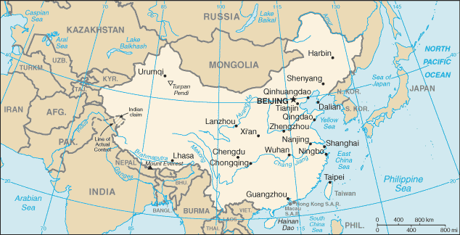
China – a demography

Slide 2
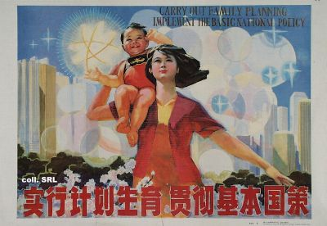
DEMOGRAPHIC DATA 2006
Population: 1,313,973,713
Age structure:
0-14: 21% 15-64: 71% 65+: 8%
Population growth rate: 0.6%
Birth rate: 13‰ Death rate: 7‰
Sex ratio: under 15 years: 118 male/100 female
Infant mortality rate:
total: 23‰ male: 21‰ female: 26‰
Life expectancy at birth: total population: 73 years
male: 71 years female: 75 years
Total fertility rate: 1.7 children born/woman

Slide 4
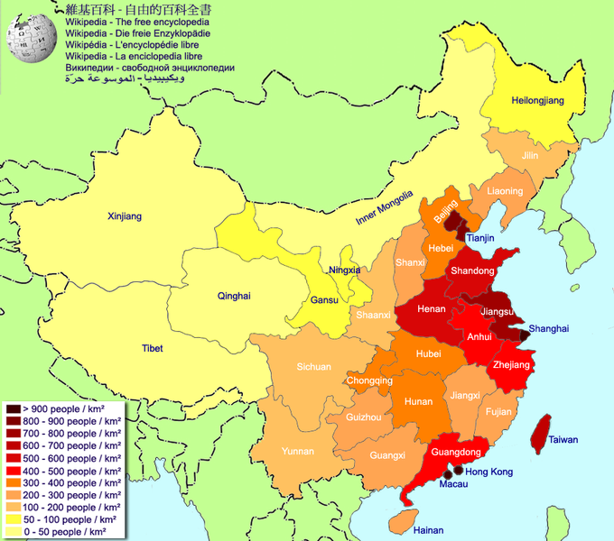
POPULATION
DENSITY

Slide 5
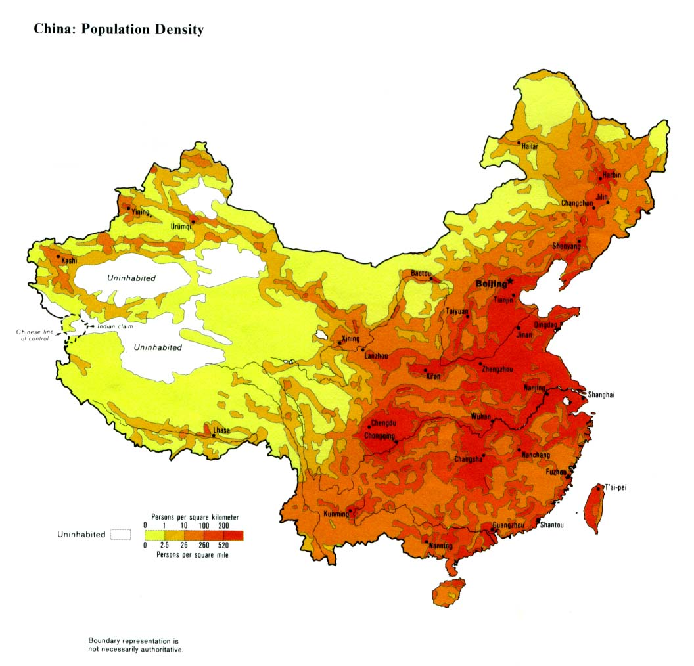
POPULATION
DENSITY

Slide 6

Later, Longer, Fewer
中华人民共和国
Zhōnghuá Rénmín Gònghéguó
People’s Republic of China

Slide 7
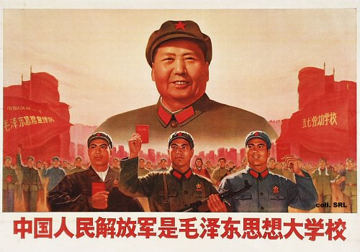
POPULATION POLICIES
During Mao Zedong's rule the population policy of China was “the more people, the stronger we are”, leading to overpopulation and a series of famines.
When Deng Xiaoping took power in 1978, his new policies focused on strengthening China's economy, and he saw overpopulation as a block to economic development.
        During the 1960s the population growth rate averaged 2.4% per year

Slide 8
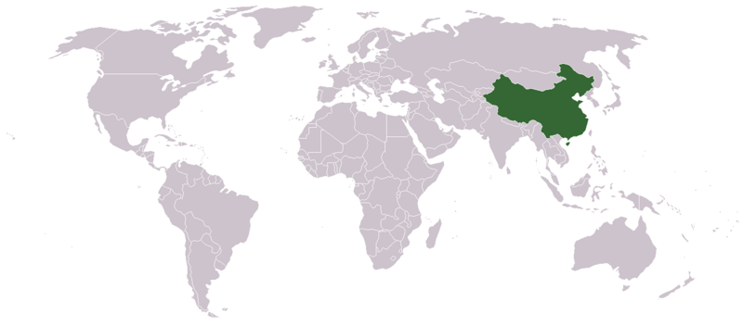

1970 POPULATION POLICY
In the 1970s the Chinese government had issued three policies to reduce the birth rate:
1 Late marriage – men were encouraged to marry no earlier than 28 years old (25 in rural areas) and women no earlier than 25 years old (23 in rural areas).
2 Longer spacing between births – couples were encouraged to allow at least a four-year gap after the first child before having another baby.
3 Fewer children – it was suggested that urban families should be limited to two children, and rural families to three children.

Slide 9
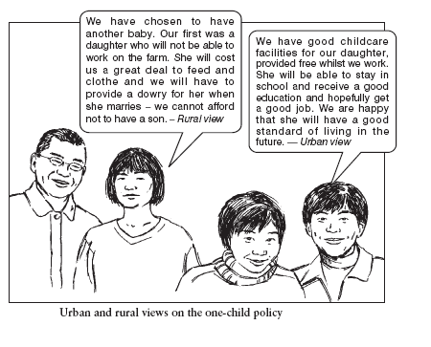
1979 POPULATION POLICY – THE ONE CHILD POLICY
In 1979 the authorities tightened their control and limited households to only one child.
The goal of this policy was to limit China’s population to 1.2 billion by the year 2000.

Slide 10
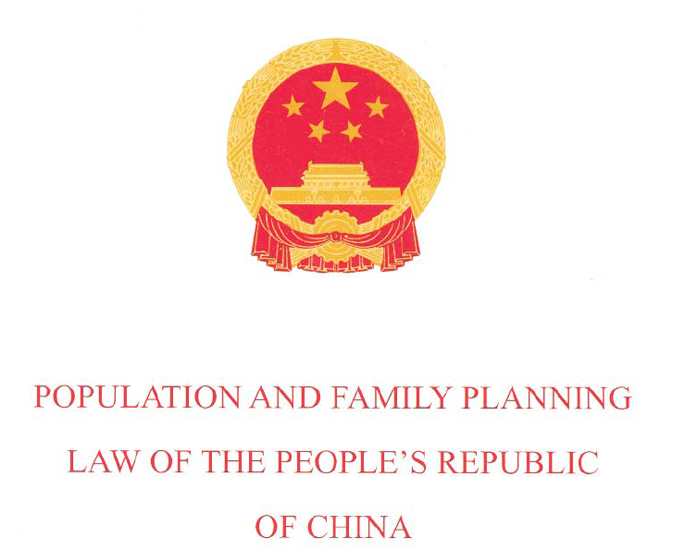
2002
POPULATION
POLICY

Slide 11

POPULATION and FAMILY PLANNING LAW
Article 8 The State gives rewards to organisations and individuals that have scored outstanding achievements in the population programme and family planning.
Article 18 The State maintains its current policy for reproduction, encouraging late marriage and childbearing and advocating one child per couple.
Article 19 Family planning shall be practised chiefly by means of contraception.
Article 22 Discrimination against,
maltreatment and abandonment of baby girls are prohibited.

Slide 12
POPULATION and FAMILY PLANNING LAW
Article 23 The State rewards couples who practise family planning.
Article 27 The State shall issue to a couple who volunteer to have only one child in their lifetime a “Certificate of Honour for Single-Child Parents”. Couples who are issued the said certificate shall enjoy rewards.
Article 35 Use of ultrasonography or other techniques to identify foetal gender for non-medical purposes is strictly prohibited.
Sex-selective pregnancy termination for
non-medical purposes is strictly prohibited.

Slide 13
POPULATION and FAMILY PLANNING LAW
Article 41 Citizens who give birth to babies not in compliance with the provisions of Article 18 of this Law
shall pay a social maintenance fee prescribed by law.
Article 47 This Law shall go into effect as of September 1, 2002.
中华人民共和国
Zhōnghuá Rénmín Gònghéguó
People’s Republic of China

Slide 14
2002
POPULATION
POLICY
MARRIAGE LAW
OF THE PEOPLE’S REPUBLIC
OF CHINA

Slide 15

MARRIAGE LAW
Article 6 In order to get married, the man shall not be younger than 22 years old and the woman shall not be younger than 20. Late marriage and late child birth shall
be encouraged.
Article 16 Both husband and wife shall be under the obligation of following the policy of birth control.

Slide 16
"Later,
Longer,
Fewer "
The Planned Birth policy of the government of the People's Republic of China is known as the One-child Policy
LATER Delayed marriage and delayed child bearing
LONGER Longer spacing between births
FEWER Fewer children – ideally one child per couple

Slide 17
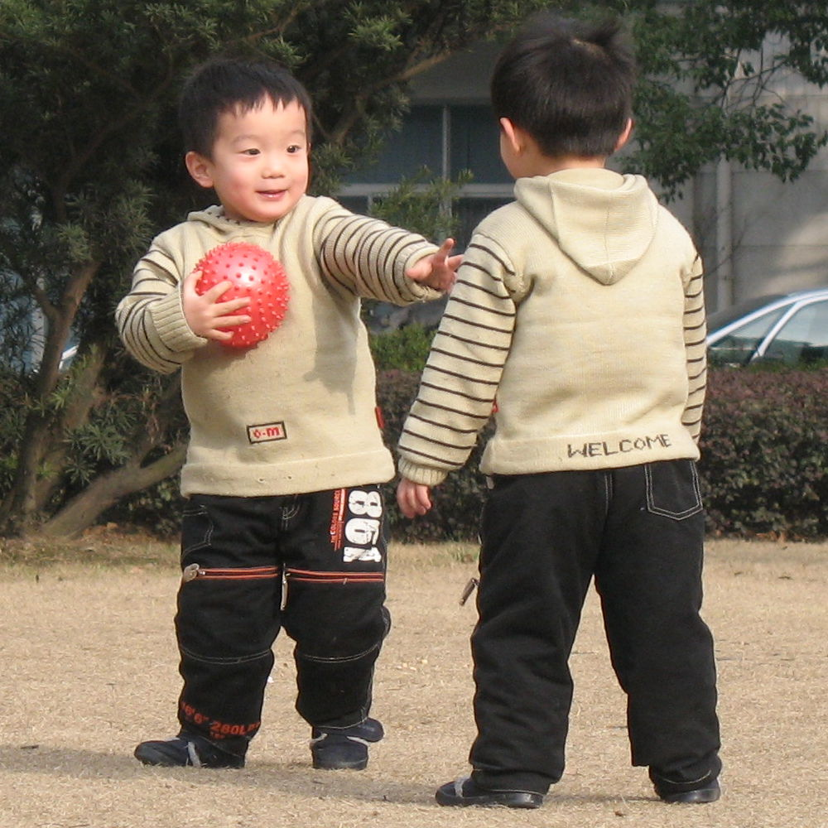
ONE CHILD POLICY – TWO CHILD REALITY
There are no sanctions
for couples who have
multiple births.

Slide 18

ONE CHILD POLICY – TWO CHILD REALITY
Wealthy couples are apparently increasingly turning to fertility medicines to have multiple births, due to the lack of penalties against couples who have more than one child in their first birth.

Slide 19
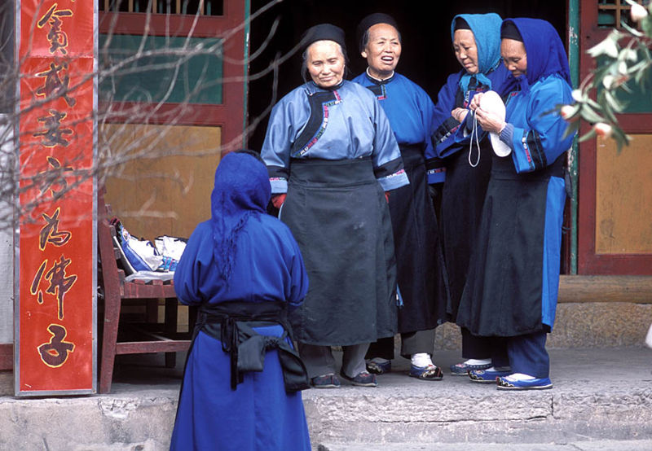
ONE CHILD POLICY – TWO CHILD REALITY
Ethnic minorities are formally excluded from the policy
Han, the majority ethnic group, in traditional costume
The People's Republic of China (PRC) officially recognizes 56 distinct ethnic groups, the largest of which are Han Chinese, who make up about 92% of the total population.

Slide 20
ONE CHILD POLICY – TWO CHILD REALITY
If both parents are only children they are allowed to
have more than one child provided the children are spaced more than 4 years
In most rural areas if the first child is a girl couples are allowed to have another child
Families who have children with mental or physical disabilities are sometimes allowed to have another child

Slide 21




ONE CHILD POLICY –
TWO CHILD REALITY
Children born outside of China
Some parents manage to be outside the country or in Hong Kong, Macau, or Taiwan when giving birth to their child. Those children do not count in the one-child policy, even if they are technically a natural born Chinese citizen through parentage.
TAIWAN
MACAU
HONG KONG

Slide 22
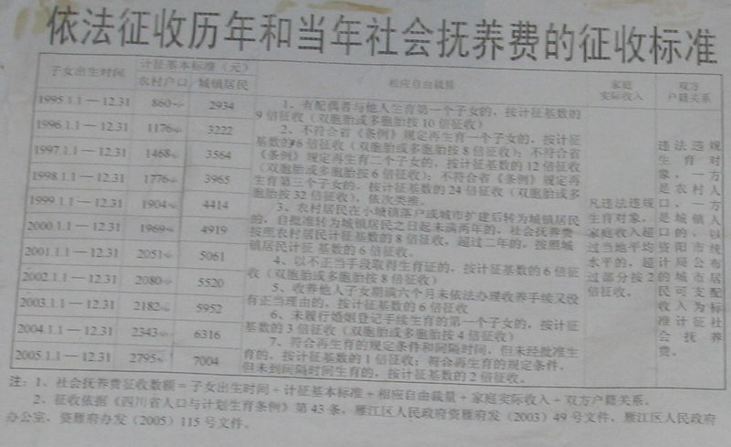
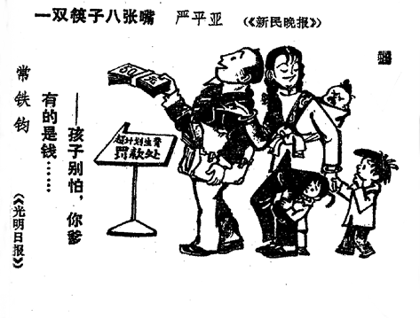
ONE CHILD POLICY – TWO CHILD REALITY
In addition to the exceptions
permitted by law some
couples simply pay a fine,
or "social maintenance fee"
to have more children.
Notice explaining the collection of the social maintenance fee (family planning fine) at Danshan, Sichuan.
As a result the overall fertility rate is closer to two children per family than to one child per family.
2

Slide 23
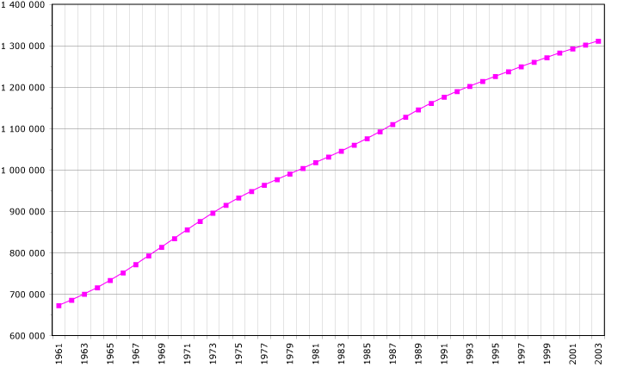
POPULATION GROWTH 1961 - 2003

Slide 25
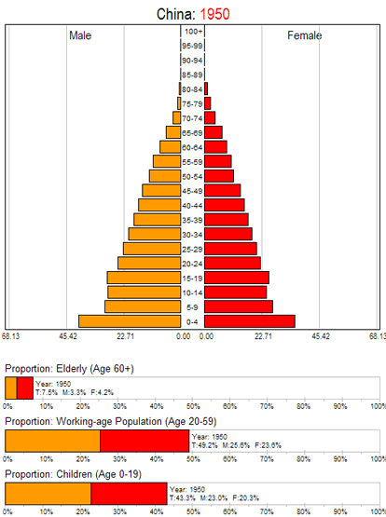
POPULATION
PYRAMID
1950 to
2050
In 1950 the population structure of China was typical of an ELDC.

Slide 26
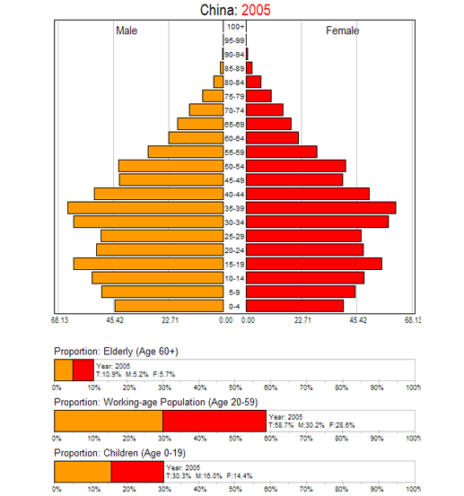
POPULATION
PYRAMID
2005
While the number of children was increasing rapidly between 1950 and about 1970, it is now declining significantly, due to China's one-child family planning programme.

Slide 27
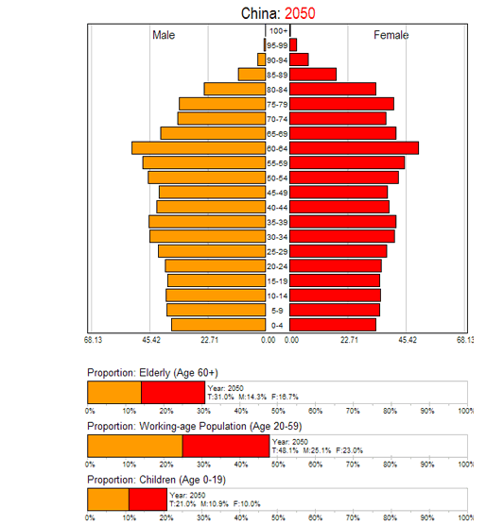
POPULATION
PYRAMID
2050?
In the next few decades, China will experience population ageing - as can be seen by the shrinking base of the population pyramid and the increasing numbers of people age 50 and above.

Slide 28
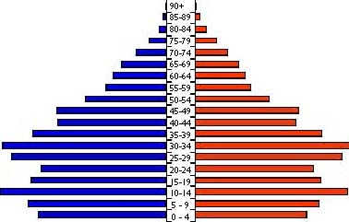
POPULATION PYRAMIDS – FEATURES of LICs
The population pyramid of a country will change through time as it develops. If a country starts to improve health care and diet, and reduce infant mortality by investing in post natal care strategies and a nationwide vaccination programme for infant diseases then people will live longer and the pyramid will become wider through the age groups
The higher life expectancy and high birth rate means a higher dependant population
Working
Age population
If population rises too quickly because life expectancy is improving and there are more potential child bearing females then the government might try to introduce some form of family planning programme allowing couples to have greater control over the number of children they have. In Chinas case they were even stricter with the introduction of the one child policy
This is shown up in an indent in the youngest age groups
The solid shapes show what the pyramid used to look like and brings out the widening of the pyramid
China

Slide 29
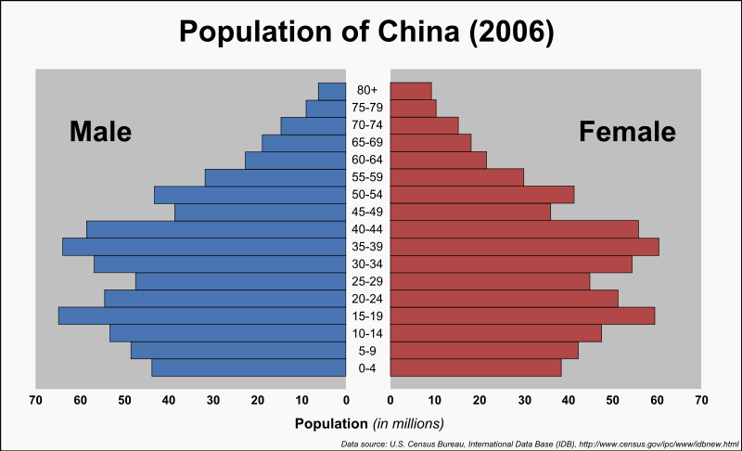
POPULATION STRUCTURE

Slide 30
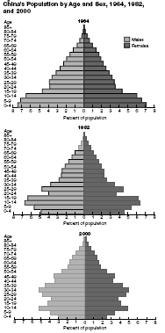
POPULATION STRUCTURE
1964
1982
2000

Slide 32
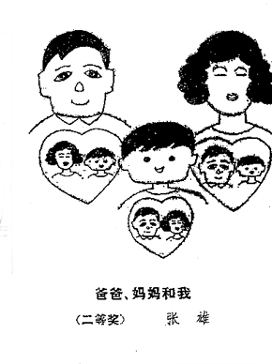
FATHER, MOTHER and I

Slide 33
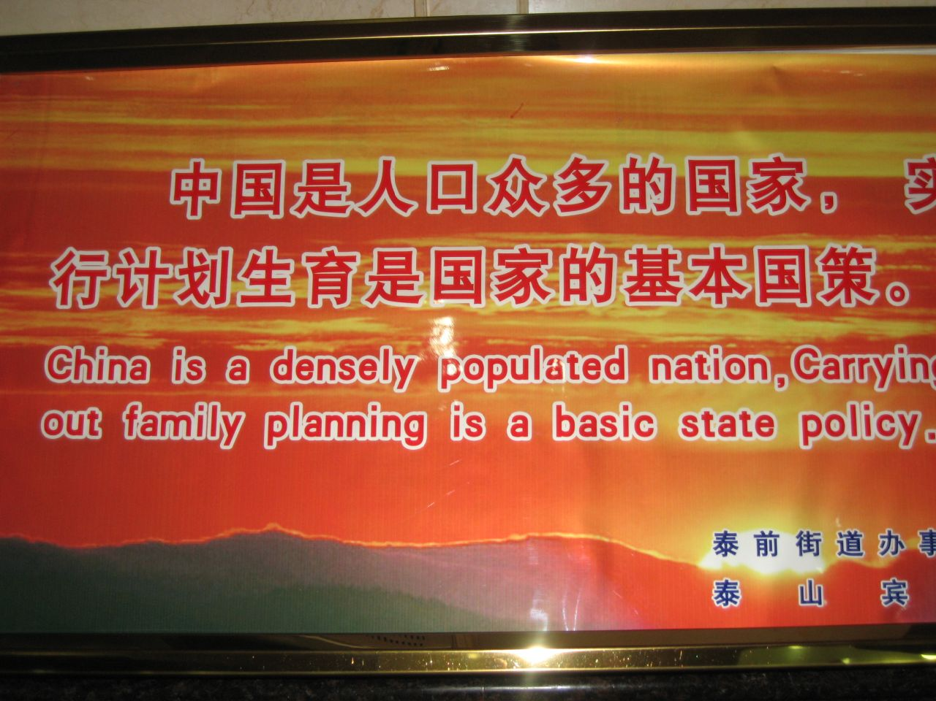
FAMILY PLANNING PROPAGANDA

Slide 34
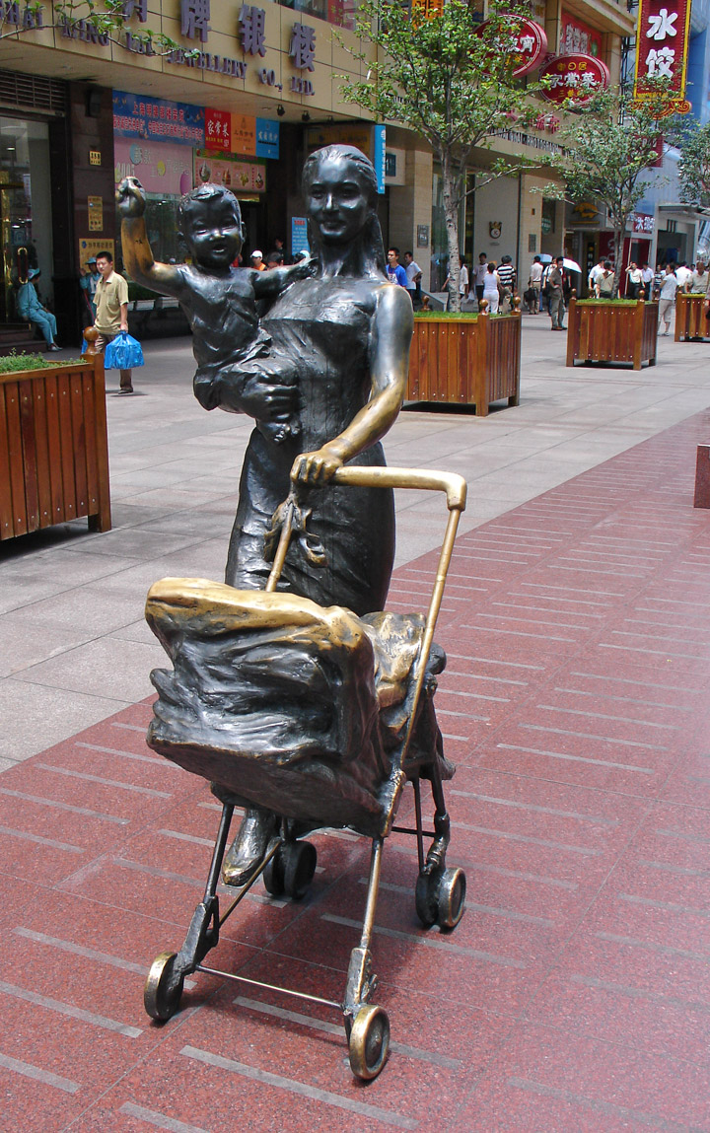
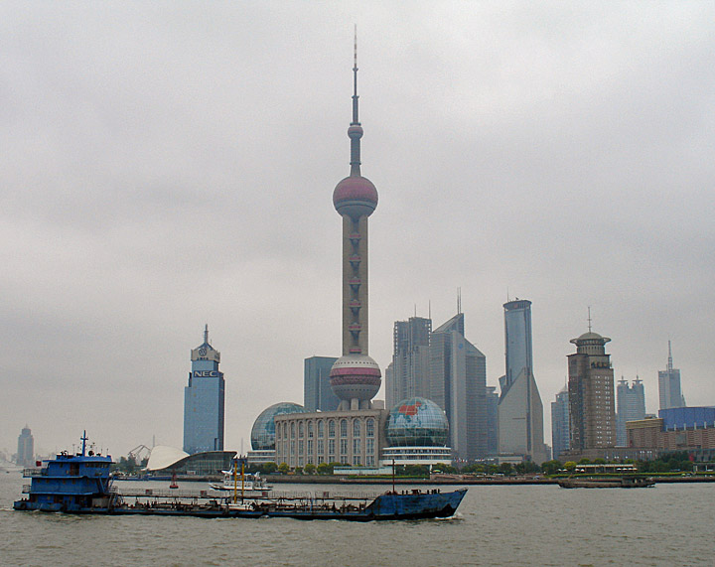
FAMILY PLANNING
PROPAGANDA
‘Modern mother’ statue, Shanghai

Slide 35
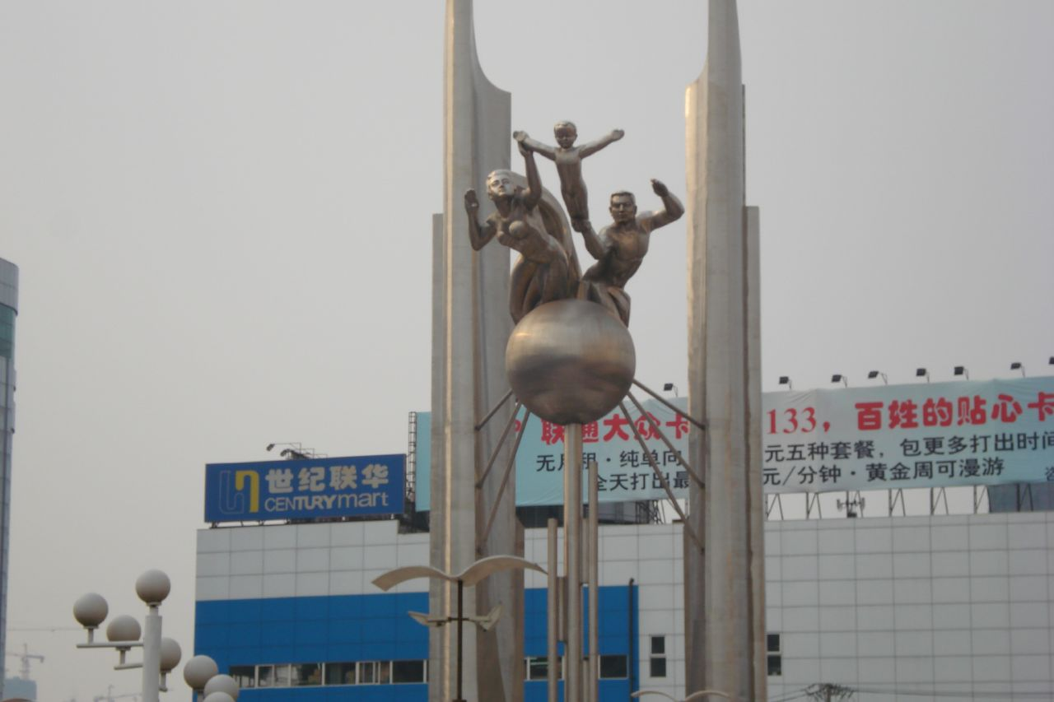
FAMILY PLANNING PROPAGANDA

Slide 36

FAMILY PLANNING PROPAGANDA

Slide 37
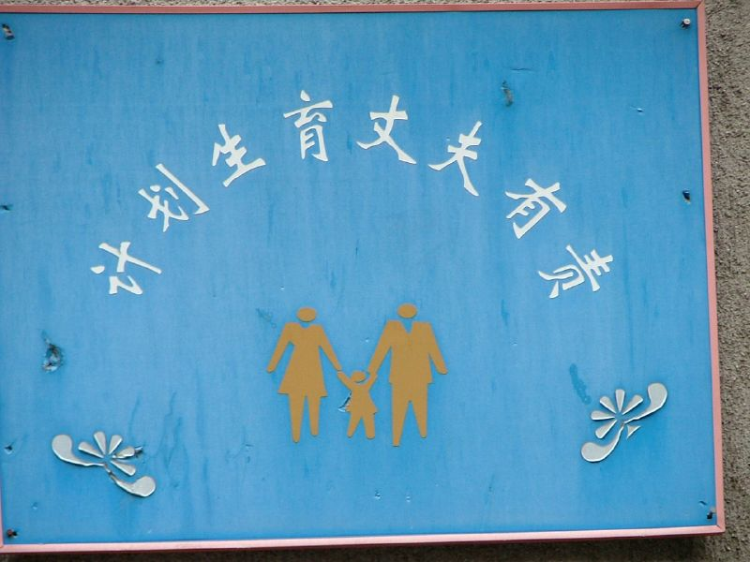
FAMILY PLANNING PROPAGANDA

Slide 38
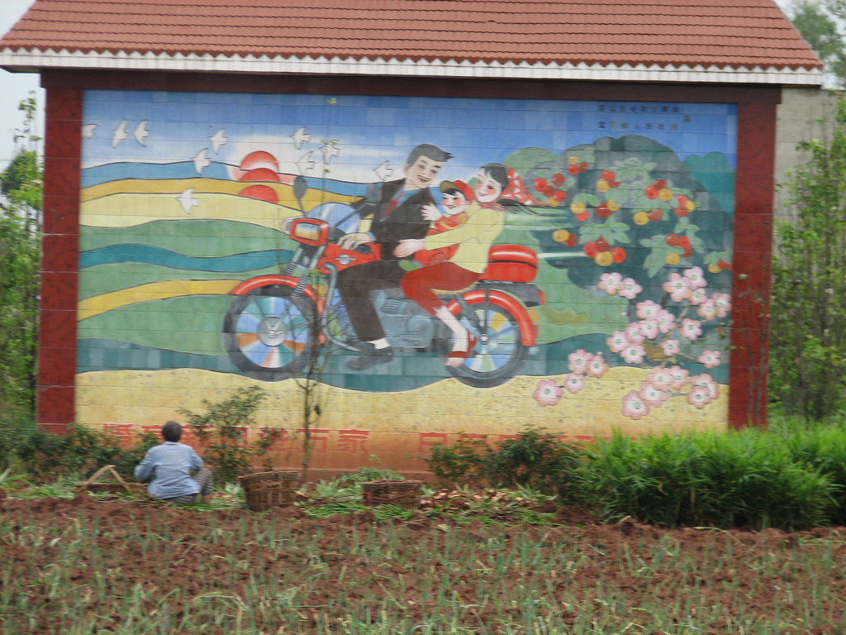
FAMILY PLANNING PROPAGANDA

Slide 39

FAMILY PLANNING PROPAGANDA

Slide 40
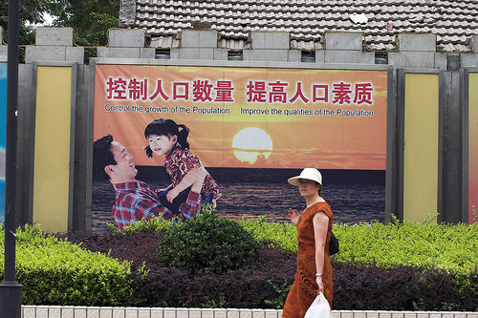
FAMILY PLANNING PROPAGANDA

Slide 41
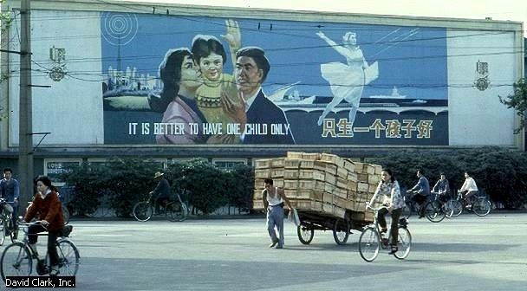
FAMILY PLANNING PROPAGANDA

Slide 42
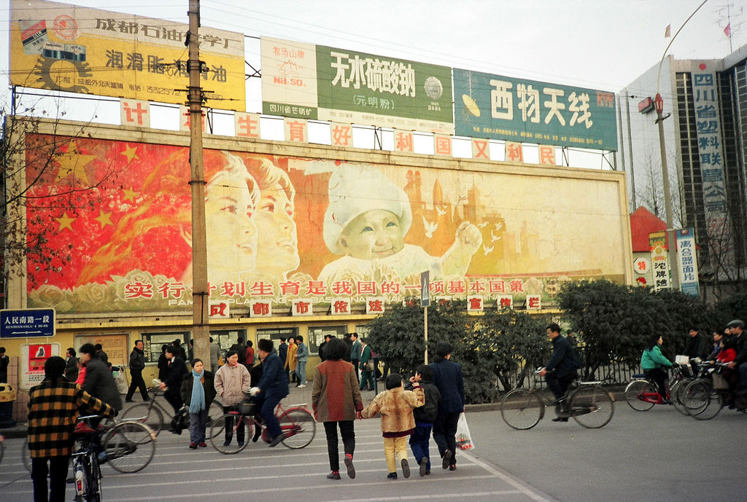
FAMILY PLANNING PROPAGANDA

Slide 43
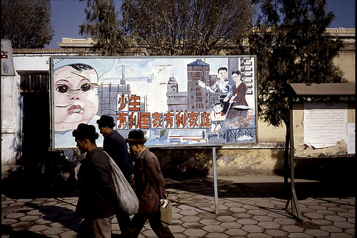
FAMILY PLANNING PROPAGANDA

Slide 44
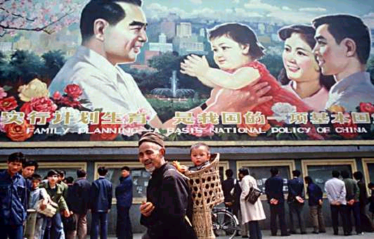
FAMILY PLANNING PROPAGANDA

Slide 45
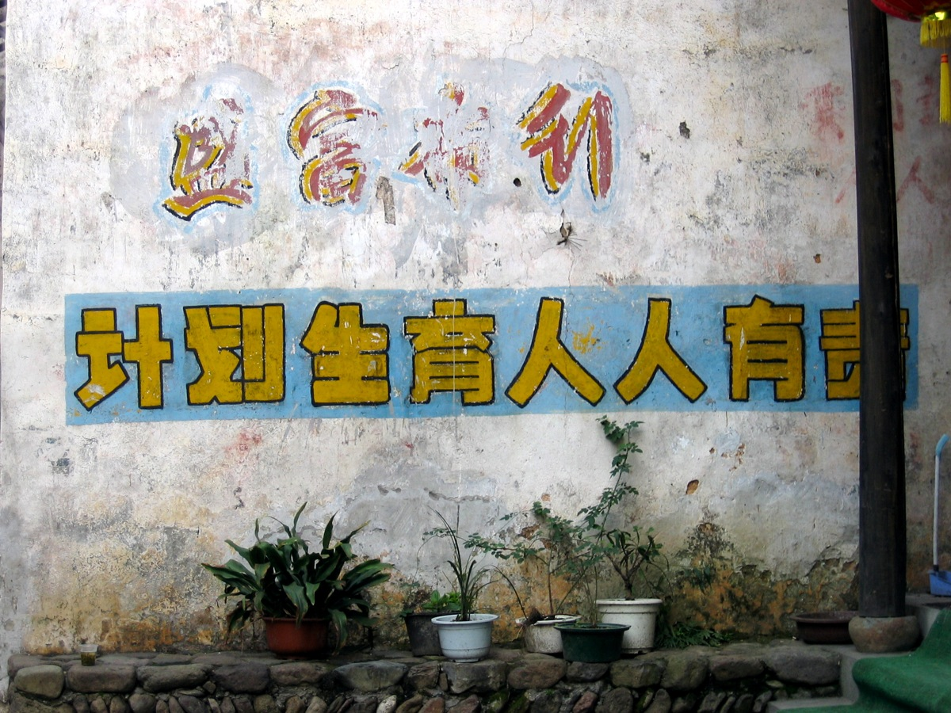
FAMILY PLANNING PROPAGANDA
“Everyone is responsible for the success of the One-Child Policy”

Slide 46
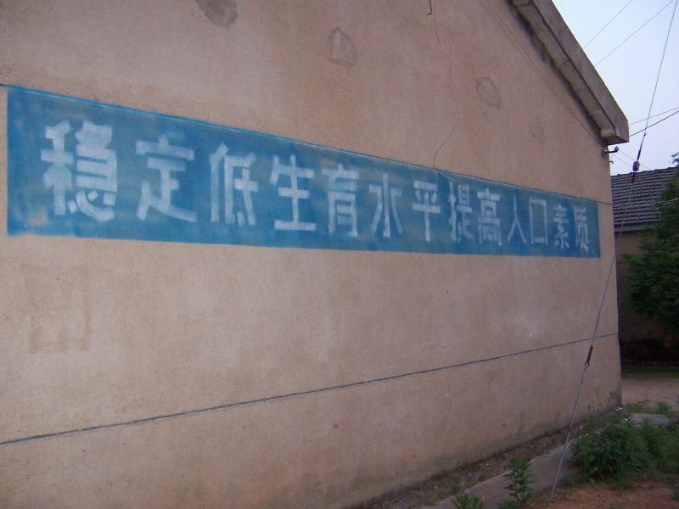
FAMILY PLANNING PROPAGANDA
“Have one child, one only and raise him wisely for the good of society.”

Slide 47
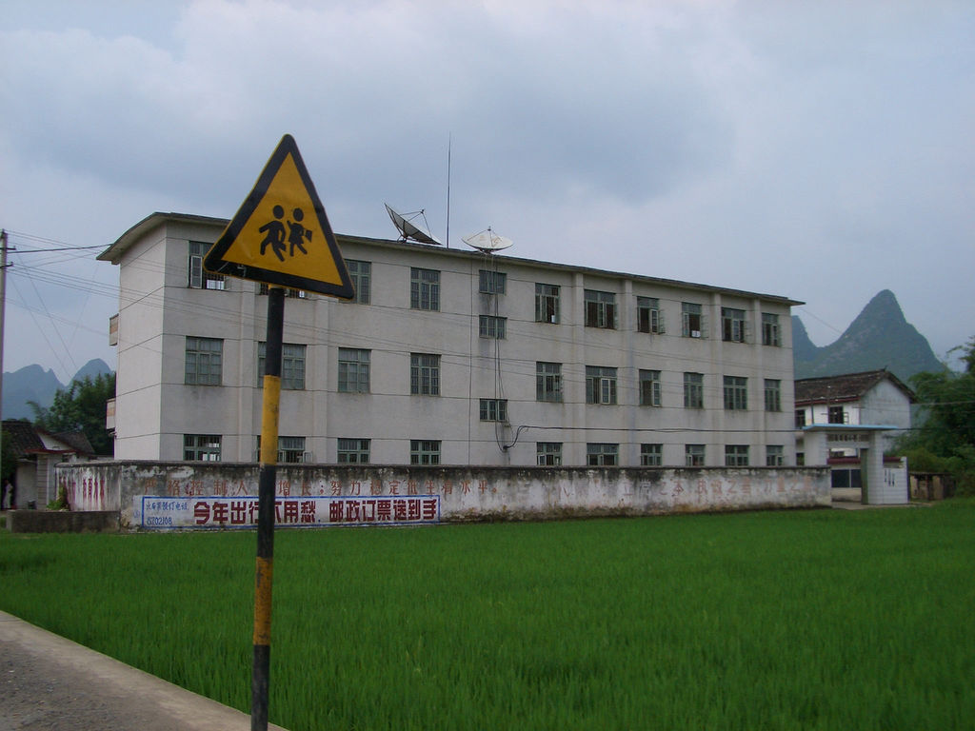
FAMILY PLANNING PROPAGANDA
“Seriously control the population growth,
work hard to make the birth rate stable”

Slide 48
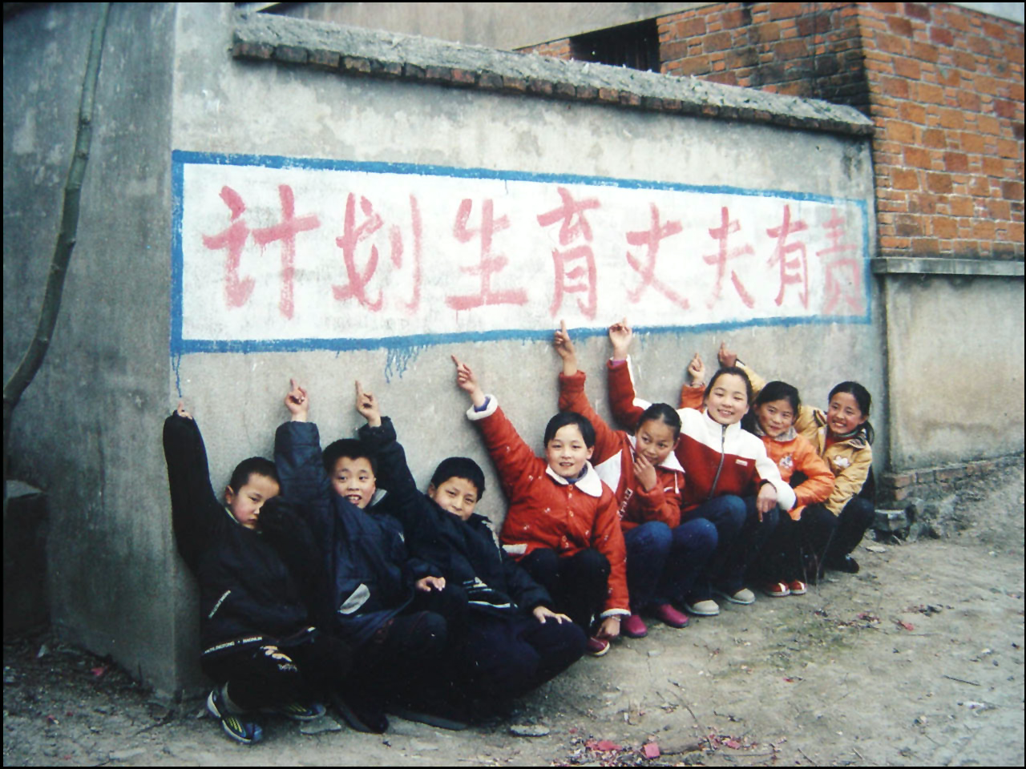
FAMILY PLANNING PROPAGANDA
“Husbands have the responsibility for family planning”

Slide 49
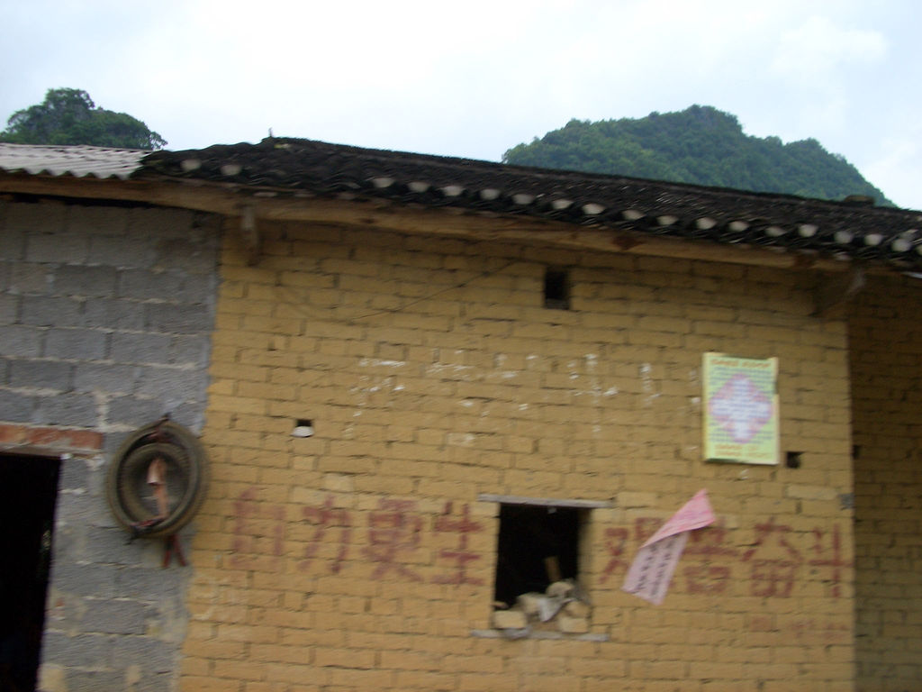
FAMILY PLANNING PROPAGANDA
“If you have an extra birth it will be a bitter and difficult struggle”

Slide 50
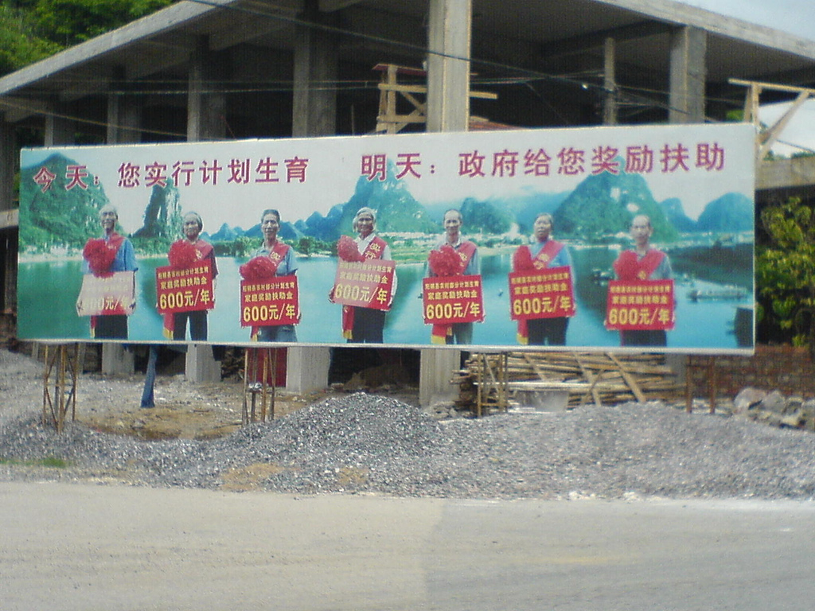
FAMILY PLANNING PROPAGANDA
Financial rewards

Slide 51
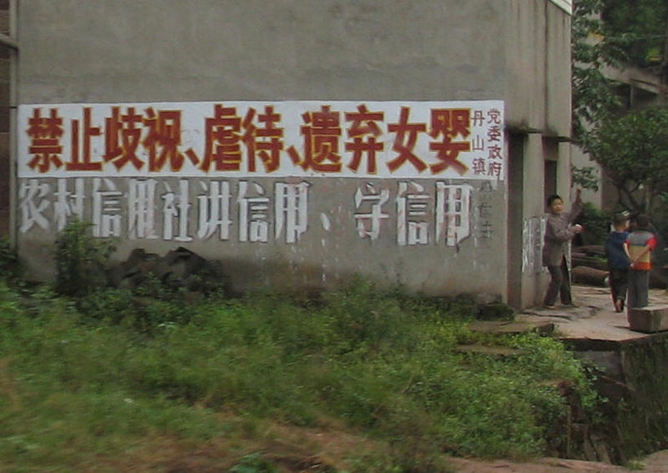
FAMILY PLANNING PROPAGANDA
“PRC family planning – don’t abandon girls”

Slide 52
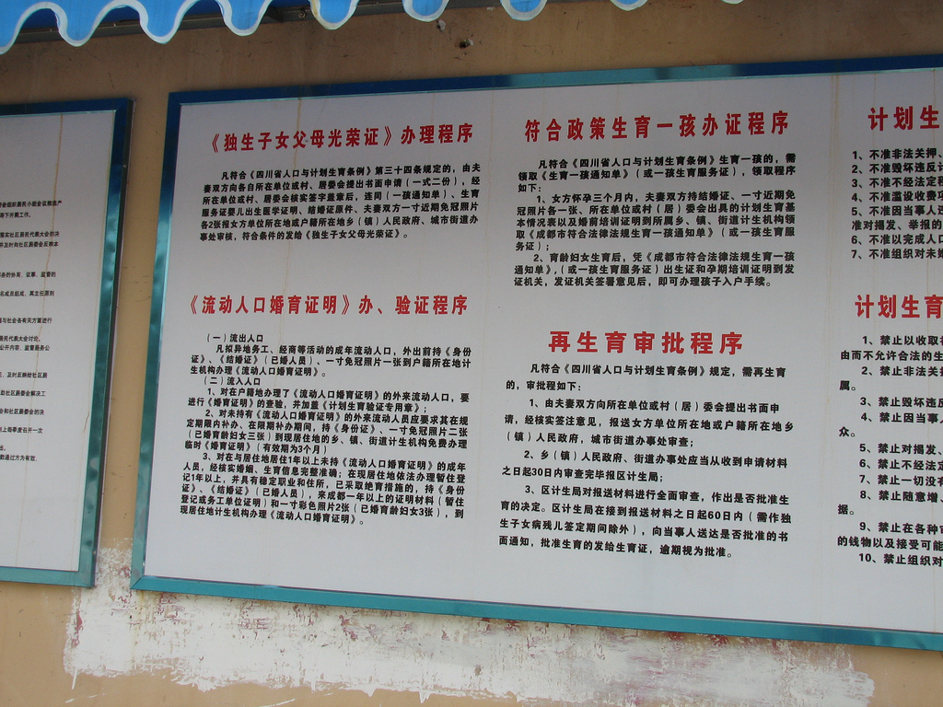
FAMILY PLANNING REGULATIONS
Family planning regulations in Chengdu

Slide 53
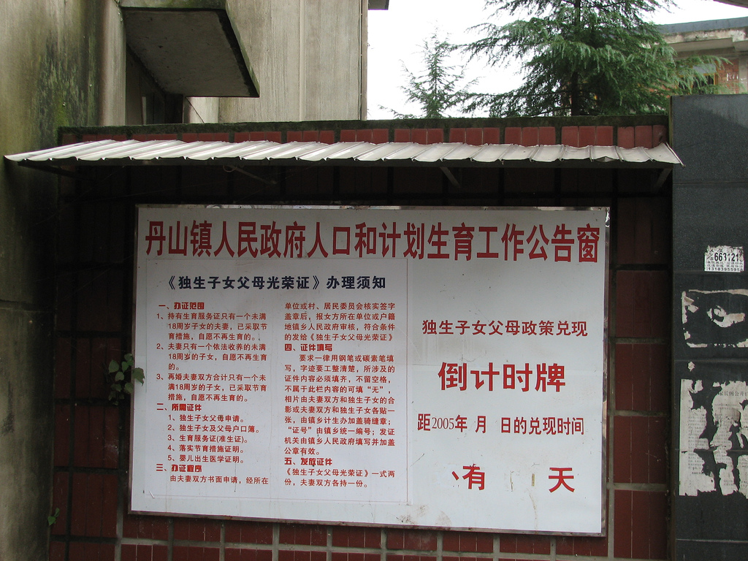
FAMILY PLANNING REGULATIONS
Policy to supplement incomes of parents
who have only one child.

Slide 54
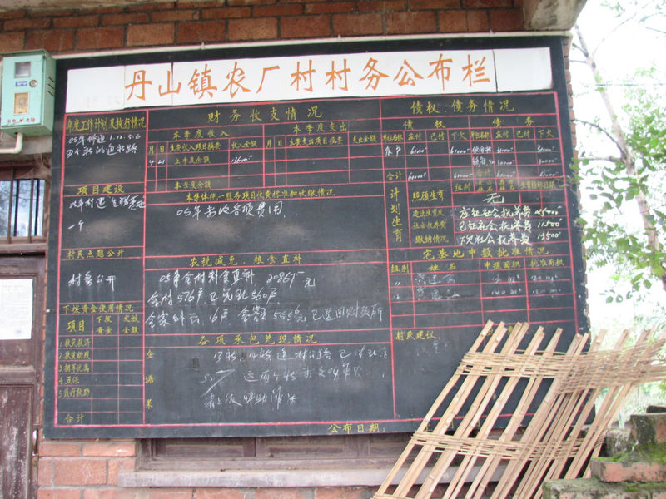
FAMILY PLANNING REGULATIONS
Family planning ‘fines’ posted on a
village noticeboard in Danshan, Sichuan.

Slide 55
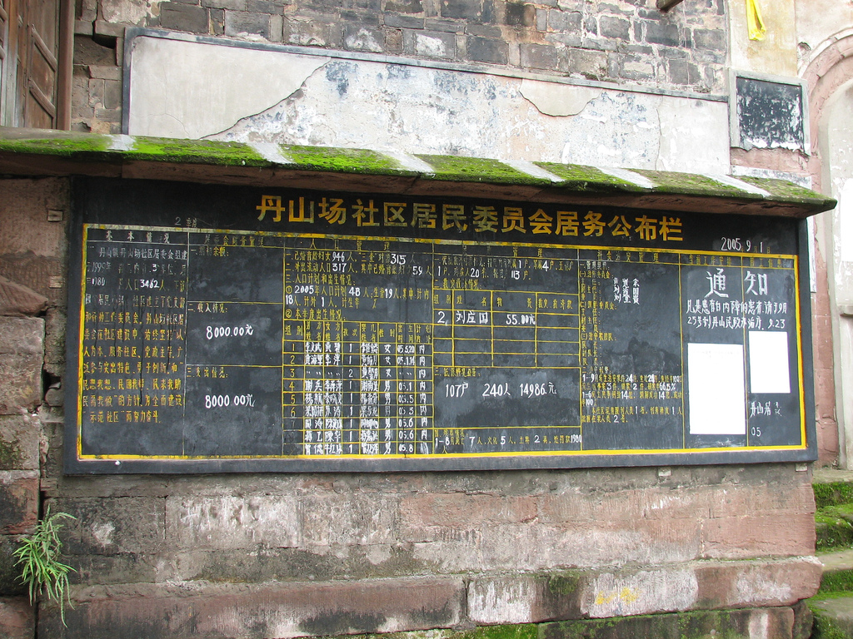
FAMILY PLANNING REGULATIONS
There were 18 births within the birth plan and one outside the birth planning rules. A second child was born to one woman, but was allowed by regulations. Many peasant families are allowed to have a second child if there first child is a girl or is a handicapped boy.
List of women who have given birth recently and whether or not the birth was outside the plan, Danshan, Sichuan.

Slide 56
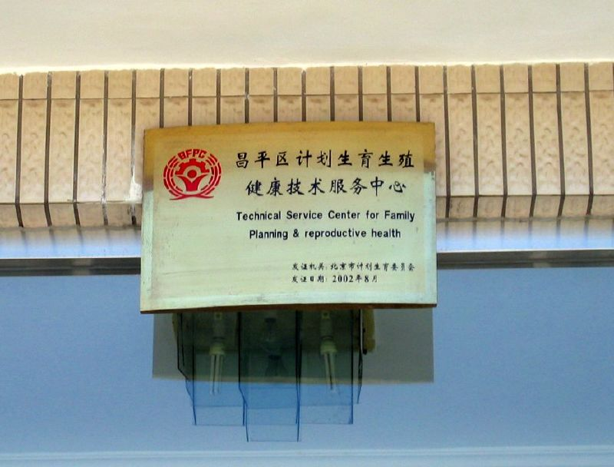
FAMILY PLANNING
Family planning clinic

Slide 57
SUCCESSES and FAILURES
The government's goal is one child per family, with exceptions in rural areas and for ethnic minorities. Official government policy opposes forced abortion or sterilisation, but allegations of coercion continue as local officials strive to meet population targets.
The one-child policy is criticised as violating basic human rights and China has been accused of meeting its population requirements through bribery, coercion, forced sterilisation, forced abortion, and infanticide, with most reports coming from rural areas.
A report in 2001 showed that a quota of 20,000 forced abortions had been set in the province of Guandong due to the reported disregard of the one-child policy.

Slide 58
SUCCESSES and FAILURES
Total fertility rate
The average number of children a woman would have
Niger 7.9
India 2.9
UK 1.8
China 1.6
Russia 1.2
China's population of 1.3 billion
is said to be 300 million smaller
than it would likely have been
without the enactment of this
policy.
The fertility rate has fallen to
1.6 births per woman (2.1 is
the replacement level rate).

Slide 59
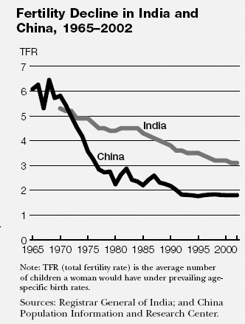

SUCCESSES and FAILURES
The world’s two population billionaires, India and China, have national policies to cut population growth.
China’s policy has been strictly enforced nationwide and more effective than India’s in reducing fertility and slowing population growth.

Slide 60


SUCCESSES and FAILURES
China is expected to be overtaken by India as the world’s most populous country in the next 25 years.
2006
China Population: 1,313,973,713
2050
1,424,000,000
2006
India Population: 1,111,205,474
2050
1,807,000,000

Slide 61
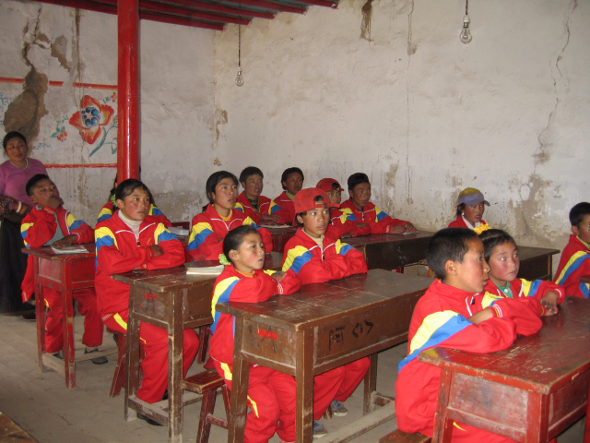
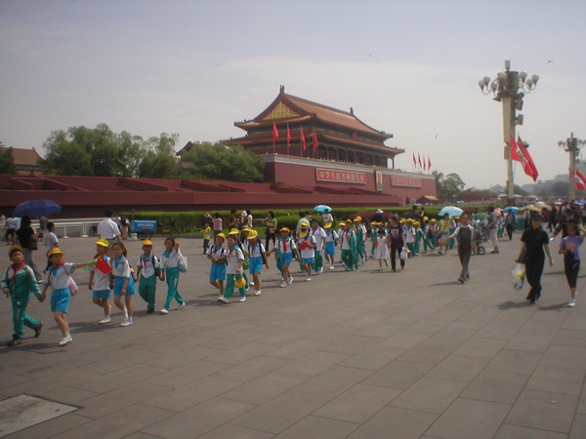
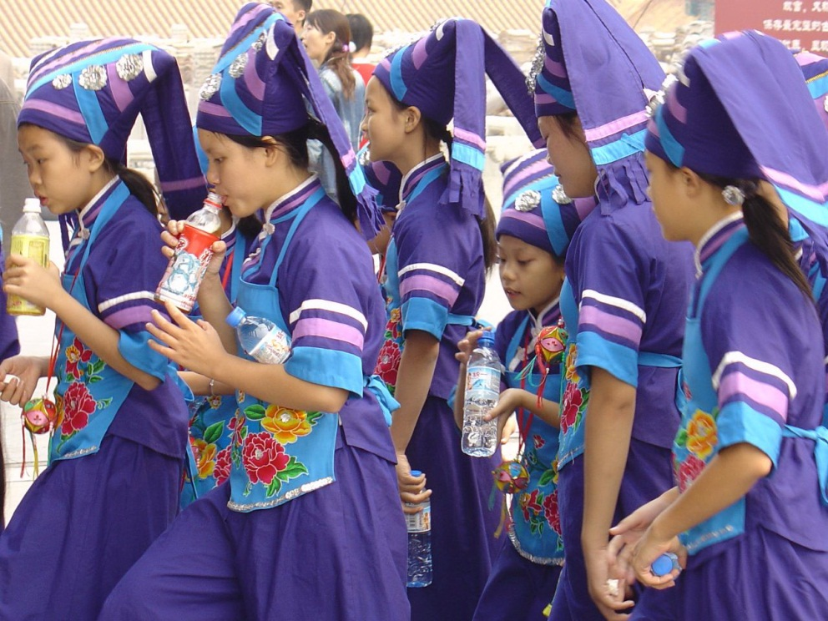
SUCCESSES and FAILURES
China has greatly decreased the number of ‘young dependents’ and so reduced expenditure.

Slide 62
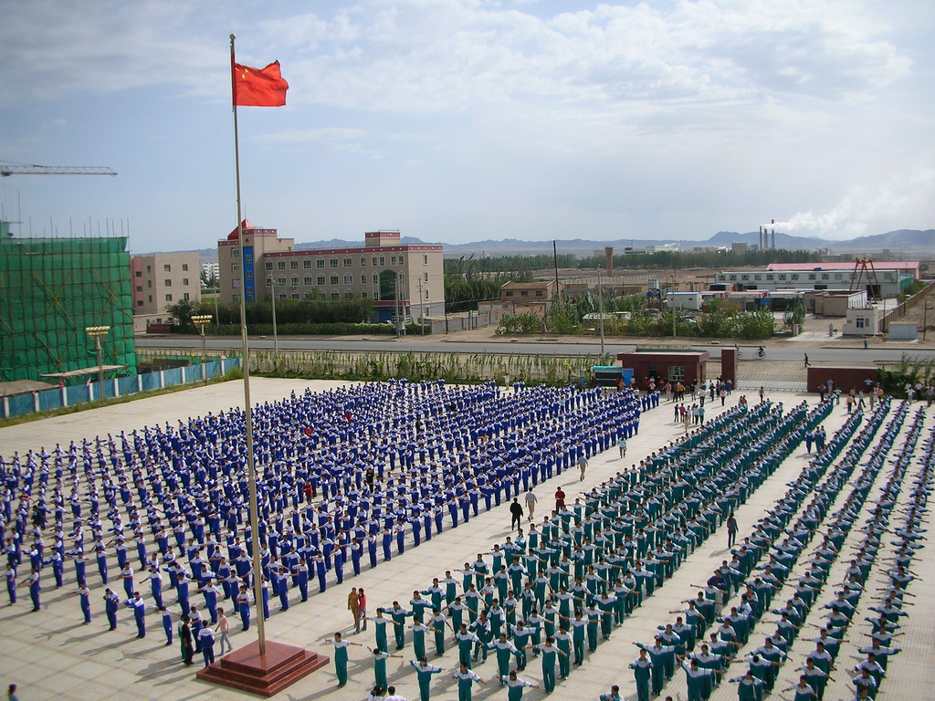
SUCCESSES and FAILURES
Morning exercises before school starts
In 1950 44% of the population were under 20 but
by 2005 this had been reduced to 30%,

Slide 63

SUCCESSES and
FAILURES
In 1997, the World Health Organisation issued a report claiming that "more than 50 million women were estimated to be 'missing' in China because of the institutionalised killing and neglect of girls due to Beijing's population control programme that limits parents to one child."

Slide 64

SUCCESSES and FAILURES
male births female births
105
100
World
China’s sex ratio at birth of 118 male infants for every 100 female infants is likely to be due to 3 factors;
underreporting of female births
excessive female infant mortality
and prenatal sex determination and sex-selective abortion
118
100
China
100
Hainan province
136

Slide 65
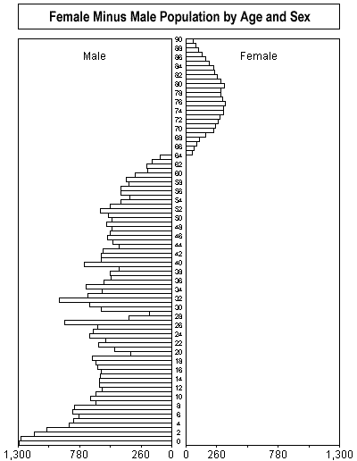
SUCCESSES and FAILURES
This population pyramid presents the female minus the male population by age. In most age groups China has a larger male than female population - according to these raw census data. Particularly, in young age groups the "surplus" in male population is substantial. This well-known phenomenon of "missing girls" is due to the strong preference for male births in the Chinese and most other Asian societies. It is believed that only boys can later keep up the family tradition. Especially the farmers want to have at least one male child for taking over the family farm.

Slide 66
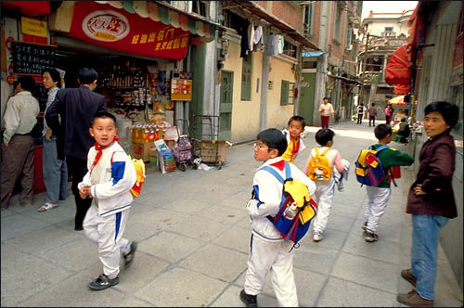
SUCCESSES and FAILURES
The traditional attitude to girls is best described in the ancient "Book of Songs" (1000-700 B.C.):
"When a son is born,
Let him sleep on the bed,
Clothe him with fine clothes,
And give him jade to play...
When a daughter is born,
Let her sleep on the ground,
Wrap her in common wrappings,
And give broken tiles to play..."
“Little Emperors”

Slide 67

Despite the not-yet wealthy family economy, the only child tends to have almost whatever he wants and whatever the parents can get. The spoiled child thus acquires the nickname "little emperor.“ In later life there is often a lack of reality and responsibility because the child has been used to taking things for granted!

Slide 68

Now that most families have only one child, all the hopes for the future of are placed on his or her shoulders. The parents' expectations of the child tend to be very high, and often unrealistic!

Slide 69
Most Chinese accept the state’s role in population control, but
many disagree with the severe restrictions on the number of
children they are allowed to have. The strong desire for sons is
central to this resistance: Families who have had a daughter
often want to try again for a son.
Son preference has a long history in China and is tied to
the social and economic roles of males in Chinese families.
Family lineage is traced through males, and sons are responsible
for caring for their parents in their old age. Marriage practices
reflect these traditions. When daughters marry, they leave
their birth families to join their husbands’ families.
In rural areas, few peasants have retirement
pensions, so aging parents depend on their
children for support. Because daughters have
traditionally married out of the family, a couple
with no son may end up without financial and
personal support. Thus, regardless of their
acceptance of the state’s control of population
growth, most Chinese citizens want at least one
son. Many couples would like a daughter as well.

Slide 70

SUCCESSES and FAILURES
September 2002
An investigation by The Telegraph has revealed that an estimated 50,000 girls and young women, some as young as eight, have been sold or abducted into human slavery in China. The trade is largely the result of the nation's "one child policy", which has led to a shortage of young women and millions of unmarried men.

Slide 71

SUCCESSES and FAILURES
Missing children!

Slide 72
SUCCESSES and FAILURES
the 1 2 4 problem
As the one-child policy approaches the third generation, one adult child supports two parents and four grandparents.
This leaves the oldest and most vulnerable
generation with increased dependency
on retirement funds,
the state, or charity
for support.
4 grandparents
2 parents

Slide 73


SUCCESSES and FAILURES
China has an ageing population and will have an increasing dependency ratio in the future.
As a result of almost 30 years of the one child policy there is a lower ‘active population’, making it more difficult to support the ‘dependent population’.

Slide 74
China’s Population: New Trends and Challenges
China experienced dramatic declines in birth and death rates over the past 50 years as the government implemented
revolutionary and controversial policies to improve health
and slow population growth. With 1.3 billion people, China
remains the world’s most populous country, but it has lower
fertility than the USA and many European countries. Fewer children, later marriage, and longer life expectancy have affected family structures and created new challenges.
The growing proportion of elderly in China is beginning to strain both national and family resources. Lower fertility means that fewer children—and sometimes only one child—will be available to care for elderly family members.
Movement toward a market economy and opening to international trade in the 1990s brought enormous economic growth, but also increased income and health inequalities, encouraged mass labour migration, and exacerbated environmental damage. The effects of these dramatic changes on China’s fertility, health, economy, and government in the 20th century will ripple through the society for the foreseeable future, and will be felt around the world.

