Slide 1
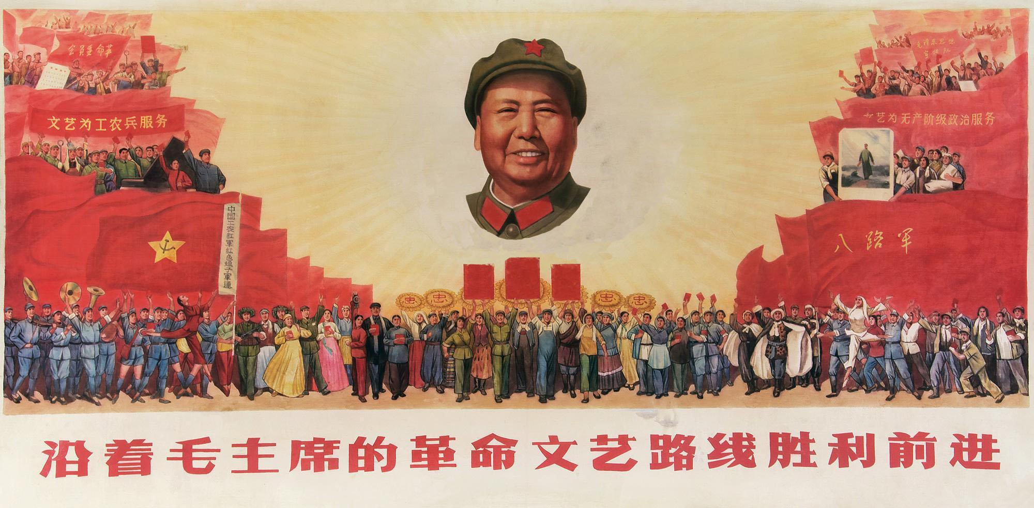
Mao posters: truth v propaganda in the revolutionary cause

Slide 2
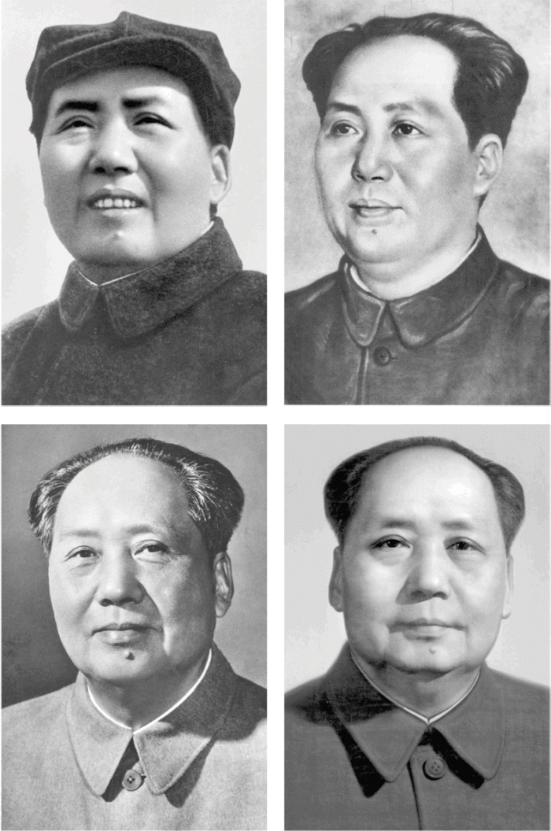
The most famous portrait in the world?

Slide 3
The most reproduced portrait ever
An estimated 900 million posters were printed of this portrait of Mao setting out on his revolutionary road at the age of 28

Slide 4
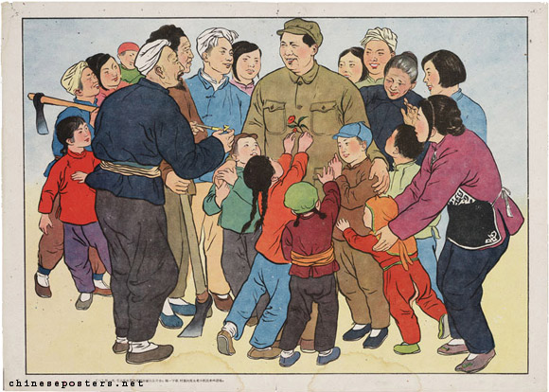
Western influence
1960 – Chairman Mao loves children
Note the influence from western graphic art
1954 –the Chinese dream

Slide 5
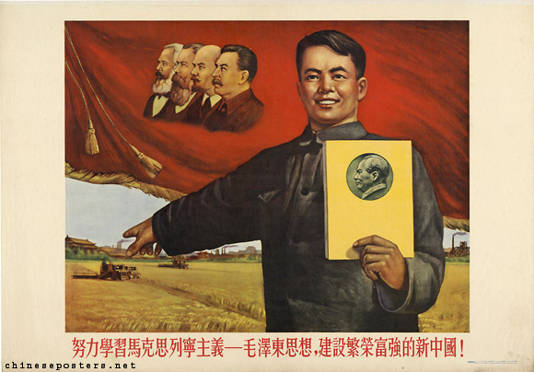
A change of tone: the influence of Stalinist Russia
From this…………
............to this

Slide 6
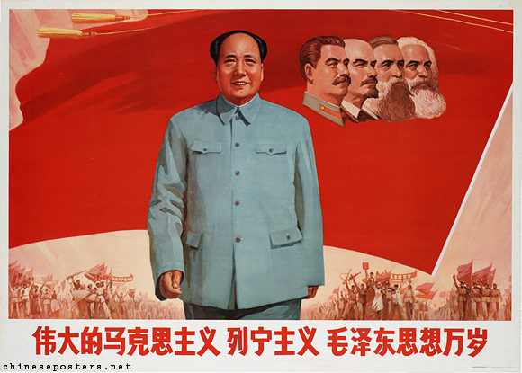
大跃进 dà yuè jìn
The Great Leap Forward 1958-61

Slide 7
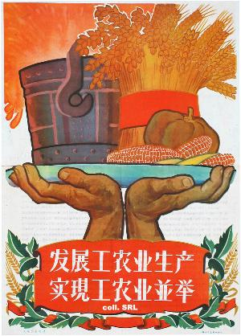
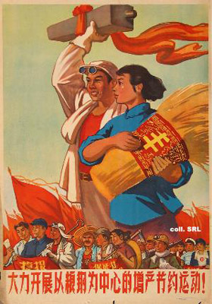
The vision: agriculture and industry
Start the movement to increase production and practise thrift, with foodstuffs and steel at the centre, with great force!,

Slide 8
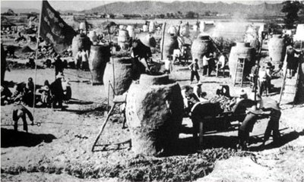
Grain production and steel production
Fleets of tractors…
…made from backyard steel

Slide 9
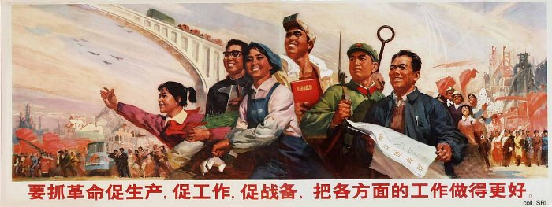
A brave new world through collective hard work

Slide 10
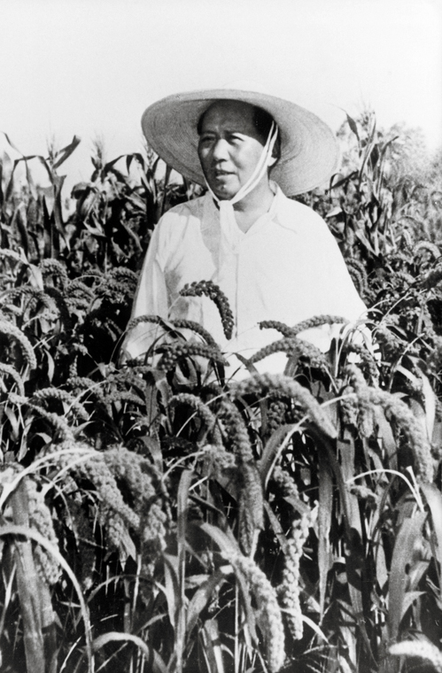
Plenty for all

Slide 11
A Chinese Utopia
The commune is like a gigantic dragon, production is noticeably awe-inspiring

Slide 12
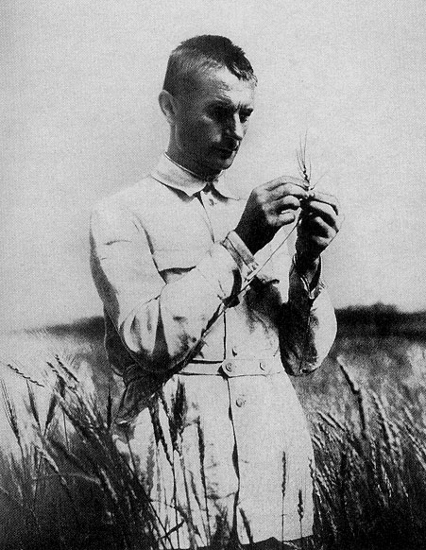
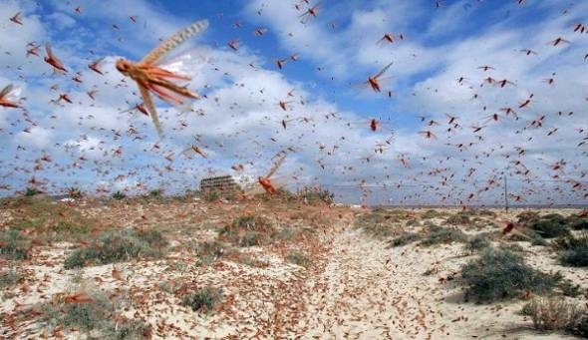
The reality was different……
…..and it began with
locusts
….and Lysenko

Slide 13
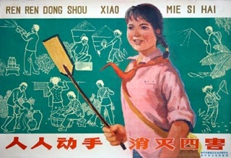
The 4 Pests Campaign

Slide 14
Useless steel and no tools or cooking pots

Slide 15
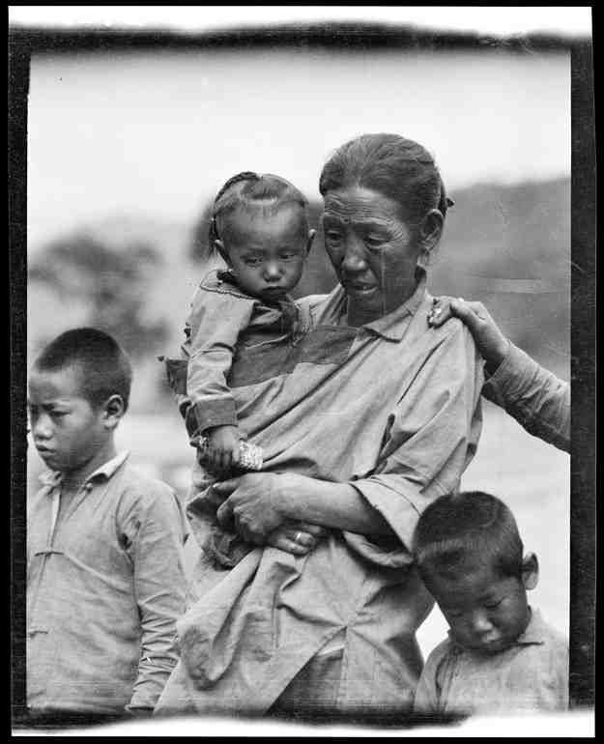
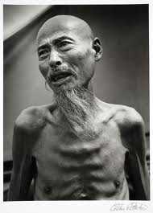
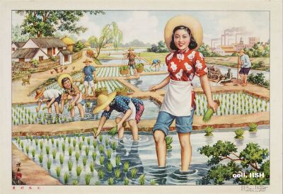
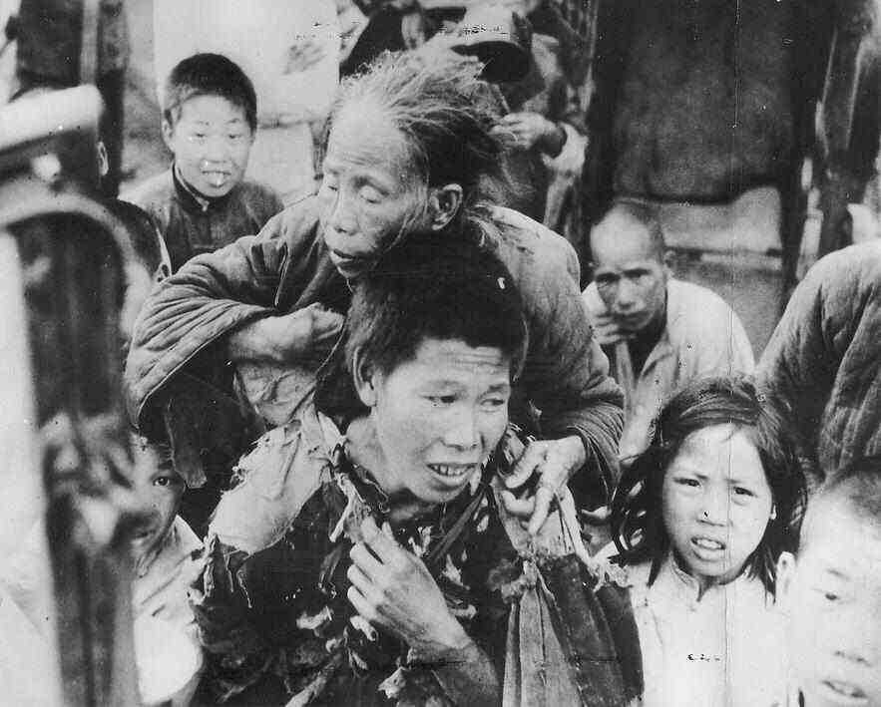
More than 40 million dead of starvation

Slide 16
And Mao’s ( temporary)fall from grace

Slide 17
The Great Leap Forward and the Great Famine

Slide 18
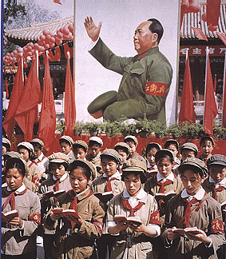
无产阶级文化大革命
The Great Proletariat Cultural Revolution
1966-1976

Slide 19
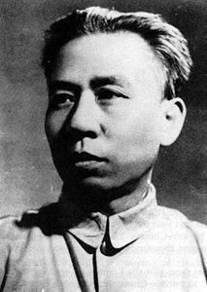
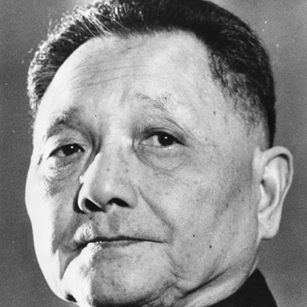
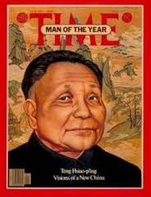
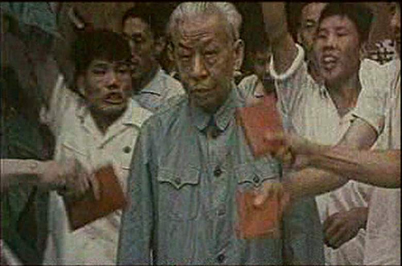
Enemies within
And their contrasting fates
Deng Xiaoping
Liu Shaoqi

Slide 20
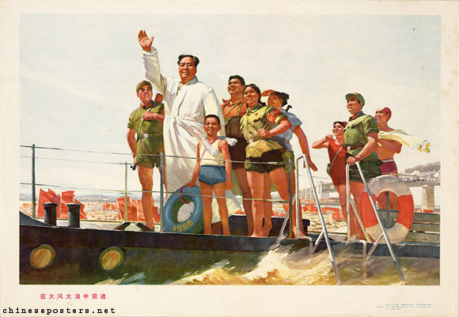
Mao’s renaissance: Wuhan, July 1966

Slide 21
Mao on the attack, Beijing 1966
Text of Mao's big character poster directed against Liu Shaoqi and Deng Xiaoping at the start of the Cultural Revolution: “China's first Marxist-Leninist big-character poster and Commentator's article on it in People's Daily are indeed superbly written! Comrades, please read them again. But in the last fifty days or so some leading comrades from the central down to the local levels have acted in a diametrically opposite way. Adopting the reactionary stand of the bourgeoisie, they have enforced a bourgeois dictatorship and struck down the surging movement of the great cultural revolution of the proletariat. They have stood facts on their head and juggled black and white, encircled and suppressed revolutionaries, stifled opinions differing from their own, imposed a white terror, and felt very pleased with themselves. They have puffed up the arrogance of the bourgeoisie and deflated the morale of the proletariat. How poisonous! Viewed in connection with the Right deviation in 1962 and the wrong tendency of 1964 which was 'Left' in form but Right in essence, shouldn't this make one wide awake?”
Bombard the Headquarters – my first big character poster – Mao Zedong 1966

Slide 22
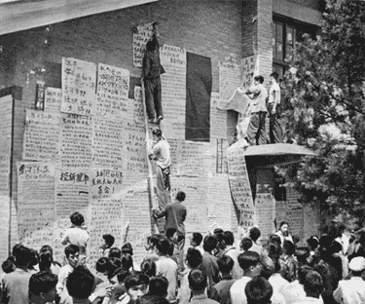
Big Character Posters and catchy lyrics
The Great Proletarian Cultural Revolution is indeed good, Oh, indeed good, indeed good and indeed, indeed good! Marxism-Leninism is popularized, Red flags flutter in the realm of social ideology. Revolutionary big-character posters are like fires spreading all over, And our triumphant songs rise up to the clouds. Ten hundred million people unite in fighting; our red state power stands firm. A new generation is growing to maturity, Going against the wind and breaking the waves, they are the heroes. The industries learn from Daqing, And the agricultural sector learns from Dazhai. News of victory is reported all around the country. Seven hundred million people follow Chairman Mao, To continue revolution and walk forward. The Cultural Revolution is good! The Cultural Revolution is good! The Proletarian Cultural Revolution is indeed good, Oh, indeed good, indeed good and indeed, indeed good!

Slide 23
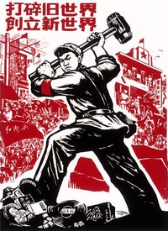
The 4 Olds
Old Customs,
Old Culture, Old Habits,
Old Ideas

Slide 24
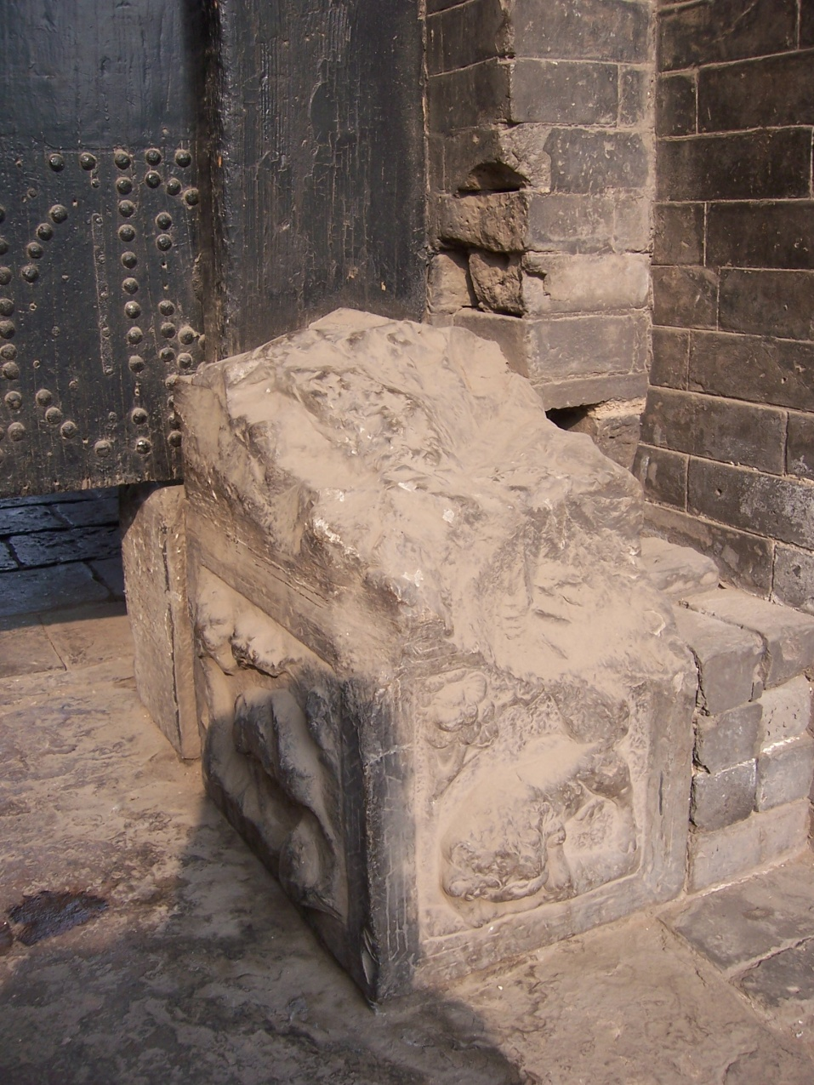
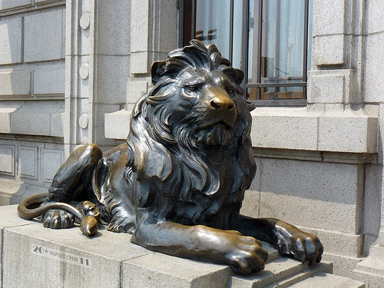

Slide 25
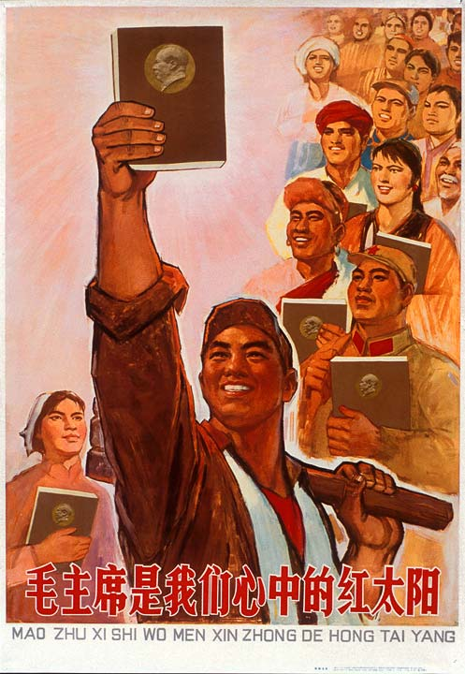
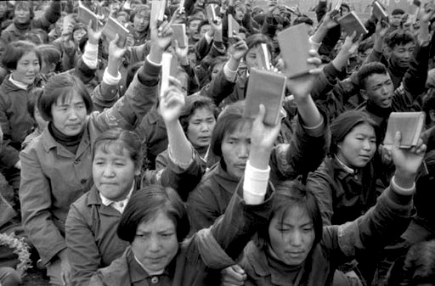
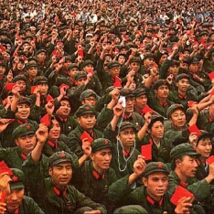

Slide 26
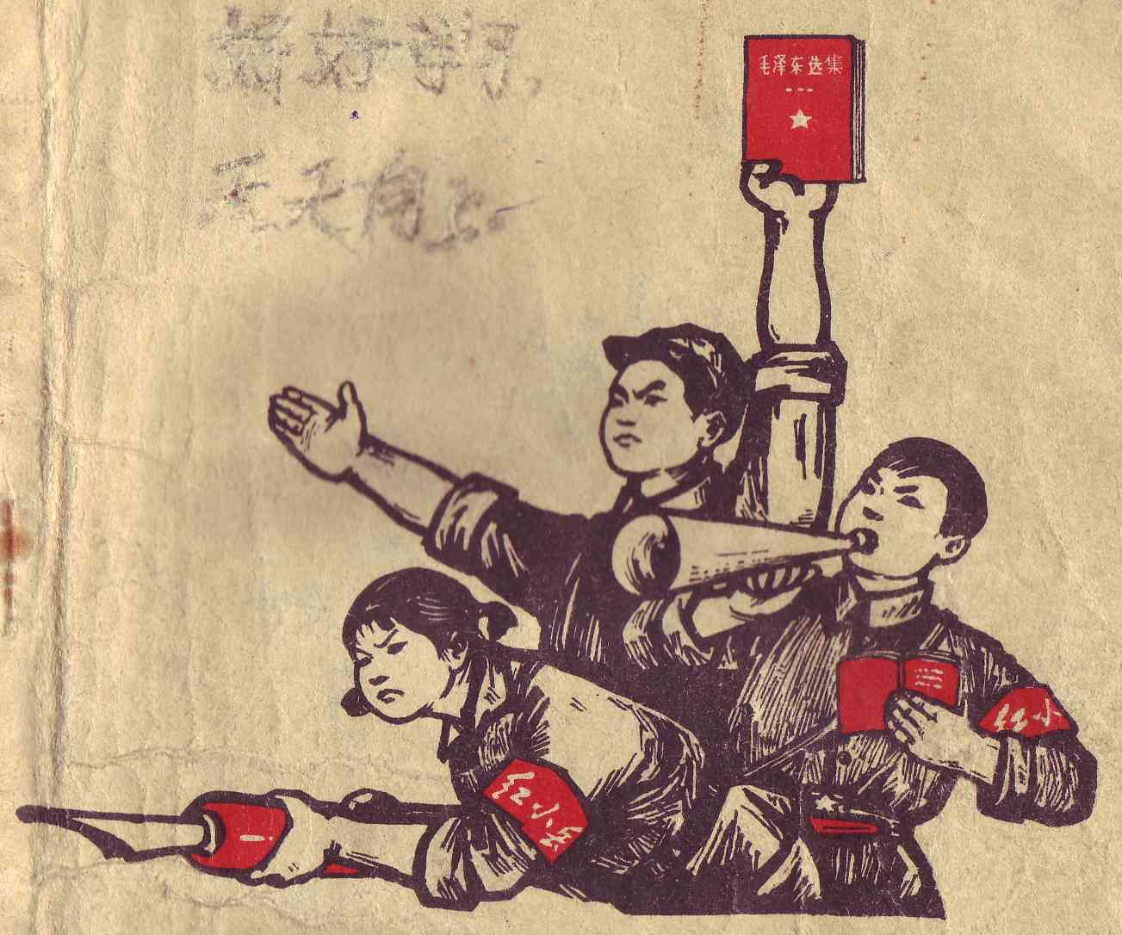
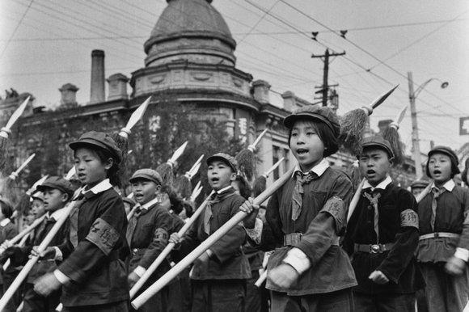
Front cover of a 1960s school book; the hand-written popular slogan “study hard and progress every day” is still faintly visible
Little Red Guards marching on National Day – the Little Red Guards replaced the Young Pioneers during the Cultural Revolution

Slide 27
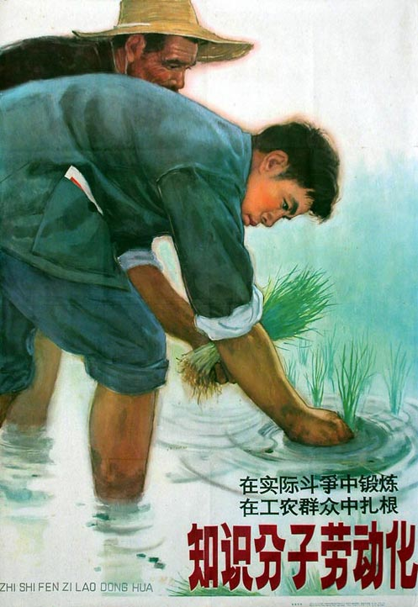
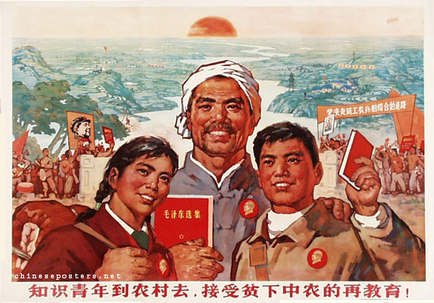
Turn the intellectuals into farmers

Slide 28
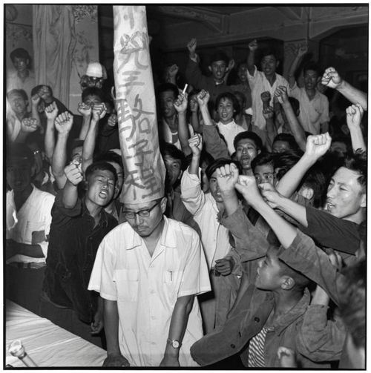
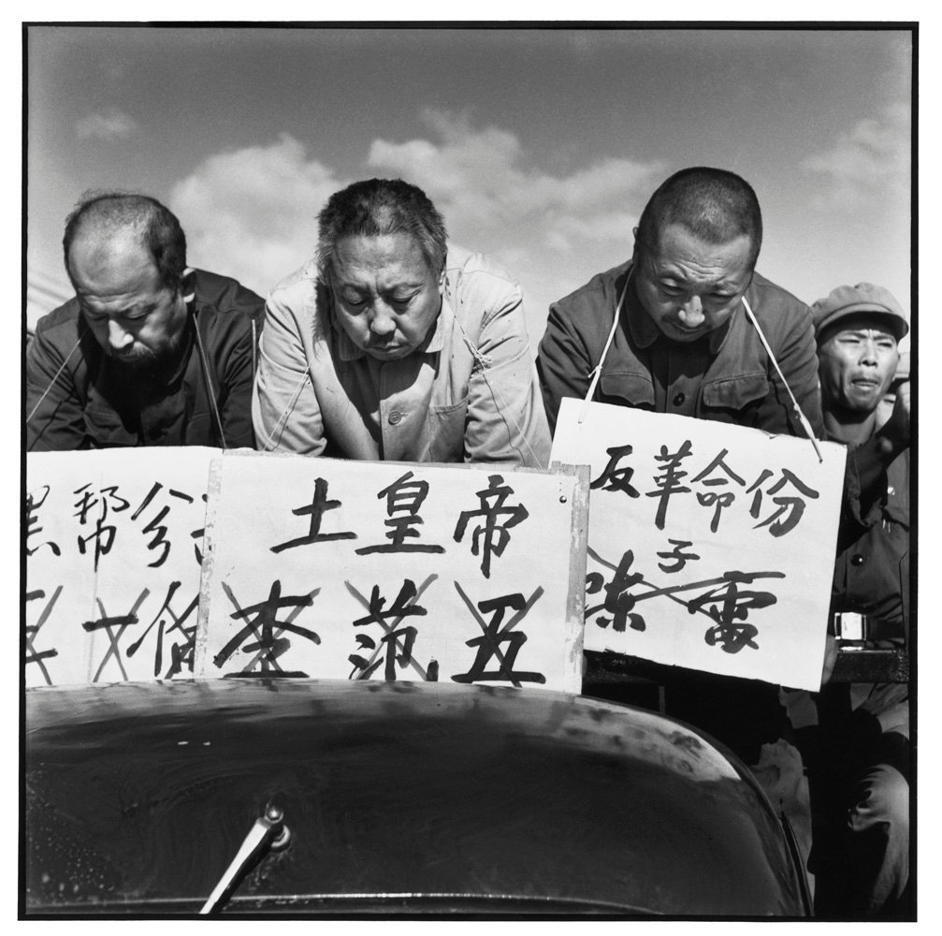
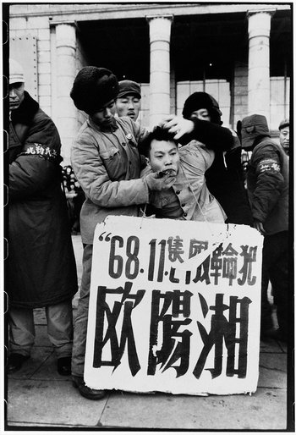
The reality of the Cultural Revolution

Slide 29
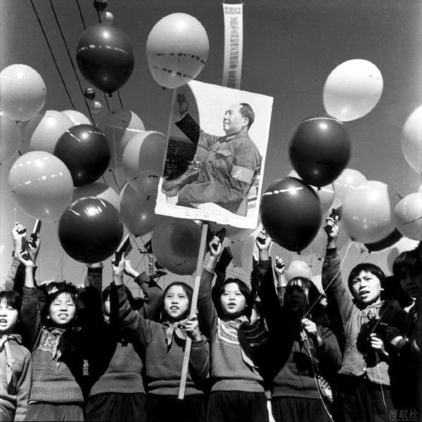
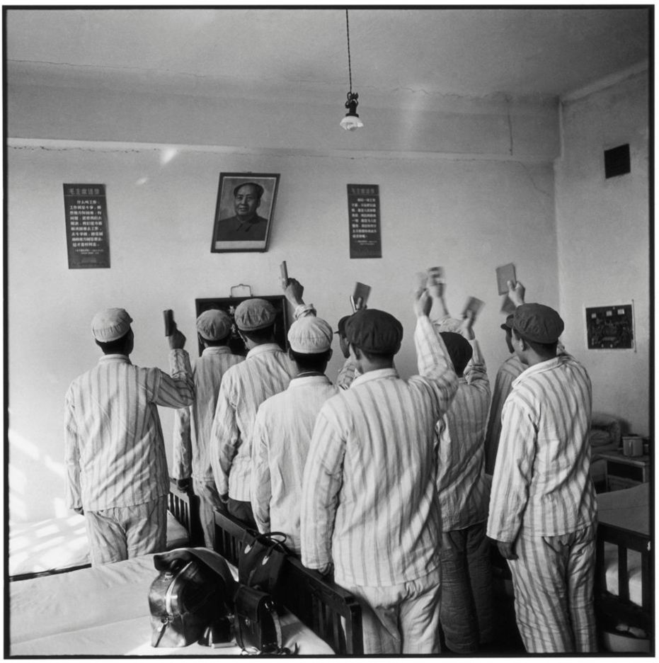
The cult of Mao

Slide 30
The Cultural Revolution

Slide 31
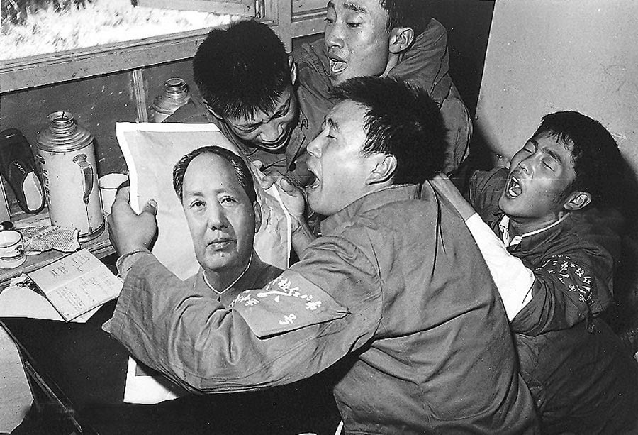
Death of Mao September 9th 1976

Slide 32
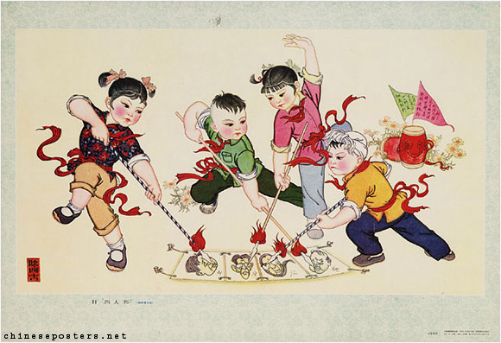
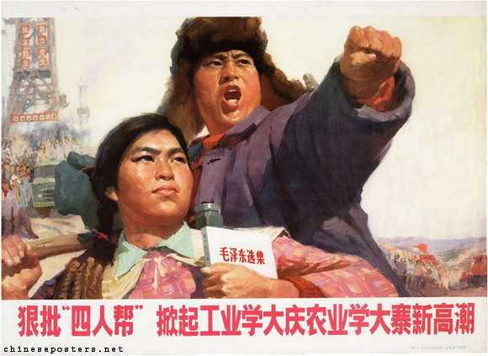
Power struggle for a new China

Slide 33
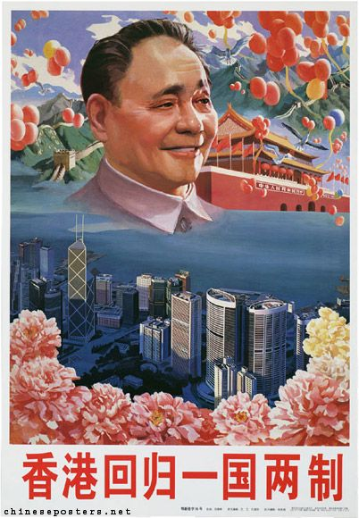
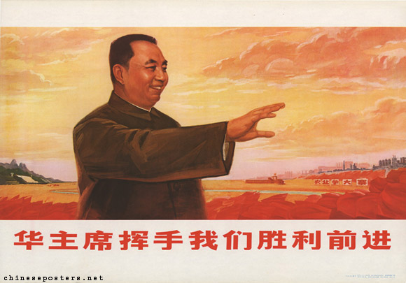
End of an era
Hua Guofeng – Mao’s chosen successor
Deng Xiaoping – the architect of modern China

Slide 34
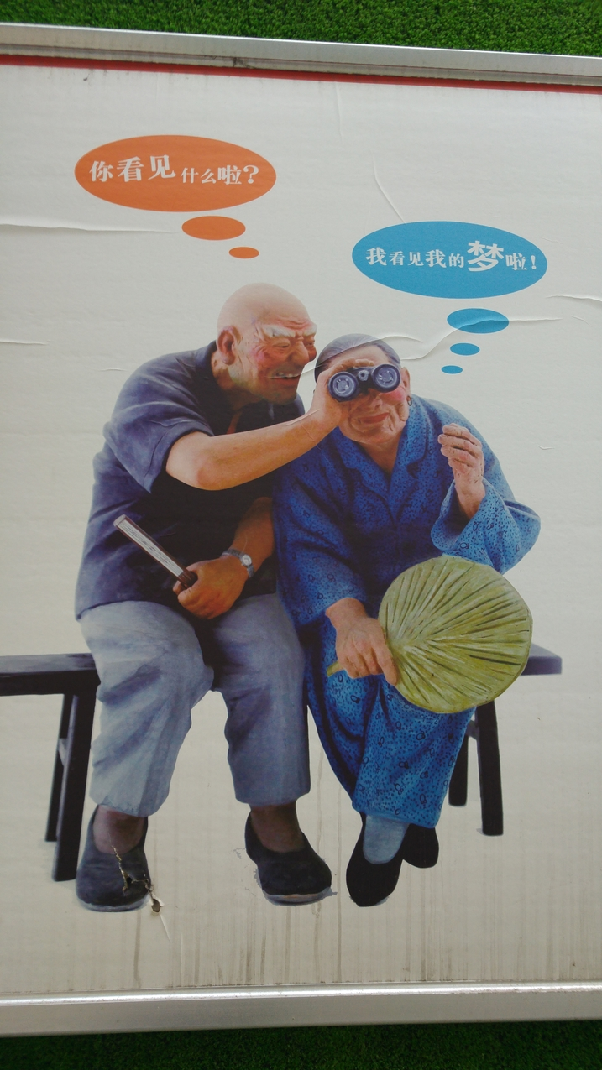
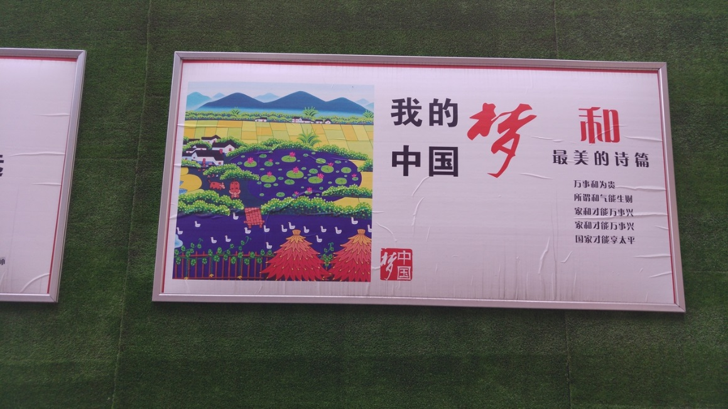
New China

