Slide 1
The Early Years of
the People’s Republic
1949- 1956

Slide 2
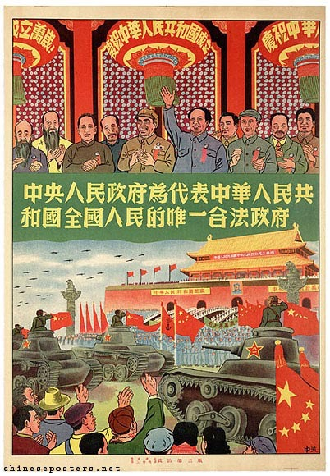
A fresh start

Slide 3
Optimism
Determination to create a new society
Huge prestige and trust for the CCP amongst ordinary people, the poor, the peasants etc
Cleaning up society (closing brothels, opium dens etc)
Problems after the war — devastation, unemployment, inflation, breakdown of public order.

Slide 4
Campaigns
1951 The three ‘anti’s — anti-waste; anti-corruption; anti-inefficiency
1952 The five ‘anti’s — anti-industrial sabotage; anti-tax evasion; anti-bribery; anti-fraud; anti-theft of government property

Slide 5
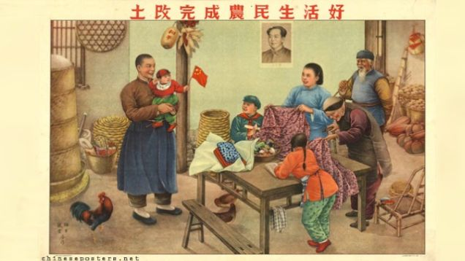
Land reform
and improving the life of peasants

Slide 6
Land reform, by 1952 ‘land to the tiller’ movement was complete.
‘Speak bitterness’ as a way to encourage peasants to speak out against their oppressors.
division of people into categories — landlords/rich peasants/middle peasants/poor peasants/landless labourers.
Importance of peasants — key to ensuring food supplies (increasing urban population) and export of food stuffs to get foreign currency to buy industrial machinery.
Some opposition by peasants themselves to land reform eg when the land was owned by a ‘lineage’ (extended family) or where family tombs were located.

Slide 7
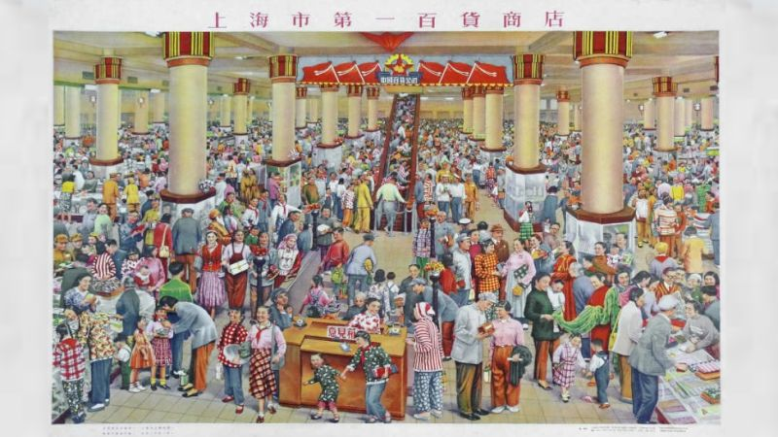
Urban and Industrial
change

Slide 8
The policy to confiscate assets of big capitalist monopolies but protect the ‘national bourgeoisie’ ‘small businesses’
State to run banks, trade, transport
‘Iron rice bowl’ jobs in the state sector (by 1958 30% of workforce were in the state sector)
Private sector still existed till the mid 1960s.

Slide 9
The First Five Year Plan
1953 - 1957

Slide 10
The First Five-Year Plan 1953 - 1957
Increase production of coal, steel and petrochemicals
Spectacular civil-engineering projects eg the Nanjing Bridge
Education investment, high quality urban schools set up.
Statistics show it was successful but the figures may have been distorted.

Slide 11
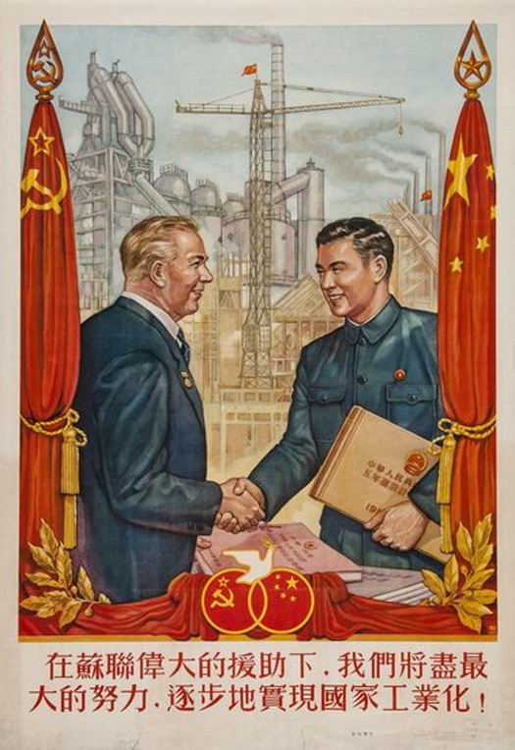
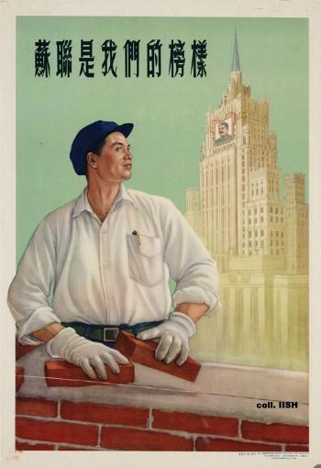
Co-operation
with
Russia
(The Soviet Union)

Slide 12
Sino-Soviet Friendship treaty 1950 (cultural/industrial co-operation and exchanges)
China wanted Russian industrial expertise and equipment.
USSR wanted an ally in the world.
Russian language taught, Russian books translated, lots of students sent to study in Russia

Slide 13
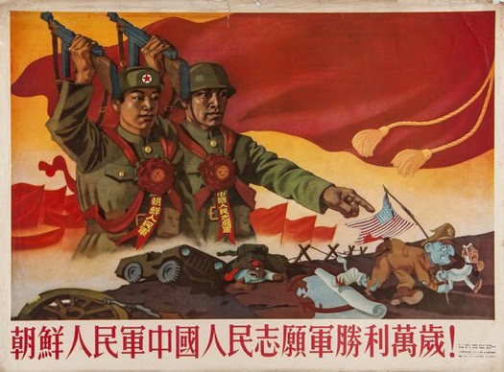
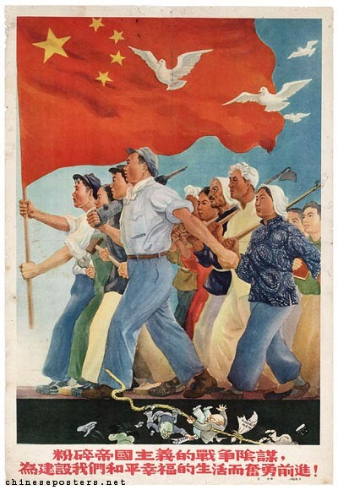
The Korean War
1950 - 1953

Slide 14
Korean War 1950-53
The USSR, China and North Korea on one side
The US, many other western countries and South Korea on the other.

Slide 15
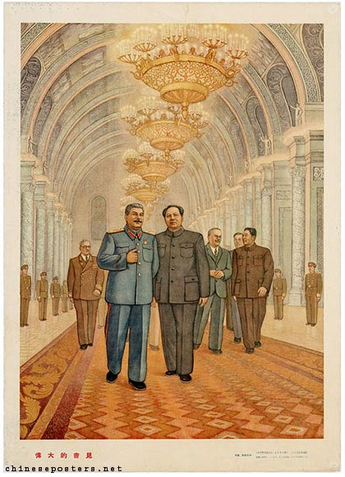
Conflict
with
Russia
(The Soviet Union)

Slide 16
Mao and Stalin didn’t get on, both wanted to be leader of the Communist world. Mao felt insulted that Stalin treated him as ‘a little brother’
1953 Stalin died. Mao also didn’t really rate his successor Krushchev even though Krushchev was more appreciative of China

Slide 17
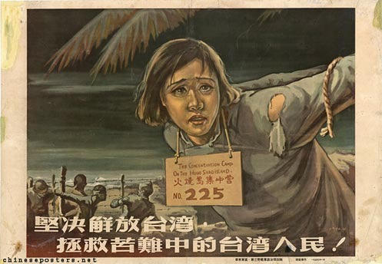
The threat from
Taiwan

Slide 18
Threat from Taiwan
The US supported Chiang Kai-shek in Taiwan as a way of ‘stopping the tide of Communism’
External threat gave the CCP the reason to clamp down on dissent

Slide 19
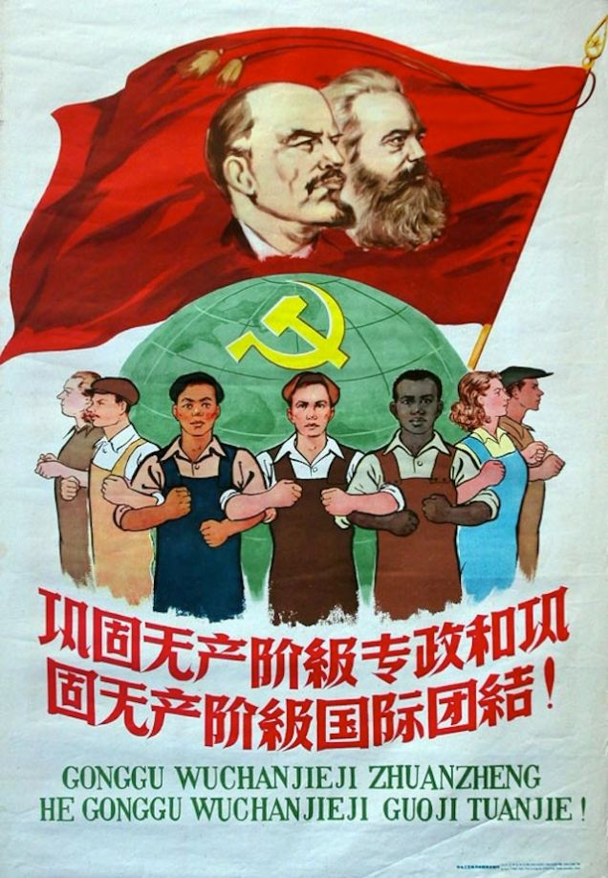
International
solidarity

Slide 20
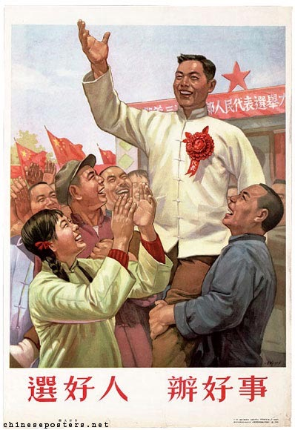
Political control

Slide 21
PRC a ‘one party state’ by 1952 (in 1949 there had been 10 separate political parties）
Neighbour hood committees of between 15-40 households.
dan wei 单位 — looked after your housing, food, schools, marriages etc
hu kou 户口— residence permit
dang an 档案— political record
Democratic Centralism and the Mass Line

Slide 22
Democratic Centralism
“true democracy in the Communist Party lay in the obedience of the members to the authority and instructions of the leaders. …..as representatives of the workers, all Communists were genuine revolutionaries [but…] only the leaders were sufficiently educated in the science of revolution to understand what needed to be done”

Slide 23
The Mass Line
群众 （qún zhòng ‘the masses, the people)
路线 (lù xiàn ‘route, guideline)
“The mass line is the political, organizational and leadership method developed by Mao Zedong and the Chinese Communist Party (CCP) during the Chinese revolution. The essential element of the mass line is consulting the masses, interpreting their suggestions within the framework of Marxist-Leninism, and then enforcing the resulting policies”

Slide 24
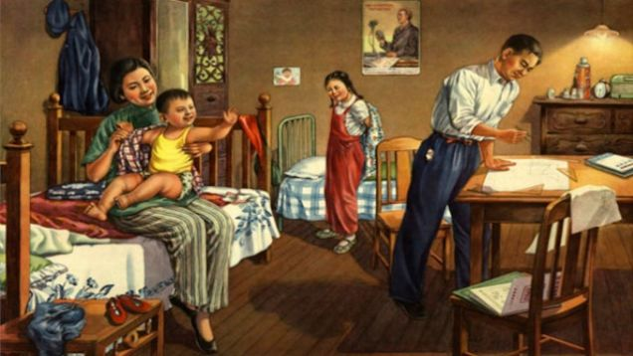
Intellectuals

Slide 25
Expertise needed — there was a chronic shortage after the war of personnel to run the country.
Had to use former GMD officials to implement policies
‘thought reform’ distrust of intellectuals ‘class enemies’
1956 Hundred Flowers campaign

Slide 26
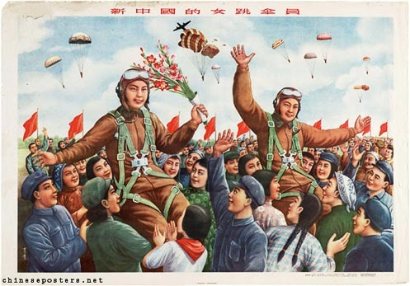
Women

Slide 27
improvement in maternity care (high birthrate) (1949 58 million people in China, by 1957 100 million)
The marriage law of 1950
1949-59 a ten-fold increase in female employment
But still in low-skilled jobs and responsible for domestic labour.

Slide 28
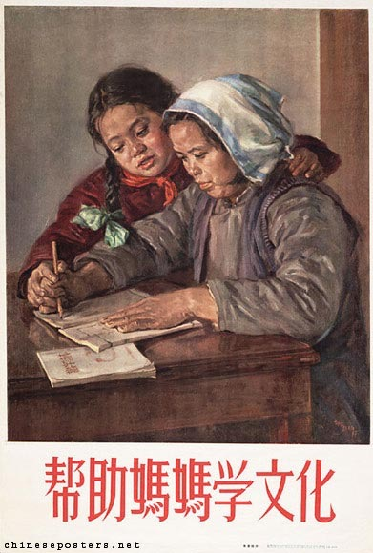
Education

Slide 29
Literacy drive to upskill the labour force and transform ‘political consciousness’ of workers and peasants
Simplification of characters — list of 1,500 aimed at teaching peasants to read.
Lack of teachers, text books, poor teaching methods.

Slide 30
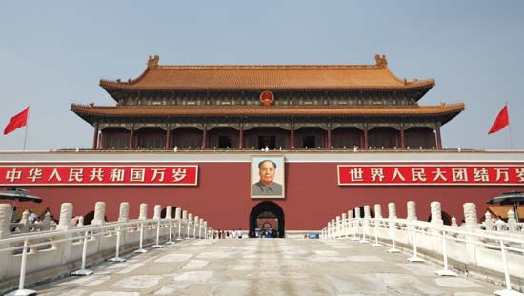
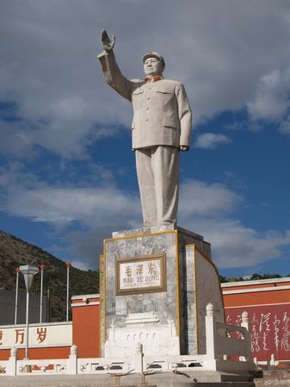
The cult of Mao

Slide 31
The ‘cult’ of Mao
Mao’s growing paranoia. “The more authority he gained, the more he feared that opposition to him was growing. It is a feature of his personality that explains why he was so ready to launch..purges against those he suspected irrationally of plotting to overthrow him…”

