Slide 1

Pre U Literature 文学
Love in a Fallen City (2) –
倾城之恋 (qīngchéng zhīliàn)
学习目标
To start analyzing倾城之恋
What does the cover tell us?

Slide 2
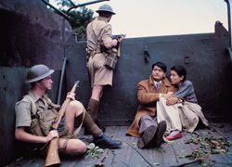
倾城之恋 – Main themes
Love
Family
Politics
Conflict
Tradition and modernity
Women and escape from repression

Slide 3
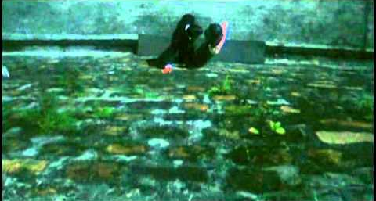
倾城之恋 – Main tools
Literary techniques
Structure
Characterisation
Language
Mood
Lyricism

Slide 4
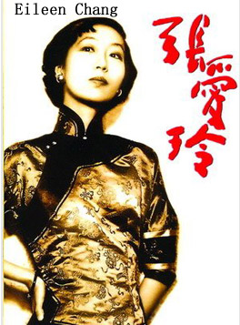
张爱玲 (zhāng àilíng)
She was born…
Her family…
She studied…
Many of her relationships…
In later life…
“Chang’s worldly form of the sublime was achieved…by viewing her father’s world from her mother’s perspective, but with an artist’s compassionate detachment,” p. xiii

Slide 5
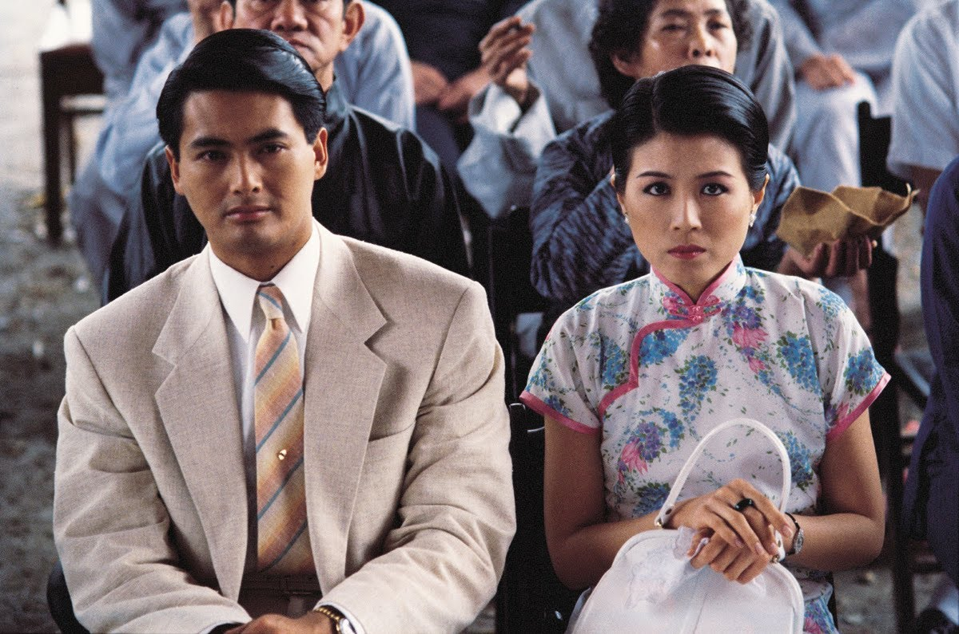
倾城之恋
Meaning of title?
First impressions?
Main characters?
Overall mood?

Slide 6
倾城之恋 – Approaches
Build up quote bank under main themes.
Link story to reality, including author’s life.
Bring in background knowledge of culture, traditions, etc.

Slide 7
Key questions – 关键问题guānjiàn wèntí
How would you describe the relationships between:
Liusu and Liuyuan?
Liusu and her family?
https://www.youtube.com/watch?v=Wnp0P_bEPGs

Slide 8
Trailer
What does the clip suggest about the relationship between Liusu and Liuyuan?
Look at body language, distance from each other, facial expressions
Note down key lyrics
https://www.youtube.com/watch?v=Wnp0P_bEPGs

Slide 9
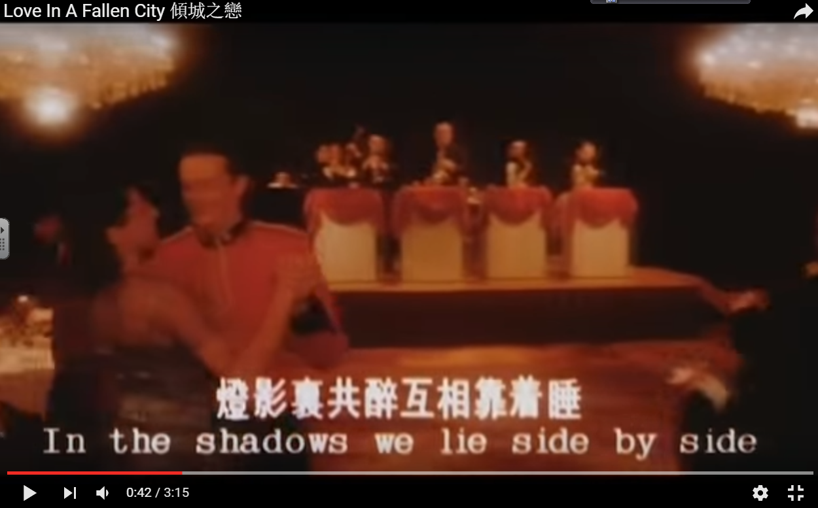

Slide 10
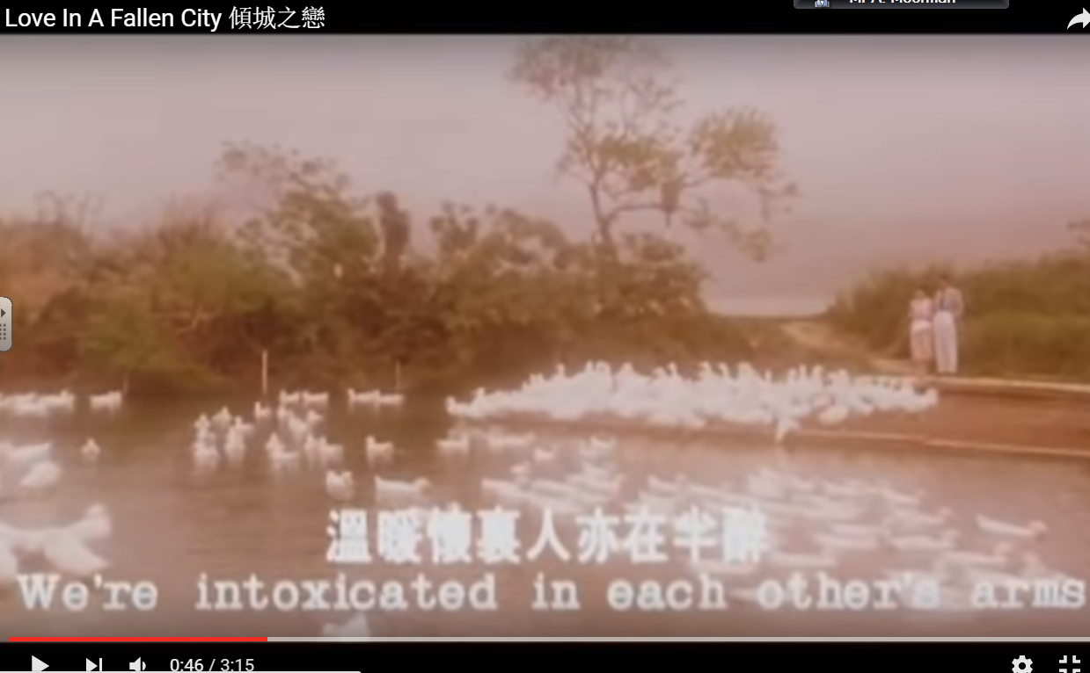

Slide 11
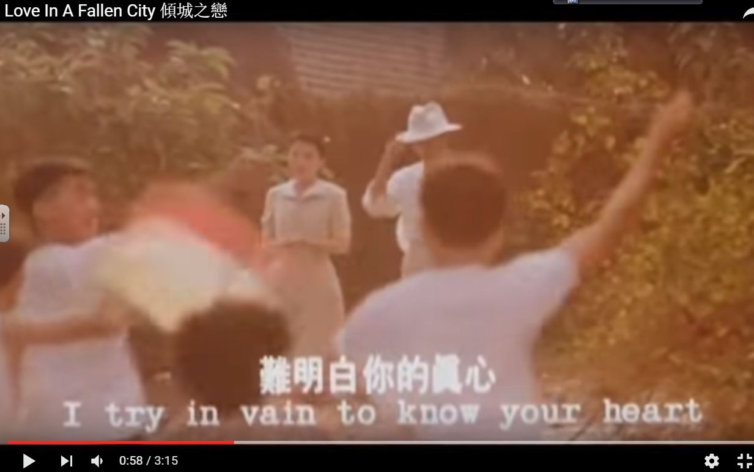

Slide 12
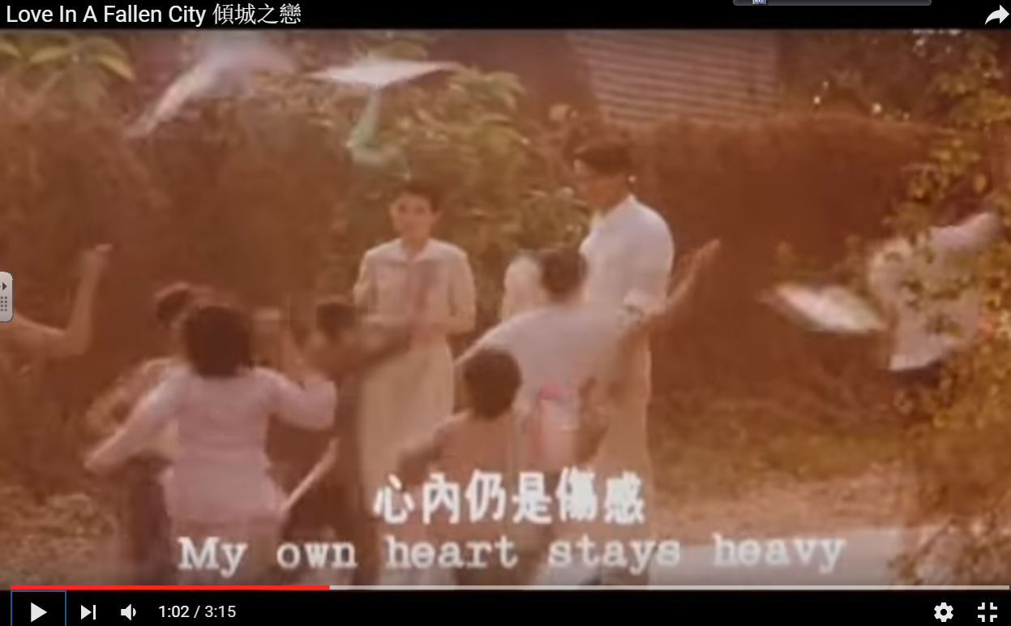

Slide 13
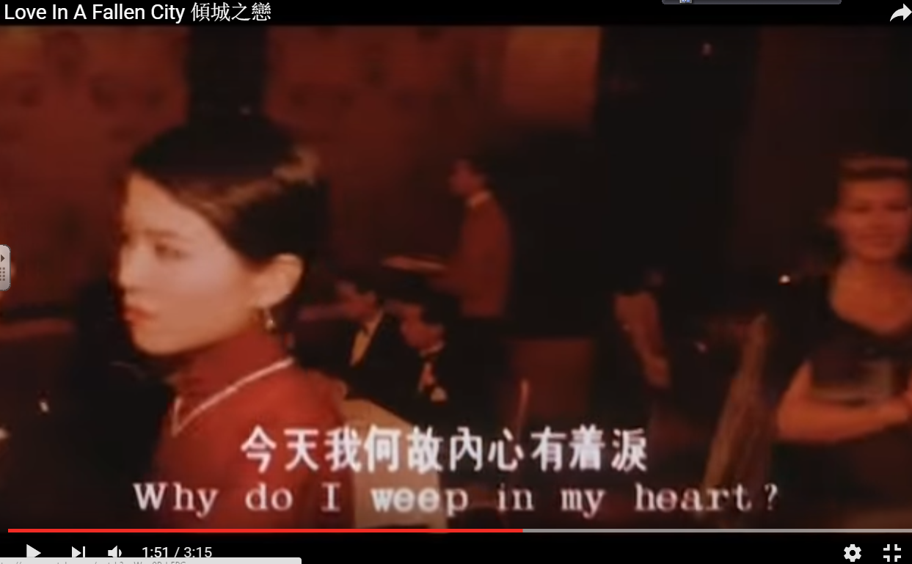

Slide 14
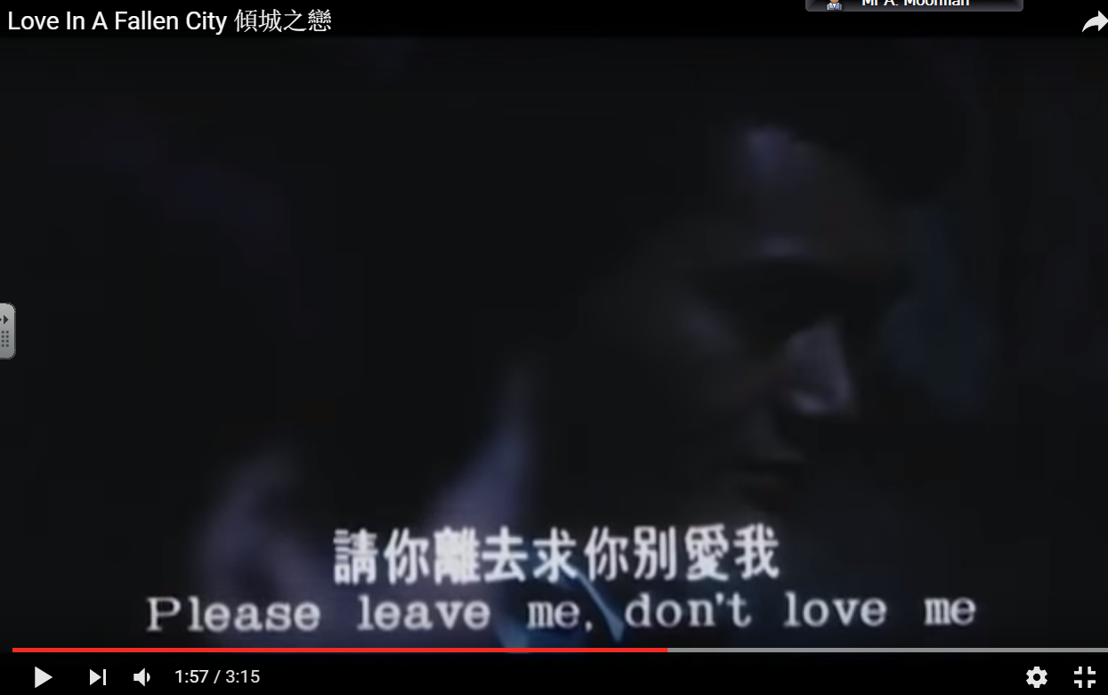

Slide 15
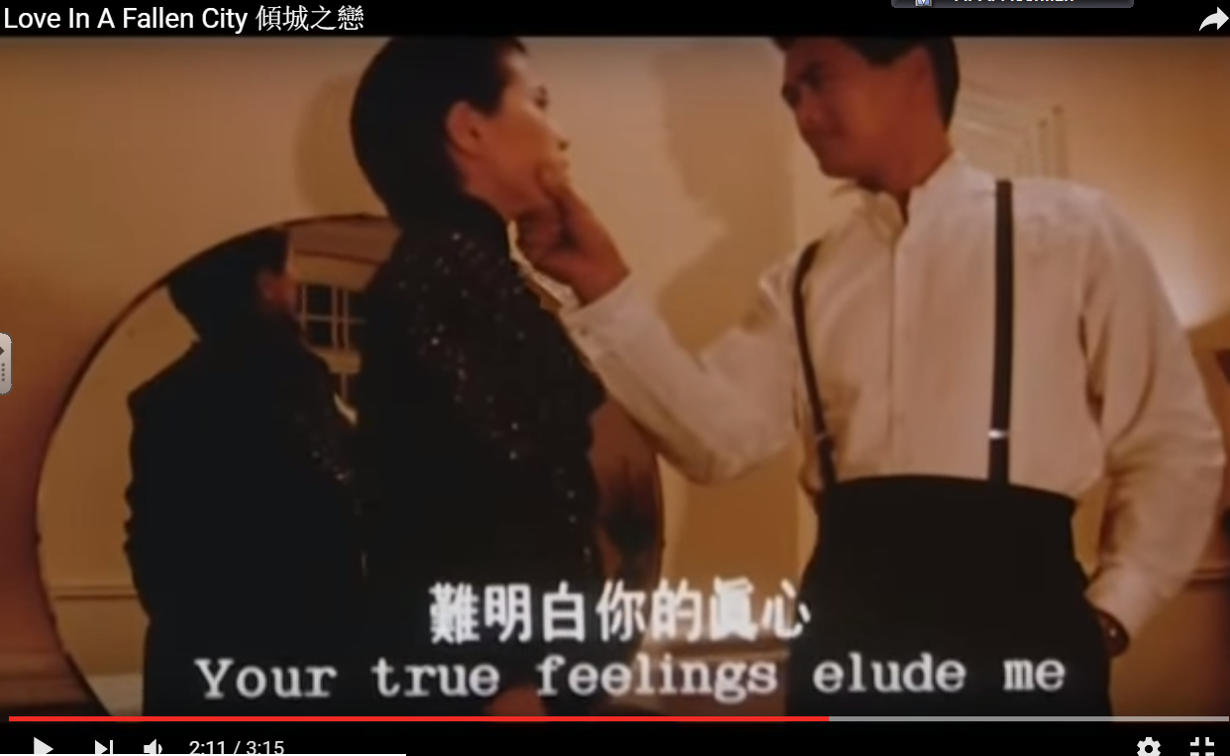

Slide 16
倾城之恋 – Quote hunt!
Pick one of the themes and search for quotes/passages that can be used

Slide 17
倾城之恋 – 作业
Prepare spider diagram on one theme, to present next time.

