Slide 1






3.2: 在哪见面？
zài nǎ jiànmiàn?
Institute of Education
IOE Confucius Institute for Schools
以
前
学
过
的
汉
字
Where shall we meet?
Jinbu 2
Chapter 3, Unit 2
In this lesson you will learn to describe the location of something using ‘place words’
Adapted from lessons donated by colleagues at Dartford Grammar School
yīn
wèi
xǐ
huān
Can you add the English? Can you use them in a sentence?

Slide 2



Without using your books, match the correct preposition to its Chinese equivalent.
EXT – What verb do we use when describing where something is? How would we describe where Stewie is?
A. on
一. 下
B. inside
二. 上
C. under
三. 里

Slide 3
今天的题目:
Describe the location of something using ‘place words’

Slide 4
Learning objectives:
ALL of you will be able to recognise the new ‘place words’ in Chinese and describe where something is.
MOST of you will be able to use ‘place words’ to describe where a place in town is relative to another place.
SOME of you will be able to describe places in town using extended sentences.

Slide 5

qián​ bian
前边

Slide 6
hòu​ bian
后边

Slide 7
zuǒ​ bian
左边

Slide 8
yòu​ bian
右边

Slide 9
páng​ biān
旁边

Slide 10
duì​ miàn
对面

Slide 11

该你了！
说一说小狗在哪？

Slide 24






Practice each character at least 5 times:
zuǒ
qián
hòu ​
yòu
páng
biān​
Extension 1: Test your memory: cover, write, check. Extension 2: write a word that contains each character. For example, for 你, you would write 你好.

Slide 25
今天的题目 – Describe the location of something using ‘place words’
1. Write out the new words from today’s lesson (pg. 62)
EXT: Based on your previous knowledge of prepositions how do you think we would use these new place words in a sentence? What sentences can you come up with?

Slide 26
+
Noun 1
在
+
Place word
商店在右边。
The shop is on the right.

Slide 27
+
Noun 1
在
+
Place word
电影院在前边。
The cinema is in front

Slide 28
Noun 1
+
在
+
Noun 2
+
+
Place word
(的)
学校在博物馆(的)旁边。
The school is next to the museum.

Slide 29
Noun 1
+
在
+
Noun 2
+
+
Place word
(的)
公园在运动中心(的)后边。
The park is behind the sports centre.

Slide 30
Noun 1
+
在
+
Noun 2
+
+
Place word
(的)
The library is to the right of the cinema.
图书馆在电影院(的)右边。

Slide 31
1. Write the two grammar structures and include an example sentence for each structure.
Grammar
1. Noun 1 + 在 + Place word
2. Noun 1 + 在 + Noun 2 + (的) + Place word
2. Complete exercise 2 on page 46.
EXT: Write the pinyin for each sentence.

Slide 32
听力
第四十六页， 练习一
1. 前边
b. 电影院
a. 银行
2. 后边
d. 火车站
3. 左边
c. 邮局
4. 右边

Slide 33
How many different direction words can you hear? Can you point to the correct direction when you hear it??!
https://www.youtube.com/watch?v=6aosRlnxg9I

Slide 34
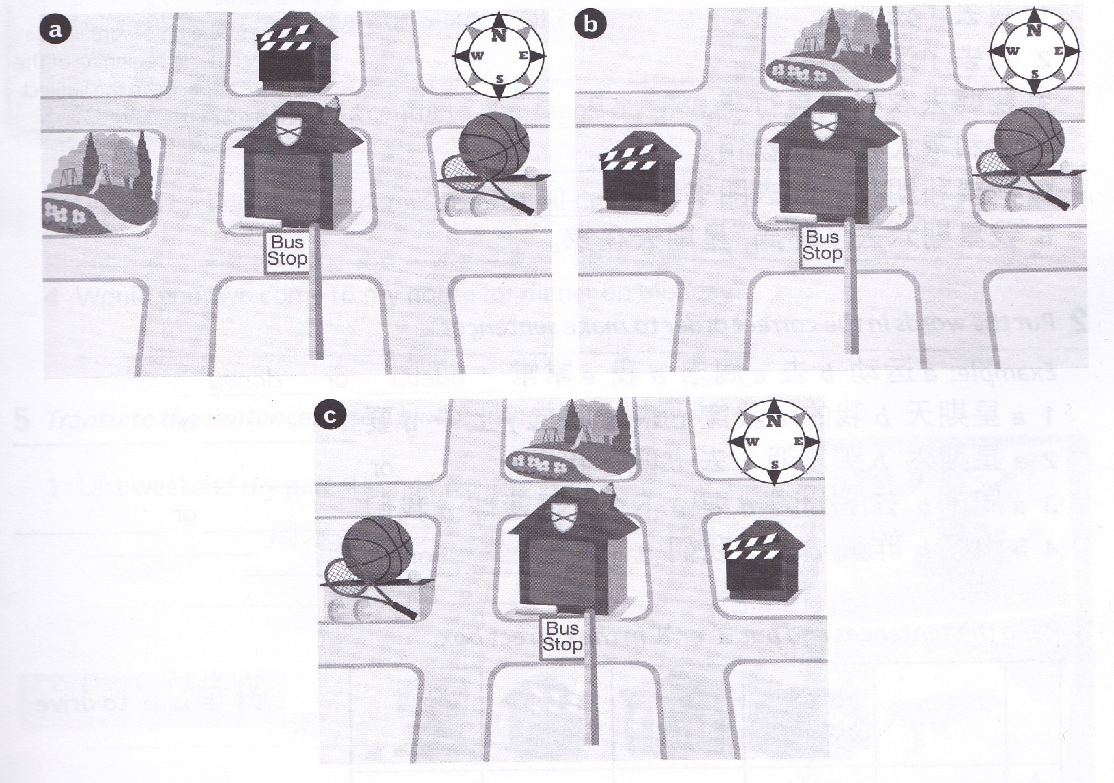
Choose a map and write 3 sentences about where places are using the new place words and grammar structure, then we will see if other people can identify your chosen map.
EXT: Include sentences about places which aren’t on the map to confuse people! Using the vocab you already known, how would we say ‘bus stop’ in Chinese?

Slide 35
该你说话！
Battleships!
1. Hide your sheet from your partner. Choose 3 squares and put a cross in each one.
2. To guess a square you must find out where the shop is. Guess a square by choosing a place in town and a place word to make a full sentence describing the location of the shop：
e.g. 商店在图书馆旁边
3.Winner is the first person to guess all 3 squares.
WARNING: If your partner doesn’t say the sentence correctly, they miss their go. If you choose correctly you can guess again. 加油！

