Slide 1
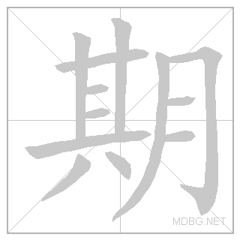
4.1: 中文很酷！ zhōng wén hěn kù
Institute of Education
IOE Confucius Institute for Schools
以
前
学
过
的
汉
字
Chinese is cool！
Jinbu 1
Chapter 4, Unit 1
In this lesson you will learn the words for school subjects and talk about school subjects.
Adapted from lessons donated by colleagues at Dartford Grammar School.
xīng
qī
Can you add the English? Can you use them in a sentence?
rì

Slide 2
yīng​ wén
英文
English

Slide 3
zhōng​ wén
中文
Chinese

Slide 4
fǎ ​wén
法文
French

Slide 5
dé ​wén
德文
German

Slide 6
shù ​xué
数学
Maths

Slide 7
kē ​xué
科学
Science

Slide 8
yīn​ yuè
音乐
Music

Slide 9
lì​ shǐ
历史
History

Slide 10
dì​ lǐ
地理
Geography

Slide 11
tǐ​ yù
体育
P.E.

Slide 12
kè
课
lesson

Slide 14
体育
地理
历史
音乐
科学
数学
德文
法文
中文
英文

Slide 15
体育
地理
历史
音乐
科学
数学
德文
法文
中文
英文

Slide 16
Practice each character at least 5 times:
tǐ​ yù
dì​ lǐ
lì ​ shǐ
yīn ​ yuè
kè
Extension 1: Test your memory: cover, write, check. Extension 2: write a word that contains each character. For example, for 你, you would write 你好.

Slide 17
Practice each character at least 5 times:
kē ​xué
shù
dé ​
wén
yīng
zhōng
fǎ
Extension 1: Test your memory: cover, write, check. Extension 2: write a word that contains each character. For example, for 你, you would write 你好.

Slide 18
Nǐ xǐ huan zhōng wén kè ma?
你喜欢中文课吗？
Do you like Chinese?
Nǐ xǐ huan bù xǐ huan shù xué kè?
你喜欢不喜欢数学课？
Do you like or not like Maths?
Nǐ bù xǐ huan shén me kè?
你不喜欢什么课？
You don’t like what subjects?

Slide 19
写
Choose one person and write out a sentence based on their answers on what subjects they like/dislike.
EXT: Can you include any connectives?

Slide 20
体育

Slide 21
地理

Slide 22
历史

Slide 23
音乐

Slide 24
科学

Slide 25
数学

Slide 26
德文

Slide 27
法文

Slide 28
中文

Slide 29
数学

Slide 30
英文

Slide 31
音乐

Slide 32
历史

Slide 33
法文

Slide 34
德文

Slide 35
科学

Slide 36
数学

Slide 37
地理

Slide 38
体育

Slide 39
http://www.youtube.com/watch?v=2XTBwvi0h2E

