Slide 1
3.1: 我们玩儿游戏吧！ wǒ mén wánr yóuxì ba
Institute of Education
IOE Confucius Institute for Schools
以
前
学
过
的
汉
字
Let’s play games!
Jinbu 1
Chapter 3, Unit 1
Learn the words for some hobbies
Talk about what you do and don’t do in your free time
Use the correct sentence structure with time phrases
Adapted from lessons donated by colleagues at Dartford Grammar School
māo
yé
bà
mā
Can you add the English? Can you use them in a sentence?

Slide 2
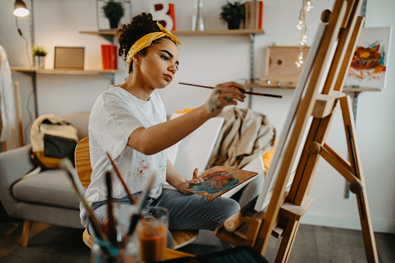
ài​ hào
爱好
Hobbies

Slide 3
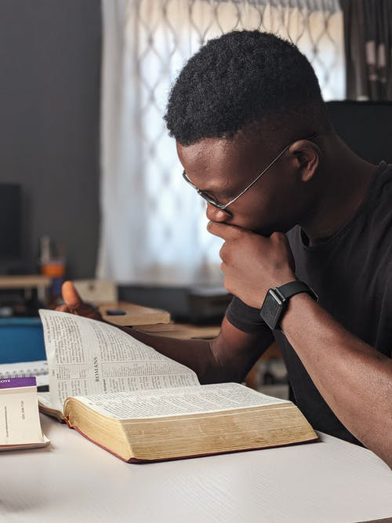
kàn​ shū
看书
看 look, watch
书 book

Slide 4
shàng​ wǎng
上网
网 net, internet

Slide 5
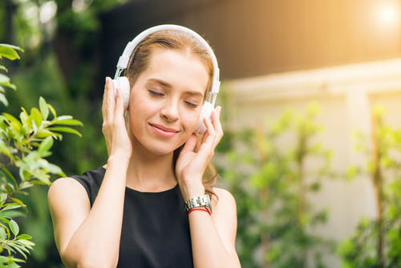
tīng yīn ​ yuè
听音乐
听 listen
音乐 music

Slide 6
mǎi​ dōng ​xi
买东西
买 to buy
东西 stuff, things

Slide 8
买东西
上网
看书
听音乐

Slide 9
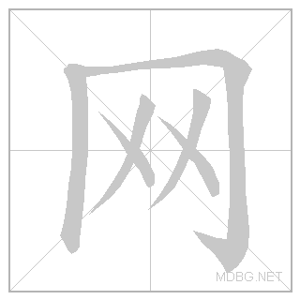
Practice each character at least 5 times:
ài​ hào
Extension :
Test your memory: cover, write, check.
Write out the new words in your vocab book and practise the characters on your sheet.
tīng
yīn ​ yuè
shàng​ wǎng
kàn​ shū
mǎi​ dōng ​ xi

Slide 10
听力
第三十六页,练习一。
For each question write down the family member and their hobby in English.
EXT: What sentence is used when describing your hobby？

Slide 11
Meet me half way
爱好 | 我的 | 买东西 | 上网 | 看书 | 你的 | 什么 | 听音乐

Slide 12
My hobby is…
我的
爱好
是

Slide 13
My hobby is reading books..
我的爱好是 看 书。
Your hobby is what?
你的
爱好
是
什么？

Slide 14
听力
第三十六页，练习二。
For each question write down the hobby in English.

Slide 15
nǐ de àihào shì shénme?
你的 爱好 是 什么？
Q.
wǒ de àihào shì....
我 的 爱好 是…
A.
shàng​ wǎng
上 网
kàn​ shū
看书
mǎi​ dōngxi
买 东西
tīng yīnyuè
听 音乐

Slide 16
Grammar
✓
我看书
=
I read books.
✗
我不看书
=
I don’t read books.
The negative of most verbs is made by adding 不 in front of the verb.

Slide 17
阅读
第三十七页，练习四。
Copy the grid and fill in based on the sentences above.
EXT: What time phrases can you find?
Where does it appear in the sentences?

Slide 18
Grammar –
Position of time phrases
今天我上网
OR
我今天上网
Sentence structure：
Time phrase is always at the very beginning of a sentence or straight after the subject.
Time phrase + Subject + Verb
OR
Subject + Time phrase + Verb

Slide 19
今天我们学了什么？
一 New words for hobbies
二 Sentence:
'My hobby is…' & 'What is your hobby?'
三 Negative: 不
四 Position of time phrases

Slide 20
Guess the character!

