Slide 1
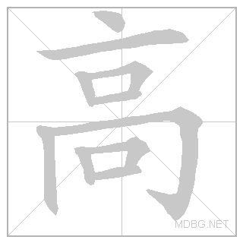
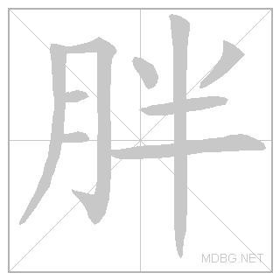
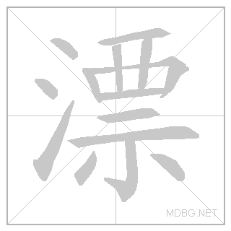
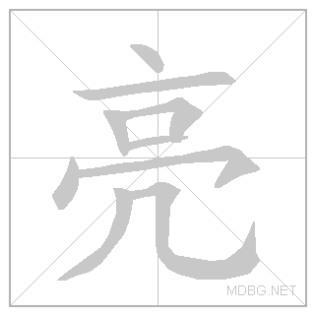
gāo = tall, high
ǎi = short
pang = fat
shòu = thin
piào liɑnɡ = beautiful
hǎo kàn = good looking

Slide 2
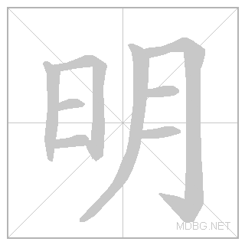
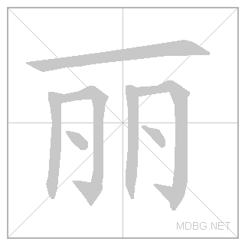
shuài = handsome, smart
cōnɡ míng = intelligent, clever
bèn =stupid
měi lì = beautiful
hěn = very, rather
zhào piàn = photo

Slide 3
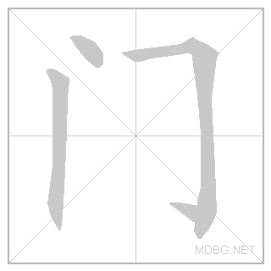
chuáng = bed
zhuō zi = desk
yǐ zi = chair
mén = door
gù zi = wardrobe
shū jià = bookshelves

Slide 4
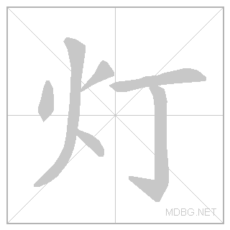
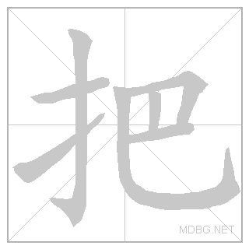
dēng = lamp/light
wò shì = bedroom
lǐ = in/inside
shàng = up
xià = under
zhāng = measure word for flat objects: table, bed etc
bǎ = measure word for chairs

Slide 5
hēi = black
bái =white
hóng = red
lǜ = green
lán = blue
huáng = yellow
sè = colour

Slide 6
shàng yī = top
dà yī = coat
chèn yī = shirt
qún zi = skirt
wà zi = trousers
kù zi = trousers

Slide 7
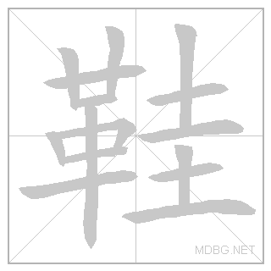
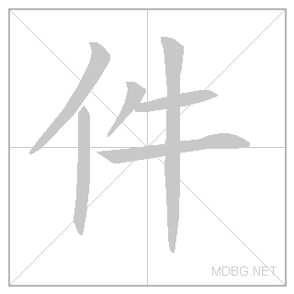
xié = shoes
yùn dòng xié = trainers
chuān = to wear
jiàn = measure word for clothes
(for upper body)
tiáo = measure word for clothes (for lower body)

Slide 8
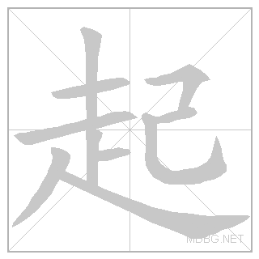
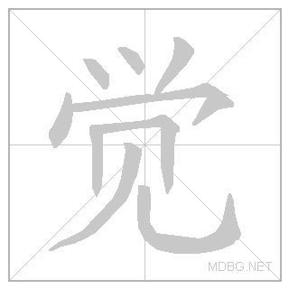
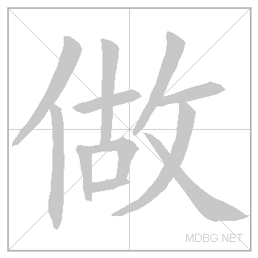
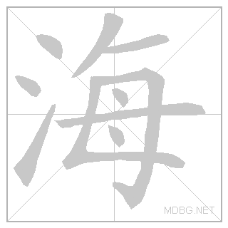
qǐ chuáng = to get up
shuì jiào = to sleep
huí jiā = to go home
zuò zuò yè = to do homework
shàng hǎi = Shanghai

Slide 9
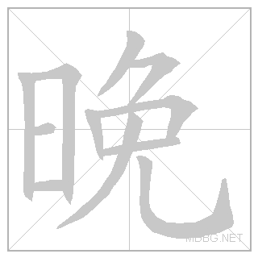
yǐ hòu = after
shàng bān = to go to work
xià bān = to finish work
wǎn shàng = evening
dōu = all/both
měi tiān = everyday

