Slide 1
Moving Beyond Rote Learning - Engaging Learners and Building Independence through Key Learning Strategies
Starter – Discuss in your group…
Do you actively teach/remind your learners “how to learn” Chinese on a consistent basis? If so, how? Have there been any long term benefits as a result?
To what extent is copying characters over and over (i.e. “the traditional method”) effective? Discuss your opinions for and against this view.
Chris Webster - Latymer Upper School
crw@latymer-upper.org

Slide 2
Rote Learning: a thing of the past?
No.
Repetition in any form is the crux of learning a language
Although it is monotonous, it is inevitably effective
Pupils are comfortable with it
But why not supplement rote-learning in a way that can engage learners and promote independence?

Slide 3
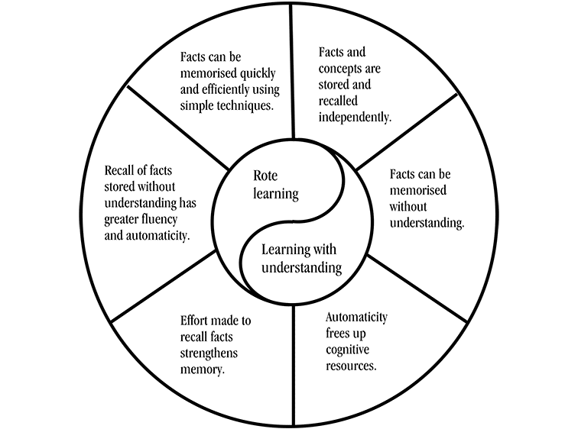

Slide 4
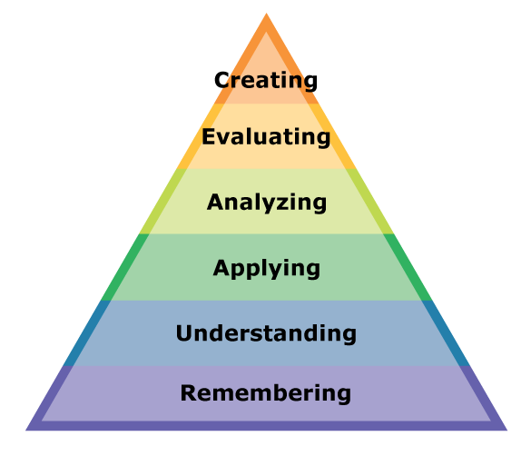
What do Bloom’s Taxonomy and Jenga have in common?

Slide 6
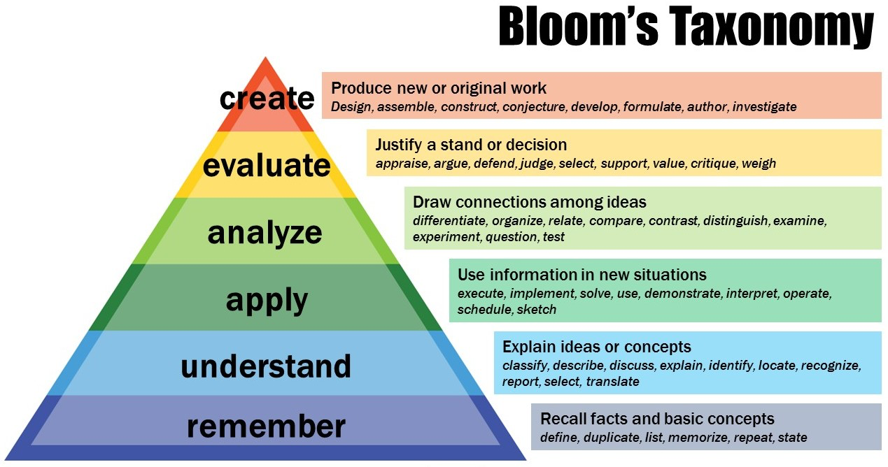

Slide 7
Notes:
Engagin ones brain!

Slide 8
- “Fun With Chinese Characters” - Shaz Lawrence (2013)
“The main problems with this traditional method of learning characters are:
1. The brain is disengaged. Writing of characters is done by rote without any awareness of what makes up each character.
2. There is no autonomous learning. Students rely on the teacher to introduce each character, and therefore students have no way of guessing at the meaning of characters.
3. There is a high drop out rate of students due to the tedious nature of repetition. The writing of Chinese characters is mastered through the rote memorization method, which has been shown to be ineffective, tedious, and the main reason many students are reluctant to learn to read and write Chinese characters.”

Slide 9
Key Learning Strategies that work
Visualisation（可视化）
Association （联想）
Mnemonics （助记方法）
Spaced repetition
（间隔重复）

Slide 10
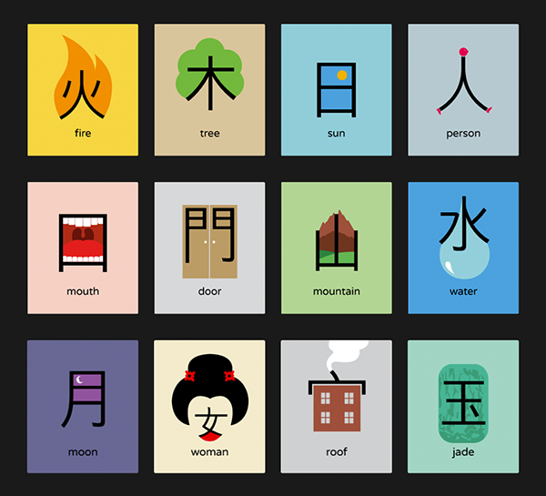
Visualisation
Remember Chineasy? What’s your opinion of it? To what extent do you use it in your teaching?

Slide 11
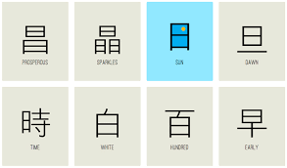
Visualisation
It works, but only with radicals
Make radicals a key part of your teaching
Radicals reappear constantly. If your pupils aren’t aware of this then they will just be copying characters over and over without any kind of engagement with the character they are learning
Notes:
Give them the radicals sheet. When giving pupils a list of radicals, have pupils circle the ones they know/don’t know as a starter to a lesson on those particular words. Have pupils break down the characters

Slide 12
Give them the tools to learn radicals
Have them memorise the simplest and most common radicals listed in the Jinbu 1 textbook
Encourage them to make pictures with them or “radical posters” to put on display
Shaz Lawrence (2013)

Slide 14
Give them the tools to learn radicals
Give them a handout containing all of the most common radicals
Pupils may find this handout daunting, but if they slowly learn them as they progress, they will eventually find the more complex characters much less difficult to memorise
Notes:
Show them handout (mandairnposter.com)

Slide 15
Visualisation
Encourage and reward pupils (especially those who enjoy doodling!) to draw pictures of radicals in a way that will help them to remember them
This not only helps prevent boredom but appeals to learners who really enjoy subjects such as art
Notes:
Give them the radicals sheet. When giving pupils a list of radicals, have pupils circle the ones they know/don’t know as a starter to a lesson on those particular words. Have pupils break down the characters

Slide 16
Shaz Lawrence (2013)

Slide 17
How do you think you could get a pupil to memorise this character in 5 minutes?
Notes:
Have audience decide what kind of pupil e.g. experienced or inexperienced pupil

Slide 18
Raising awareness about the importance of radicals
Do the same exercise with your pupils
They will realise that it is nigh on impossible to remember this character as a whole without knowing what each of the radicals are!
How long do you think it would take to memorise this character through just pure rote learning?

Slide 19
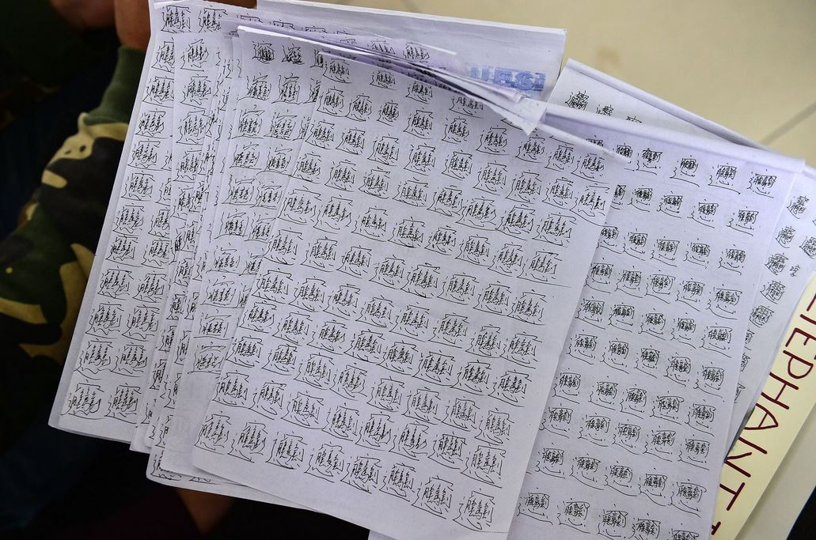

Slide 20
Association （联想）
Visualisation is where you associate a radical with a certain image
The same method applies to tones and pinyin as well
How do you get a pupil to associate a plane with the word “飞机”(fēijī)?
Let pupils come up with their own – if you reward them, they’ll eventually start to do it without you telling them to and it will inspire your teaching!
Notes:
Go to “fiji” in a plane which is high in the sky

Slide 21
飞机(fēijī)

Slide 22
Mnemonics

Slide 23
Chinese character spacing
When you read a 汉字(Chinese character), you need to look at the spacing. The spacings are:
No
spacing
Shaz Lawrence (2013)
Notes:
Stick in

Slide 24
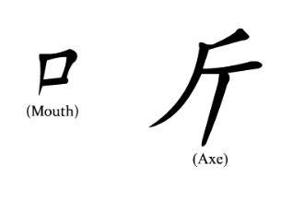

Slide 25
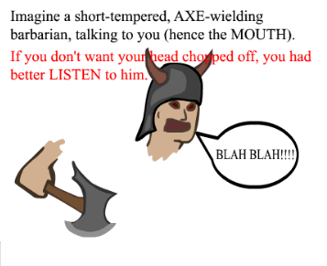
taken from www.memrise.com

Slide 26
Mnemonics
Have pupils make their own “mems” like the one above on memrise
Encourage to make mems for any particularly difficult characters and reward accordingly

Slide 27
Why Use Mnemonics?
Pupils love to come up with mnemonics as it enables them to be creative and engage with the characters on a personal level
Encourage them to write their own while making notes during lessons
Give them examples of your own to inspire them
Remind pupils that they should only link the mnemonic they create with the radicals that make up the character. Have them link the pinyin, tones and meaning as well where applicable
Making mnemonics is a skill that has to be developed, don’t expect pupils to come up with anything amazing straight away
Celebrate any minor success with mnemonics
Remind pupils that there are no “foolproof” mnemonics – the ones that have a strong personal connection to you are the most effective, as everyone is unique

Slide 28
Student example of “滑”

Slide 29
Spaced Repetition
Spaced repetition software e.g. Quizlet
Highly effective software where pupils can revise anywhere at anytime as it can be downloaded to any mobile device. This means no excuses for not having revised for a vocab test
Skritter, Memrise etc have mnemonics written for almost every character, demonstrating how powerful they are in helping pupils to remember characters
Tell pupils not to cram, the most effective learning is spaced out over the week and will be more likely to stay in one’s long-term memory
my quizlet username: latymer_mandarin

Slide 30
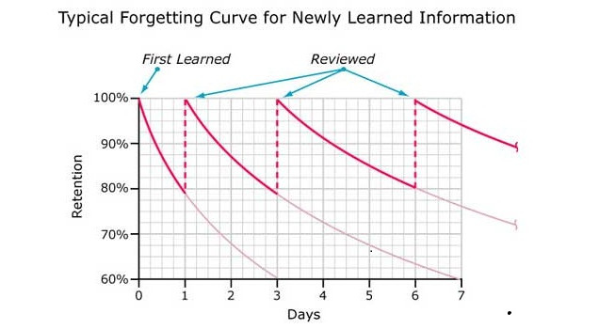
Notes:
Pupil

Slide 31
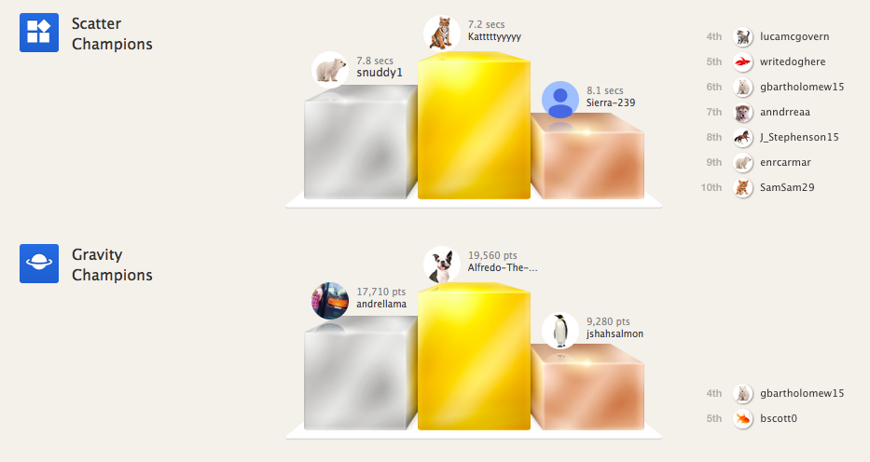
Spaced Repetition
To prevent pupils from cramming, monitor their activity on Quizlet in a class set and reward those for coming 1st, 2nd or 3rd for a certain vocabulary set

Slide 32
When should we teach learners these strategies?
At the very beginning of their Mandarin studies and if you haven’t yet, start to incorporate them
Have your pupils watch this video on learning techniques in class or for homework and write down why such techniques are helpful: https://www.youtube.com/watch?v=Ay_zUGnreWQ
Follow up their reflections when marking their books
The video is good for learners who claim not to have access to a computer or mobile device, as it tells them ways of doing spaced repetition without a computer
Give pupils time to try out different strategies, eventually they will find one that works for them. Try not to punish them with endless retests - this only fosters negativity towards the subject

Slide 33
When shouldn’t we teach these strategies?
If a pupil strongly believes that pure rote learning is the only way forward and is comfortable with it
If a pupil is willing to put in the time and effort that pure rote learning requires
If such a pupil complains that Mandarin is “so hard” or “I’m not good at Mandarin”, question their learning techniques, do not encourage a fixed mindset – put the onus on them

Slide 34
Thank You! Feel Free to Ask Questions! Chris Webster crw@latymer-upper.org

Slide 35
Recommended Reading
http://www.hackingchinese.com/a-minimum-effort-approach-to-writing-chinese-characters-by-hand/
http://www.fluentin3months.com/mandarin-chinese-is-easy/
https://www.quora.com/Why-do-I-find-Chinese-so-easy-to-learn
https://blog.memrise.com/2011/01/27/why-is-mandarin-so-incredibly-easy-to-learn/
https://www.britishcouncil.org/voices-magazine/why-native-english-speakers-can-learn-mandarin-easily

Slide 36
Find a character we have learned or going to learn that you find particularly hard

Slide 37
Using spacing, break it down into its separate radicals. Either find them on the radicals sheet or give names to them for whatever you think they look like

Slide 38
Think of a story to help you remember it. Each part of the story MUST include the name of each radical (or the name(s) given to the radicals you found), the pinyin, its tone and its English meaning. Look at the EXAMPLE below for inspiration (taken from Memrise)
EXAMPLE:

Slide 40
Practice the stroke order of that character referring to a character practice sheet or the stroke order rules stuck in your book (alternatively you can just do the global stroke order TOP-BOTTOM/LEFT-RIGHT as it works most of the time)

Slide 41
Say the story out loud quietly to yourself as you write each radical for the character then eventually its pinyin and then English meaning.

Slide 42
Each time you finish a character, check and compare it with the example. Ask yourself does it look the same? If not, do it again by looking carefully at the example.

Slide 43
Do “look, cover, write, check” each time you write the character until you think you have it stuck in your memory

Slide 44
Tell Mr. Webster which character(s) you have been practised before moving onto the next one. He will test you randomly on it within the next few weeks to see if you remembered it!

Slide 45
Using a mini-whiteboard or a blank un-used space in your exercise book, please do the following:
Find a character we have learned that you find particularly hard
Using spacing, break it down into its separate radicals. Either find them on the radicals sheet or give names to them for whatever you think it looks like
Think of a story to help you remember it. Each part of the story MUST include the name of each radical (or the name(s) given to the radicals you found), the pinyin, its tone and its English meaning. Look at the EXAMPLE below for inspiration (taken from Memrise)
Practice the stroke order of that character referring to a character practice sheet or the stroke order rules stuck in your book (alternatively you can just do the global stroke order TOP-BOTTOM/LEFT-RIGHT as it works most of the time)
Say the story out loud quietly to yourself as you write each radical for the character then eventually its pinyin and then English meaning.
Each time you finish a character, check and compare it with the example. Ask yourself does it look the same? If not, do it again by looking carefully at the example.
Do “look, cover, write, check” each time you write the character until you think you have it stuck in your memory
Tell Mr. Webster which character(s) you have been practised before moving onto the next one. He will test you randomly on it within the next few weeks to see if you remembered it!
EXAMPLE:

