Slide 1
Teaching History in the Pre-U Mandarin Course
Ashley Hern
Manchester Grammar School
a.hern@mgs.org

Slide 2
Challenges
Scope of the curriculum
Depth vs. breadth
Available teaching time
Writing and marking essays
Complexity of ideological issues
Historical context

Slide 3
Opportunities
Placing contemporary China into a historical context
South China sea conflict
Chinese/Japanese relations
Understanding contemporary Chinese politics
Making Chinese history part of a global historical context
Treating Chinese history seriously

Slide 4
Where do I start?
Importance of context
China’s place in world history
The importance of the 19th century and the Qing dynasty
Placing the GMD & the CCP in the context of the 4th May movement and modernisation paradigm

Slide 5
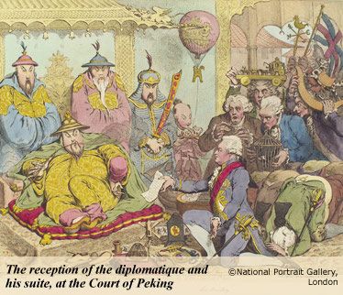

Slide 6
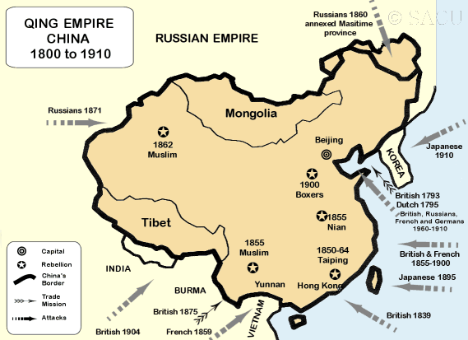

Slide 7
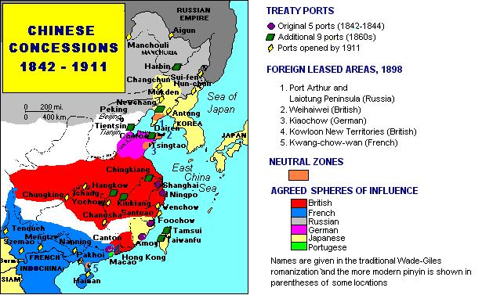

Slide 8
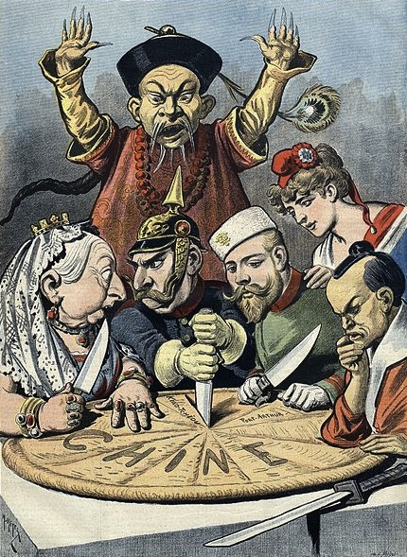

Slide 9
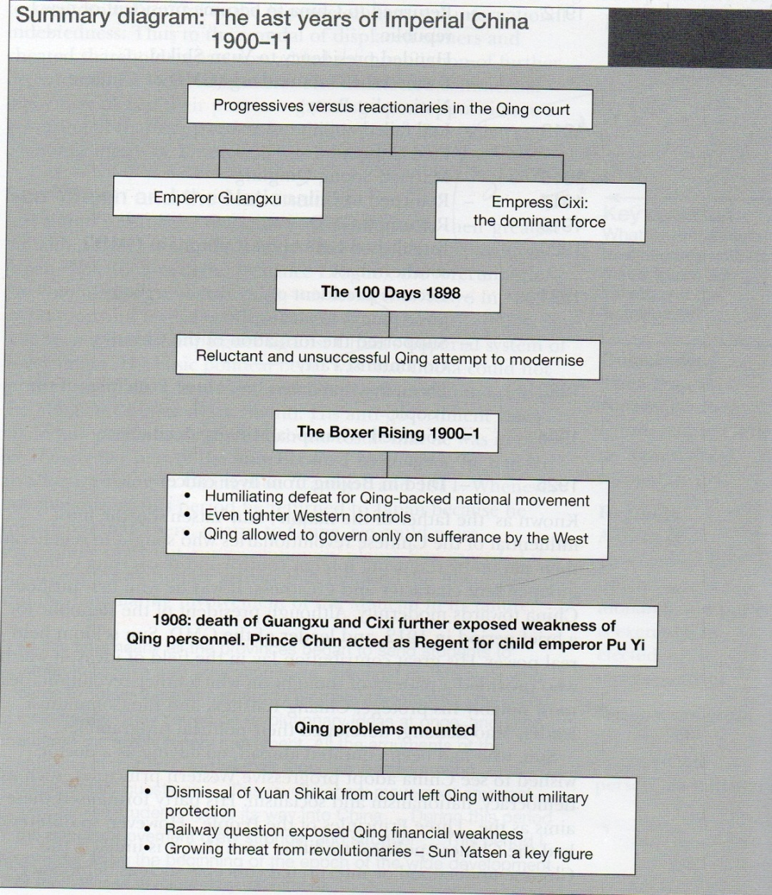

Slide 10
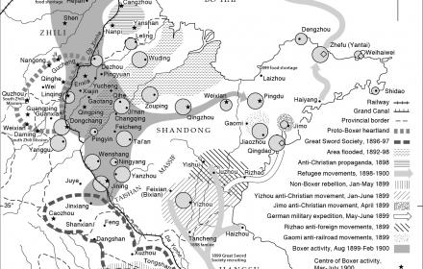

Slide 11
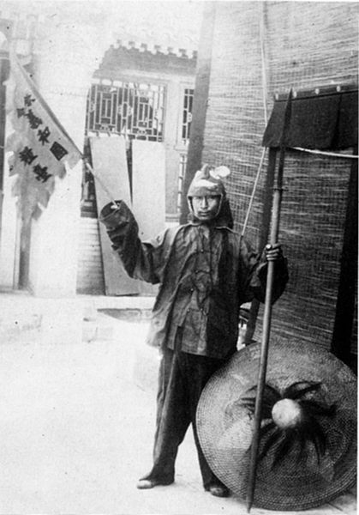

Slide 12
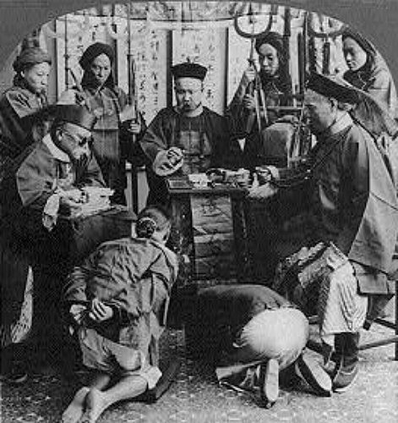

Slide 13
China had become highly de-centralised leading to weak central government and strong local autonomy
The Chinese government had no effective system of raising revenue
China had little modern infrastructure – roads, railways, industry etc.
China’s problems in the early 20th century
China was a largely agricultural & peasant society
Many Chinese were locked in traditional mindsets – foot binding for women; classical knowledge; hierarchy
Foreign influence – both through Christianity and Imperialism - meant China no longer fully controlled its own destiny
The breakdown in central authority had made China violent and unstable

Slide 14
Qing Solutions to Chinese Weakness
Reforming the Chinese alphabet in the interests of efficiency rather than exclusivity
Forbidding traditional practices seen as “backward” e.g. foot binding
Attempts at reform = making China “modern”
Sending students abroad to learn from western industrial and scientific developments
Attempts to create modern national army “New Army”
Contracting out revenue raising e.g. customs, to foreigners using modern western methods

Slide 15
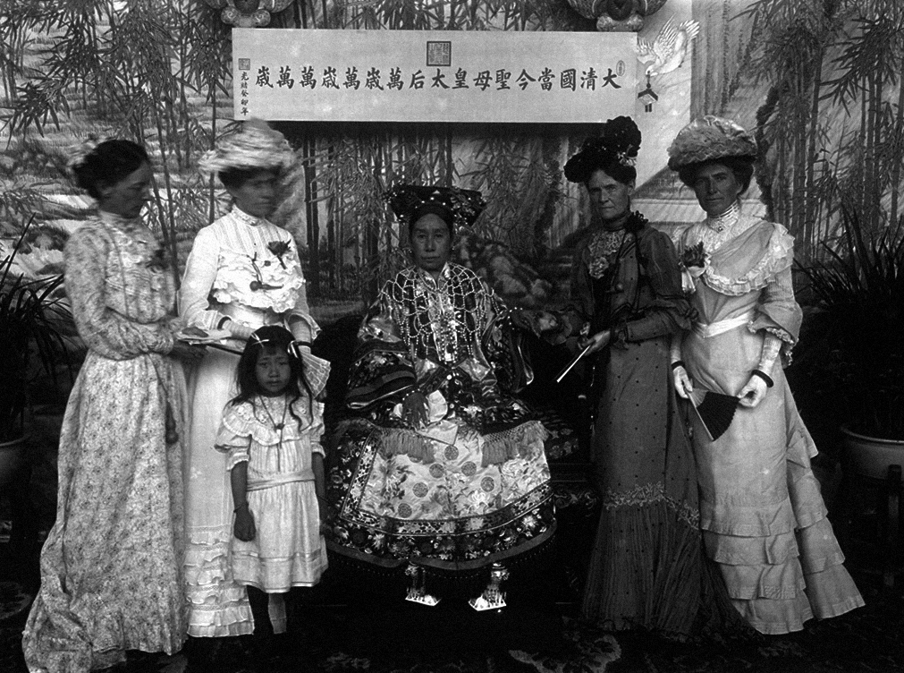

Slide 16
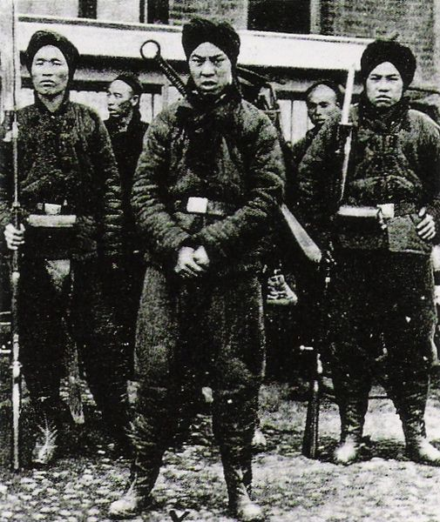

Slide 17
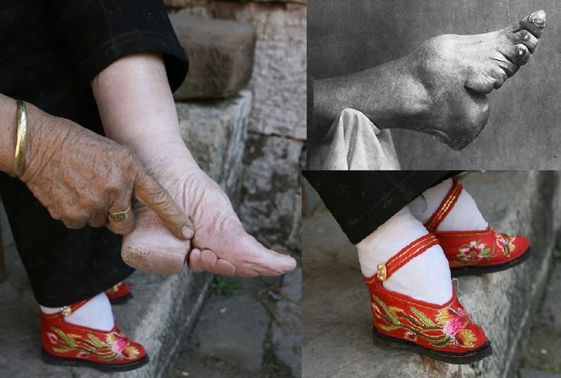

Slide 18
Modernising Dilemma
How do you introduce modern economic and technological practices without political reform?
The Democracy problem – can you take the best of western practices without becoming like them?
How do you retain the best characteristics of Chinese culture while making the country more competitive?

Slide 19
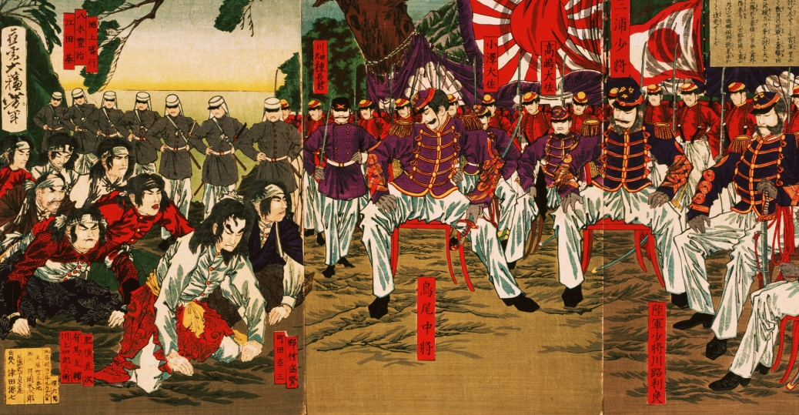
Japan – the Meiji Restoration

Slide 20
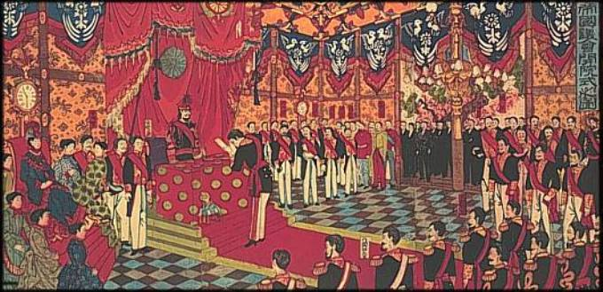

Slide 21
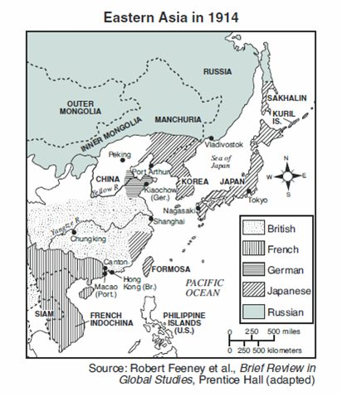

Slide 22
Collapse of Qing Empire in 1911
Chinese Republic 1911 - 1919
Yuan Shikai’s attempt at seizing power prevents democratic institutions consolidation
China fragments into over 30 local warlordships ruled over by a local military strongmen – this greatly weakens central government
Japan humiliates China with its demands during the war, and the Allies rewards Japan with the territory of Shandong taken from the Germans during the war
4th May Movement

Slide 23
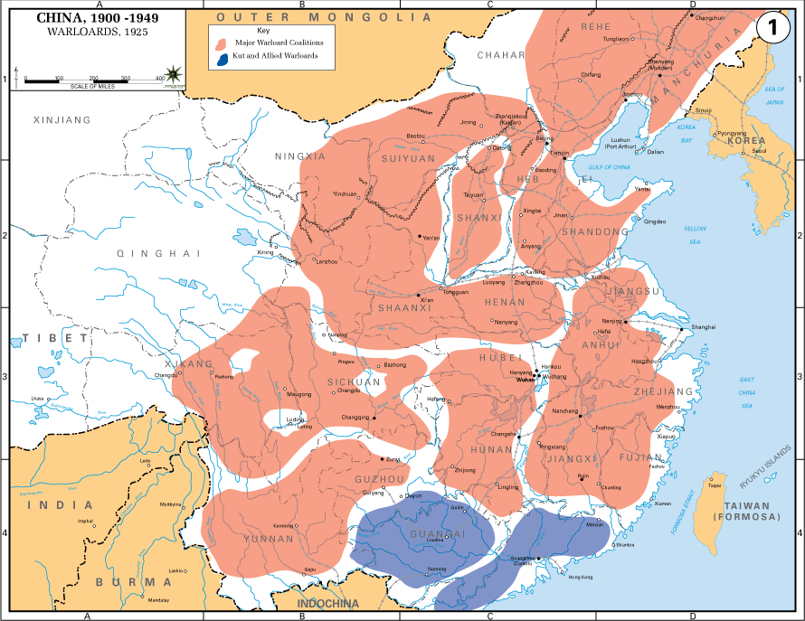

Slide 24
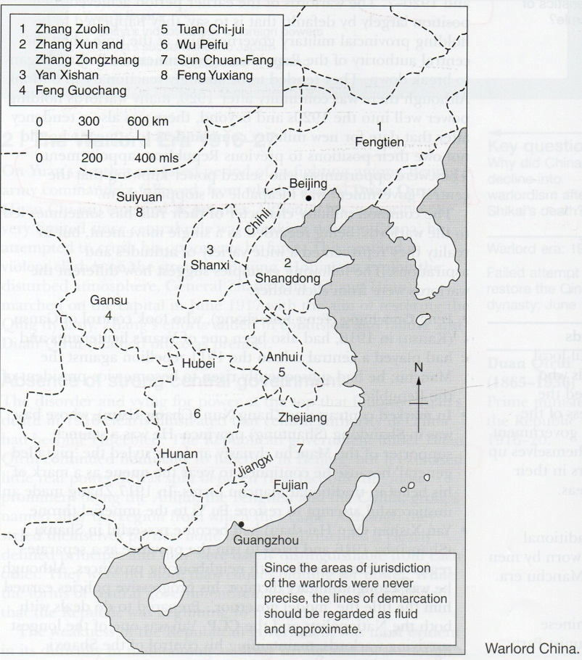

Slide 25
What problems did the warlords cause?
China was divided: as the warlords fought between themselves, there was an absence of strong central government e.g. Fengtian & Zhili factions fought for control of Beijing between 1922 and 1924
Economic problems: in the absence of good economic management the warlords printed money to pay their soldiers ➔ inflation; warlords also levied taxes
Breakdown in law and order: to fund themselves the warlords re-started the opium trade with the resulting social problems. Warlord troops often stealing property and harassing the local population.

Slide 27
Political Consequences of the 4th May
A wave of young educated and nationalist Chinese wanted to create a modern, strong and proud China. This led to growth in support for 2 political parties:
The Kuomintang/Guomindang (KMT/GMD)
The Chinese Communist Party (CCP)

Slide 28
Pre-U History Syllabus Breakdown
The Sino-Japanese War 1937 – 1945
The Second United Front
The GMD’s conduct of the war
The CCP in Yun’an
The international context
Key exam questions:
Who emerged stronger from the Sino-Japanese War?
What was more significant, internal developments or external factors?
Key debate (see Rana Mitter)
Did Chiang’s mistakes lose him the war?
Were the CCP the real anti-Japanese resistance?

Slide 29
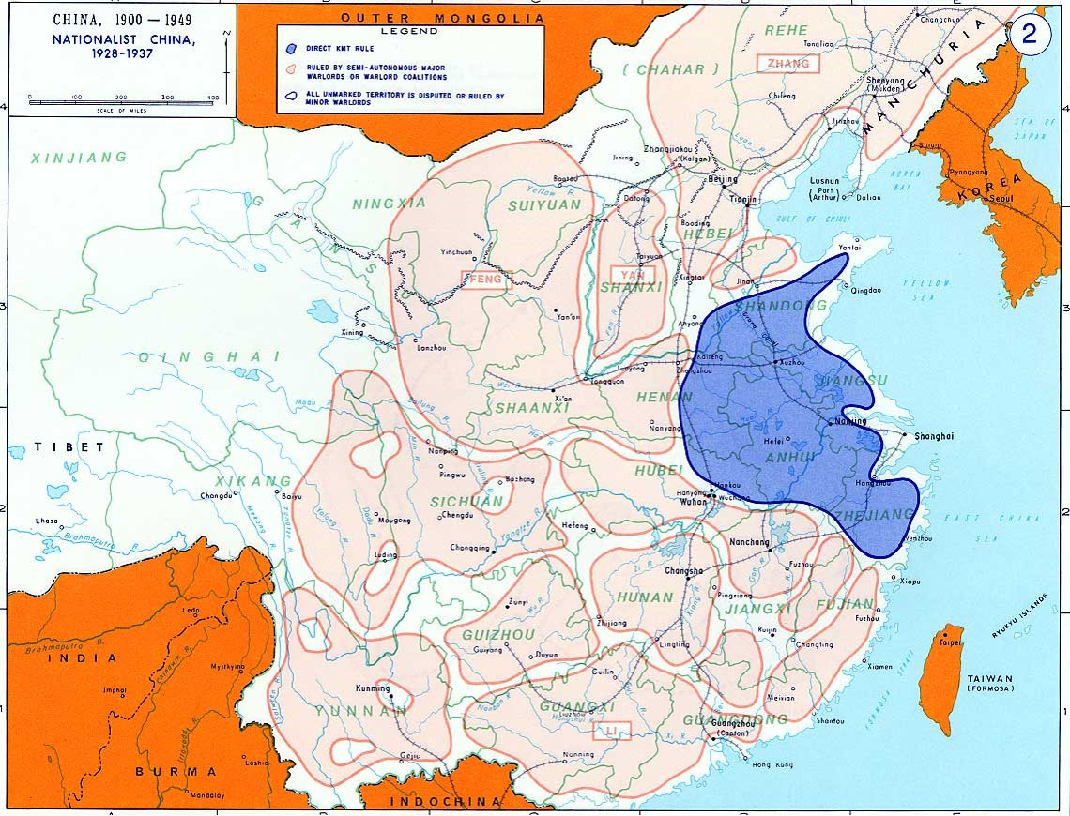

Slide 30
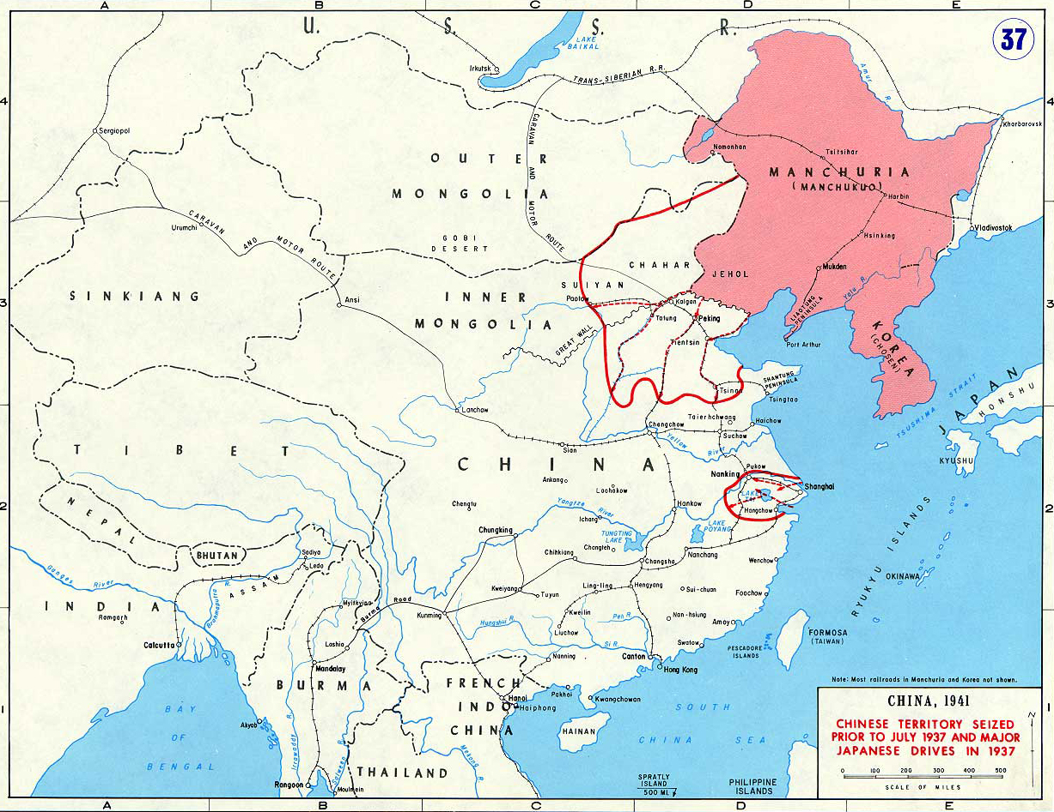

Slide 31
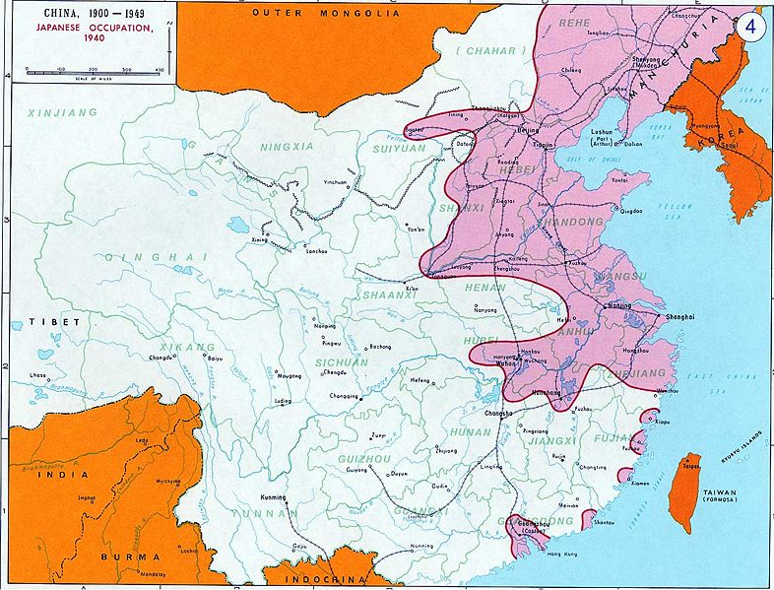

Slide 32
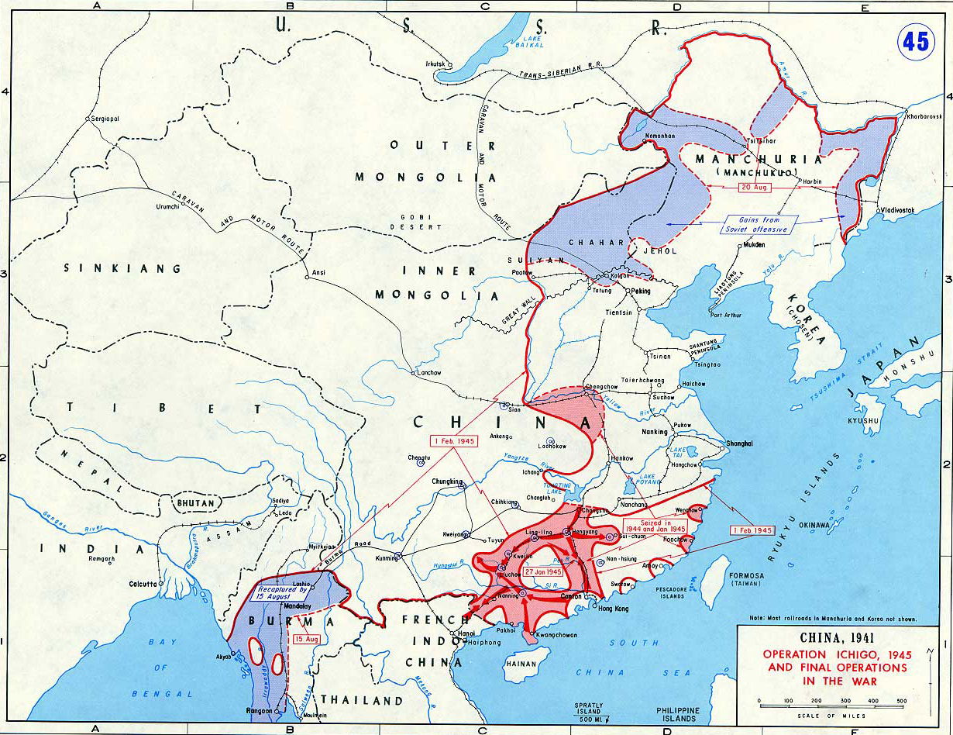

Slide 33
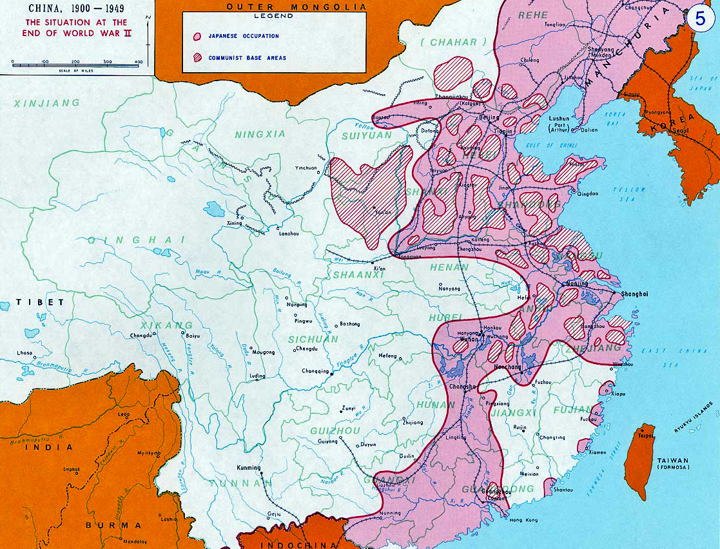

Slide 34
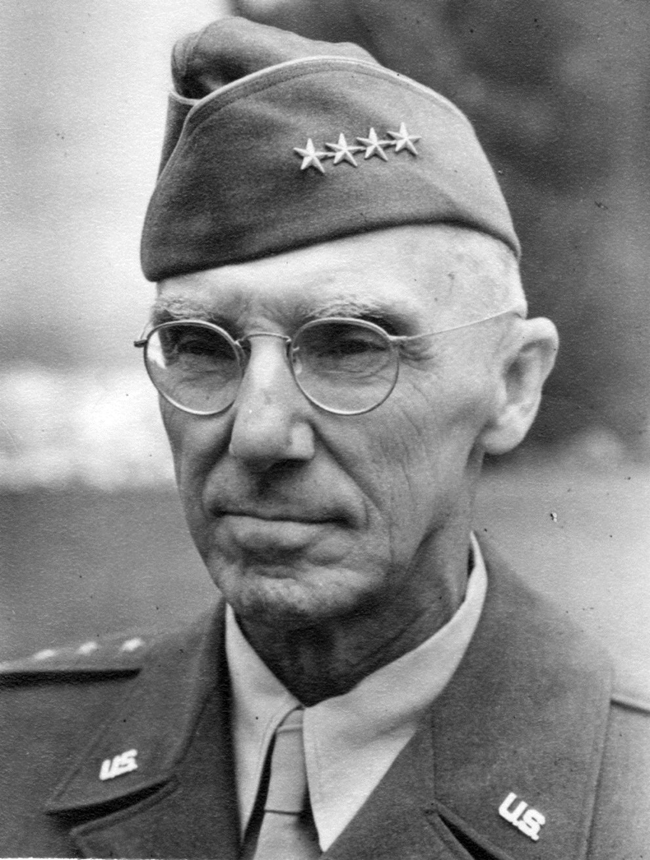
“Vinegar” Joe Stilwell

Slide 36
Pre-U History Syllabus Breakdown
The Civil War 1945 – 1949
The end of the Second United Front
The GMD’s weaknesses & the conduct of the war
The CCP’s strengths
The international context
Key exam questions:
Was it GMD mistakes or CCP strengths that led to the victory of the CCP?
What was more significant, internal developments or external factors?
Key debate
Did Chiang’s mistakes lose him the war?
How far did the CCP win by default?

Slide 37
Pre-U History Syllabus Breakdown
Mao’s theoretical developments
The key elements of Mao Zedong Thought
Two Revolutions theory
The “Mass Line”
Rectification
Role of art & literature in society
Liberation or control?
Intimidation
Cult of Personality
“Maostalgia” in modern China

Slide 38
Pre-U History Syllabus Breakdown
The Establishment of the People’s Republic
The new political and administrative structures of the PRC
The effects of the Korean War
Land Reform
The First Five Year Plan
Edication
Mass mobilisation projects
Key exam questions:
How far did the CCP succeed in changing China between 1949 and 1956?
How far did Mao put the ideals of the Yun’an years into practice?
Key debate
How far were the 1950s a “golden age” in China?
How far did Mao act in his own interest rather than the CCP’s or China’s?

