Slide 1
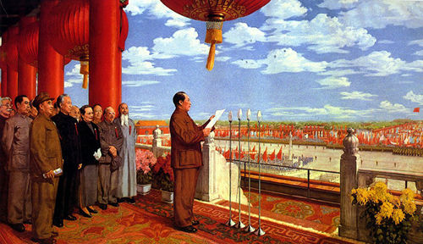
Exam Success: How to prepare students to write History Essays
Chinese Culture: The Founding of the Peoples Republic of China

Slide 2
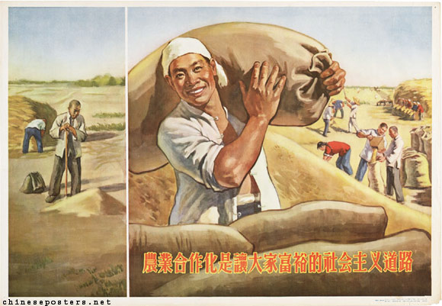
1. Knowledge
Key Skill: Explaining evidence in relation to the question

Slide 3
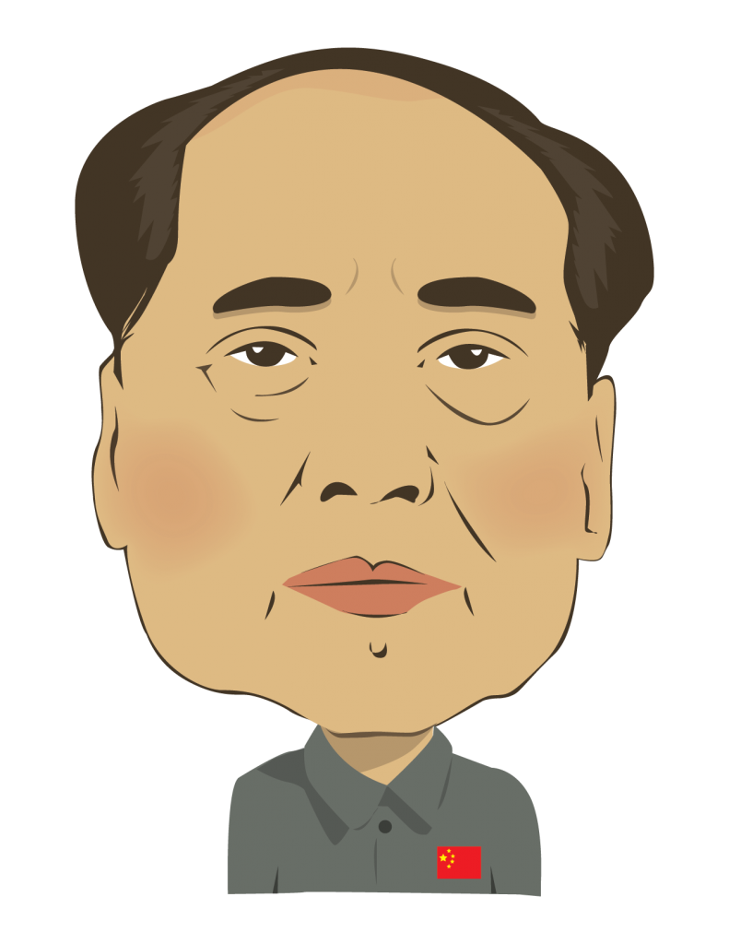
PRC: The Early Years - Political and Social Reform
Problem | WWMD? | What did Mao do? | How successful was Mao?
Order and Control: 37 years of warlord rule has produced social disintegration and criminal habits on a vast scale. It has been estimated that there were 1 million bandits in the countryside by 1949. Thieves and gangsters stalked the cites and many women turned to prostitution as a means of survival. There were also many ex-GMD sympathisers who had not managed to escape to Taiwan.
Foreigners: there are still many foreigners living and working in China. The regime is VERY suspicious of them.
The Bureaucratic / Capitalist Class: it’s 1952 and you are concerned that there are still remnants of this class of people in China.
Political Parties: there are still multiple political parties which worries you.
The general population: you are worried about the way the population are thinking. Are they plotting against you? Are they having ‘un-communist’ thoughts? Are they supporting other parties / political groups?
The middle class: you are increasingly worried about China’s bourgeoisie. You have used them to help settle the teething problems of the PRC. However you are determined to turn China into a fully Marxist state in which only one class will exist – the proletariat (revolutionary workers).
Who are you ruling? You are worried about the lack of information you have about your population.
You are concerned about the position of women in china. In a truly communist society all citizens should be equal.
WWMD?
Notes:
Questions in the History paper will tend to ask students to evaluate success or importance.
Therefore the key to success in the final examination is getting them to practice analysing information in this fashion throughout the course.
e.g. for this activity, how successful was Mao

Slide 4
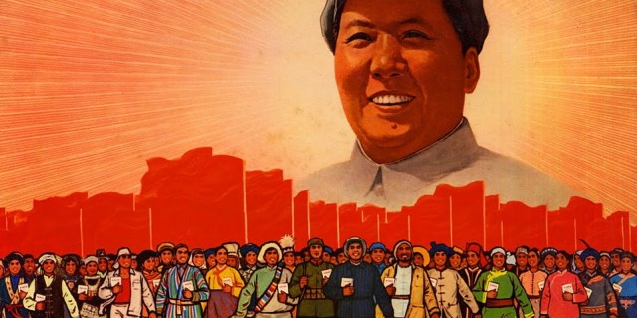
1. Knowledge: Review Task for Students
Explaining evidence in relation to the question
Look through this activity completed by one of my students.
Highlight / Underline:
What has she done really well?
Could any thing be improved?

Slide 5
2. Approaches to Planning
Topic? | What is the question asking you to do? | Factors? | Answer the question
How far do you agree with the statement that ‘the early 1950s was a golden age when China was truly at peace’?
Early years of the PRC | Judgement on whether China was ‘at peace’ in the early years of the PRC | 1. National Government Structures (peace) 2. Social order – getting rid of gangs etc. (peace) 3. Land reform – redistribution (pleases peasants but less pleasant for landowners) 4. Foreigners (not peaceful) 5. Korean War (not peaceful) | Overall, in some respects the 1950s were a Golden Age when China was at peace due to the new focus on law and order and national government. However, it would be wrong to judge China as being truly at peace as the PRC revolution did bring turmoil to the lives of foreigners and rich landowners.
To what extent was the Chinese Communist Party successful in revolutionising the education of the population in the period 1949-56?
What methods did the new government of the People’s Republic of China use to achieve political control (1949-1956)? How successful were these methods?
How far would you agree that the role of the Soviet Union was crucial in the early years of the People’s Republic of China (1949-56)?
How far were the policies and ideology developed in the Yan’an period implemented in the early years of the People’s Republic of China?

Slide 6
2. Approaches to Planning
Topic? | What is the question asking you to do? | Factors? | Answer the question
To what extent did the Second United Front against Japan (1937-45) give the Chinese Communist Party valuable breathing space?
Mao described the Red Army as ‘the fish who swam in the sea’, the sea being the Chinese peasants. To what extent is the relationship with the peasantry fundamental to the Chinese Communist Party’s ultimate victory over the Japanese and the Guomindang?
To what extent did the wider international situation (1937-49) help to ensure that the Communist Party of China won the Civil War, leading to the founding of the People’s Republic of China?

Slide 7
2. Approaches to Planning
How far would you agree with the view that role of the Red Army was the most important factor in the development of the CCP in the period from 1935-1945?
Introduction:
One key factor in the development of the CCP in the period 1935-45 was… | This was when… | This was key to the development of the CCP in the period 1935-45 because… | Comparison to most important factor
The role of the Red Army | …at Yanan Mao had prioritised consolidating the military force of the CCP. Traditionally soldiers had a poor reputation in Chinese society. Mao instructed the Red Amy to behave differently and thus he laid down a code of conduct for his troops… | … it endeared the Red Army to the rural population whose previous experience of marching armies had been bitter. This sensitivity of the army to the peasants played a key role in the growth of the party from 40,000 in 1937 to 1 million by 1945. | However, the role of the Red Army was not as important as Mao’s leadership as it was Mao’s vision which drove the positive transformation of the Red Army.
Mao’s political idea’s
Communist control in the countryside
The Rectification of Conduct Campaign
Conclusion:
Conclusion: Explain important factor and why. Explain the interrelationship between factors. Make sure you provide a concise answer to the question here.

Slide 8
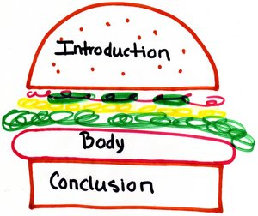
3. Introductions and Conclusions

Slide 9
Introductions
Answer the question | Context | Factors | Overall…(most important or JU on success)
How far do you agree with the statement that ‘the early 1950s was a golden age when China was truly at peace’?
To what extent did the Second United Front against Japan (1937-45) give the Chinese Communist Party valuable breathing space?
What methods did the new government of the People’s Republic of China use to achieve political control (1949-1956)? How successful were these methods?
How far would you agree that the role of the Soviet Union was crucial in the early years of the People’s Republic of China (1949-56)?

Slide 10
Conclusions
Overall… (answer the question – refer to most important factor OR make and overall JU on success) BECAUSE | Refer to other factors discussed | Therefore…
Mao described the Red Army as ‘the fish who swam in the sea’, the sea being the Chinese peasants. To what extent is the relationship with the peasantry fundamental to the Chinese Communist Party’s ultimate victory over the Japanese and the Guomindang?
To what extent was the Chinese Communist Party successful in revolutionising the education of the population in the period 1949-56?
To what extent did the wider international situation (1937-49) help to ensure that the Communist Party of China won the Civil War, leading to the founding of the People’s Republic of China?
How far were the policies and ideology developed in the Yan’an period implemented in the early years of the People’s Republic of China?

Slide 11
4. Writing
Look through this essay. Underline or highlight the following:
Introduction
Has the question been answered?
Is there some contextual knowledge about the period?
Have the factors been introduced?
Paragraphs
Precise evidence
Explaining the evidence in relation to the question
Mini-conclusion at the end of the paragraph (summing up what has been discussed)
Conclusion
Has the question been answered?
Are any relationships between factors explained e.g. X led to Y
Is there a hierarchy of judgement e.g. the most important factor / success…

Slide 12
5. Marking
Annotation | Explanation | EXAMPLE
EXP (explain) | Evidence has been explicitly explained in relation to the question i.e. the exact words in the question have been used to explain the evidence. | This was therefore the most important way in which the CCP achieved control because…
AN (analysis) | At the end of a paragraph there is a comparison between factors. | Although the CCP’s peasant focused policies were important for increasing membership and eventually taking power they were not as important as Mao’s leadership as it was Mao who skilfully moulded the party’s policy platform.
J (judgement) | An explained judgement in relation to the question | Overall, it is clear that Mao’s leadership was the most important reason why the CCP was able to gain control by 1949 because it was his ability to adapt communist theory to the Chinese situation alongside revolutionising both the Red Army and agricultural policy that ultimately led the CCP to take control in 1949.

