Slide 1
女
男

Slide 2
女
男

Slide 3
女
男

Slide 4
女
男

Slide 5
红队
蓝队
紫队
绿队

Slide 6
红队
hóngduì
蓝队
lánduì
紫队
zǐduì
绿队
lǜduì
黄队
huángduì
橙队
chéngduì

Slide 7
黑队
hēiduì
白队
báiduì
灰队
huīduì
粉红队
fěnhóngduì
棕队
zōngduì
Notes:
For primary. Print off two copies and lineup on board. Tick points on for good work/behaviour and points off for poor behaviour. Say team with most points get a sticker each at the end.

Slide 8
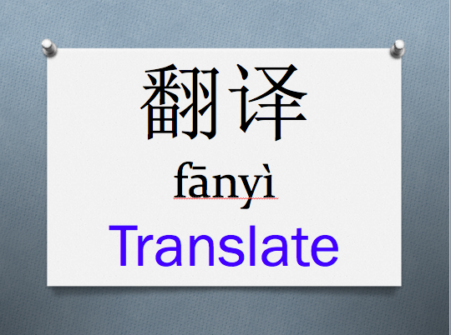
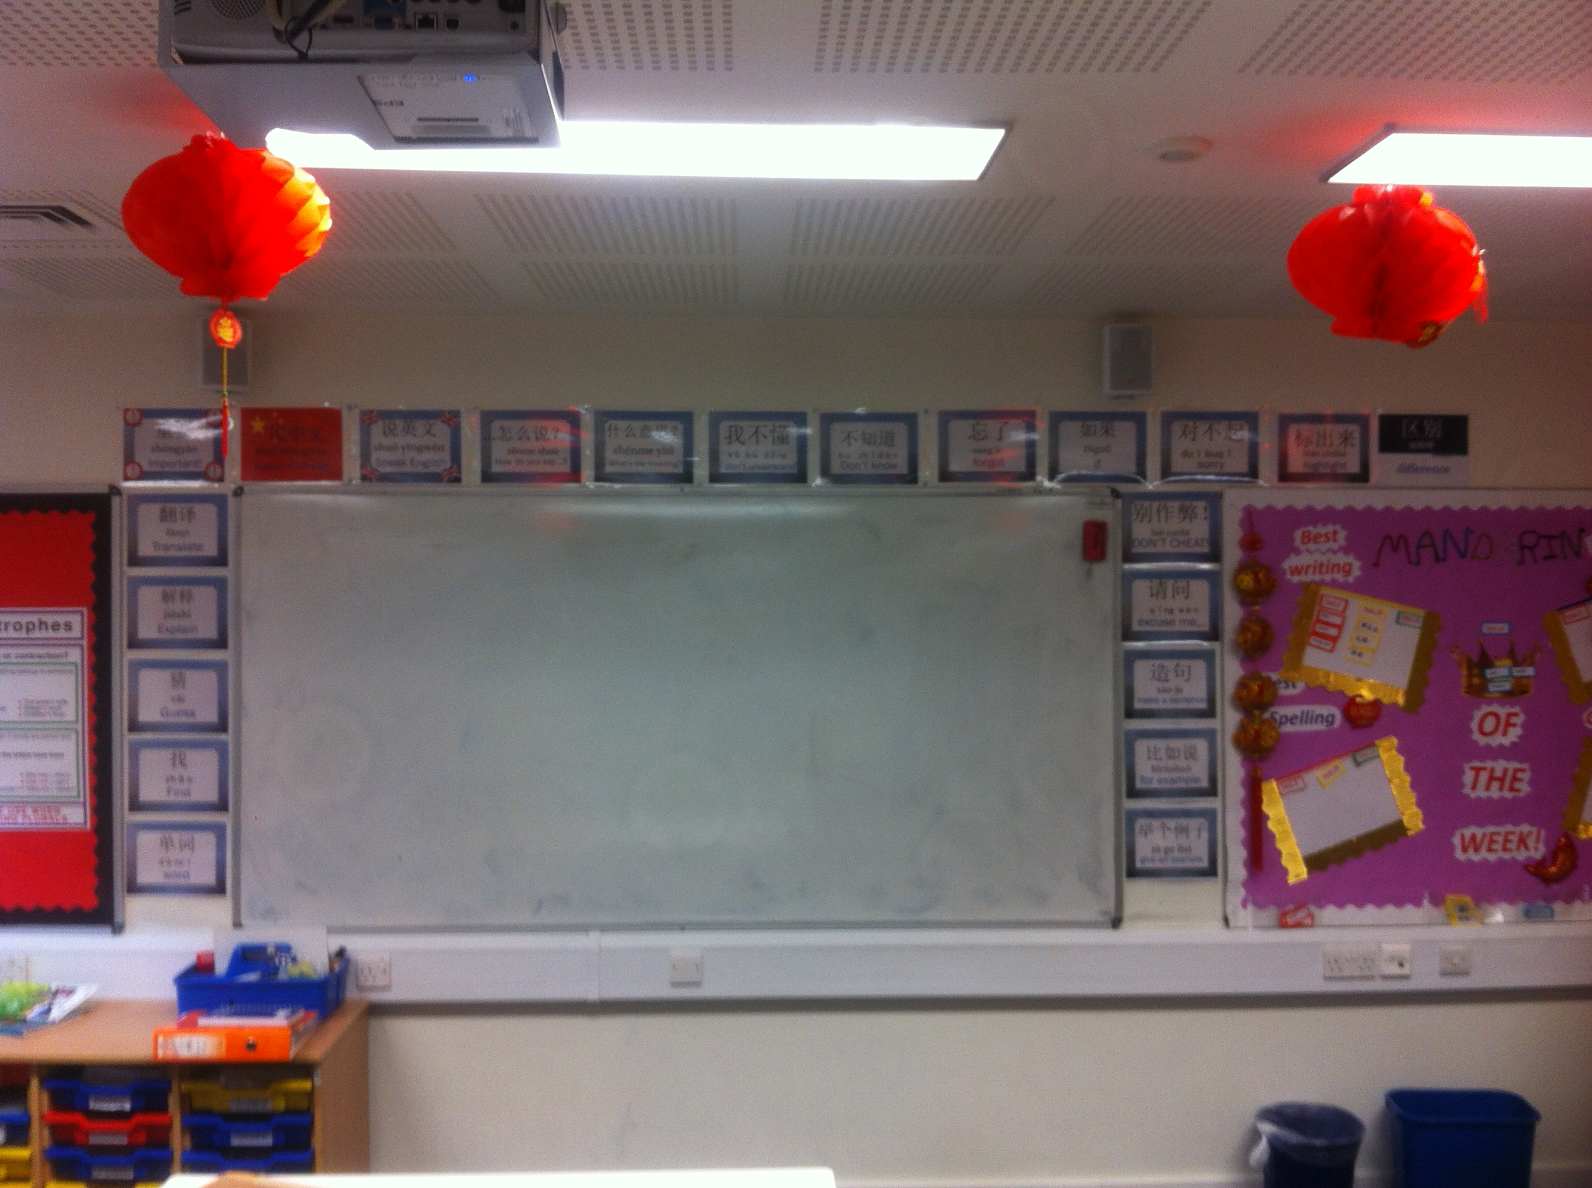
Strategies
VISUALS (Wall Posters, Colour Coding)
Notes:
USE INTERACT! here

Slide 9
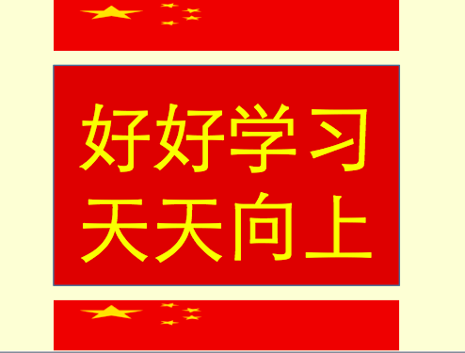
Strategies
MANTRA
Notes:
USE INTERACT! here

Slide 10
Strategies
干嘛!
BANTER
帅哥！
美女！
别这么二！
Notes:
USE INTERACT! here

Slide 11
Troubleshooting
请交换本子，然后给同桌打分。
Rephrasing
Swap books right?
对，然后给同桌打分(+mime)
Notes:
FROM JONES AND HALLIWELL

Slide 12
Troubleshooting
请交换本子，然后给同桌打分。
Jenny同学请来解释。
Pupil Interpreting
We swap books with each other and give each other a score
对！非常好！
Notes:
FROM JONES AND HALLIWELL. DON’T PATRONISE!!!!!!!!!!

Slide 13
Troubleshooting
对，然后给同桌打分(+mime)
。
Classroom Codeswitching
I still don’t get it
给你的partner打分(+mime)
Notes:
FROM MACARO (2010) – Classroom codeswitching is where you “add” English words to a sentence primarily said in Mandarin.

